Slide 1
Share, Learn & Connect: University of the Pacific
March 14, 2019
Technology 201—
Productivity Apps and Systems for Work, Work Travel and Life
Vanessa Ea
Associate Director of Admissions
vea@uccs.edu
Notes:
8:30 - 8:35AM

Slide 2
Technology 201—
Productivity Apps and Systems for Work, Work Travel and Life
Agenda
Calendars
Email
Internet of Things (IoT)
Communication
Project Management
Tech/ Apps for Life
Notes:
Does navigating your Work Outlook calendar and personal calendar and maybe even your kids’ calendars make you cross eyed? Are you an Inbox Zero type but just can’t seem to get there? And how can The Internet Of Things help you get and stay organized? Come to this session to hear about some of the technology and tools admission counselors could consider using to stay on task, both on the job and in life.

Slide 3
Technology 201—
Productivity Apps and Systems for Work, Work Travel and Life
Calendars
Outlook vs Google
Linking Calendars
Cozi
Summit
Paper Based is allowed!
Event Management
repvisits
signupgenius
Google Doc
Notes:
5-7 Minutes for each topic/ slide
8:35 - 8:45AM

Slide 4
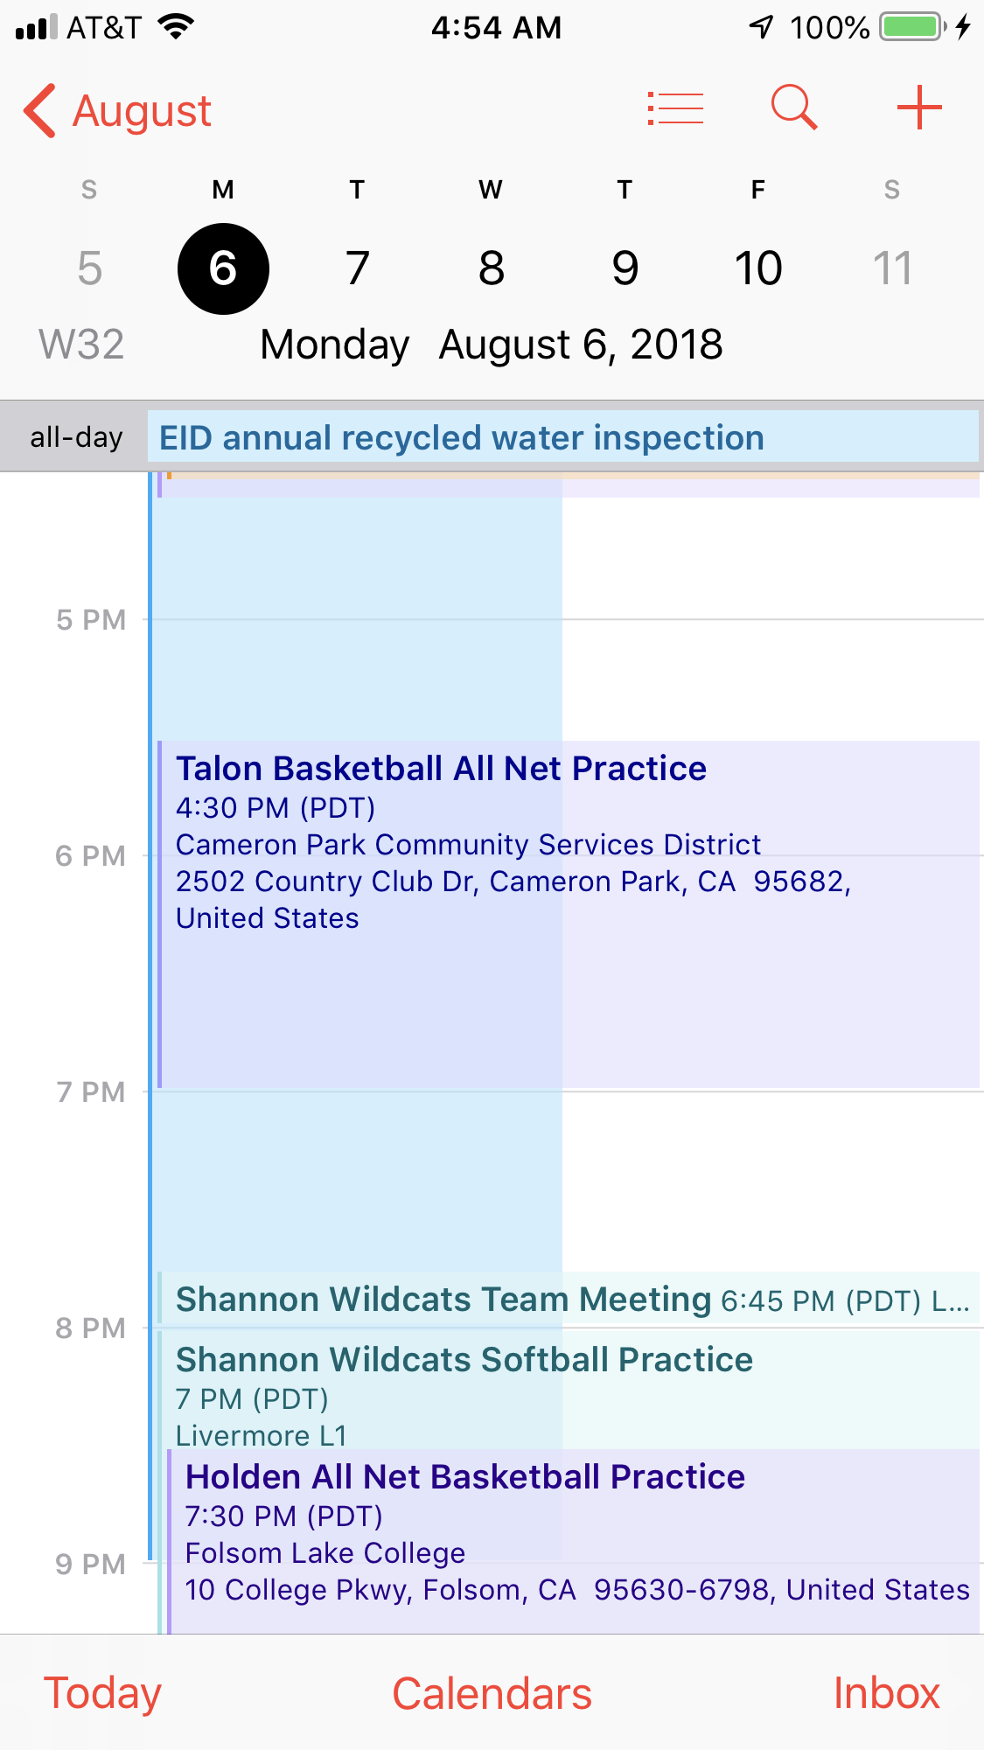
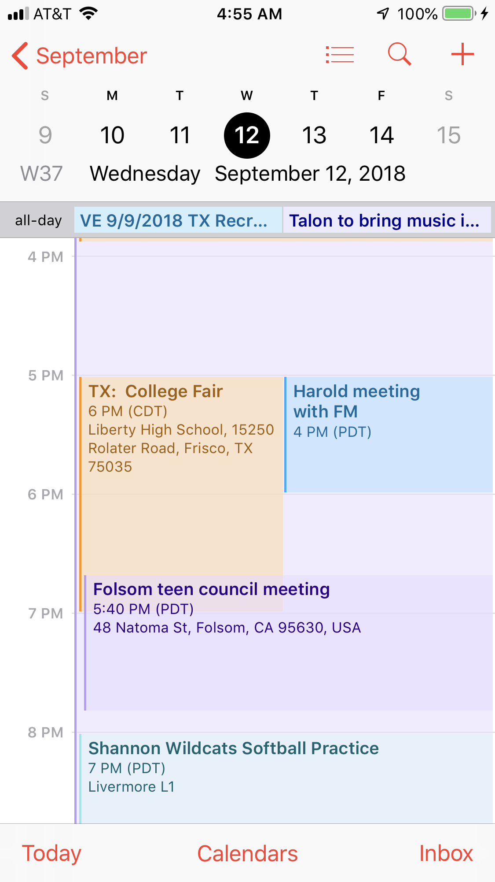
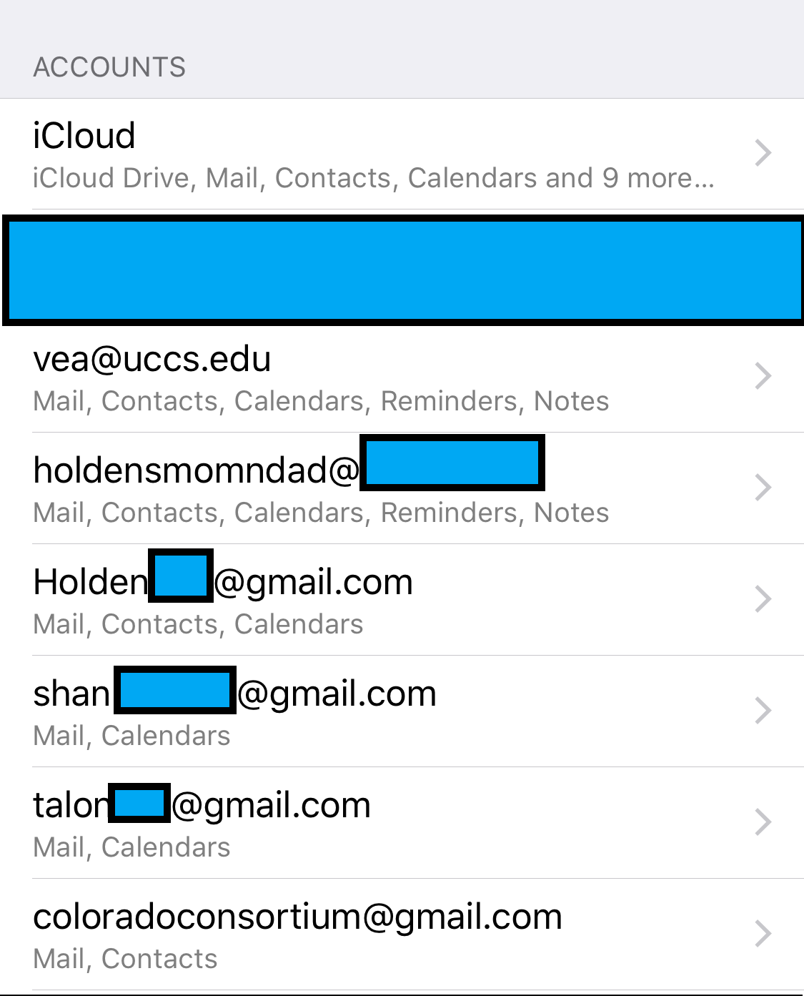
Calendars
Linking
Notes:
Technologically Mixed Family: Android & Apple devices

Slide 5
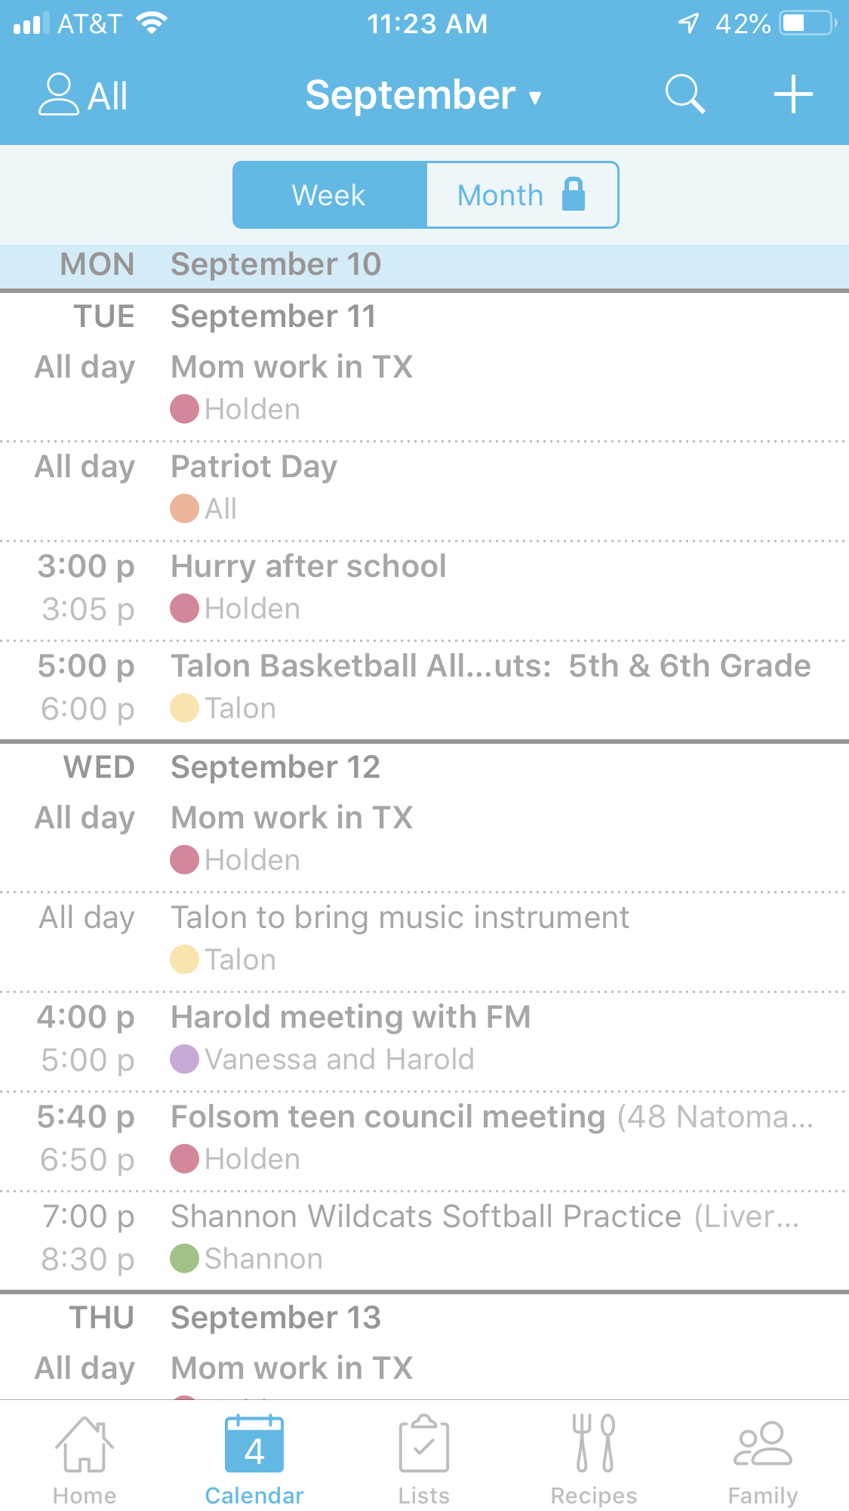
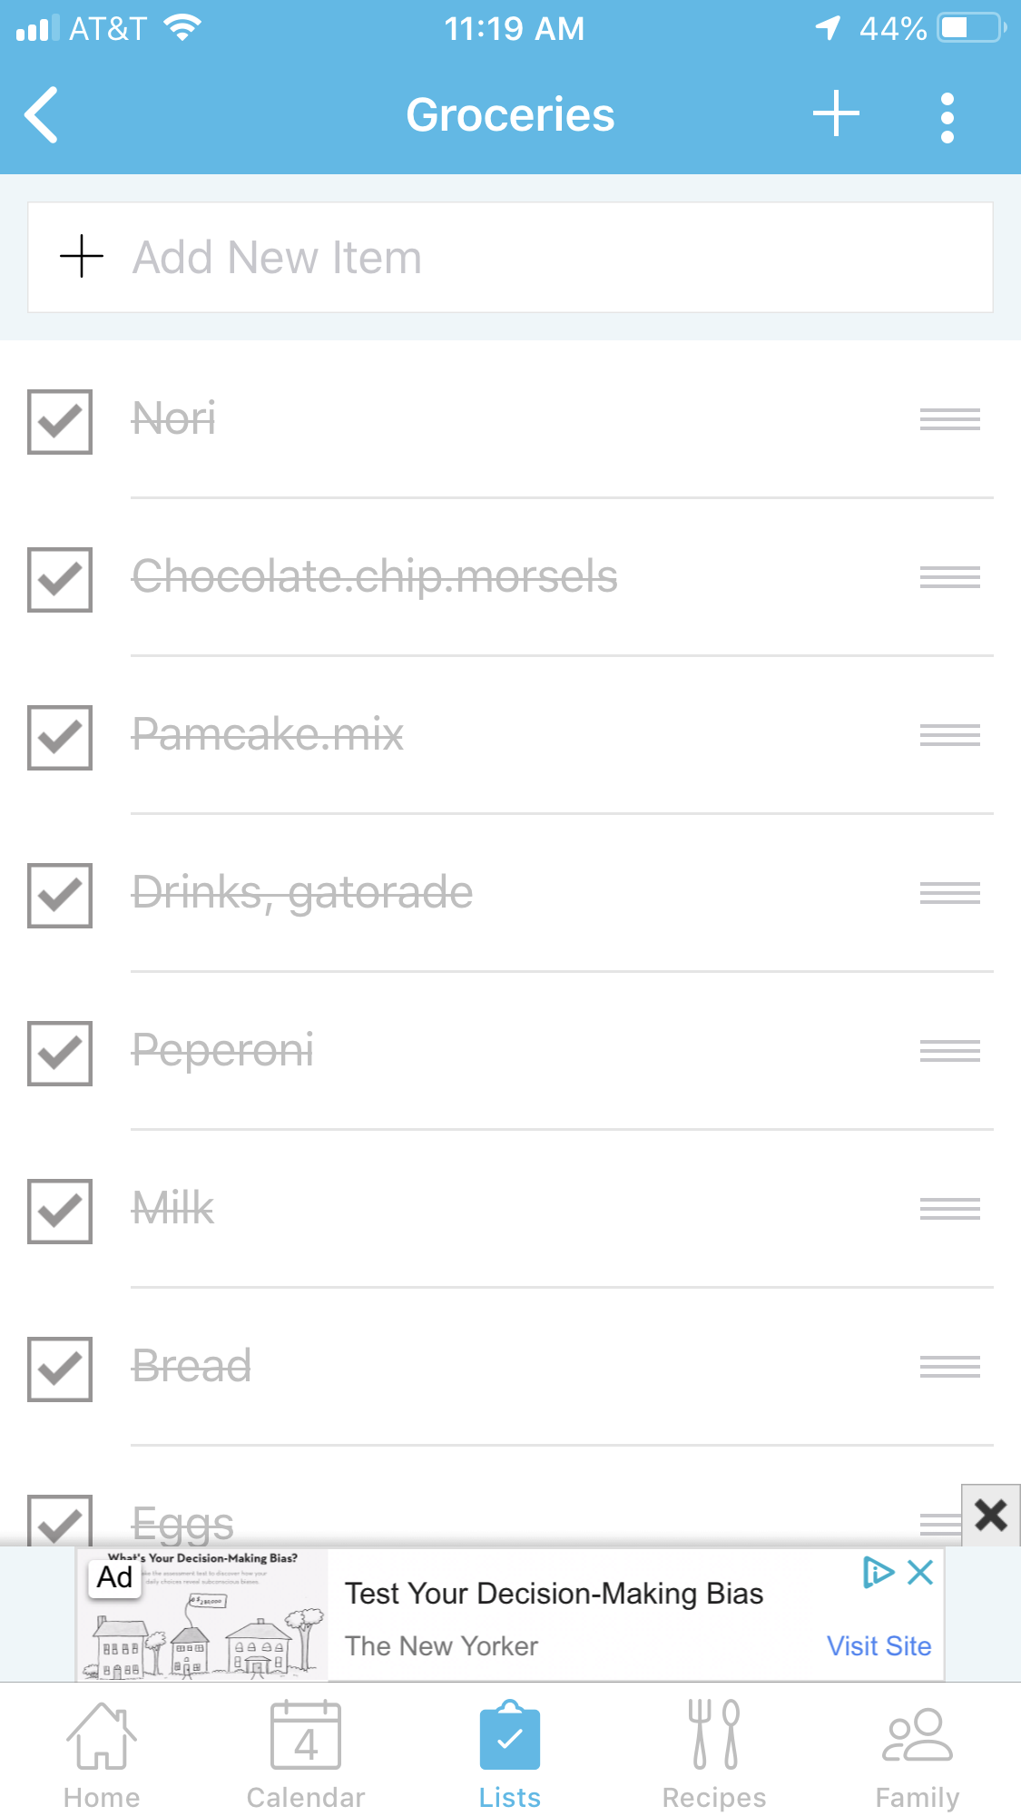
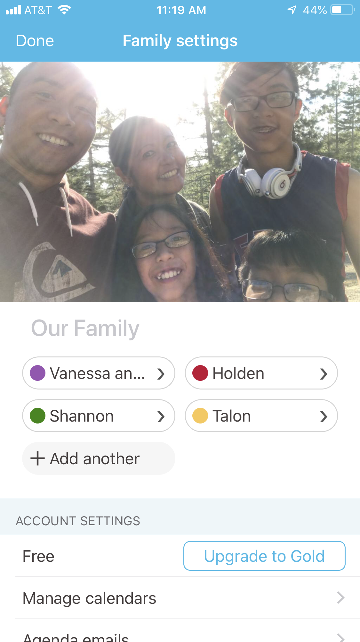
Calendars: Cozi App

Slide 6
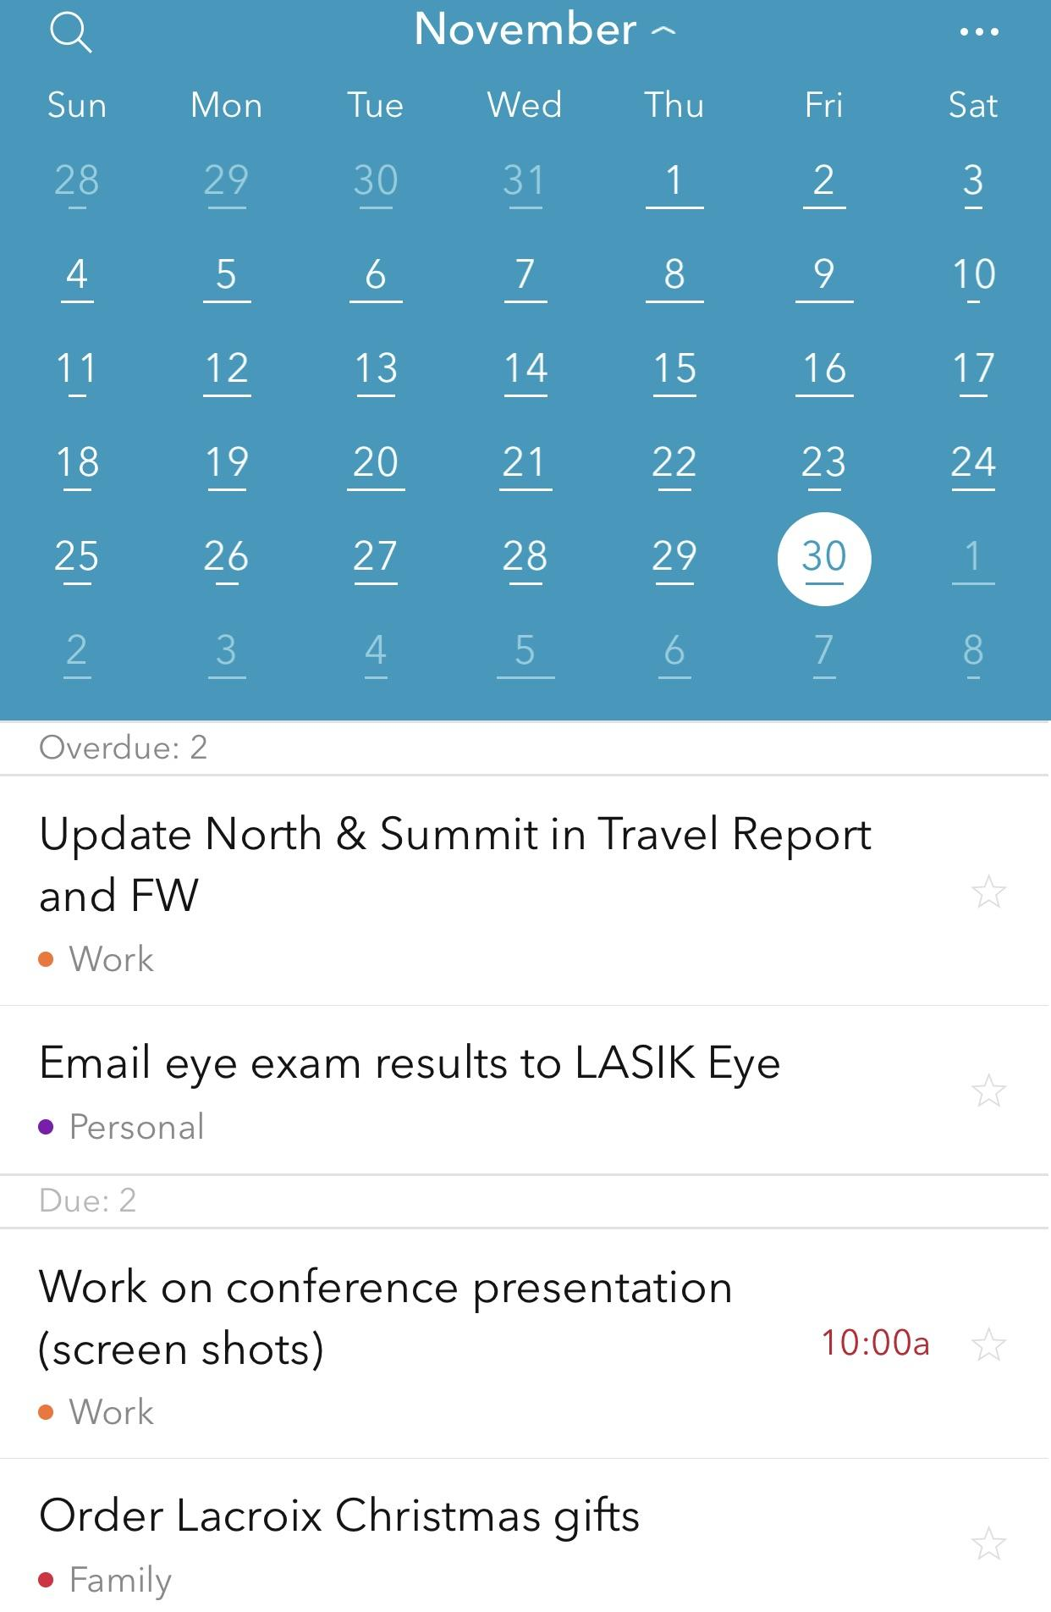
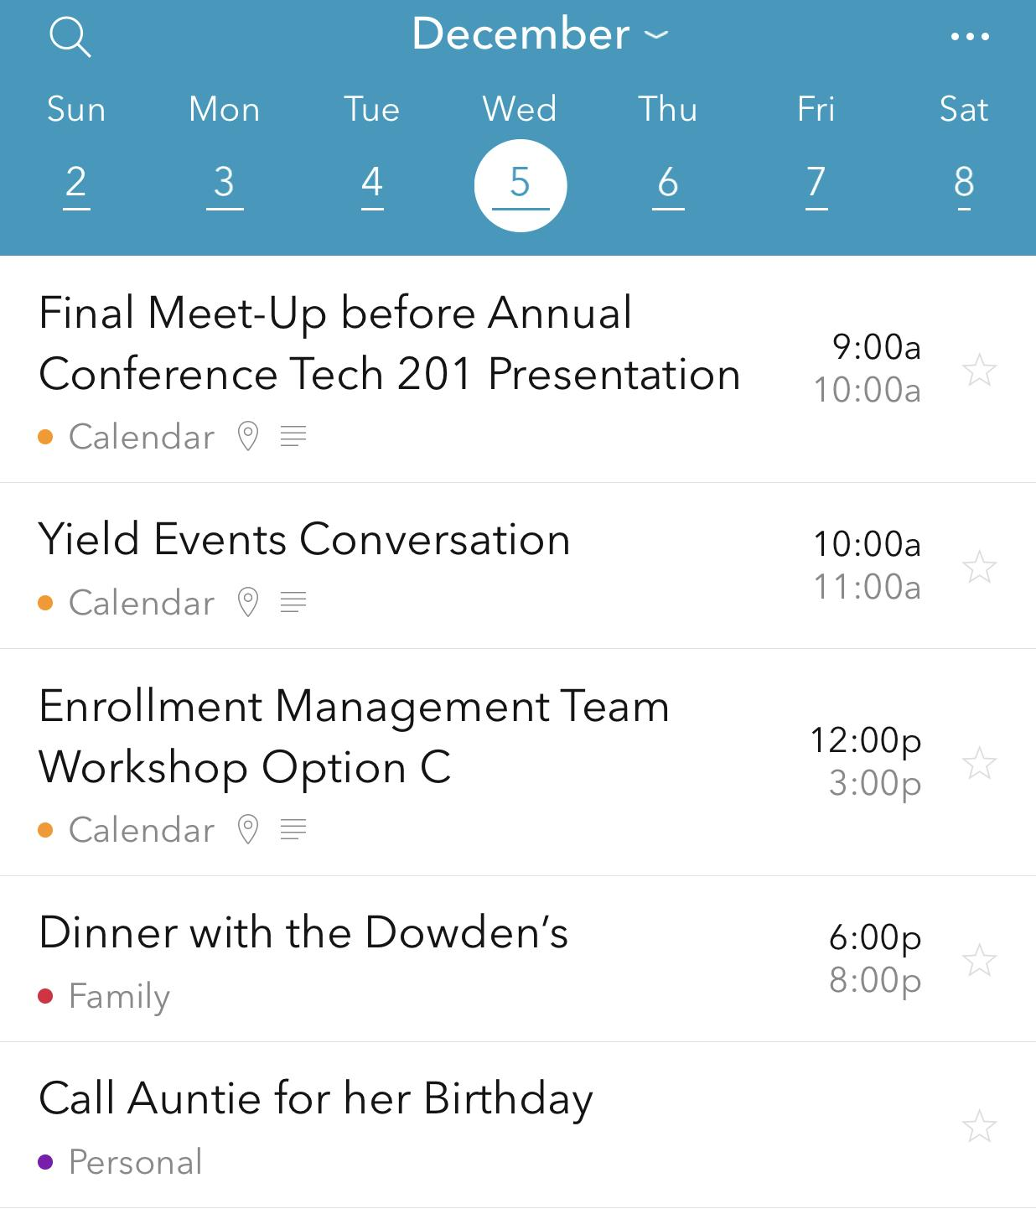
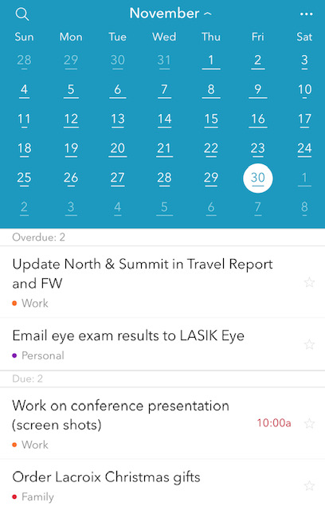
Calendars: Summit App

Slide 7
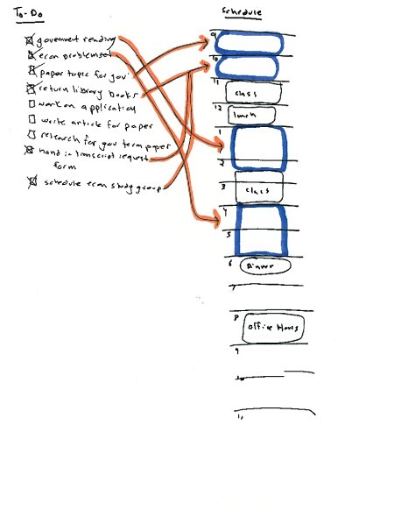
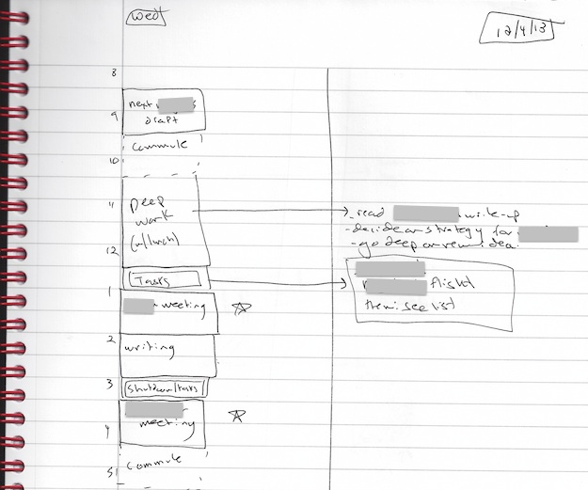
Calendars- Paper Based is allowed!
Cal Newport’s method:
write out schedule
write out to-do list
plug in important/urgent items to your schedule
add missed items to next day’s schedule
www.calnewport.com
Notes:
5-7 Minutes for each topic/ slide
Paper Based: How to be a Straight A student, Cal Newport

Slide 8
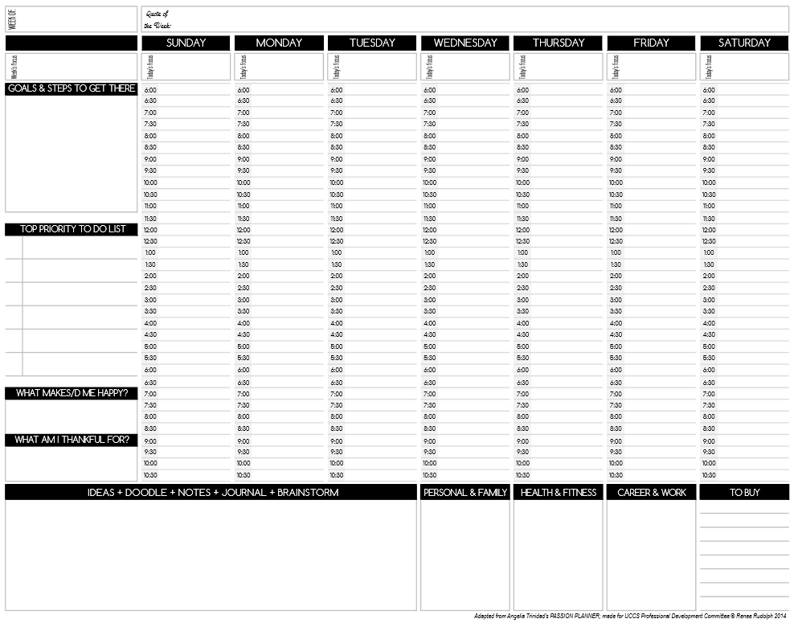
Notes:
5-7 Minutes for each topic/ slide
Paper Based: How to be a Straight A student, Cal Newport

Slide 9
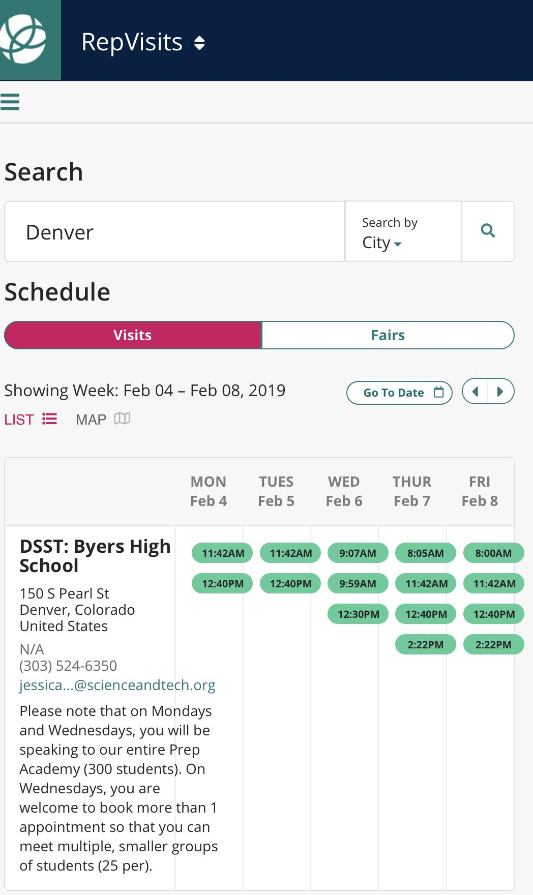
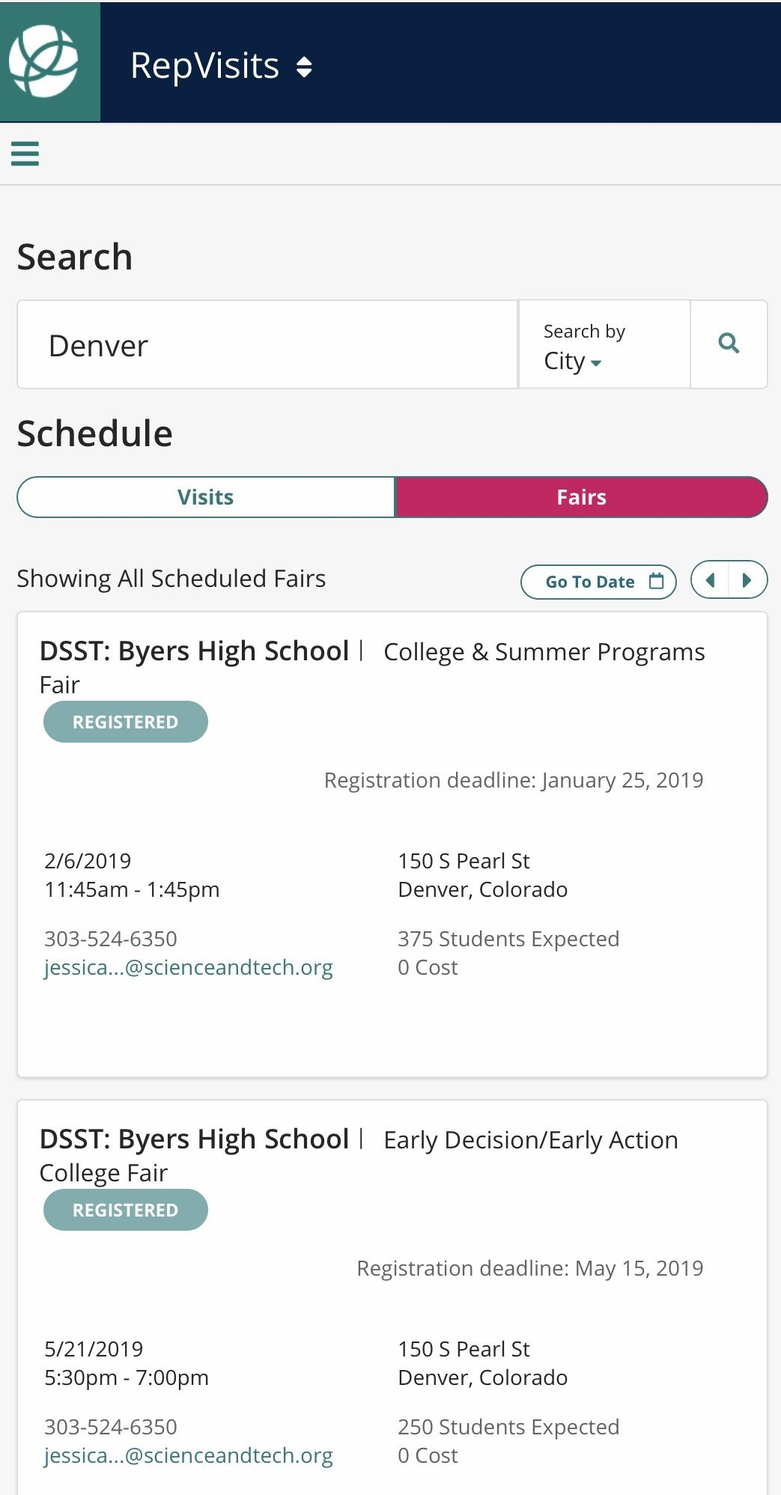
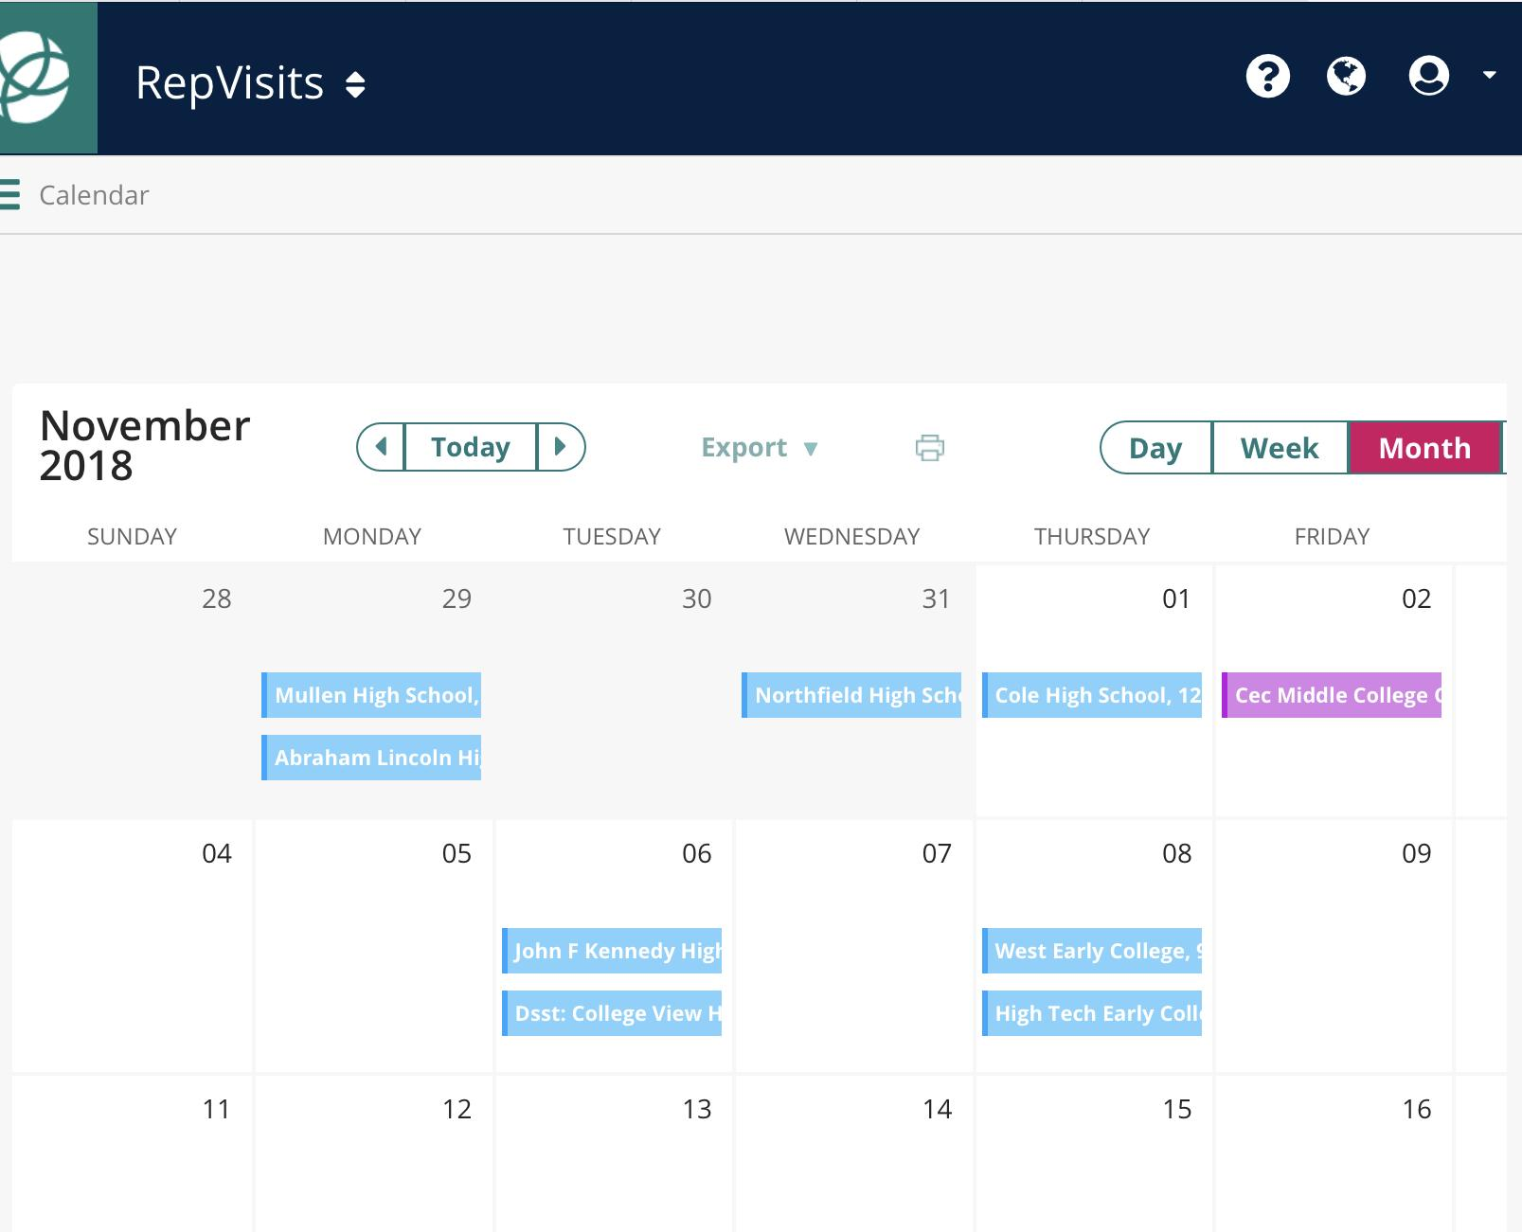
Event Management
RepVisits

Slide 10
Event Management
SignUpGenius
Notes:
Google Docs is another tool
Another one is YouCanBook.Me ($10/ month)

Slide 11
Technology 201—
Productivity Apps and Systems for Work, Work Travel and Life
Email
Priority Inbox
Automated Email
Canned Responses
Different Signatures
Quick Parts
Boomerang
Managing more than one email account: Shift
Notes:
8:45 - 8:55AM
Priority Inbox:
What You See - Unread at the top and a specific label next (i.e., To Do)
Canned Responses: Stop re-writing the same email over and over again. Enable it on Gmail under Settings, then Keyboard Shortcuts.

Slide 12
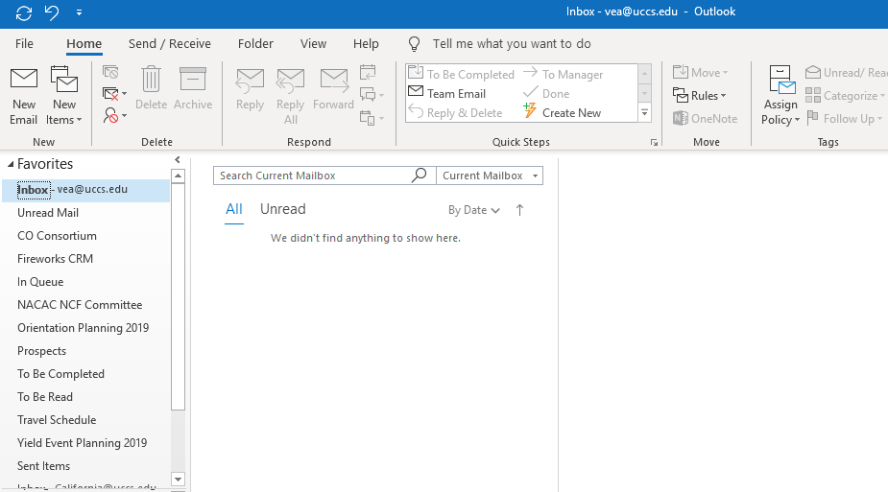
Inbox Zero?

Slide 13
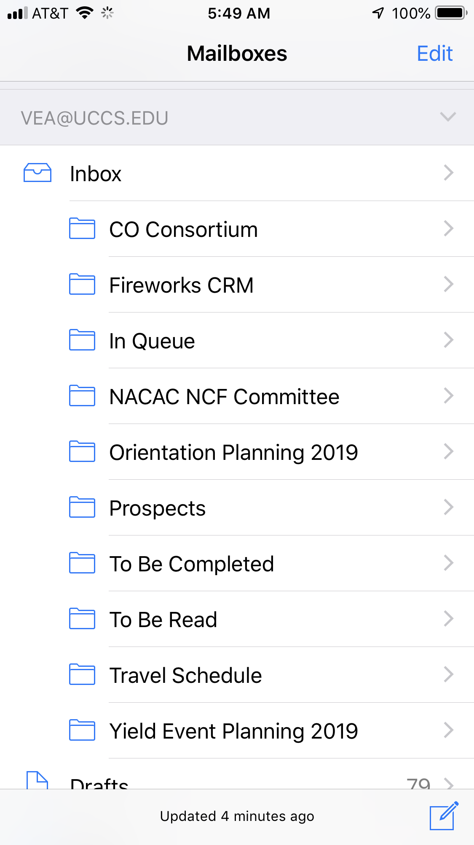
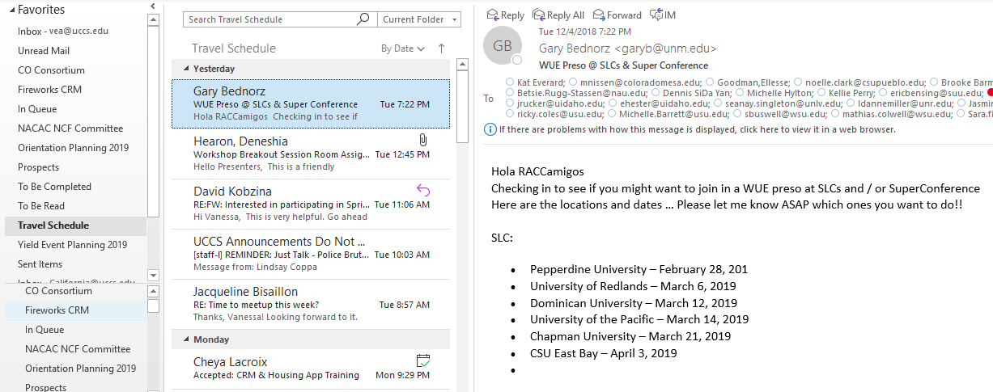
Notes:
Inbox Clumping

Slide 14
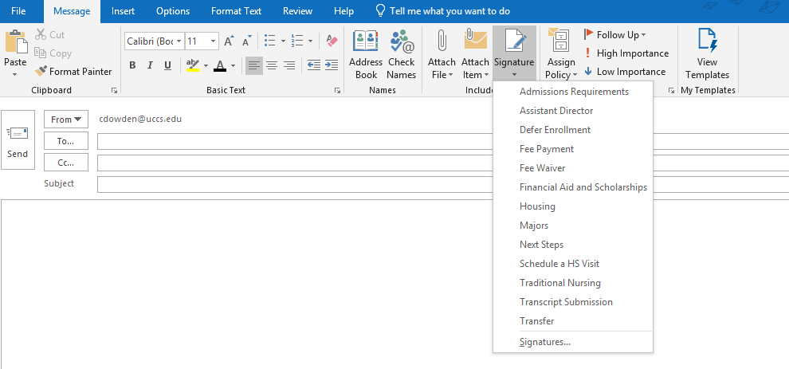
Quick Parts
Different Signatures

Slide 15
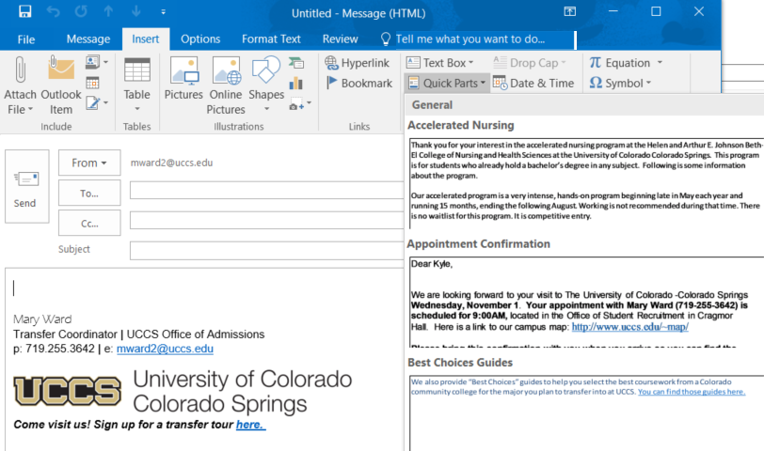
Quick Parts
Useful for information that is regularly given
appointment confirmations
general responses to specific inquiries
“Save Selection to Quick Parts”
Notes:
Priority Inbox:
What You See - Unread at the top and a specific label next (i.e., To Do)
Canned Responses: Stop re-writing the same email over and over again. Enable it on Gmail under Settings, then Keyboard Shortcuts.
Boomerang: Delay Send emails, Follow-up on Unresponsive Emails, Pause Inbox, Send a response only if no one else responds, Have an email come back when you’re ready for it

Slide 16
Technology 201—
Productivity Apps and Systems for Work, Work Travel and Life
Email
Priority Inbox
Automated Email
Canned Responses
Different Signatures
Quick Parts
Boomerang
Managing more than one email account: Shift
Notes:
8:45 - 8:55AM
Boomerang: Delay Send emails, Follow-up on Unresponsive Emails, Pause Inbox, Send a response only if no one else responds, Have an email come back when you’re ready for it

Slide 17
Technology 201—
Productivity Apps and Systems for Work, Work Travel and Life
Internet of Things (IoT)
“Hey Alexa, Siri, Google…”
Smart Home: Speakers, Garage Door, Doorbell/ Camera, Thermostat, Wifi Smart Plugs
Smart Car: Dash
IFTTT
Location Based Apps
Life360
Rocketbook
Notes:
8:55 - 9:02AM
Some Home Automation/ Peace of Mind While Away From Home: Wyze Cam, Garadget, Ecobee, Nest
Dash: Tracks mileage, crash notification
Examples of IFTTT (many recipes are premade and can be found online):
If weather app say it’s raining or will rain, send reminder to grab your umbrella
If you’re in a meeting, then mute your phone
If receipt (Uber, Hotel, Hertz) received, then send to Dropbox
If phone is missing, then ask Alexa to call it
If Fitbit says I’m awake, start brewing coffee (if you have WeMoCoffeemaker)

Slide 18
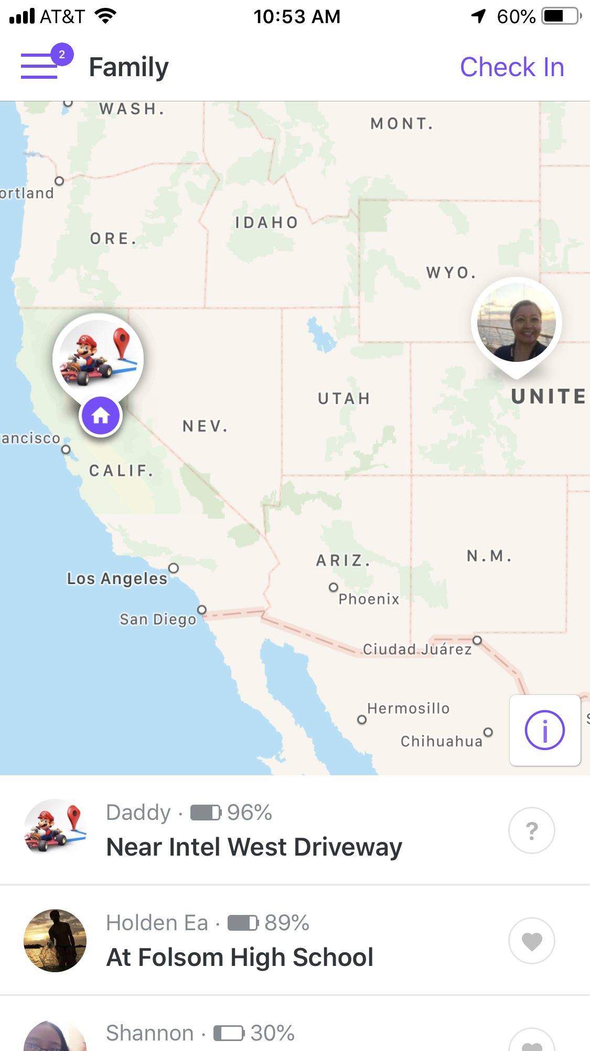
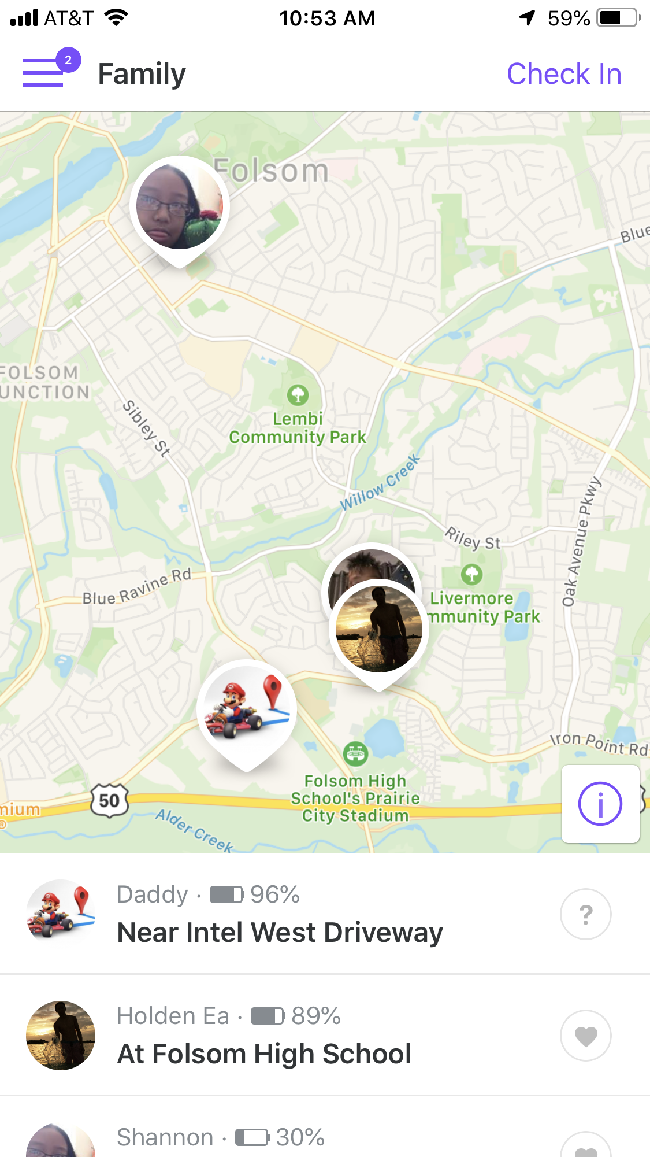
Location Based App: Life360

Slide 19
Technology 201—
Productivity Apps and Systems for Work, Work Travel and Life
Internet of Things (IoT)
“Hey Alexa, Siri, Google…”
Smart Home: Speakers, Garage Door, Doorbell/ Camera, Thermostat, Wifi Smart Plugs
Smart Car: Dash
IFTTT
Location Based Apps
Life360
Rocketbook
Notes:
8:55 - 9:02AM
Some Home Automation/ Peace of Mind While Away From Home: Wyze Cam, Garadget, Ecobee, Nest
Dash: Tracks mileage, crash notification
Examples of IFTTT (many recipes are premade and can be found online):
If weather app say it’s raining or will rain, send reminder to grab your umbrella
If you’re in a meeting, then mute your phone
If receipt (Uber, Hotel, Hertz) received, then send to Dropbox
If phone is missing, then ask Alexa to call it
If Fitbit says I’m awake, start brewing coffee (if you have WeMoCoffeemaker)

Slide 20
Technology 201—
Productivity Apps and Systems for Work, Work Travel and Life
Communication
Video Meetings
Zoom, Google Hangouts, Webex, new-Group FaceTime
Microsoft Teams
WhatsApp
Timed Communication
Text: SMS Scheduler
Notes:
9:02 - 9:09AM
Video Meetings: Connection speed is key!
Limitless Uses: Virtual Meetings, Drop-in “Office Hours”, Webinar for parents and students, Recording How-To Videos
Zoom: if you have more than 2 attendees, zoom will timeout after 40 minutes with the free version
Google Hangouts: Free, can have group chats up to 150 people, can have a group call with 10 people
WhatsApp: free, send messages using wifi or internet to any smartphone, unlimited number of contacts on group chat
FaceTime: free, need apple device, group FaceTime with up to 32 people

Slide 21
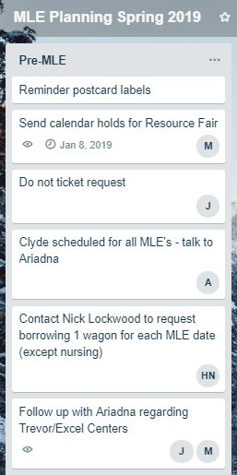
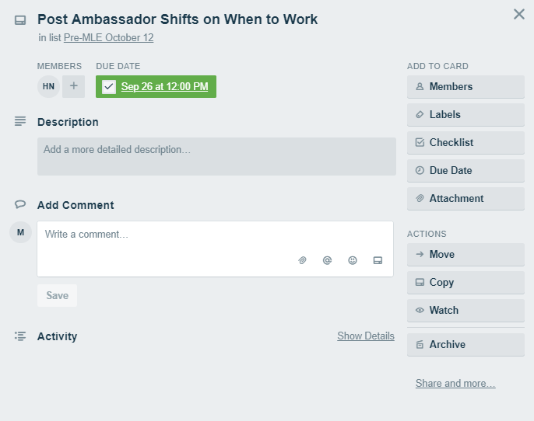
Project Management: Trello
Notes:
9:09- 9:14AM
Slack is another commonly used tool.
-Streamlined
-Targeted communication and a collaborative workspace all in one
-Mobile Functionality

Slide 22
Technology 201—
Productivity Apps and Systems for Work, Work Travel and Life
Tech/ Apps For Life
Fitness: Garmin, Fitbit, Apple Watch
Food/ Nutrition
Health Care while Traveling
Check your medical insurance
Lighting
Shopping Desktop Apps:
Honey
Ebates
Notes:
9:14 - 9:20AM
Basic fitness device uses: track steps, send reminders to move your body, heart rate, sleep patterns
Community Apps for Fitness, ie. Stridekick
Running: MapMyRun, Zombies, Run!
Popsugar 5-minute Workouts
For Nutrition/ Weight, ie. WW
Health Care: Find out what you have through insurance--access to nurse via phone or chat, email doctor. Or services like Talkspace, Amwell/ Teladoc
Lighting: Happy Light, Sunrise based alarm clock, Blue light coating for glasses, blue light filter on devices
Free Apps: Calm & Headspace (Meditation), Sworkit
Paid Apps: Pocket Yoga & Yoga Collective, 7 minute workout

Slide 23
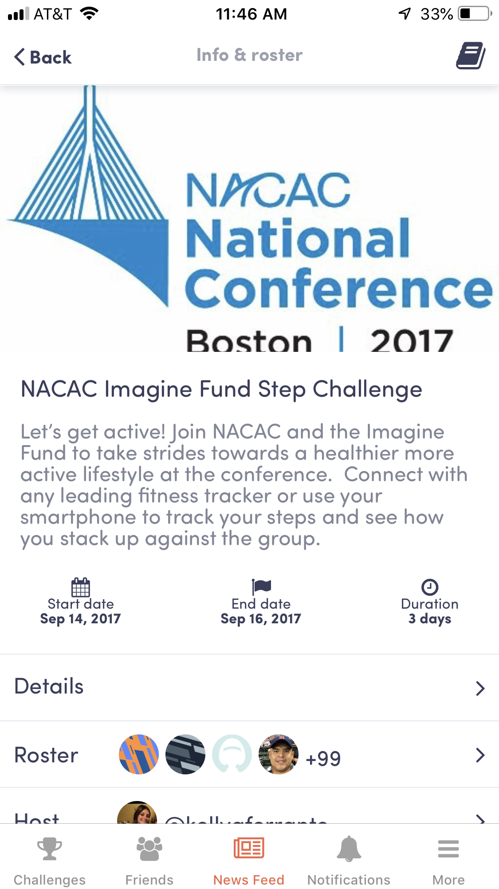
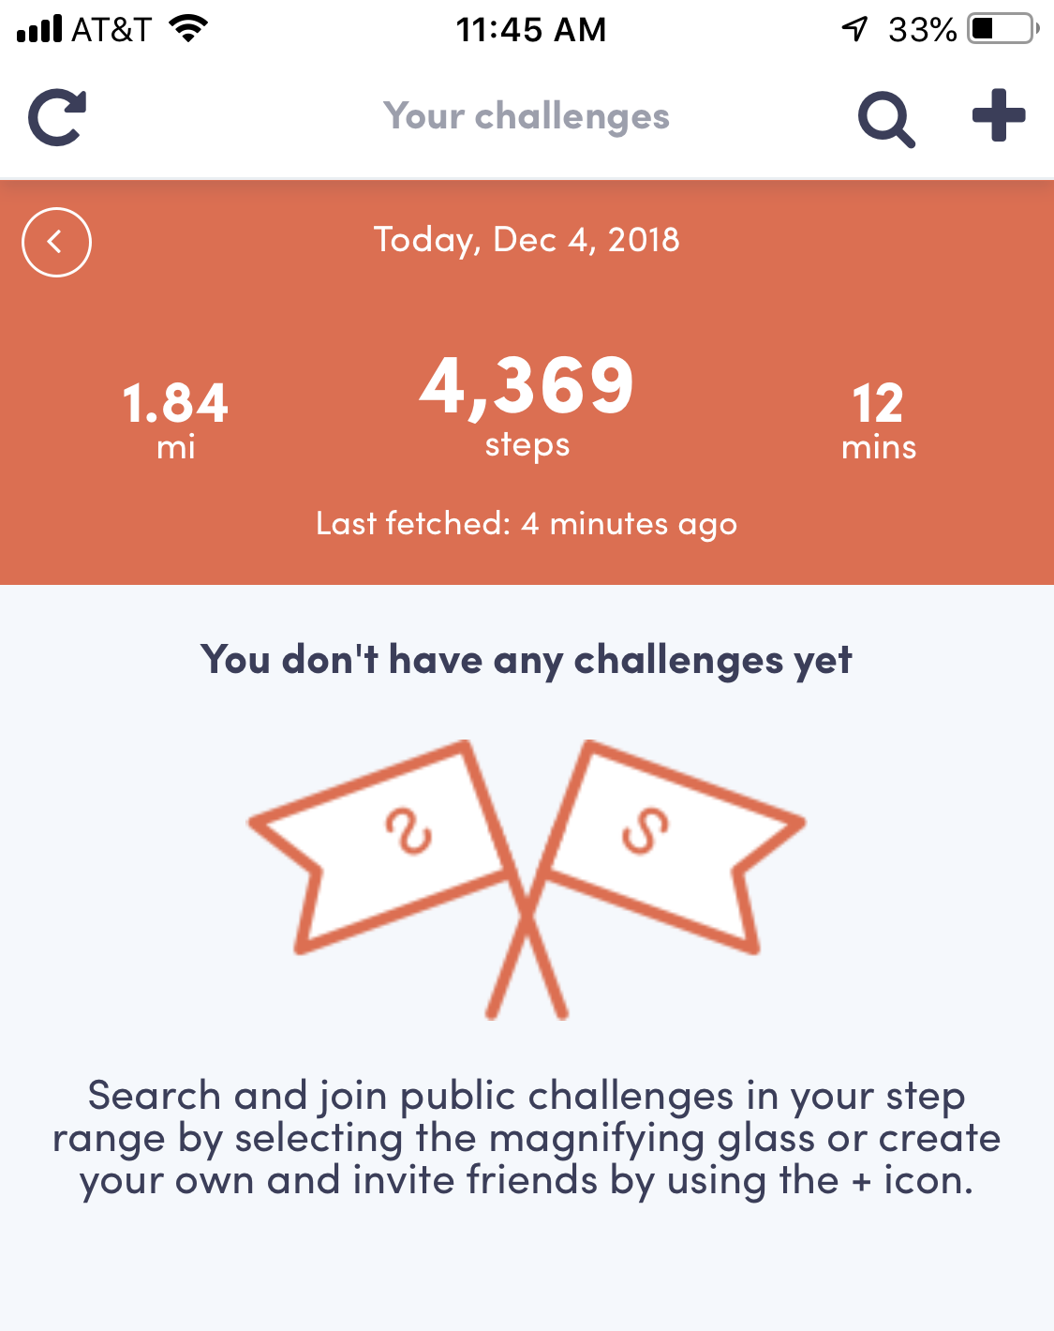
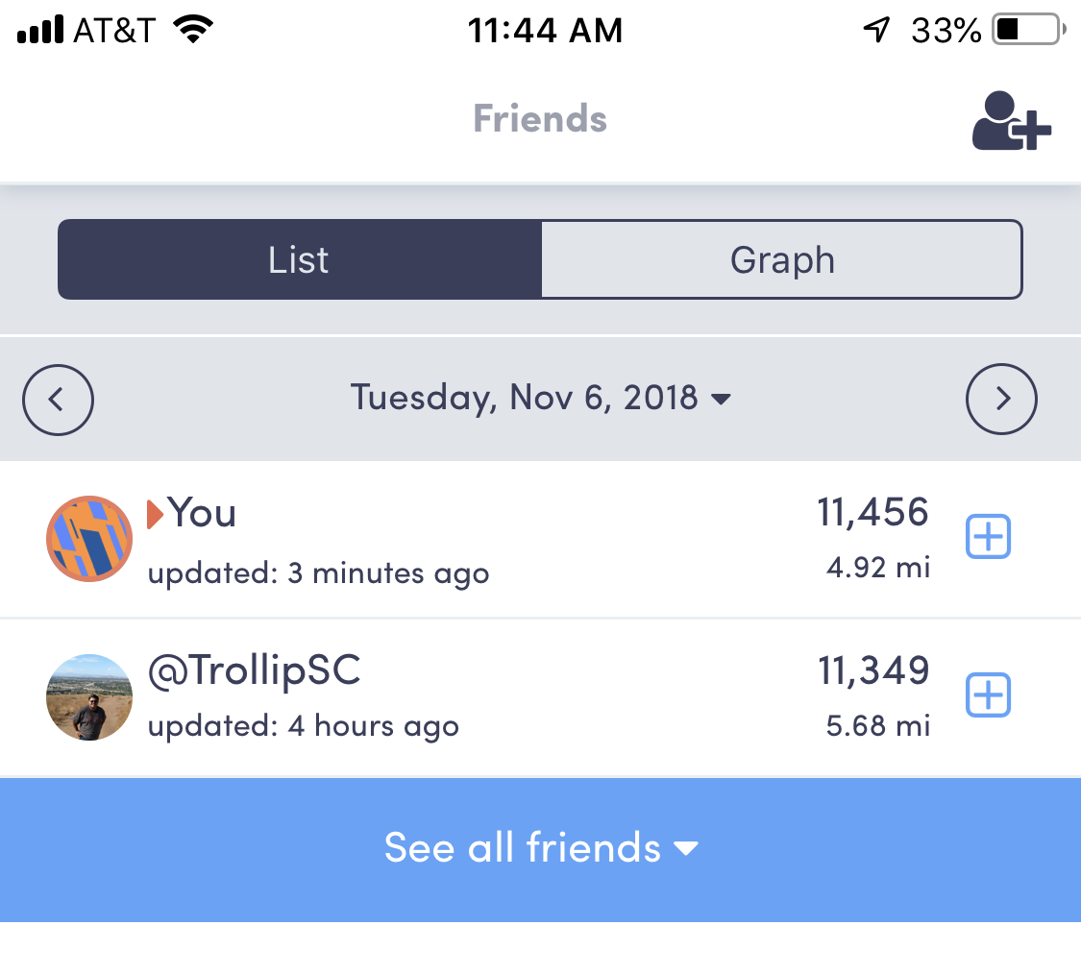
Community App for Fitness: Stridekick
Notes:
9:12 - 9:20AM
Basic fitness device uses: track steps, send reminders to move your body, heart rate, sleep patterns
Community Apps for Fitness, ie. Stridekick
Running: MapMyRun, Zombies, Run!

Slide 24
Technology 201—
Productivity Apps and Systems for Work, Work Travel and Life
Tech/ Apps For Life
Fitness: Garmin, Fitbit, Apple Watch
Food/ Nutrition
Health Care while Traveling
Check your medical insurance
Lighting
Shopping Desktop Apps:
Honey
Ebates
Notes:
9:14 - 9:20AM
Basic fitness device uses: track steps, send reminders to move your body, heart rate, sleep patterns
Community Apps for Fitness, ie. Stridekick
Running: MapMyRun, Zombies, Run!
Popsugar 5-minute Workouts
For Nutrition/ Weight, ie. WW
Health Care: Find out what you have through insurance--access to nurse via phone or chat, email doctor. Or services like Talkspace, Amwell/ Teladoc
Lighting: Happy Light, Sunrise based alarm clock, Blue light coating for glasses, blue light filter on devices
Free Apps: Calm & Headspace (Meditation), Sworkit
Paid Apps: Pocket Yoga & Yoga Collective, 7 minute workout

Slide 25
Technology 201—
Productivity Apps and Systems for Work, Work Travel and Life
https://tinyurl.com/y2rruhuc
Vanessa Ea
Associate Director of Admissions
vea@uccs.edu
Notes:
9:20 - 9:30AM
Leave 10 minutes for questions/ discussion

