Slide 1
Understanding the Transfer Process
Kailyn Doyle
Transfer Specialist
Humboldt State University

Slide 2
High School
Destigmatize the community college process
Encourage students to determine their long term goals
Help students identify possible 4-year institution(s) of interest
Encourage students investigate admissions requirements, programs, processes, deadlines
Attendance at CSU visits
Encourage students meet A-G requirements, as lower division transfer may be an option
Can be made up in at community college
Connect/contact possible 4-year institutions
Get on info list serve, join social media pages, and other communications

Slide 3
While at California Community College
Publicize broader admissions information
Application location (www.calstate.edu/apply)
System deadlines
Transcript request process
Utilize assist.org, transferology.com, and institution course catalogs to ensure accurate information
Encourage students to research next steps and plan accordingly
Make a 4 year plan inclusive of CCC and beyond
Clarify the difference between AA/AS and AA.T/AS.T
If possible, align graduation deadlines with admissions deadlines
Financial Aid literacy
Normalize the transition

Slide 4
CSU Transfer Minimum Admission Criteria
Upper Division
Lower Division*
Meet FTF admission requirements
Eligibility Index (ACT/SAT and HS GPA)
A-G CA College Prep
Less than 60 units
Math & English w/ C- or better
2.00
60+ transferable units
Golden 4 w/ C- or better
English
Speech
Critical Thinking
Math
30 units LD general education
*individual CSU campus dependent
**review impaction requirements for each CSU campus
***no more than 70 units from community college
****CSU accepts Ds for general education, except Golden 4

Slide 5
Associate Degree for Transfer (AA.T/AS.T)
Guarantees:
CSU admission – may not be campus of choice
Extra point bump in admission decisions
Graduate CSU in no more than 60 units in similar program
May have to complete lower division units while at CSU
No standard pathway, because is dependent on coursework provided by each individual CCC
Some CSUs (or programs) will only admit transfer students who have earned an ADT
Great option for new students who know their intended bachelor’s degree
Eliminates issues of articulation not matching major requirements

Slide 6
Cal State Apply
Extended Profile
If not set correctly, will require unnecessary information or prevent intended major/program
All fields must be complete to move on
Look for faint/faded boxes if save is not an option
If need to go to another section, can select in menu to left
If attempting to leave a section incomplete, will flag you to either agree to not save section or to complete/trash what is already entered
CA ID # not required
If an obvious topic is not listed in “subject” select Special Topics
Fee waiver available, but only known at the end

Slide 7
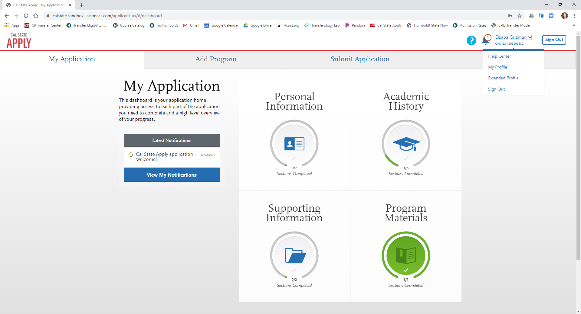

Slide 8
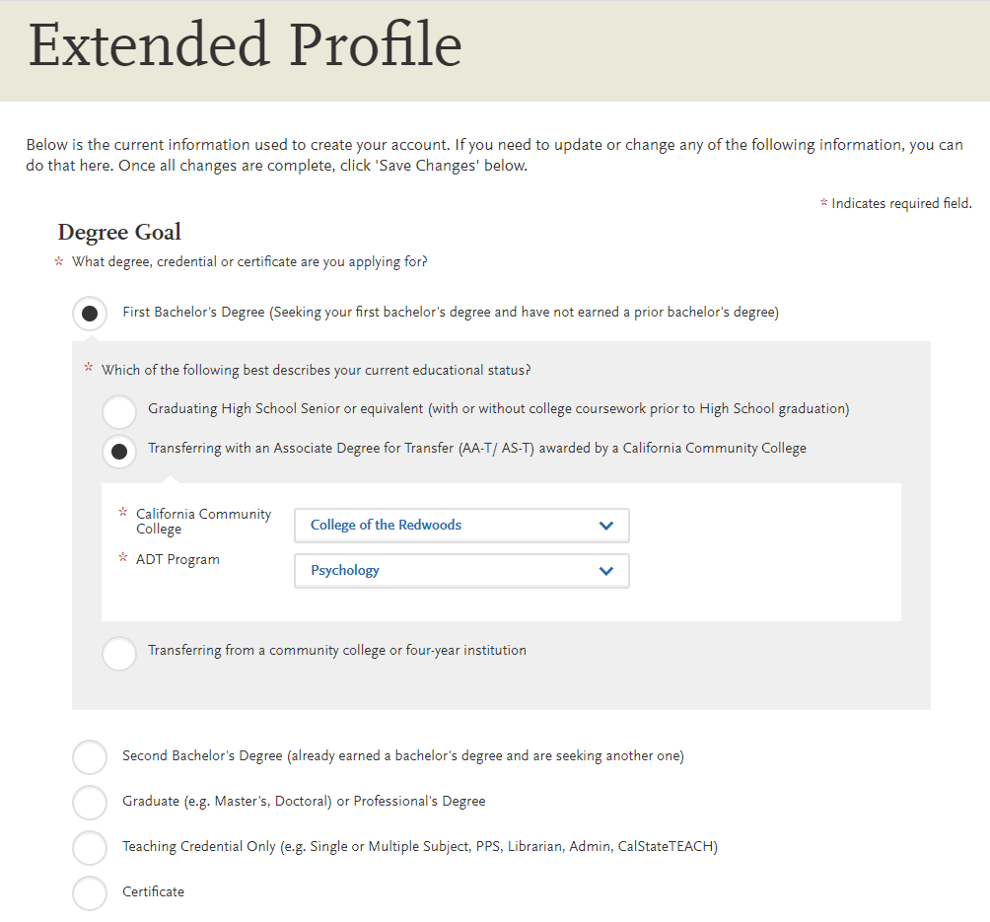

Slide 9
Cal State Apply Applicant Help Center
Starting Your Cal State Apply Application
Filling Out Your Cal State Apply Application
Sending Your Official Test Scores to Cal State Apply
Submitting and Monitoring Your Cal State Apply Application
Plus PDF Guides Freshman Coursework Entry
Transfer Coursework Entry
Transfer Academic Update Guide
Transfer Application Guide
International Applicant Guide
Graduate Application Guide

Slide 10
Cal State Apply Tidbits
Plan for approximately 2 hours
Can save work and return in stages
No essay required
No additional requirements or considerations beyond academic progress

Slide 11
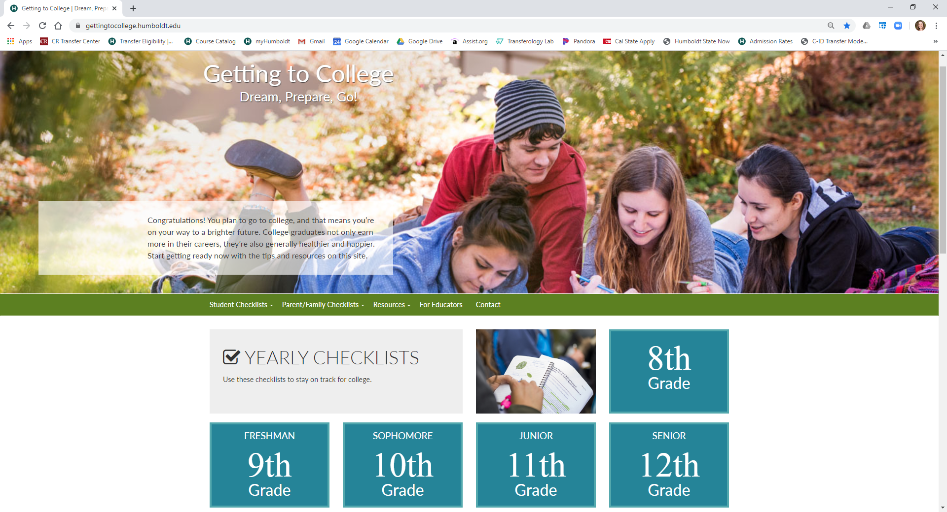
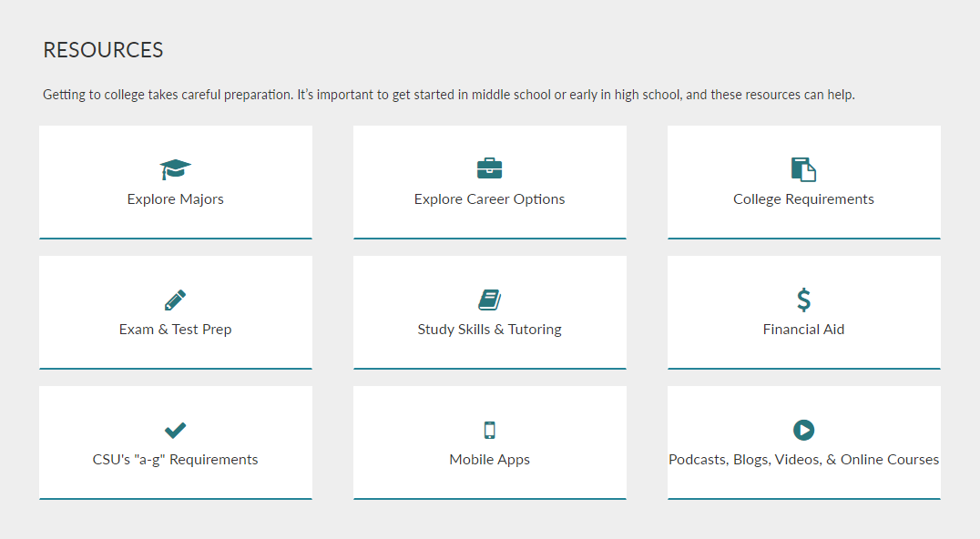
Getting to College
https://gettingtocollege.humboldt.edu

Slide 12
General Process – steps to enrollment
CSU Application Priority Deadline: Oct. 1-Nov. 30
FAFSA application (year prior): Oct. 1-March 2 (recommend earlier)
Also necessary for most scholarships
Scholarship applications: Nov. 15-Jan. 31
Transcripts, SAT/ACT scores, AP scores sent to institutions: March 1
Admission Decisions (conditional/provisional) sent 4 weeks of receiving transcripts
Accept/Decline Enrollment for Admission: May 1
Orientation/Registration: June-Aug
Final Transcripts: July 15
Vaccinations: start of school~

Slide 13
How Best to Work w/ CSU
Continually review articulation agreements
Review curriculum and match to programs at 4-year institutions
Particularly useful for local service area or high transfer rates
Identify partnership opportunities
Include/invite faculty in these processes
Think outside strictly counseling support
Attend CSU sponsored events, workshops, and seminars
Join the CSU Counselor Portal at counselors.calstate.edu
Designed with HS/CCC counselor audience in mind
Seeks feedback from counselors to improve the process

