Slide 1
DACA STUDENTS: A DISCUSSION
Presenters: Kathleen Crisp and Ernesto Espinoza, University of the Pacific admission counselors for DACA students

Slide 2
Dreamers, DACA, Undocumented: history, terminology, legislation
There have been many attempts by U.S. Congress and other government agencies to find a legal pathway for youth brought to the U.S. as children. These children, known as “undocumented” youth, do not have legal residency in any country.
The first attempt to find a pathway to legal citizenship status was the Development, Relief and Education for Alien Minors (DREAM) Act introduced by Congress in 2001. At least ten versions of the Act have been introduced since then, and none of them have passed. Qualifying students, in this Act, are called “Dreamers.”

Slide 3
DREAM Act, cont.
Most recent version (2019) had the following qualifications, which eventually would lead to permanent residency after two years:
Entered the U.S. under the age of 18
Entered four years prior to the Act and never left the U.S.
Enrolled in high school or admitted to an institution of higher education or technical education school
Has never been convicted of any “crime involving moral turpitude”
Has not been convicted of a crime of domestic violence

Slide 4
Deferred Action for Childhood Arrivals (DACA)
DACA, created by former Secretary of Homeland Security Janet Napolitano in 2012, provides temporary relief from deportation and work authorization to undocumented students brought to the U.S. as children. It was implemented via executive decision by former President Barack Obama.
The program stopped taking applications in 2017, and the Trump Administration introduced plans to rescind the program. A federal judge blocked the plan in 2018 and students can still apply for it. The ruling was appealed, and the case is now before the U.S. Supreme Court. A decision is expected Summer 2020.

Slide 5
DACA Qualification
Have come to the United States under the age of sixteen;
Have continuously resided in the United States for a least five years;
Are currently in school, have graduated from high school, have obtained a general education development certificate, or are honorably discharged veterans of the Coast Guard or Armed Forces of the United States;
Have not been convicted of a felony offense, a significant misdemeanor offense, multiple misdemeanor offenses, or otherwise pose a threat to national security or public safety;
Are not above the age of thirty.

Slide 6
DACA Qualification (cont.)
Individuals must also complete a background check and, for the process to be developed by U.S. Citizenship and Immigration Services (USCIS), must be 15 years or older unless they are subject to a final order of removal. Only those individuals who can prove through verifiable documentation that they meet these criteria will be eligible for deferred action.
DHS and its components will implement a process by August 15, 2012 to allow eligible young people to request deferred action and employment authorization. In the meantime, individuals who believe they are eligible should not submit a deferred action request.

Slide 7
DACA Qualification (cont.)
Individuals who are not in removal proceedings or who are subject to a final order of removal will need to submit a request for a review of their case and supporting evidence to USCIS. Individuals with questions or seeking more information on the new process may call the USCIS hotline or visit the USCIS website.
Additional information is available from the Immigration and Customs Enforcement (ICE) Office of the Public Advocate.

Slide 8
California DREAM Act
The California DREAM Act Application allows undocumented students to apply for state financial aid. They do not need to be DACA qualified to apply.
The California Nonresident Tuition Exemption Education Code, also known as AB 540, allows certain students to be exempt from paying nonresident tuition and allows them to apply for financial aid.
AB 540 applies to the following groups:
High school attendance in California for three or more years

Slide 9
California DREAM Act, cont.
Earned credit that is the equivalent of three or more years of full-time, high school course work and attended a combination of elementary, middle, and high school for a total of three years
Attained credits earned at a California adult school
Attained credits at a California community college
Any combination of these.

Slide 10
California DREAM Act, cont.
And…
Graduated or will graduate from a California high school, or
Attained an associate’s degree at a California community college, or
Fulfilled the minimum transfer requirements from a community college to a California State University or University of California
Will register or enroll in an accredited and qualifying California college or university, and complete an affidavit stating that the student will legalize their immigration status as soon as they are eligible, and do not hold a valid visa.

Slide 11
Source material
National Immigration Law Center https://www.nilc.org/issues/daca/daca-heads-to-scotus-scenarios/
American Immigration Council https://www.americanimmigrationcouncil.org/research/dream-act-daca-and-other-policies-designed-protect-dreamers
California Student Aid Commission https://www.csac.ca.gov/post/california-nonresident-tuition-exemption

Slide 12
Undocumented Students and
Admission to College
Test Optional: When a student has the ability to choose whether or not they may submit their SAT or ACT score. Not submitting will mean they will be evaluated through other components of their application.
Test optional is different from test flexible, test blind, etc.
Some schools require a GPA minimum to allow a student to go test optional.
Consider test optional colleges and universities (as of 2019, there are 84 test optional schools in CA).
All CSU are now test optional, but test scores may be required as a supplement for impacted majors/programs.

Slide 13
Financial Support for DACA/ DREAM Act/Undocumented Students
League of United Latin American Citizens (LULAC) Scholarship: Awards between $250 to $2000 worth of scholarship every year regardless of status.
UC Blue and Gold Opportunity Plan (DREAM Act only). Pays remainder of tuition if eligible. UC’s only.
UC DREAM Loan Program (DREAM Act only). Maximum loan amount of $4000 per year for a maximum of $20,000
CSU/UC Middle Class Scholarship (DREAM Act only). Amount varies per student and institution.

Slide 14
Private Organizational Support for DACA/ DREAM Act/Undocumented Students
Immigrants Rising: A San Francisco based organization that offers free professional mental health services, legal in-take service, and financial support through partnerships for undocumented students.
They create a PDF file every year containing a long list of scholarships that do not require proof of citizenship.
Offer additional support services to 32 different public colleges and universities through the California Campus Catalyst Fund.

Slide 15
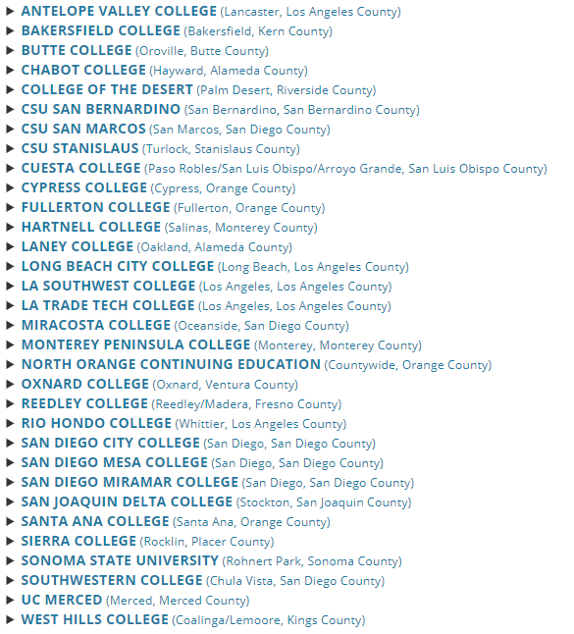
CA Campus Catalyst Fund Schools

Slide 16
Source Materials
Immigrants Rising
https://immigrantsrising.org/
Test Optional Colleges
https://blog.prepscholar.com/test-optional-colleges-list
League of Latin American Citizens
https://lulac.org/
Blue and Gold Opportunity Program, DREAM Loan, Middle Class Scholarship
https://admission.universityofcalifornia.edu/tuition-financial-aid/types-of-aid/blue-and-gold-opportunity-plan.html

