Slide 1
Access and Opportunities at
California's Private Colleges and Universities

Slide 2
Presenters
Michael Daly
Assistant Director of Admissions – University of the Pacific/
Northern California Chairperson – Private Colleges of California (PCoC)
Rebecca Williams
Associate Director of Admission –
Mills College
Julissa Ramirez-Romo
Undergraduate Admissions Counselor –
Dominican University of California

Slide 3
INTRODUCTION
“PCoC” for short (pronounced, “Peacock”)
Association of California private colleges and universities
Established in 2018
17 Member Schools and growing – All members are non-profit and WASC-accredited.
Mission - To help students and their families learn about California private colleges and universities as viable options for their higher education and career preparation needs.
Outreach and Education Activities - Mini-college fairs at high schools (day or night), guest speakers at college workshops, essay reviews, university application case studies, etc.)
URL: https://sites.google.com/view/privatecollegesofcalifornia/home

Slide 4
Overview of California Private Schools
78 Private Non-Profit Colleges & Universities in California
25 campuses in Northern California, 53 in Southern California
Undergraduate Enrollment ranges from 60 - 20,000 students
Traditional Programs to Non-Traditional Programs
Liberal Arts, STEM, and Professional Programs offered

Slide 5
Common Myths and Misconceptions About Private Colleges and Universities
ACCESS:
Price
Admission
Diversity
Inclusiveness
OPPORTUNITIES:
Size
Program Choices
Research and Internships
Career Preparation

Slide 6
ACCESS TO PRIVATE COLLEGES AND UNIVERSITIES:
MYTHS AND MISCONCEPTIONS

Slide 7
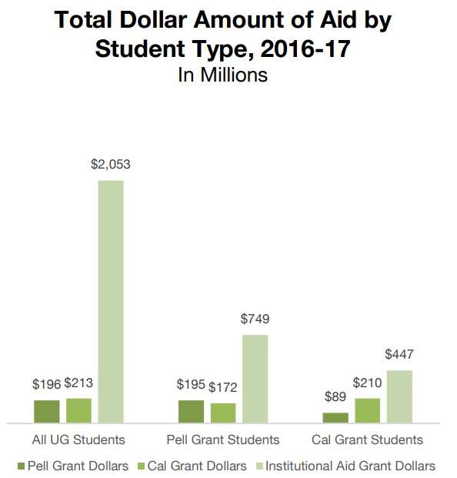
“They’re too expensive!” Generous Financial Aid Available At California Private Colleges
California Private Colleges provide over $2 billion in institutional aid.
22% was for Cal Grant Students
On average, private colleges award $2 in scholarship money for every $1 of Cal Grant money.
*source: aiccu.edu
Notes:
$18,865 was the average amount of institutional grant aid provided to Cal Grant Students.
63% of students, on average, are receiving institutional aid from AICCU colleges (at or above 90%)

Slide 8
Graduate In Less Time At California Private Colleges

Slide 9
“They’re too hard to get accepted to.” California Private Colleges and Universities Vary In Their Selectivity and Admissions Processes
California’s private colleges and universities often review applications holistically, are generally more flexible in their academic requirements, and consider factors that CSU and UC schools do not.
Most programs at CA private colleges and universities are not impacted as they are at CSU and UC schools.
Acceptance rates depend on the student’s major choice and can vary from 10% to over 80%.
Admissions Officers will work with students individually to help them get into the program of their choice.
Notes:
Test Optional

Slide 10
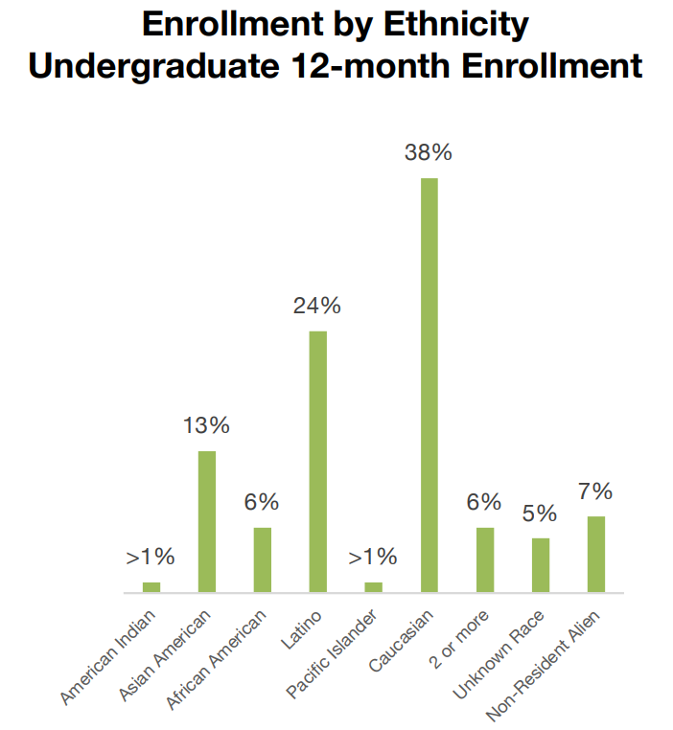
“They lack diversity.” California Private Colleges Are VERY Ethnically-Diverse
In 2016-17, over 60% of students enrolled in California Private Schools were of an ethnic background other than Caucasian.
Notes:
Prominent in the college’s mission
40% HSI, 49% first gen,

Slide 11
“If I go to a religiously-affiliated private school, I’ll feel like an outsider if I don’t practice that faith.” Most religiously-affiliated schools have very inclusive campus environments and celebrate the diversity of faiths represented by their students
Researching a ‘best fit’ religiously-affiliated campus:
Coursework
Dress Code/Honor Code
Mandatory Services
Student Organizations
Religious History
Notes:
Coursework: what, if any, religion courses are mandatory as a part of the curriculum. Do they teach a specific dogma/religion or are they more broad brush, or give the option for that
Dress code: it’s highly unusual for colleges to have a dress code, the presence of one is a good indicator that religion is a significant part of the campus culture.
Honor code: these are common, but look to see if it focuses on academic integrity/student rights or if it is about limiting/controlling student behavior w/regards to religious practice.
Mandatory services: this is pretty straightforward, is it mandatory, minimum number to attend, fines for not attending or do they leave it to the discretion of the individual student
Student organizations: are they diverse, (ex: muslim student assc., jewish student assc., lgbtq+ assc., pro-choice?)
Religious history: many universities/colleges’ religious affiliation function as more of an homage to their history and founding by a religious group, and don’t play a big part in the day-to-day life of the campus culture and student body. Others do not, their affiliation is at the core of the institution and how it governs and operates. It’s best to decipher this in your college search process.

Slide 12
OPPORTUNITIES AT CALIFORNIA PRIVATE COLLEGES AND UNIVERSITIES:
MYTHS AND MISCONCEPTIONS

Slide 13
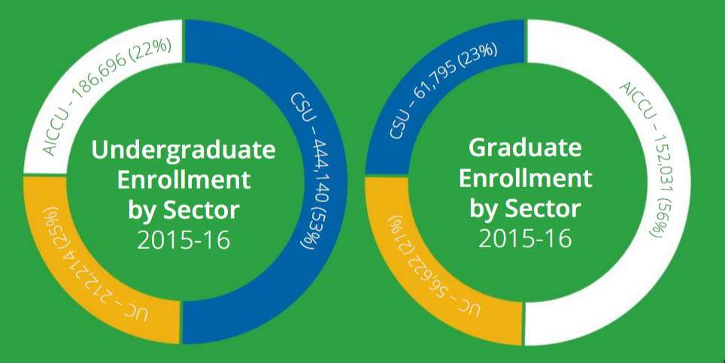
“They’re very small.” CA Private Colleges and Universities Educate Large Numbers Of Students
22% of California’s 4-year undergraduate population & 56% of its graduate students are enrolled at Private Schools. Enrollment at some CA private schools can be as high as 20,000 students.
*source: aiccu.edu

Slide 14
“Not enough opportunities for research and internships at private universities.” The opposite is actually true!
Private colleges and universities have fewer students which many consider relates to fewer opportunities for learning exploration.
Larger schools serve larger student populations in which prime internship opportunities are harder to obtain or are not easily accessible.
11:1 Student to Faculty Ratio for AICCU – more individualized attention, chance for student to create strong connections with faculty and staff. faculty and staff

Slide 15
“It’s harder to get a good job if you go to a private college - many big companies don’t know much about them.” Employment Rates and Starting Salaries For California Private College Graduates are generally higher than those at most CSU and UC schools
Owners and managers of many top organizations are graduates of California private colleges and universities:
Most California private colleges and universities have close partnerships with top organizations in many different fields and are located in close proximity to them
On average, graduates of California private colleges and universities enjoy a higher post-graduation employment rate and starting salary than their public university counterparts
Notes:
Bullet Point #1: - Congresswoman Barbara Lee (Mills College)
- TV Executive Joan Ganz Cooney (Dominican University of California)
Real Estate Developer Alex Spanos (University of the Pacific)
Bullet Point #2: Sacramento Kings, Cisco, Google, FDIC
Bullet Point #3: UOP – 3rd highest alumni salaries in CA, 90%+ employed full-time within 6 months of graduation, 89% employed or seeking higher edu within 6 mos. (Mills)

Slide 16
In Conclusion
California’s Private Colleges and Universities:
Are affordable to a wide range of students.
May be easier to get accepted to than many public universities.
Offer highly diverse and inclusive learning environments.
Provide access to more research and internship opportunities for more students.
Come in all sizes – small and large
Offer a wide diversity of study programs and research opportunities.
Help students graduate sooner and get rewarding good-paying jobs faster.

Slide 17
What Can PCoC Do For Counselors?
Support your efforts to educate students and about the viability and accessibility of a CA private college/ university education.
Education activities including: mini-college fairs (day or evening), PCoC member school guest speakers for classes and college workshops throughout the school year.
To request a PCoC event at your school, contact our Regional Outreach Coordinators:
Northern California – Michael Daly – mdaly@pacific.edu
Southern California – Hervey Malone II – hmaloneii@pacific.edu

Slide 18
Questions??

