Slide 1
Goodbye
Safety Schools!
Re-thinking the College List - New Terms
and Ideas
Debbie Austin
College Advisor
St. Francis High School

Slide 2
What terms have YOU used? How do YOU define them?
Common Terms
Reach
Realistic
Target
Likely
Safety
Back-Up

Slide 3
We decided to flip the script!
Start with Yes, Yes, Yes schools.
List should primarily be Target schools.
It’s ok to have some Reach schools.
What is a Lottery school?
Notes:
What does YES, YES, YES mean? Not everyone’s YES school will be the same. For some, it will be CCC, for others it’s a school that guarantees admission for certain GPA’s and is affordable. The negative feeling of a “back-up” or “safety” school is replaced by the positivity associated with a YES school.

Slide 4
What does a quality college list look like?
YES YES YES
_______________
Target
__________________
Reach
_____
Lottery
This Photo by Unknown Author is licensed under CC BY-NC-ND
This Photo by Unknown Author is licensed under CC BY-NC
Notes:
Shows highest value on YES, YES, YES schools. Shows largest portion are TARGET schools. REACH schools might be financial reach. Shows tiny portion of LOTTERY schools at the bottom.

Slide 5
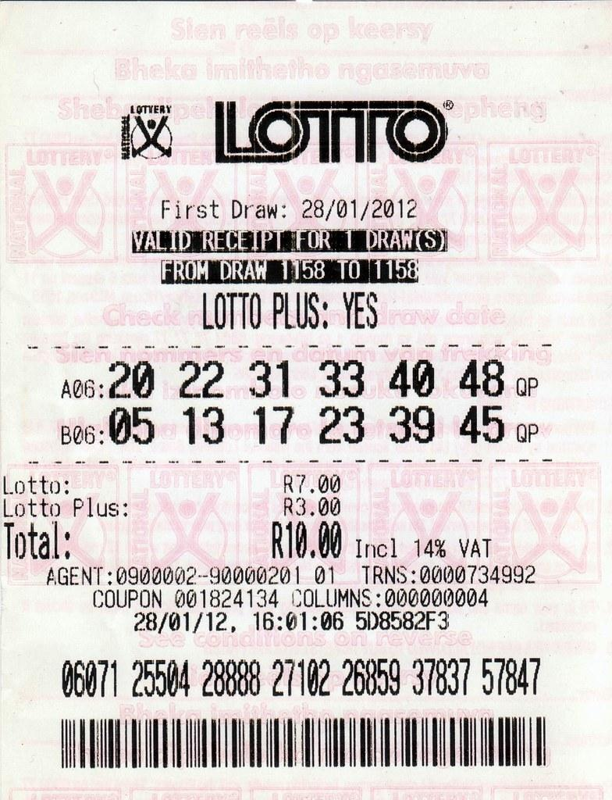
Imagine
these
scenarios...
This Photo by Unknown Author is licensed under CC BY-SA-NC
How
This Photo by Unknown Author is licensed under CC BY-NC-ND
Notes:
“I got into my YES school!”
“I got acceptances from all of my target schools”
“I didn’t win the Lottery, but I still have a lot of choices to make….”

Slide 6
Will students be happy with their choices?
We hope so

Slide 7
College needs to be affordable
Community College is free!
Net Price Calculators can often help families decide whether or not to apply to a school.
Some colleges have scholarship levels on their website.
What does “we meet demonstrated need” mean? With or without loans?
This Photo by Unknown Author is licensed under CC BY-NC-ND

Slide 8
Questions, thoughts, sharing…

