Slide 1
The Struggle is Real: Counseling the Emotionally Fragile Student
Karen Ellis, Head College Advisor – Palisades Charter High School
Eli Shavalian, Associate Dir. of College Counseling – Shalhevet High School
Noor Haddad, College Counselor - Collegewise

Slide 2

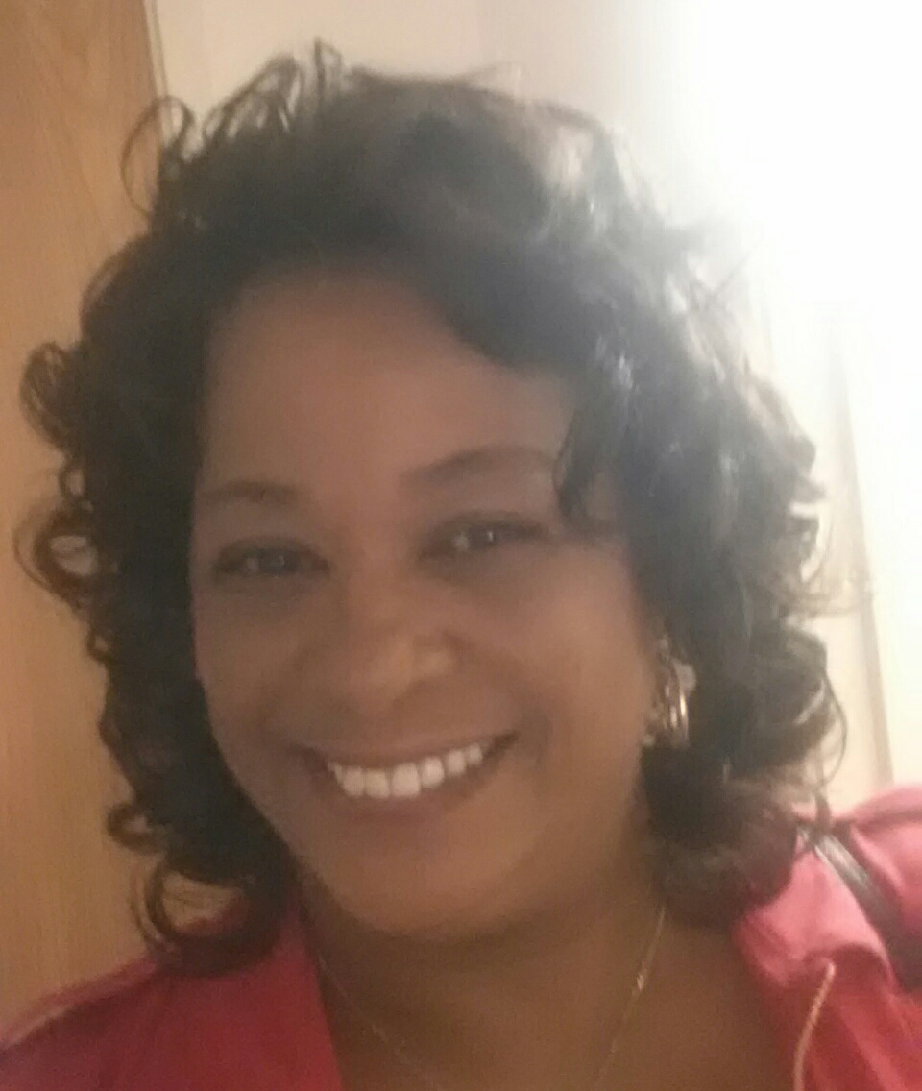

Presenters
Eli
Karen
Noor

Slide 3
Defining “Emotionally Fragile”
This may include students that are diagnosed with depression, anxiety, bipolar disorder, etc.
Characteristics to look out for
Students may not be diagnosed but are prone to high-stress

Slide 4
Minimizing Stress in the Conversation
Opening up the conversation: how is everything going? Making student feel comfortable
Building trust and earning confidence
Breaking the ice and building rapport before getting into business
Asking lots of questions of the student rather than making demands

Slide 5
Adapting your Counseling Methods
Being aware of needs of each student rather than students as a whole
Each student is on their own timeline
Meet the student where they are (It is okay to have minimum or no knowledge about the process)
Walk them through the process where necessary
Take “baby steps”

Slide 6
Your Process, Your Voice
Make sure student knows not to compare themselves to other students
Student “runs their own race”
Allow student to be open about the stress of the process

Slide 7
Breaking the Stigma
Create a welcoming space
Have signage in your office making mental health normal
Encourage student to be honest with classmates about stress
Speak to cultural aspect of the stress/mental health stigma

Slide 8
Resources for Students and Families
Set boundaries for yourself (do not become a therapist)
Point to school psychologist if available
Point to resources available at school (workshops, clubs)
Talk to parents without overstepping
Talk to student about college mental health counseling centers
Notes:
“Equity in Mental Health Framework” – The Steve Fund and JED Campus, http://www.stevefund.org/equity-mental-health-framework/
National Alliance on Mental Illness: https://www.nami.org/
National Minority Health Awareness Month: https://www.nami.org/Get-Involved/Awareness-Events/Minority-Mental-Health-Awareness-Month/Minority-Mental-Health-Stories
CureStigma: https://www.curestigma.org/

Slide 9
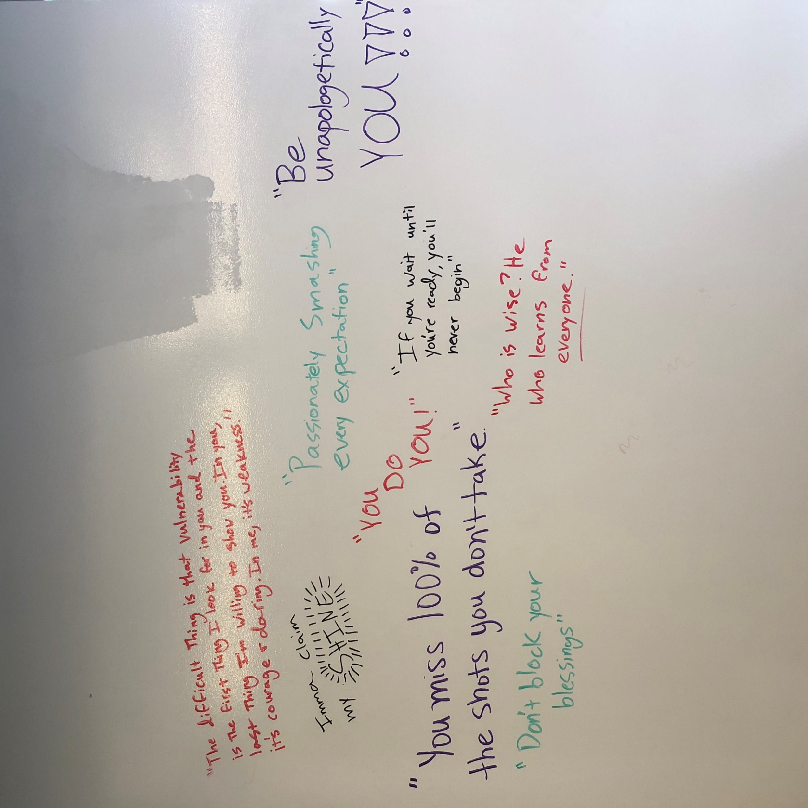
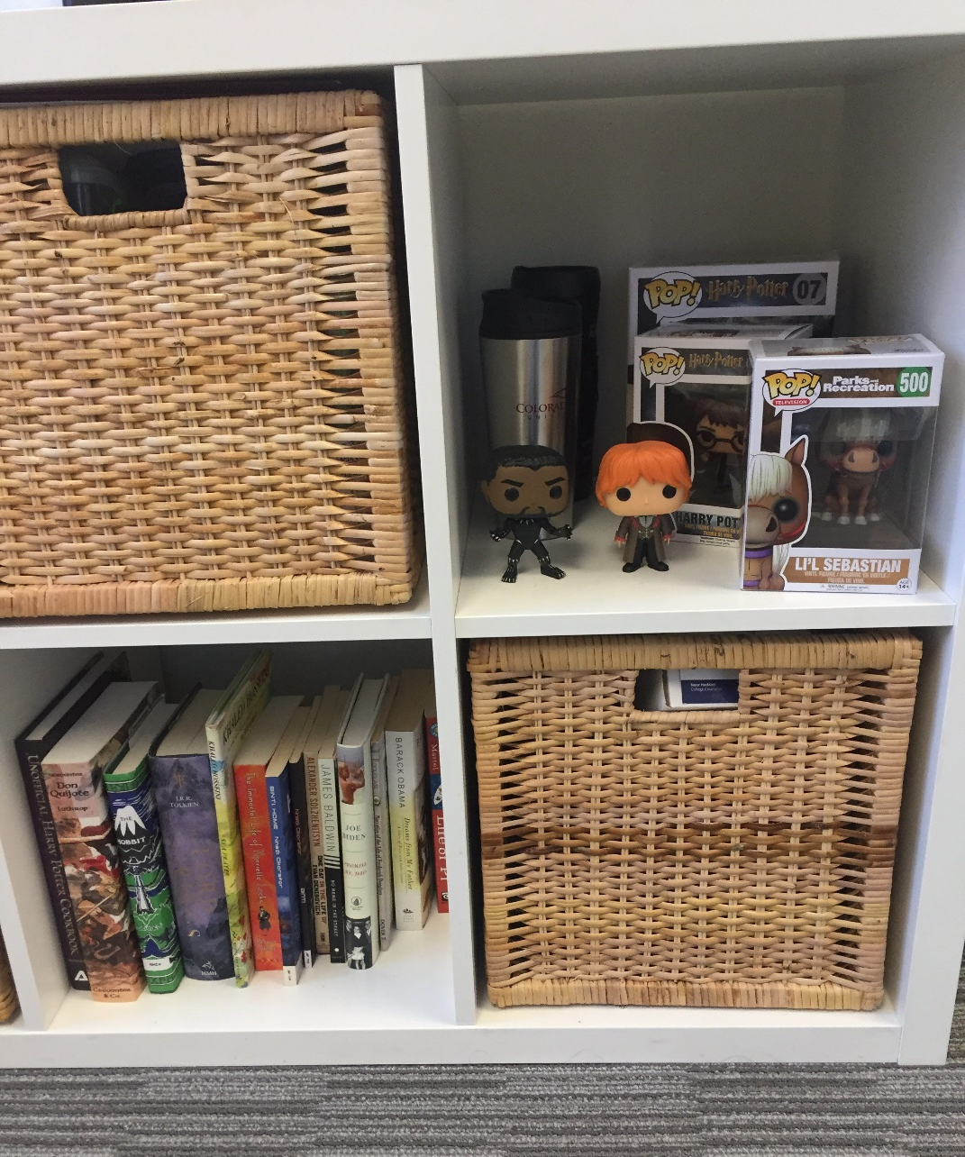
Closing Thoughts
Always remind students you are here to help them by using “we” statements
Encourage students to ask questions now and later if they arise

Slide 10
Thank you!
Contact us:
Karen: kellis@palihigh.org
Noor: noorh@collegewise.com

