Slide 1

Talking WUE:
We Understand & Explain
Linda Dannemiller
University of Nevada Reno
Jasmine Bryan
University of New Mexico
Notes:
JB

Slide 2
Western Undergraduate Exchange
(WUE)
Pronounced “woo-wee”

Slide 3

What is WUE?
A regional tuition-discount agreement
Administered by the Western Interstate Commission of Higher Education
Notes:
JB

Slide 4
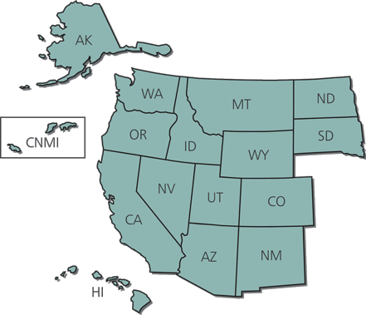
Western Undergraduate Exchange
15 Western Participating States & 1 US Territory:
Alaska Arizona
California Colorado
Hawaii Idaho
Montana Nevada
New Mexico
North Dakota South Dakota
Oregon Utah
Washington Wyoming
Northern Mariana Islands

Slide 5
WUE
Founded in 1987
Largest program of its kind in the US
150 Participating two- and four- year public institutions.
In 2018-2019 more than $417 million was saved by 42,579 students.

Slide 6
WUE Schools have 3 tuition rates:
  Resident Tuition (in-state students) $10,000
  Non-Resident Tuition (out-of-state tuition) $25,000
  WUE Tuition 150% of in-state tuition $15,000

Slide 7
WUE only applies to public institutions
Only public schools have in-state and out-of-state tuition, so only public schools are part of WUE

Slide 8
University of Nevada, Reno Tuition Rates
 | Out of State Students | WUE Eligible | NV Advantage Discount
Tuition | $20,653 | $9,697.50 | $12,930
Total Cost | $30,153 | $19,097.50 | $22,330

Slide 9
University of New Mexico Tuition Rates
 | Resident Tuition | Non-Resident Tuition | WUE Tuition (990 or 19) | WUE Plus (1100 or 22)
Tuition | $7,322 | $22,586 | $10,983 | $7,322
Total Cost | $17,186 | $32,450 | $20,847 | $17,186
Notes:
JB:

Slide 10
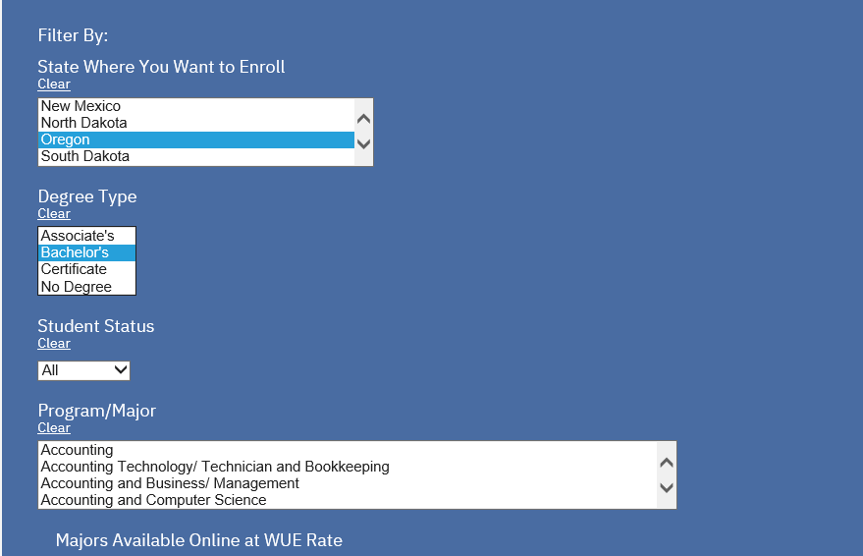
Search WUE Schools at: https://www.wiche.edu/wue

Slide 11
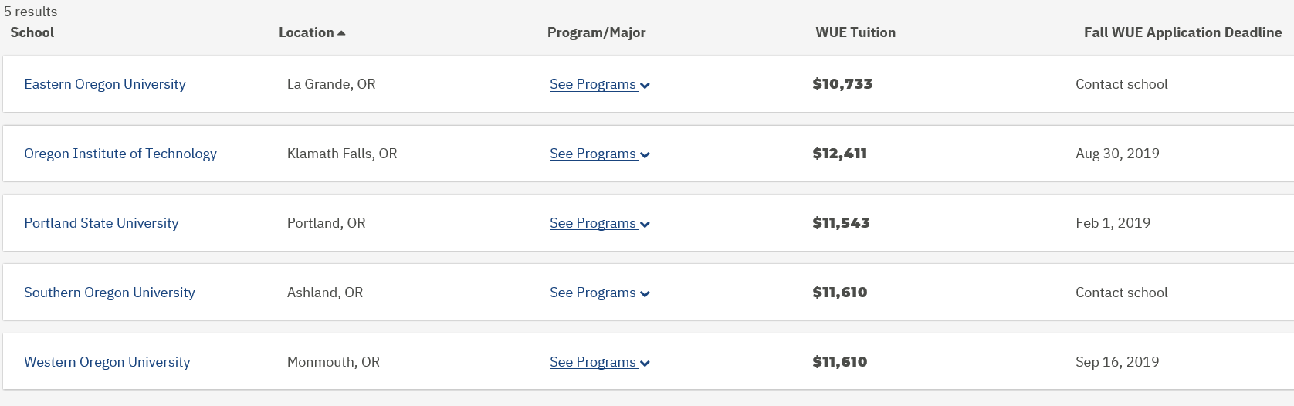
Results

Slide 12
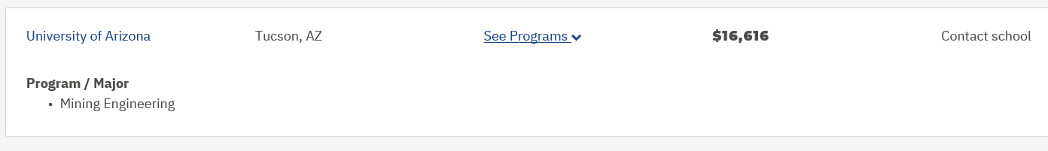
Click on See Programs for WUE eligible majors

Slide 13
Click on University to get details:
University of Nevada, Reno
WUE Admissions Info*
WUE Rate for Transfer Students: Yes, all majors
Majors Available Online at WUE Rate: No
Separate WUE Application Required: No
Minimum High School GPA: 3.25
Minimum SAT: 1240
Minimum ACT: 26
Minimum College GPA (Transfer-only): 3.3
*Requirements may vary by major

Slide 14
Click on University to get details:
University of New Mexico
WUE Admissions Info*
WUE Rate for Transfer Students: Yes, all majors
Majors Available Online at WUE Rate: Varies by major
Minimum High School GPA: 3.0
Minimum SAT: 990
Minimum ACT: 19
Minimum College GPA (Transfer-only): 3.0
*Requirements may vary by major

Slide 15
For the most accurate info:
Use the WICHE/WUE Site to find the colleges that participate.
Use the colleges website for the most up-to-date information.

Slide 16
Keeping your WUE Benefit
WUE reduced tuition benefits are generally renewable each year
Since it is based on in-state tuition, it will increase as tuition increases.

Slide 17
Keeping your WUE Benefit
Each college sets what is necessary to keep the WUE reduced tuition benefit.
Full time status and GPA are often a requirement
What happens when the student changes majors…

Slide 18
Beware:
Colleges can limit who
receives the WUE

Slide 19
Fine Print – Not all are eligible
GPA
Test Scores
Major
Freshman vs. Transfer
On-campus classes vs online
Deadlines
Separate application
Limited Number
FAFSA – need component

Slide 20

WUE Brochure

Slide 21
In Summary…
WUE saves your students money
WUE tuition rates are 150% of the in-state tuition
Not all students will receive the WUE even though they attend a WUE School.
WUE is generally renewable

Slide 22



Linda Dannemiller
Senior Coordinator, Regional Admissions & Recruitment (Northern California)

Slide 23










*Established: 1874 (Flagship)
40% diversity: States & Countries: 50 & 80
*Avg Class Size: 26
Student-Professor Ratio: 20:1
*7 Residence Halls to Choose From
*NCAA Division I Athletics
Men’s Sports: 6 Women’s Sports: 10
A National Tier I University
*300 Clubs & Organizations
*No Impacted programs, students graduating in 4 yrs.
*Student Body: 22,000
(18,000 undergrad)
Notes:
LD

Slide 24

Fall 2016 Admission Profile
New Freshman:
  3.6 academic GPA (weighted)
  Core Courses:
    English: 4 years
    Math: 3 years
    Natural Science: 3 years
    Social Science: 3 years
  24 ACT
  1120 SAT
Notes:
LD

Slide 25
Tuition & Scholarships
Tuition Reduction Awards:
Western Undergraduate Exchange - $11,000
3.25 Academic CORE GPA
1240 SAT or 26 ACT
Nevada Advantage - $8,000
3.0 Academic CORE GPA
1120 SAT or 22 ACT
Automatic scholarships:
provided to incoming freshman depending on gpa and test scores
National Merit award: $16,000
*Presidential award: $8,000
Silver & Blue award: $2,500
Pack Pride award: $1,500
*Stackable with WUE and Nevada Advantage
WUE Tuition: $9,657 year (COA $19,097 yr.)
Nevada Advantage Tuition: $12,930 year (COA $22,300 yr.)
Out of State Tuition: $20,653 year (COA $33,000 yr.)
Room and Board: $9,400 year
Notes:
LD

Slide 26



University of New Mexico
Jasmine Bryan – Regional Recruitment Specialist
Public Flagship with 17,000 students
Located at a mile-high elevation in Albuquerque
Tier 1 Research University
Ranked 18th in patents
Division 1 - Mountain West Conference
200+ Majors: Engineering, Law, Architecture, Medicine, MBA in 5 years, Film, Photography
Notes:
JB

Slide 27



New Mexico – A World-Class Destination
Albuquerque International Balloon Fiesta
Santa Fe – an hour away
Skiing within 45 minutes of campus
Best Cities for Foodies – Travel & Leisure
World’s second longest tram – 4,000 foot rise.
Home to more than 270 art galleries

Slide 28


Scholarships at UNM with 3.0
WUE Plus Scholarship 1100 SAT or 22 ACT
WUE Scholarship
980 SAT or 19 ACT
$22,586 Out-of-state tuition
-15,264 WUE Plus Scholarship
$ 7,322 tuition after scholarship
$22,586 Out-of-state tuition
-11,603 WUE Scholarship
$10,983 tuition after scholarship
Notes:
JB

Slide 29



Finish in 4 years
Graduate in four years…
  Last semester is tuition free!
Notes:
JB

Slide 30
Resources
RACC: Regional Admissions Counselors of California (www.regionaladmissions.com)
Fiske’s Guide to Colleges
US News and World Report
Princeton Review
College Board
Notes:
JB

Slide 31
Thank you
Any questions?
Notes:
JB

