Slide 1
Small School Master Scheduling with Big School Aspirations
Margarita Landeros, Ed.D., M.Ed., P.P.S. and Christopher Miller, M.S.
Camino Nuevo High School No. 2

Slide 2
Goals for the Session
Understand key components of master scheduling for small schools
Analyze your school's scheduling readiness
Identify your scheduling team and timeline

Slide 3
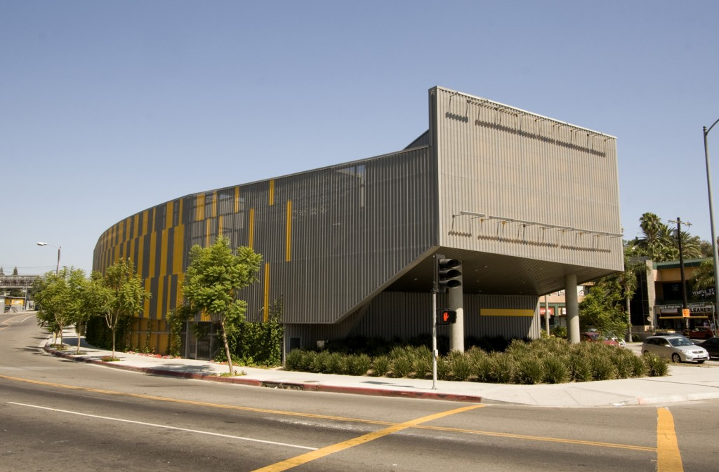
Our School
We have between 465 - 480 students each year, with about 98% Latinx population
Our school serves the area of MacArthur Park.
We have a teacher staff of 24 and 2 full-time counselors who loop with their grade levels.
On average, 75% - 80% four-year acceptance, 72%-76% enrollment.

Slide 4
Fundamentals of Our Program
All students must complete A-G course requirements to graduate.
Students move in cohorts allowing Administrators and College Counselors to track graduation progress.
All students take college advisory classes and receive college entrance exam preparation.
Student transition plans have been a part of all IEPs for the last nine years.
All students have had full-inclusion since the opening of the school.
We have an eight-period bell schedule, with a Seminar and Advisory period.

Slide 5
Identify your Goals
What is it that you are trying to achieve?
Examples:
Create a master schedule with department preps.
What are your school’s three major objectives?
Examples:
Every student receives a math support lab.
All students receive reading intervention.
Students scoring “x” in this exam will automatically have to enroll in “y” class.
What will drive your schedule?
Examples:
Student Choice
Teacher Requests

Slide 6
Scheduling Goals: Adult vs Student-Centered Thinking
“What if we built our schools, our schedules, our teaching around the needs of our students?” (Autumn Pino 2017)
Adult-Centered Narrative | Student-Centered Narrative
The English department does not want to teach reading intervention classes. That history teacher really loves teaching 12th grade students. | Reading level assessment indicate 70% of our student body is reading below grade level, how can we provide reading intervention classes? Our 10th graders struggle with expository writing standards and need a history teacher with an English background (12th grade teacher).

Slide 7
Constraints
We review our Bell Schedule to maximize outcomes for our key priority areas.
Identify high needs student populations and ancillary intervention/acceleration classes.
Account for elective classes, special programs and college classes
Student populations to account for
Special Education (Know Your Co-Taught Classes)
English Language Development (Know Student Levels and Placement)
Accelerated AP and Gifted Students (Be Aware of Students Over Two AP Classes as these truly cause constraints)

Slide 8
Project Class Counts and Needs
Anticipate cohort movement
Review historical grades and current enrollment
Determine summer school offerings and rosters
Analyze incoming cohort data to create core class master schedule
Analyze current student data to predict support/intervention courses

Slide 9
Determine Special Rosters
These are often the guiding constraints in your master schedule:
Special Education Program Rosters
Learning Centers and/or Special Day Classes (if applicable)
Co-taught Math and English Classes
English Language Development Program Rosters
Advanced Placement Program Rosters
Other interventions based on your goals

Slide 10
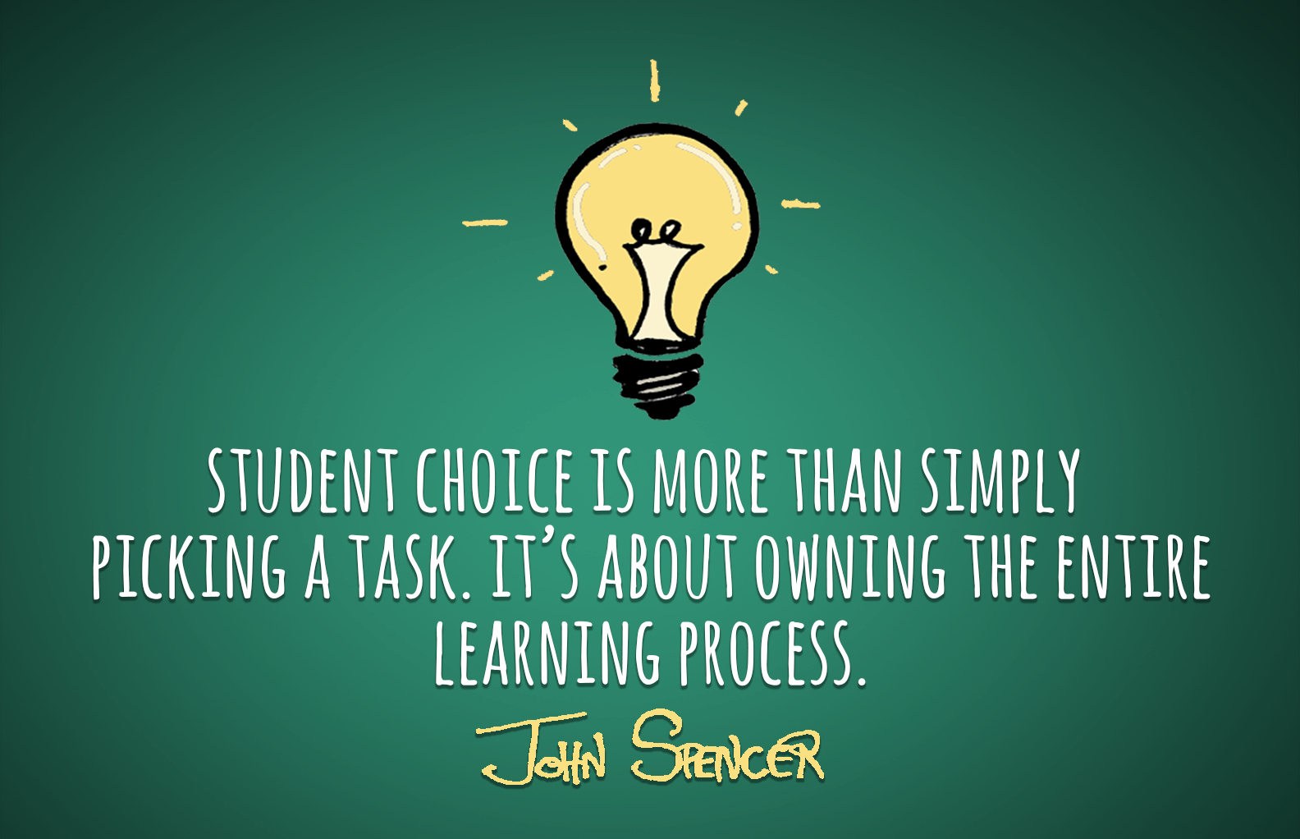
Student Course Requests
Students complete course requests on PowerScheduler through large group counseling sessions.
Counselors meet with each student one-by-one to review course selection and ensure that classes align to their graduation plans and college-readiness.
Adjustments are made to the requests.
Requests guide the creation of the Master Schedule.

Slide 11
Align Department Conference Periods
Before committing to the Master Schedule in PowerScheduler or your SIS, we ensure the following:
Departments have aligned conference periods
Special education teachers have conference period aligned to full inclusion model
Account for any other special conference periods that need to be embedded

Slide 12
The Players: The Master Scheduling Team
Assistant Principal of Instruction collaborates with College Counselors for Master Scheduling, College Program Implementation and our Special Education Program
Student information system expert works with the master scheduling team to ensure technical set up is ready and aligned with scheduling timeline
Department Heads and school leadership confirm teacher placement and course selection
School Operations Manager works with incoming students to confirm enrollment and ensure we transfer them into our SIS for class requests

Slide 13
Organize the Players
Identify who will be the individuals who will teach the courses, and their number of sections
Engage in the difficult conversations needed, especially when you are requesting someone to adjust their predicted assignments
Ensure that all teachers know their course assignments before they leave for the summer

Slide 14
Summary
Identify your goals to target the essentials
Ensure your bell schedule will support your goals
Define your constraints, class counts and special rosters
Let students drive the master schedule
Your students with the highest needs must take priority
Engage in the difficult dialogue

Slide 15
Thank you!
Contact Information:
Margarita Landeros (Maggie)
margarita.landeros@caminonuevo.org
Christopher Miller (Chris)
chris.miller@caminonuevo.org

