Slide 1
College Decisions Require Financial Literacy
Anna Takahashi, Todd Hicks, Christian Sherrill
Have a laptop or tablet? Sign in and connect to Wifi now, as it’ll come in handy during this session!

Slide 2
1. PAYBACK Paying for College Simulation
2. Anna & Todd’s Top 3
3. Counselor’s Quest: free resources you can use tomorrow
4. Q&A
Agenda

Slide 3
1. PAYBACK Paying for College Simulation
timeforpayback.com

Slide 4
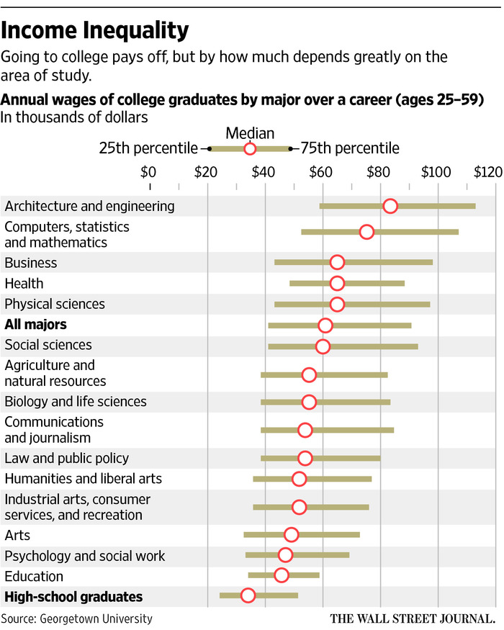
Anna & Todd’s Top 3
Favorite Data Crunch:
What’s the Value of a College Major?

Slide 5
Anna & Todd’s Top 3
Favorite Video:
Credit Card Debt Explained

Slide 6
Anna & Todd’s Top 3
The Apartment...
Note: All costs are monthly Rent: $2250 Rent must be mailed, one single check or money order, by the 10th of each month; $250 fee for late payment Rooms: One master bedroom (with a bathroom attached) Two smaller bedrooms, about the same size, but one has 2 windows and the other has 1 Two bathrooms, one attached to the large master bedroom and one off the hallway Has a large living room but no separate dining room Has a standard kitchen Utilities: Water, Trash, Sewer is included in the cost of your rent Your electric bill is different every month, based on usage, but averages $110. The bill is due by the 22nd of each month; $25 fee for late payment. Roommate A has a window AC unit for the living room, but using it adds an average of $45/mo to the electric bill Your gas bill (for cooking) also varies by month but averages $28. The bill is due by the 23rd of each month; $25 fee for late payment. | Renter’s Insurance: Renter’s insurance is roughly $15, but each roommate must pay for his/her own, if desired Parking: Apartment is eligible for one onsite covered parking garage spot ($95/mo paid to landlord) Optional uncovered parking lot spaces down the block ($45/mo paid to landlord, who pays the city) Furniture: You’ve all got your own furniture, plus some random stuff your parents gave you to furnish the main rooms of the apartment Entertainment: Roommate A has a Netflix account that costs $14/mo. Other roommates can create a profile under this account but need to split the cost with Roommate A. The bill is due on the 1st of the month and is set to autopay. Cable Only options in your area are $0 for broadcast TV, $80 for basic cable, $125 for premium cable Internet Only is $60 per month Basic Cable + Internet: $115 Cable bill is due by the 20th of each month; $25 fee for late payment
Favorite Project:
Budgeting with Roommates
Roommate A... Name:
Has a time-consuming job that keeps them out of the house between 8am and 8pm most weekdays Would love to get a dog and would prefer the big room so they can keep the dog’s bed and crate in the bedroom Loves sports and wants at least the basic cable package so they can watch ESPN when home | Owns a car Has their finances in order in terms of steady income, not swimming in student debt, no credit card debt, etc. Is pretty forgetful with deadlines Typically eats a quick breakfast at home but eats lunch at the company cafeteria and eats a lot of takeout after they get home from work late

Slide 7
Anna and Todd’s Students Choice Awards
Everything in the NGPF Arcade!
Money Magic
Payback for College
Spent
Shady Sam

Slide 8
3. Counselor’s Quest
Solo OR in pairs:
Head to ngpf.org
Use your quest to explore hundreds of free, customizable resources for teaching personal finance - tailored for your work.
My challenge to you: find at least 3 resources you - or a colleague - would use with students. Be ready to share...

Slide 9
4. Questions

Slide 10
Thanks!
annat@eastside.org
todd.hicks@cristoreysj.org
christian@ngpf.org

