Slide 1
STEM's Many Branches: College Planning for Students Considering Majors in Science, Technology, Engineering, and Mathematics
Presented by: Nicole Pilar, David Mills, and Taylor Patterson

Slide 2
Main Objectives
Deep-dive definition of what STEM means on the college level
Overview of what STEM education looks like on the college level within those different programs
How are STEM programs treated differently in the admissions process
How students can best prepare and how counselors can assist
Notes:
Nicole

Slide 3
What is STEM?
Notes:
Taylor

Slide 4
Choosing the Right Program for You
Science: “How and why does this work?”
Technology: “How do I apply this to actually PRODUCE something?”
Engineering: “How can I use this?”
Math: “Why does calculus work?” vs. “How to make calculus useful?”
(Always check the curriculum before you apply!)
Notes:
Taylor
In working with student, this helps to determine their interests in the area of STEM and what the style/purpose of their desired major will be.

Slide 5
What is STEM?
Common majors
biology
chemistry
physics
Less common major examples:
planetary science
forensic science
entomology
crop science
speech and hearing science
Notes:
Nicole
ASU: Applied Biological Sciences (Sustainable Horticulture), Biochemistry, Biochemistry (Medicinal Chemistry), Biological Sciences (Neurobiology, Physiology and Behavior), Biological Sciences (Genetics, Cell and Developmental Biology), Biophysics, Chemistry (Environmental Chemistry), Earth and Space Exploration (Astrobiology and Biogeosciences), Earth and Space Exploration (Astrophysics), Forensic Science, Speech and Hearing Science
Purdue:, agronomy, animal sciences, anthropology, applied meteorology and climatology, aquatic sciences, atmospheric science/meteorology, biochemistry, biology, brain and behavioral sciences, cell-molecular-developmental biology, chemistry, computer science, crop science, cybersecurity, data visualization, developmental and family science, ecology-evolution-environmental sciences, environmental geosciences, genetics, environmental studies, environmental health science, food science, forestry, health and disease, horticulture, global studies, insect biology, kinesiology,law and society (criminology), linguistics, medical laboratory sciences, microbiology, natural resources and environmental science, neurobiology and physiology, physics, planetary sciences, nursing, nutrition and dietetics, N&D fitness and health, nutrition science, occupational health science, pharmacy, plant genetics-breeding- and biotechnology, plant science, plant studies, political science, psychological sciences, radiological health sciences, science education, soil and water sciences, speech-language-hearing sciences, sustainable food and farming systems, turf management and science, veterinary nurse, wildlife

Slide 6
Technology vs Engineering
Image from http://www.rit.edu/emcs/admissions/academics/majors/engineering-tech-or-engineering
Notes:
David
Engineering and engineering technology are separate but closely related professional areas that differ in curricular focus and career paths.
Curricular Focus –
Engineering programs often focus on theory and conceptual design. These programs offer more foundational analysis of problems.
Engineering technology programs usually focus on application and implementation. These programs stress current industrial design practices
Engineering programs typically require additional, higher-level mathematics, including multiple semesters of calculus and calculus-based theoretical science courses
Engineering technology programs typically focus on algebra, trigonometry, applied calculus, and other courses that are more practical than theoretical in nature.
Career Paths –
Graduates from engineering programs often pursue entry-level work involving conceptual design or research and development. Many continue on to graduate-level work in engineering. Graduates from ABET-accredited bachelor level engineering degree programs are eligible to become registered professional engineers (P.E.) in all U.S states and territories by a process of two examinations (the FE and PE exams) and documentation of engineering work experience.
Graduates of four-year engineering technology programs are most likely to enter positions in sectors such as construction, manufacturing, product design, testing, or technical services and sales. Those who pursue further study often consider engineering, facilities management, or business administration. Graduates from ABET-accredited bachelor level engineering technology degree programs are also eligible to become registered professional engineers by the same process in many (but not all) states.

Slide 7
What is STEM?
Typically a version of engineering
electrical engineering technology
Less common major examples:
audio engineering technology
construction management and technology
food science and technology
Notes:
David
ASU: Aeronautical Management Technology (Air Traffic Management), Aeronautical Management Technology (Air Transportation Management), Aeronautical Management Technology (Professional Flight), Aeronautical Management Technology (Unmanned Aerial Systems), Construction Management and Technology, Digital Culture (Graphic Information Technology), Graphic Information Technology, Graphic Information Technology (User Experience), Human Systems Engineering, Manufacturing Engineering, Environmental and Resource Management, Engineering (Automotive Systems)
Purdue: (AG) agriculture systems management, occupational health science, radiological health sciences, (Liberal Arts) industrial design, sound for the performing arts, (Management) industrial management, supply chain information and analytics, (Polytech - 14 “engineering technology” majors) aeronautical engineering technology, animation, audio engineering technology, automation and systems integration engineering technology, building information modeling, computer and information technology, computer engineering technology, construction management technology, cybersecurity, data visualization, electrical engineering technology, energy engineering technology, engineering/technology teacher education, flight, game development and design, industrial engineering technology, mechanical engineering technology, mechatronics engineering technology, network engineering technology, robotics engineering technology, supply chain and sales engineering technology, systems analysis and design, unmanned aerial systems, UX design, virtual product integration, visual effects compositing, web programming and design.

Slide 8
What is STEM?
Common majors:
mechanical engineering
electrical engineering
civil engineering
Less common major examples:
robotics engineering
environmental engineering
nuclear engineering
biomedical engineering
Notes:
David
Purdue: aeronautical/astronautical, agricultural, biological, biomed, chemical, civil, computer, construction, electrical, environmental and ecological, environmental and natural resources, industrial, interdisciplinary, materials, mechanical, multidisciplinary, nuclear
ASU: Materials Science and Engineering, Mechanical Engineering (Computational Mechanics), Mechanical Engineering (Energy and Environment), Industrial Engineering, Environmental Engineering, Electrical Engineering (Electric Power and Energy Systems), Construction Engineering, Computer Science (Cybersecurity), Civil Engineering (Sustainable Engineering)

Slide 9
Technology vs Engineering
•Aeronautical
•Audio
•Automation/Systems Integration
•Computer and Information
•Computer
•Construction Management
•Electrical
•Energy
•Industrial
•Mechanical
•Mechatronics
•Network
•Robotics
•Supply Chain & Sales
•Aeronautical/Astronautical
•Agricultural
•Biological
•Biomedical
•Chemical
•Civil
•Computer
•Construction & Management
•Electrical
•Environmental/Ecological
•Environmental/Natural Resources
•Industrial
•Materials
•Mechanical
•Nuclear
Notes:
Taylor
https://www.admissions.purdue.edu/majors/index.php
There are 17 engineering majors available at Purdue and 14 engineering technology majors. The bold are the overlap of the program. (interdisciplinary and multidisciplinary are not listed)

Slide 10
What is STEM?
Common majors:
statistics
economics
(drumroll) mathematics
Less common major examples:
mathematics & secondary education
financial mathematics and statistics
data science
actuarial science
Notes:
Nicole
Purdue: (management) accounting, economics, (science) actuarial science, data science, mathematics - 4 options, mathematics education, statistics - 2 options
ASU: Actuarial Science, Applied Mathematics, Applied Mathematics for Life and Social Sciences, Mathematics, Mathematics (Statistics), Statistics, Business Data Analytics, Accountancy, Computational Forensics, Computational Mathematical Sciences

Slide 11
BA vs BS
Chemistry, BA - Do you want to help solve important societal problems related to energy, the environment, medicine and new materials? Learn how to take on these problems at the atomic and molecular levels and develop critical-thinking and problem-solving skills useful for a wide range of careers.
Chemistry, BS - Chemists study the nature of materials to solve important societal problems at the atomic and molecular levels. You will learn the skills needed to help you find solutions related to medicine, energy, electronics and technology, and air quality. These skills can aid you in a career in environmental policy, research or education.
Notes:
Nicole
Bachelor of Arts (BA): A Bachelor of the Arts degree program provides students with a more expansive education, requiring fewer credits that are directly linked to a particular major. Instead, students are expected to earn credits in a variety of liberal arts subjects. Courses in the humanities, English, the social sciences, and a foreign language are typically part of this degree program. Students can pick and choose from a broad array of courses to fulfill these requirements, allowing them greater flexibility to customize their education to match their individual goals and interests.
Bachelor of Science (BS): Programs resulting in a Bachelor of Science degree are generally more strictly focused on their subject matter, requiring more credits that are directly linked to the major. Students are expected to concentrate their academic energies on mastering the technical and practical facets of their field. They have fewer opportunities to explore topics outside of the subject of their major.

Slide 12
How to Prepare in High School
(Academics)
Most–Demanding Math and Science Curriculum
4 Years Math (including calculus*)
3 Years Science (including chemistry and physics)
Other Coursework
4 Years English
3 Years Social Studies
2 or 3 Years Foreign Language
1 or more Years Electives
Notes:
David
https://webapp4.asu.edu/programs/t5/undergrad/false
https://www.admissions.purdue.edu/majors/index.php

Slide 13
Example: ASU Engineering Requirements
Must Have Math and Science Curriculum:
4 Years Math (one year each of algebra I, geometry, algebra II, and an advanced math class for which algebra II is a prerequisite)
3 Years Science (1 year each from biology, chemistry, earth science, integrated sciences or physics)
1210 SAT or
24 ACT or
3.00 minimum ABOR GPA or
class ranking in top 25 percent of high school class
Other Coursework
4 Years English
2 Years Social Studies
2 Years Foreign Language
1 Year Fine Art or CTE
AND
Notes:
David

Slide 14
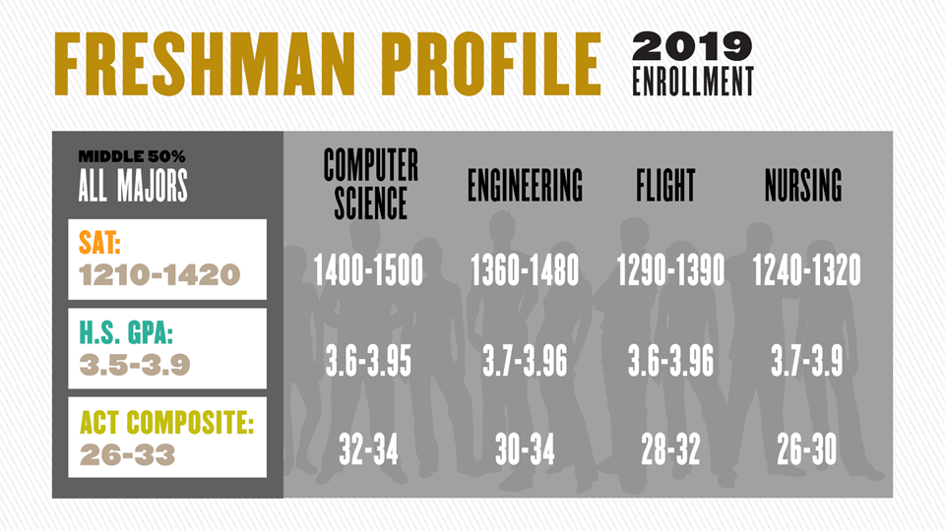
Example: Purdue Engineering Requirements
Must Have Math and Science Curriculum:
8 semesters of Math
6 semesters of science
2 must be chemistry
Other Coursework:
8 semesters of English
6 semesters of Social Studies
4 semesters of foreign language
Notes:
Taylor
This list includes the minimum high school course expectations for students that apply. Students should meet or exceed these.
Applications are reviewed individually and holistically with two primary questions in mind: are you academically prepared to succeed in your desired academic program? Are you a competitive candidate in the context of the overall pool or applicants for the program based on available space?
Though this question is often asked, there is no definitive answer. You can use our Freshman Class Profile Page to see “middle 50%” ranges for GPAs and SAT or ACT tests. However, these ranges represent the entire freshman class — the middle 50% for individual majors may be higher or lower based on space availability or the rigor of the program’s curriculum.

Slide 15
Five Skills Strong Applicants Demonstrate
Persistence
Creativity
Patience
Teamwork
Tolerance for Ambiguity
Notes:
Nicole

Slide 16
Resource Links
Undergraduate Majors|ASU Degree Search
Me3 Game
“find a degree that fits you”
Majors at Purdue
can narrow majors by career interest and academic college
Career Mapping Visualization System
Collegewise Guide to STEM
Notes:
Add ABET research site - which one?
https://amspub.abet.org/aps/name-search?searchType=institution
Engr vs Engr Tech definition from ABET: https://www.abet.org/accreditation/what-is-accreditation/what-programs-does-abet-accredit/

Slide 17
Questions?
Nicole Pilar: NicoleP@collegewise.com
David Mills: david.e.mills@asu.edu
Taylor Patterson: tmpatter@purdue.edu

