Slide 1
Postsecondary Success Planning:
A Process & A Plan
Thursday, March 14, 2019

Slide 2
Warm-Up: Stand up / raise your hand if . . .
You knew you were going to college since the day you were born.
You knew you were going to college sometime in middle school.
You knew you were going to college Freshman or Sophomore year of high school.
Ahem, so what if I decided my Senior year? I went, didn’t I?
Your family helped you navigate the college application process because they knew a lot about it.
Your family helped support you through the college application process, but knew very little about it.
Your college counselor or guidance counselor at your school help you navigate the college application process.
A teacher/mentor/other adult helped you navigate the process.
What? There are people to help you with the college process?
You applied to colleges based on the extensive research that you had done prior to your Senior year.
You applied to colleges because you knew a little bit about them and they “seemed” like a good fit.
You applied to colleges because they looked so pretty in guidebooks (internet for everyone but the old-timers).
Your family saved money for college since the day you were born.
Your family supported you through the financial aid process.
Wait, you have to reapply each year for the FAFSA?
You selected the college that you attended because of a well thought out process you used to evaluate your decision.
. . . Well, here goes nothing?!
Notes:
(2 min)
Rhiannon → Jacquie → Luangchee

Slide 3
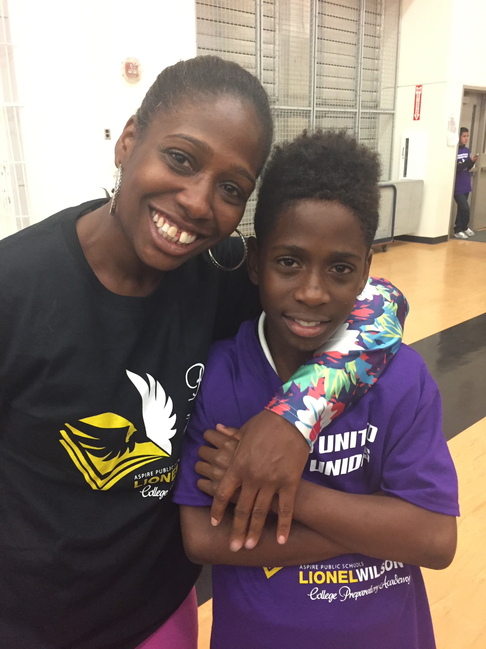
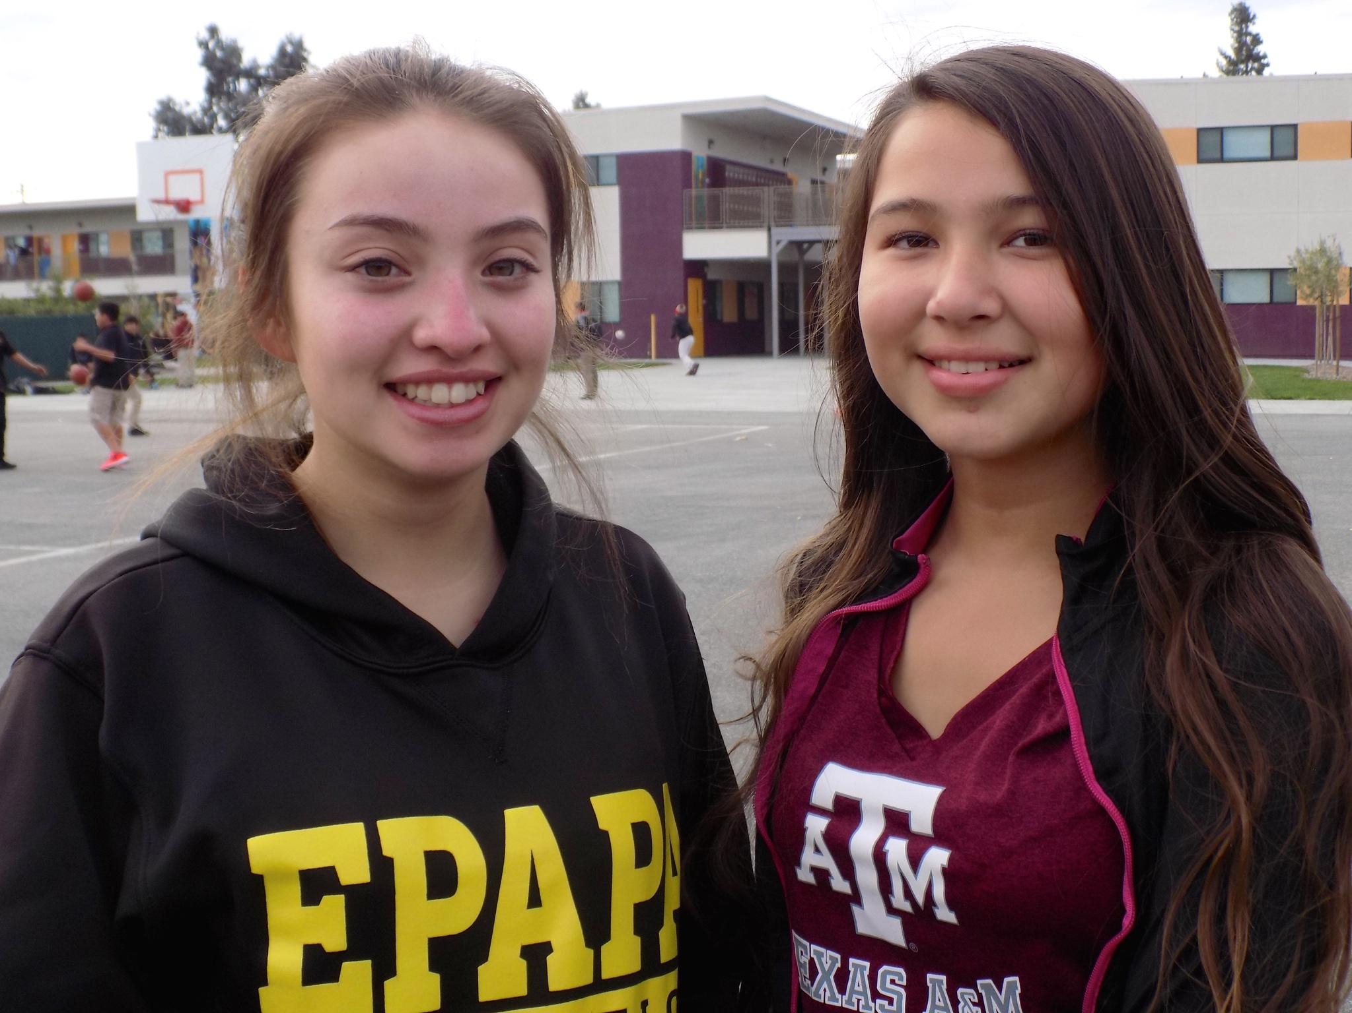
The “Why”
Completing a post-secondary program transforms outcomes - financial, social, health & wellness - for students, families, and communities.
Building a college-going identity is a complex process for both students and their families.
Navigating one’s way through post-secondary education isn’t easy, especially for a student or family doing it for the first time.
There are steps we can and do take to equip and empower students and families in this process.
Notes:
(Rhiannon, 1 minute)
--Our team is here because we know post-secondary programs transform outcomes.
--We also know that pursuing and completing post-secondary programs is not easy.
--As we just heard, it’s a complex process that requires a variety of resources and supports over a period of time.
--We also believe this - we can take steps to equip and empower families in this process.
--The decision to pursue opportunities is ultimately theirs, and we’re here to guide, advise, support and advocate for them throughout this process.
-- I suppose that is what brings you here today. We’re thankful you’re here.
--I want to reassure you about something: what we do here today is completely informed and inspired by “science” if you will. We are not on this journey alone.
--everything you experience today was brought to you straight from the work of researchers out of Harvard University and the University of Virginia. When we talk college affordability and financial aid - we are in this with our tremendous partners and exceptional practitioners at uAspire. I feel like uAspire and Aspire are a total match - more about them later.

Slide 4
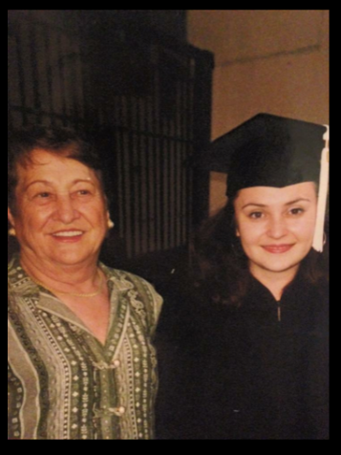
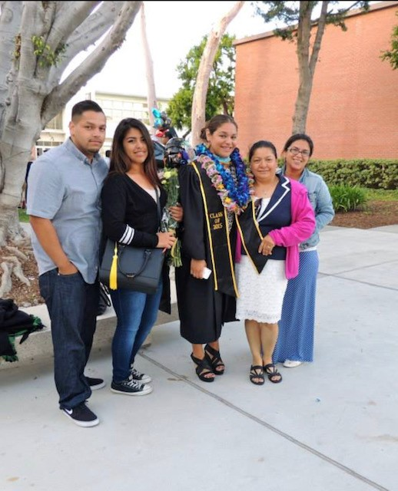
Introducing Team Aspire (Post-Secondary Access and Success)
Rhiannon Carabajal Killian, Aspire Home Office PSS Team
Northwestern University near Chicago, IL - History & Political Science (B.A.)
Jacqueline Grimaldi
Academic/College Counselor - Golden State preparatory
CSU, Long Beach
M.S School Counseling
Sonoma State University, CA - Psychology (B.A)
Luangchee Xiong
Academic & College Counselor
Aspire Langston Hughes Academy
CSU, Stanislaus- B.A. in Psychology
Univ of La Verne- M.S. in Ed. Counseling
CSU, Stanislaus- Ed.D. in Ed. Leadership
Notes:
All (30 sec)

Slide 5
The Senior Year Experience
APPLY → ASSESS → ATTEND
FALL
SPRING
SUMMER
College Match
Financial Aid: DREAM/FAFSA
PSSP Surveys & Plan
Advising
2-3 data cycles: PSSP Snapshots
4 data cycles: App Snapshot Reports
7 data cycles: Financial Aid Reports
Plan: Complete project / pathways plan
Student differentiated advising
Student differentiated advising
88%PSSP approval rating
Student differentiated advising
Historically: 80+% submission rates!
Notes:
(Rhiannon, 30 sec)
--We see the work that we do as both an art and a science. We utilize data to inform and inspire action, and it’s really the experience and background of our counselors that use the data to help differentiate support and advising for our students.
--We have very distinct data cycles throughout a student’s Senior year. Today we’ll be zooming into the spring experience for our seniors.

Slide 6
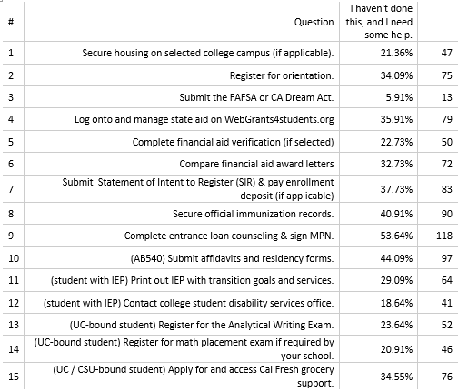
PSSP Snapshot 2 Data - Has the melt already started?
Notes:
(Rhiannon, 30 sec)
Our spring work is inspired by the research and investigations of Benjamin Castleman and Lindsay Page. Their research found that “one in five high school graduates who have been accepted to and intend to enroll in college fail to matriculation anywhere fall semester as a result of unforeseen challenges they encounter during the summer.” They refer to this phenomenon as “summer melt”. They suggest that there are several steps that schools can take over the summer to address this melt.
Our team has taken it a step further, and we tested the hypothesis that melt is actually happening earlier than the summer, and there steps we can and should take to address their concerns while they are still with us.

Slide 7
Post-Secondary Success Planning is
A Plan
And
A Process
Notes:
(Rhiannon, 30 sec)
--About a year and a half ago, HO staff, counselors and other administrators assembled to sketch out a vision for what post-secondary planning at Aspire would include.
--Rooted in the belief that college-going is a developmental process and that summer melt is real and preventable, we determined that we needed a two pronged approach.
--We need a process for assessing student needs, interests and progress and an advising corps nimble enough to differentiate advising at any point spring semester.
--We also need a plan - something that students complete to build agency and understanding in a very complex system.

Slide 8
District Data - PSSP Snapshots
Snapshot 1
(January - February)
496 / 501 Seniors
Snapshot 2
(March - April)
452 / 501 Seniors
Snapshot 3
(May - June)
369 / 501 Seniors
“Although this transition is very overwhelming, with the support of my college counselor, family and friends I know I will be okay.”
“I'm scared that I won't get into any 4 year college”
“I'm going to need help in choosing whether to go to a trade school or a community to study a trade. I’m leaning with going to community just to study the trade that i want.”
“I honestly feel so lost. There is so much to do and I don't even know what half of the things are.”
“I need more money, I can't afford college.”
“About the verification. What do I do next?”
“Thank you and all of aspire :)”
“I think we should do more to find out what majors work best for us. For example, that personality test helped but we should do more with that..”
“The reason I'm feeling sad is because I gave up going to my dream school because of financial needs and ending up going to the one school I never wanted to go. I don't know why I'm sharing this but its upsetting to have to put of my dreams to get the bigger picture. I don't hate my decision but I also don't love it. It's just sad to know I am letting my dream school slip through my hands.”
Notes:
(Rhiannon, 30 sec)
Our PSSP Snapshots are part of our Process. They are simply electronic questionnaires produced by the Home Office (me) and administered to Seniors by our counselors like Luangchee and Jacquie.
Through this questionnaire students take about 10 minutes to tell us a few major items: (1) their plans after high school, (2) the steps they are taking to make those plans possible, and (3) their thoughts and feelings at that moment.
We have 3 spring snapshot windows and there are clear themes that emerge in each. (give themes from each)
Now i’m going to walk you through some elements of Snapshot 1 and ask Jacquie and Luangchee how they actually use this data to inform and inspire their advising.

Slide 9
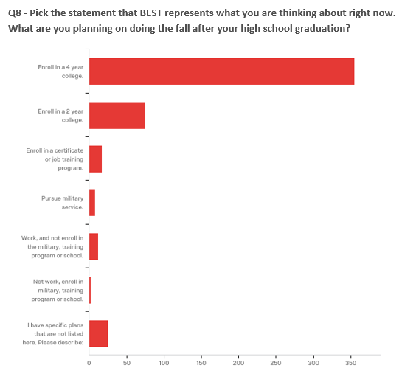
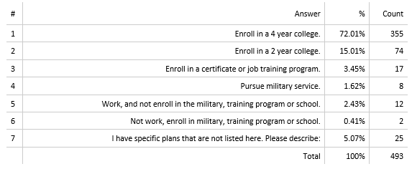
Data - District PSSP Snapshot 1
Notes:
(Rhiannon, 30 sec)
Each snapshot contains the exact same 2 questions: (1) What are you planning on doing the fall after your high school graduation, and (2) a question about their thoughts and feelings. This is a roll-up of what Aspire Seniors said about their plans last year in January and February. Most said they were 4 year college-bound and, surprisingly, a whole other group said they had specific plans that they expanded upon in their short answer.

Slide 10
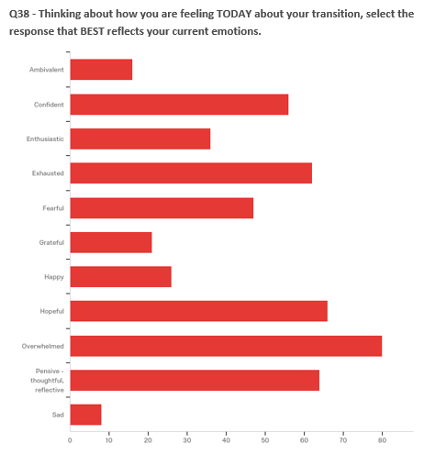
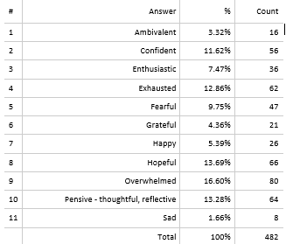
Data - District PSSP Snapshot 1
Notes:
(Rhiannon, 30 sec)
First snapshot is always a tale of extremes: students are either extremely overwhelmed and fearful, or confident and hopeful.

Slide 11
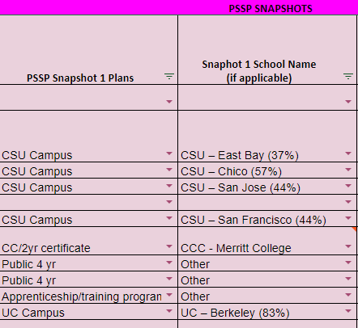
Snapshot 1 (January - February)
How did you use information about intended plans last year? Any changes for this year?
How did you use information about thoughts and feelings last year? Any changes for this year?
Notes:
(3 minutes, Rhiannon asks questions & Jacquie / Luangchee responds)

Slide 12
PSSP - A Plan

Slide 13
The 4 Year University Timeline
February/March
March/April
April/May
May/Summer
College Acceptances & Snapshot Responses
Financial Aid in Class:
Students use UAspire Comparison Tool
Students submit Intent to Register:
Deposit and
Needed Documentation
PSSP Presentations
Documentation is submitted to colleges
College Comparisons: acceptances are tracked on Naviance & Financial Aid packages on Google Classroom
Financial Aid with Families
1:1 Financial aid meetings with families & students compare packages
PSSP Creation Begins
Office Hours @ GSP for alumni
Summer Program Reg:
Register for EOP Summer Bridge or similar program
Notes:
Jacquie (2 min)
The more specific planning starts in the spring whens the post secondary options become more realistic as admission decisions start rolling in. At GSP all students apply to 4 year colleges and in the spring we start looking to see if they stay with the 4 year option or if they plan for 2 year college as well as trade/vocational programs.

Slide 14
The 2 Year College/Trade Program Timeline
February/March
March/April
April/May
May/Summer
2 Year College Counselor present in class
Financial Aid:
Meetings w/ families about possible aid & program
PSSP Creation
Students decide on transfer option or trade program
PSSP Presentations
Students submit documentation to CC
Students get introduced to IGETC/TAG/Trade Programs at local CC
Snapshot Response: use survey info to set meetings with families
Completing steps to enroll:
Students complete assessments or transcript review @ CC
Office Hours @ GSP for students
Notes:
(1 minute)
Luangchee
We recognize that 4-year colleges may not work for everyone for various reasons. Therefore, we work with our local community colleges to have a representative come out to our site and provide our students with information about the opportunities and services available on their campus. Students are introduced to the IGETC, TAG agreements,and trade school programs available with the 2-year college.
Just like the 4-year track students, we meet with our 2-year students and families in late March and April to discuss financial aid and we use our survey snapshot responses to help us facilitate the meeting and guide students on what their next steps are.
Our students begin working on their PSSP in late April and May while completing the enrollment process for their 2- year college. Presentations take place the last half of May.

Slide 15
The Post Secondary Plan
The portfolio includes the following:
2/4 year plan with course sequence from their major
A map from their desired campus with important offices for first generation students
Calendar of upcoming events including
Including summer programming
Orientation
Move in date
Academic Start Date
Budget for the 1st year after high school
Resume/Cover Letter
Notes:
Jacquie (30 sec)

Slide 16
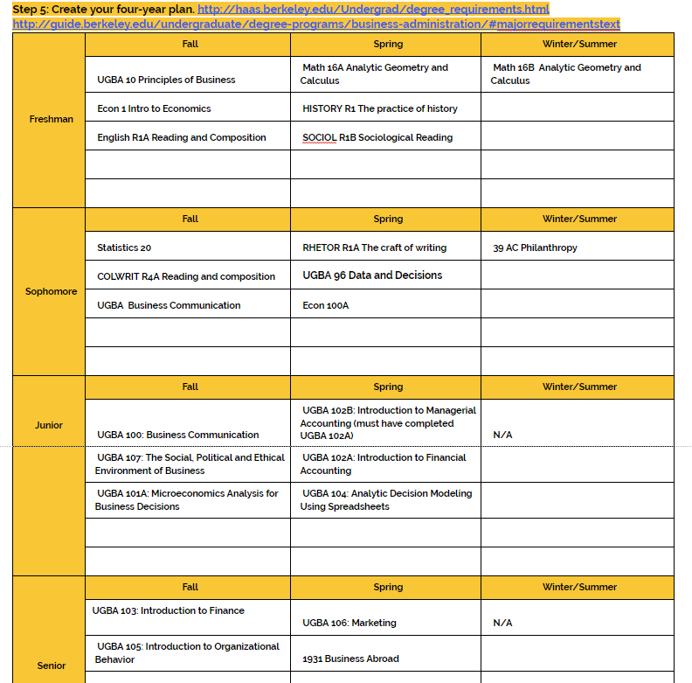
PSSP Includes
2yr/4yr course roadmap
Students research roadmap @ perspective college & major’s website
Most campuses will have this on website, if not students connect with alumni or select a plan B
For undeclared students: search a major that they would like to explore
Notes:
Jacquie (2 min)
Main point for the post secondary student plan is for students to get an idea of what are possible classes & be knowledgeable of how to plan out course sequence

Slide 17
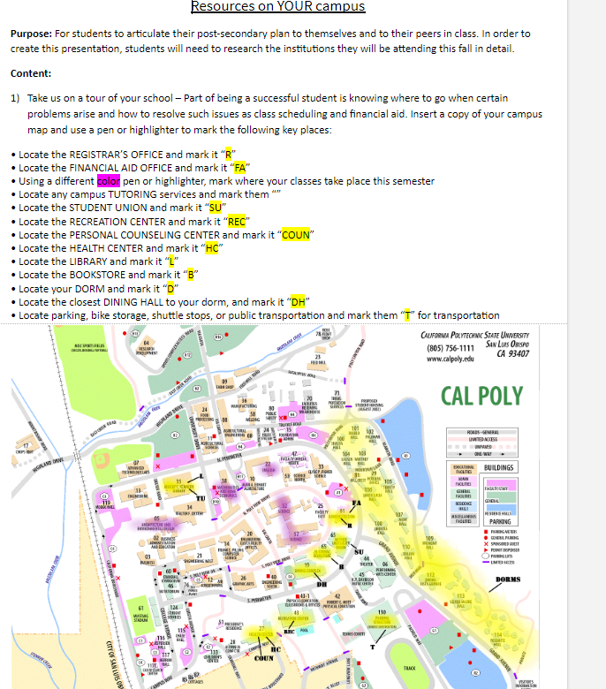
Resources on Campus
Offices & Description of Office:
Registrar's Office
Financial Aid
Tutoring Services
EOP/student support Programs
Scholarship Office
Student Union
Personal Counseling Center
Library
Notes:
Jacquie (1min)

Slide 18
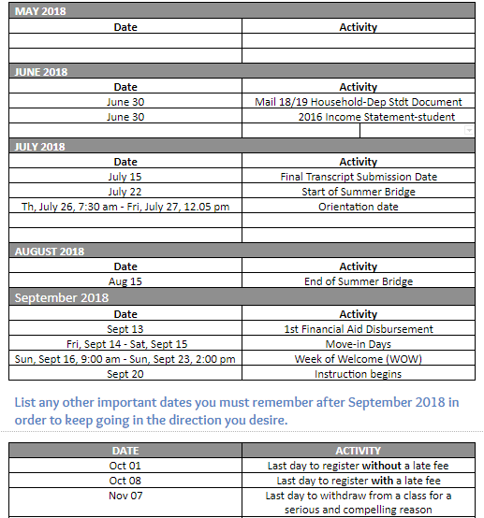
Matriculation Plan
Checklist with dates for successfully beginning in the fall including the following:
o Orientation date, Last day to add classes, Last day to drop with a ‘W’
o Early Start Class – Start & End dates
o Placement Exam Dates
o Housing Move in Dates
o Document submission dates
o Class start dates
o Final Transcript Submission Date
o Financial Aid Disbursement date
Notes:
(1 minute)
Luangchee
This image is an example of the matriculation plan that we ask our students to complete. The chart breaks down tasks month by month. Students are expected to indicate the date of each task and specify what the task is. Students are asked to conduct research for the college they are planning to attend and identify important dates and deadlines; including what is listed on their to-do’s in their portal for that college.
Examples of things that would go on here include start and end dates for early start classes, scheduled placement exams, housing move in dates, final transcript submission date, and financial aid disbursement dates.

Slide 19
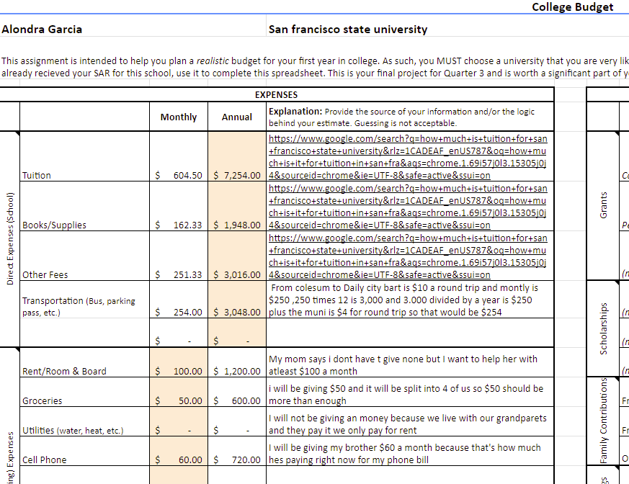
Budget for 1st year
Notes:
(1 minute)
Luangchee
Our students are asked to complete a budget for their first year in college, or their first year after high school. The budget template includes how much income the student has, how much the student’s expenses are, and how much the student saves. Under expenses, the spreadsheet breaks down more specifically into sections such as school, entertainment, communication, and personal. It further specifies the section with subsections to ensure the students are truly considering what falls in that category and how much they would be spending.

Slide 20
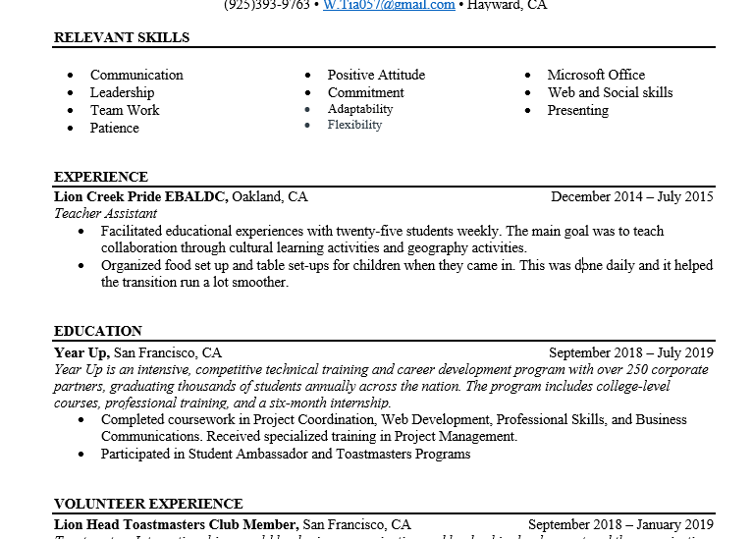
Resume/Cover Letter
Students complete a Resume and a Cover Letter for a potential job
Notes:
Jacquie (1min)

Slide 21
Counselor Tracker
Differentiated Advising Tracking with summer program enrollment & completed tasks
Financial Aid Completed
High School Program Involvement
Summer Program Enrollment
Applied to CSU’s
Applied to UC’s
Applied to a minimum of 6 or 9 colleges
Demographic information
Notes:
Jacquie (2min)

Slide 22
Military Pathway
Research
Identify branch of interest
Identify requirements and next steps
Conduct 2 interviews
Complete research and interview reflection
Identify a plan
Find and meet with recruiter
Research and take ASVAB
Service commitment time
Identify on base and off base support systems
Timeline
Notes:
(1 minute)
Luangchee
We acknowledge that college is not for every student and we work with our students to ensure they pathway they choose after high school is one that they are satisfied with. Hence, our PSSP also includes options for the military and workforce route.
In our military pathway, we ask our students to research their branch of interest and identify the requirements and next steps that they need to take. Once they complete this section, they are expected to conduct two interviews with individuals who have enlisted in that branch they are interested in. After completing the interview reflections, they begin to create their plan with a timeline if they are still interested in this pathway. They make arrangements to meet with a recruiter, take the ASVAB, understand their service commitment time, and most importantly, identify their support systems on the base and off the base.

Slide 23
Workforce Pathway
Letter of Interest/ Cover Letter
Examples provided to students
Students encouraged to find examples online
Resume
Examples provided to students
Students encouraged to find examples online
Conduct a mock interview
Complete interview reflection
Develop a plan and timeline
What resources can you use to find a job?
What’s your timeline to obtain a job?
What type of job are you looking for?
Complete a budget
Plan to financially support themselves
Track job applications
Plans for professional growth
Notes:
(1 minute)
Luangchee
Students who are pursuing the workforce pathway are asked to generate a resume and a general cover letter that they may adapt to different job positions. They must conduct a mock interview with an adult, preferably someone who has experience on an interview panel, and complete an interview reflection where they think about the feedback provided to them by their interviewer and how they can improve in interviews. Students are then expected to develop a plan, complete a budget, track their submitted job applications, and take the time to consider their plans for professional growth within their area of interest.

Slide 24
PSSP - A Process

Slide 25
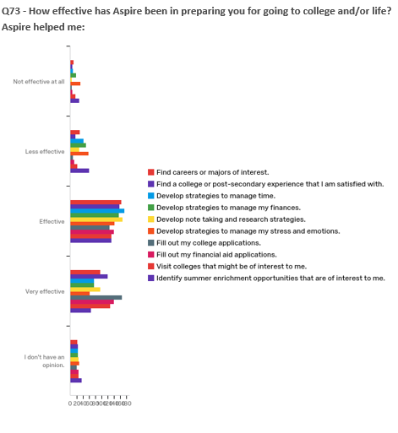
PSSP Snapshots 2 & 3
Notes:
(Rhiannon, 2 min)
In Snapshots 2 & 3 we add a few additional questions or elements to get more information from students.
We still ask the same two questions we did in Snapshot 1, and we see how their responses change.
In Snapshot 2, we explicitly collect updates on acceptances, denials, waitlists; financial aid - their EFC, and verification status; and we added in a milestone checklist.
In Snapshot 3, we ask them for their final post-secondary plan; updated contact information; and, their feedback on how Aspire has prepared them in academics and transition.

Slide 26
Snapshot 2 (March - April) & Snapshot 3 (May - June)
How did you use information about intended plans last year? Any changes for this year?
How did you use information collected in some of the other questions last year? Any changes for this year?
How did you use information about thoughts and feelings last year? Any changes for this year?
Notes:
(5 min, Rhiannon asks questions & Luangchee / Jacquie respond)

Slide 27
Implementing this at your school site . . .
Suggestions on ways to implement the PSSP
Focus on particular groups to start
As an assignment in various courses
Math
Economics
English
Check in with students based on similar post-secondary goals
Student presentations of plan
End of year project/exhibition
Resources that are helpful to combat summer melt
Counselor who checks in and provides support
Counselor/teacher review of plans and ensuring details are included
Notes:
(1 minute)
Luangchee

