Slide 1
Politics, Amiright?
Learn how to
actively advocate
for Students
Share, Learn, and Connect 2019

Slide 2
Presenters
Jessica Largent
Admissions Counselor, UCSD
Breanne Boyle
Senior Director & Master Counselor, Collegewise
Maureen Chang – WACACGRAC@WACAC.org
Chair, WACAC Government Relations Committee
Alma Mater College Admission Consultants
Scott Hoback
Senior Assistant Director of Admission - SoCal Regional
Amy Brennen
College Counselor – Insight Education LLC

Slide 3
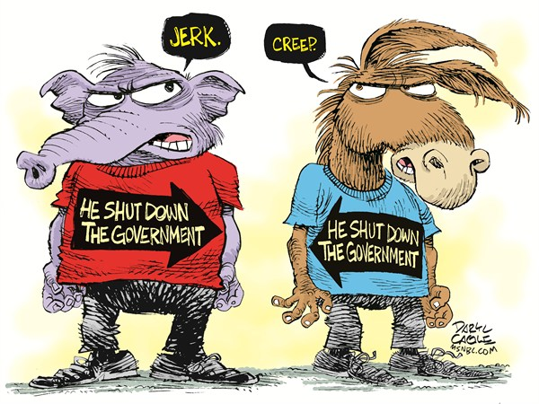
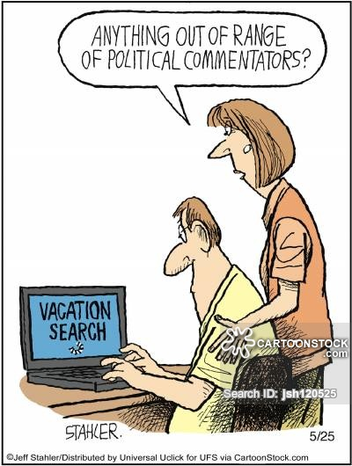

Slide 4
Session Agenda
What is GRAC? What do we do?
Go over NACAC and WACAC stances on current topics – Take note of what topic is important to you!
Take the topic you care most about from the topics we discussed.
NOW we will give you tools to affect change!

Slide 5
WACAC Government Relations & Advocacy Committee (GRAC)
Educating WACAC members on legislative issues related to higher education, counseling, and student access to college
Visits with state and federal elected officials
State legislative conference in Sacramento in February (2020: 2/10-2/11)
Organizing workshops, trainings, and webinars
Collaborate with and advise WACAC lobbyist
National legislative conference in DC
Serve on the NACAC government relations committee

Slide 6
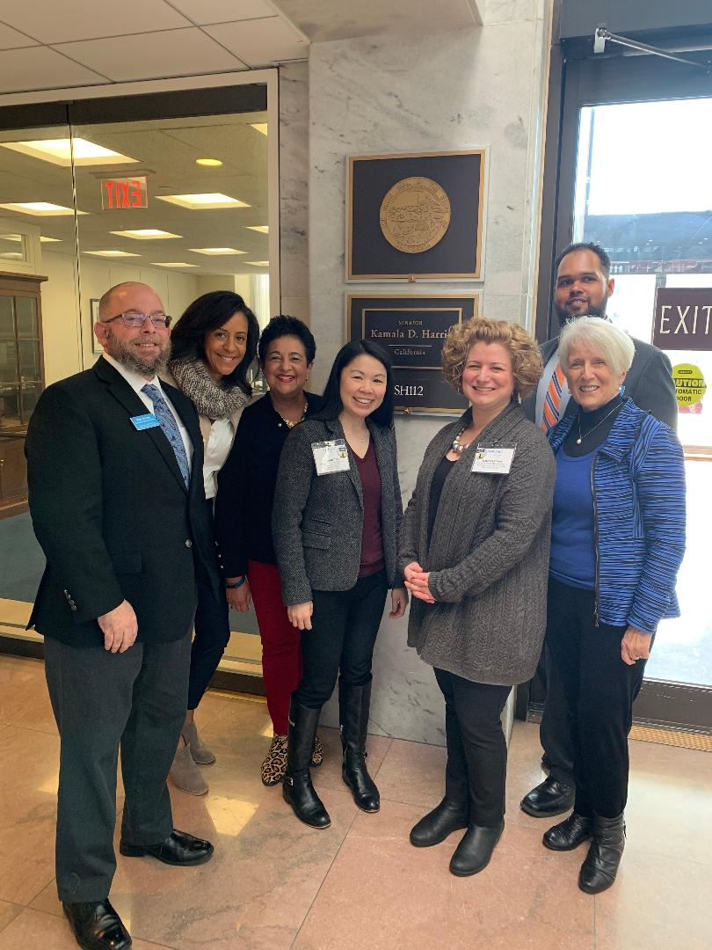
National Advocacy - NACAC

Slide 7
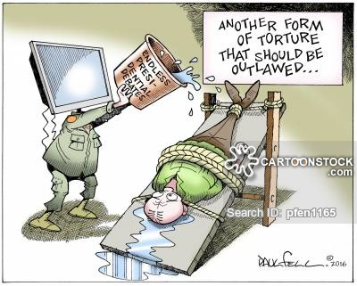
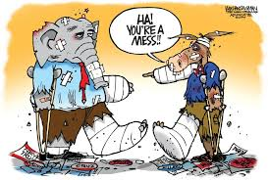
NACAC Legislative Priorities
ACCESS TO QUALITY COUNSELING
SUPPORT STUDENT MOBILITY AT AN INTERNATIONAL LEVEL
DEFERRED ACTION FOR CHILDHOOD ARRIVALS (DACA)
PROTECT STUDENTS IN THE ADMISSIONS PROCESS FROM UNSCRUPULOUS COLLEGES AND PREDATORY LENDING

Slide 8
ACCESS TO QUALITY COUNSELING
A 2013 study found the number of hours school counselors spent on college counseling was a strong predictor of the school’s four-year college going rates. It also noted that school counseling departments that offered financial aid assistance to students were approximately 12 percentage points higher in four-year college going rates compared to schools that did not offer that type of assistance (Engberg & Gilbert, 2013).

Slide 9
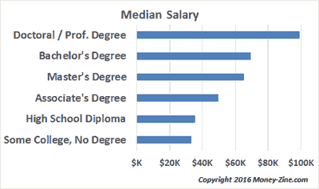
Notes:
Attaining a higher education degree can have a significant impact on annual income. Remember, the higher the income, the more taxes paid, so it is beneficial for everyone when the population is better educated.

Slide 10
Public secondary counselors spend less than a quarter of their time on postsecondary admission counseling
Postsecondary admission counseling 21%
Choice and scheduling of high school courses 23%
Personal needs counseling 25%
Academic testing 13%
Occupational counseling and job placement 7%
Teaching 5%
Other nonguidance activities 6%
Notes:
Public school counselors do not have enough time to dedicate to helping students apply for college AND financial aid

Slide 11
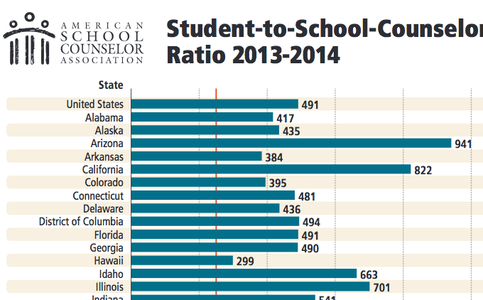
Notes:
Suggested ration is less than 250:1. Only Vermont (195:1) and New Hampshier (217:1) meet those standards.

Slide 12
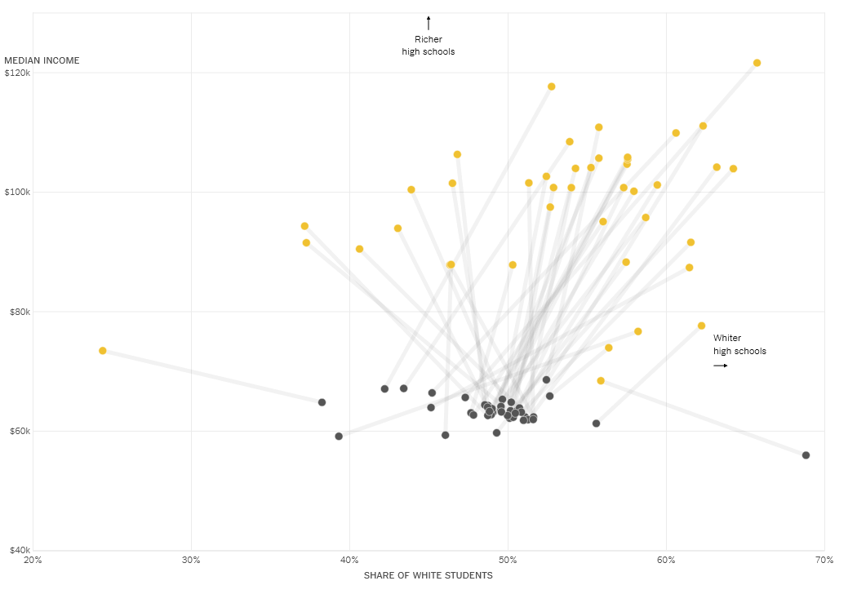
Colleges visited high schools for recruiting that were whiter and wealthier than those they don’t
www.nytimes.com/interactive/2018/04/13/opinion/college-recruitment-rich-white.html?auth=login-email.
Notes:
Further complicating things is that most private colleges primarily recruit from whiter and richer high schools,

Slide 13
STUDENT MOBILITY AT AN INTERNATIONAL LEVEL
Notes:
NACAC is partnering with NAFSA: Association of International Educators and its “Welcome to Succeed Campaign” to defend international students and scholars.

Slide 14
INTERNATIONAL UNDERSTANDING
IS GREAT ….
BUT MONEY TALKS !!!!!!
Notes:
We are all familiar with the many wonderful reasons for a student to study abroad and for students from other countries to come to the US. Legislators are interested in personal stories, but in the end it all comes down to dollars and cents. What benefits do international students bring with them and why should we let them into the country!

Slide 15
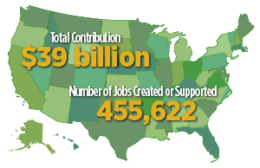
The Economic Impact of International Students on the US economy.
Notes:
NAFSA's latest analysis finds that the 1,094,792 international students studying at U.S. colleges and universities contributed $39 billion and supported more than 455,000 jobs to the U.S. economy during the 2017-2018 academic year. That is 3 jobs created for every 7 students who choose to study here. Also, the $39 billion contriubrion to the economy from international students dwarfs the $21.6 billion contributed by the soybean industry. International students are only 5.5% of all college students so the idea they are taking spots from US citizens is inaccurate.

Slide 16
Unfortunately, the number of international students coming to study in the US has dropped by 6.6% since the 2016 election as students choose to go to Canada, Australia, and the UK rather than come to the US. Surveys show this is caused by a combination of the unwelcoming rhetoric by the current administration and concerns about gun safety.

Slide 17
DEFERRED ACTION FOR
CHILDHOOD ARRIVALS
Notes:
DACA began in 2012 by executive order. January 2018 State of the Union address tied DACA/DREAM Act to extreme positions. NACAC advocates for a clean DACA/DREAM Act solution, that is, separate from other immigration issues.
Deferred Action for Childhood Arrivals (DACA) is an American immigration policy that allows some individuals with unlawful presence in the United States after being brought to the country as children to receive a renewable two-year period of deferred action from deportation and become eligible for a work permit in the U.S. To be eligible for the program, recipients cannot have felonies or serious misdemeanors on their records. Unlike the proposed DREAM Act, DACA does not provide a path to citizenship for recipients, known as Dreamers.

Slide 18
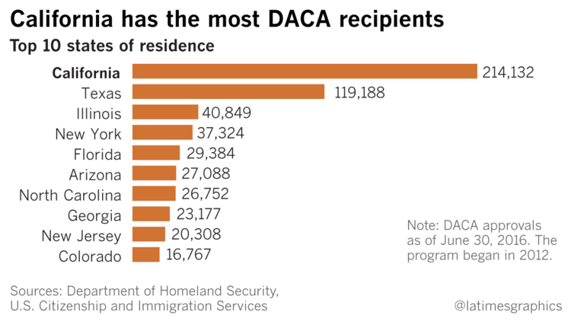
Notes:
2.1 million are eligible for DACA status. Only 800,000 have signed up. This is due to many reasons from distrust of the government to the high cost of applying for DACA status. Existing DACA students are able to renew their status but no new applications are available.

Slide 19
The beneficiaries of the proposed DREAM Act would have had to meet the following requirements to qualify:
Be inadmissible or deportable from the United States, or be in Temporary Protected Status.
Younger than 18 years old on the date of their initial entry to the United States
Have proof of having arrived in the United States before age 16
Have proof of residence in the United States for at least four consecutive years since their date of arrival
If a male born in 1960 or later, have registered with the Selective Service
Be between the ages of 12 and 35 at the time of bill enactment
Have graduated from an American high school, obtained a GED, or been admitted to an institution of higher education
Be of good moral character
800,000 DACA
3,600,000 DREAMers
10,700,000 undocumented immigrants
Notes:
Please note : DACA students are one subgroup of undocumented students. The groups overlap, but are not identical in all cases. Eleven years ago, there were around 12.2 million undocumented immigrants in the US (up from 3.5 million in 1990) while Pew's most recent report estimates there were around 10.7 million living here in 2016, the lowest estimate in a decade.
Because DACA was designed in large measure to address the immigration status of the same people as the DREAM Act, the two programs are often debated together, with some making little distinction between them and others focusing on the difference between the DREAM Act's legislative approach in contrast to the implementation of DACA through executive action.^{[40]} As of January 2017, 740,000 people have registered through DACA.^{[41]} On September 5, 2017 the Trump administration rescinded the program.^{[42]}

Slide 21
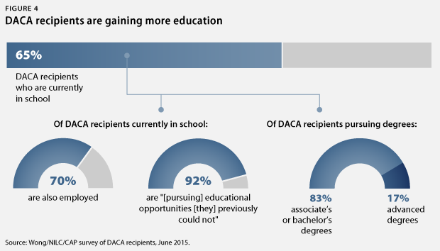

Slide 22
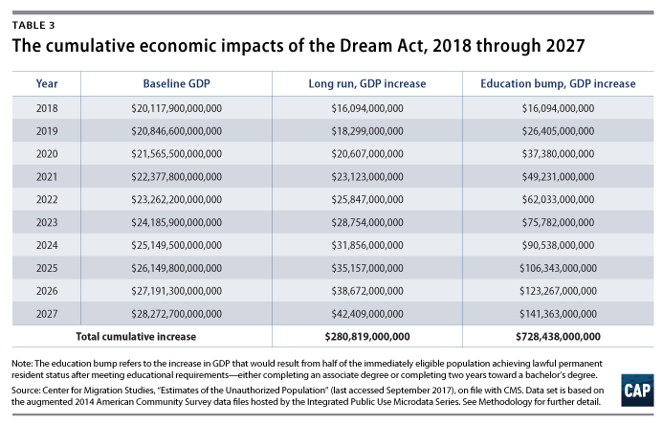
Notes:
And … if we follow the money, we can see the huge economic benefits of legalizing Dreamers.

Slide 23
UNSCRUPULOUS COLLEGES
AND PREDATORY LENDING

Slide 24
It appears that we are seeing the beginning of yet another boom cycle for for-profit colleges at the cost of students and taxpayers.
The Department of Education recently held hearings as part of the Trump administration’s campaign to dismantle two key regulations designed to ensure that unscrupulous colleges don’t prey on students and the federal student aid system.
This campaign aims to reverse Obama administration efforts to guard against very poorly performing career college programs and misleading business practices that the for-profit sector challenged vehemently on Capitol Hill and in the courts.
Spiro Protopsaltis, The Washington Post

Slide 25
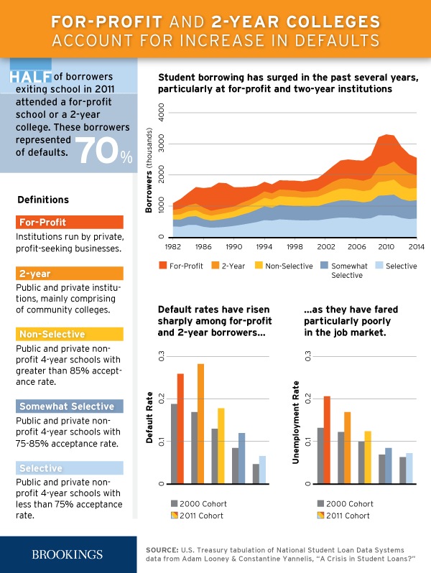
Notes:
For Profit college students represent 9% of students, but are 34% of students who default on their loans.

Slide 26
THE STATE OF CALIFORNIA STEPS IN TO PROTECT ITS OWN
More than half of student loan defaulters in California hail from for-profit colleges, and more than 30,000 Californians have filed for loan discharges based on mistreatment by their college. Hundreds of thousands of students would benefit from the protections provided in these bills."
Introduced bills include:
AB 1340 (Asm. Chiu) to ensure career education programs deliver value to students;
AB 1341 (Asm. Berman) to create protections against illegitimate nonprofit conversions and covert for-profit institutions;
AB 1342 (Asm. Low) to prevent unjust enrichment of corporations during nonprofit conversions;
AB 1343 (Asm. Eggman) to prevent schools from being funded solely by taxpayer-funded programs;
AB 1344 (Asm. Bauer-Kahan) to protect Californians enrolling online in schools based in other states;
AB 1345 (Asm. McCarty) to prevent institutions from offering incentives or setting quotas for enrollment counselors; and
AB 1346 (Asm. Medina) to expand financial relief available to harmed students under the Student Tuition Recovery Fund.
Notes:
List courtesy of The Institute for College Access & Success, announcement 2-27-19 . AND this leads us into a glimpse of the California legislative scene. Not necessarily endorsed by us.
AB – 1343 - Eggman

Slide 27
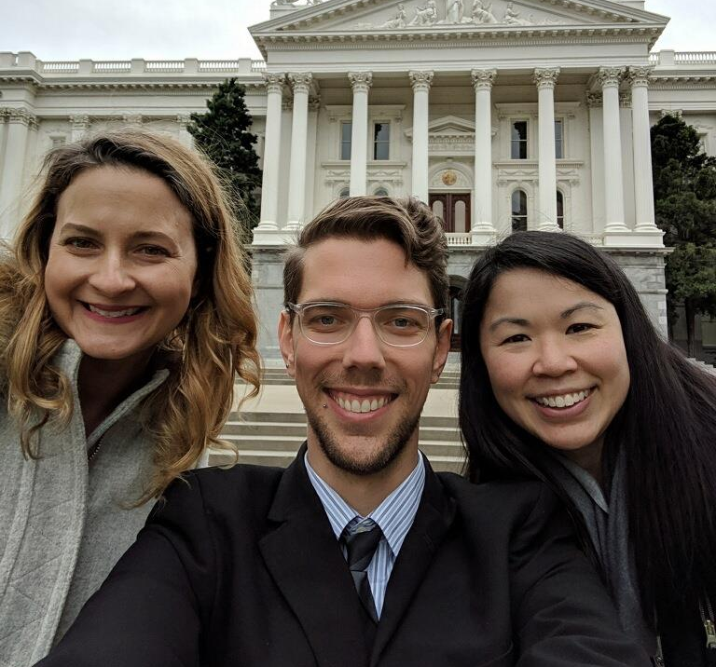
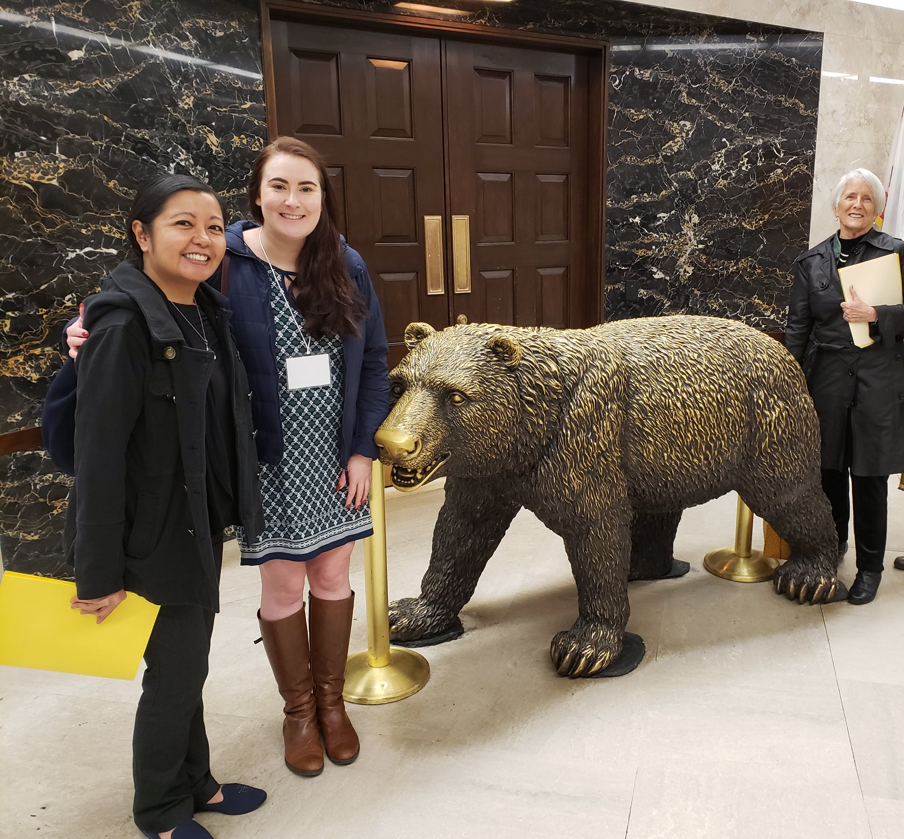
WACAC LEGISLATIVE TRIP
2019
Notes:
GRAC Legislative Trip to Sacramento. February 12, 2019. Happy GRACers posing with Biohazard Bear and in front of the capitol building.
- Technically, ESSA eliminated programs such as Elementary and Secondary School Counseling Program (ESSCP) and fee waivers for AP/IB
States decide how to use the grant money
State legislature can influence how money is used
-

Slide 28
California Highlights 2019
AJR2 - Petition the Feds to increase the Pell Grant annual maximum
AB2 - Expansion of the California Promise Program
SB428 - Increased access to mental health services for students.
AB140 - Establish the California Kickstart My Future Loan Forgiveness Program.
SB2 – Statewide Longitudinal Student Database
Notes:
AJR2 (Assembly Joint Resolution 2) -Petition Congress and the President to increase the maximum Pell Grant amount from $6,095 to at least $7,500 to further help low income college students. Also a NACAC Goal.
AB2 (Assembly Bill) - California Promise Program allows some Community Colleges Us to establish pledge programs for entering first-time students who are both interested and able to complete baccalaureate degrees in four years. It can waive fees for two years. This has been piloted and is slated to grow.
SB 428 will require applicants for new and renewed teaching credentials to complete a course in Youth Mental Health First Aid (YMHFA.) YMHFA is a comprehensive training specifically designed to equip educators, family members, and caregivers with the skills and knowledge to identify, understand, and respond to the signs or risk factors of mental illness and substance use disorders in youth. CEU program requirement.
AB140 – Pilot Program: Would provide grants to eligible applicants to help alleviate the burden of federal student loan debt for recent California graduates. ic, program participation, enrollment, and statewide assessments. 24 months loan repayment plan where 100% of your monthly loan is covered.
- SB2 - This bill would express the intent of the Legislature to establish the Statewide Longitudinal Student Database to collect and store data regarding individual students as they matriculate through P–20, as defined, and into the workforce

Slide 29
Now it’s your turn to take control

Slide 30
WACAC as a Resource for Legislators & Staff
DATA
STATISTICS
ANECDOTES AND EXPERIENCES
WACAC'S +2000 ACTIVE MEMBERS
LEGISLATIVE ENDORSEMENTS
Notes:
College Fairs- 9300 students attended, 9 fairs in CA, NV
Spring conference best practices 900 attendees
50% membership increase since 2006
college search, finding fit
financial aid & scholarship workshop
athletic recruitment
case study night
college entrance exams
college search
essay writing
college search, finding fit
financial aid & scholarship workshop
athletic recruitment
case study night
college entrance exams
college search
essay writing

Slide 31
Individual Activity: What Would You Say?
Tell a legislator your thoughts about one of these topics.
Consider:
Why does this issue matter to you personally?
Share your story! You are the expert!
Back up your story with facts.
Be specific. “This is happening in your district
and is impacting X number of kids. I want to help
you understand the situation.”
Notes:
Write your thoughts on one of these topics.
Be specific - – Consider using data to support your points

Slide 32
Group Activity: Staffer and Constituent
Give name and address.
Why does this issue matter to you?
Staffer will listen to concern.
You do not need to defend your position.
YOU are their boss. You have this right.
Notes:
Pair up and pretend you are calling your representative
staffer will be matching concern with topic they are tracking

Slide 33
1) FWD.US (Automatic Phone Dialing) - Call Congress Easily
2) Callyourrep.Co (Phone Number And Office Address)
3) Callmycongress.Com (Includes Voting Record, Twitter, Phone)
Thesixtyfive.Org (Scripts)
Resistbot. Text “Resist” To 50409

Slide 34
Who Are Your Reps?
1. FED: COUNTABLE.ORG
SEN. DIANE FEINSTEIN - (415) 393-0707
SEN. KAMALA HARRIS- (415) 981 - 9369
2. STATE: FINDYOURREP.LEGISLATURE.CA.GOV
3. LOCAL: VISIT THE CALIFORNIA SCHOOL BOARD ASSOCIATION
Notes:
Not sure who your reps are?
Fed: Countable.org
State: Findyyourrep.legislature.ca.gov
Local: Visit the California School Board Association
Assembly-
Kevin Mullin- 22
David Chu- 17
Phil Ting – 19
Bonta - Oakland

Slide 35
Get out your phone. No, really.
Look up your legislator!
Save the number of your legislator!
Make a call today!

Slide 36
Take Action Now!
Visit NACAC knowledge center,
WACAC Advocacy Center
Join the WACAC GRAC Facebook group
Visit the non-partisan Countable.org
Text ‘Resist’ to 50409
Join a local political group

Slide 37
If you are interested in learning more about NACAC’s current legislative priorities and/or about how to help DACA students, register to attend the 2019 SuperACAC Conference in Phoenix, May 20-22.
Registration ends April 27, and spots are going fast! Register Now!!!

