Slide 1
PATHWAYS TO NURSING: AN OVERVIEW FOR CA HIGH SCHOOL STUDENTS
JON RICE - UNIVERSITY OF SAN FRANCISCO
NICOLE PILAR - COLLEGEWISE

Slide 2
Goals and Outcomes
Lay of the land: Status of Nursing today
Understanding different routes students can take
Comparative Analysis of UC vs. CSU vs. Private Schools
Advice for students
What the life of a Nursing student is like
Other options for Nursing

Slide 4
PATHWAYS FOR INCOMING FRESHMAN
DIRECT ENTRY
PRE-NURSING
Automatically admitted into clinicals part of program=avoiding stress of applying into higher division
VERY COMPETITIVE
Typically must maintain academic performance to maintain your spot
Not as many programs out West
Admitted into lower division coursework=less competitive for incoming freshman
Must apply into the upper division clinical work, similar to applying to college all over again
Not guaranteed a spot and must compete with other applicants

Slide 5
PATHWAYS FOR INCOMING FRESHMAN
Associate Degree in Nursing
Bachelor of Science in Nursing
2-3 years
Pass the NCLEX-RN National Licensing Exam
Allows student to begin working in field sooner
Good for students that are not 100% sure they want nursing as career
Can be harder to move up within the field
4 years
Pass the NCLEX-RN National Licensing Exam
Extensive clinical practicums
Allows for more advanced nursing roles, including nurse practitioner, nurse midwife or clinical nurse leader – all of which require an MSN
Trend toward the BSN as a the standard Pre-Licensing degree
ADN to BSN Bridge
Average Salary in CA = $76,731
Average Salary in CA = $94,300
Notes:
https://www.bsnedu.org/california-salary/

Slide 6
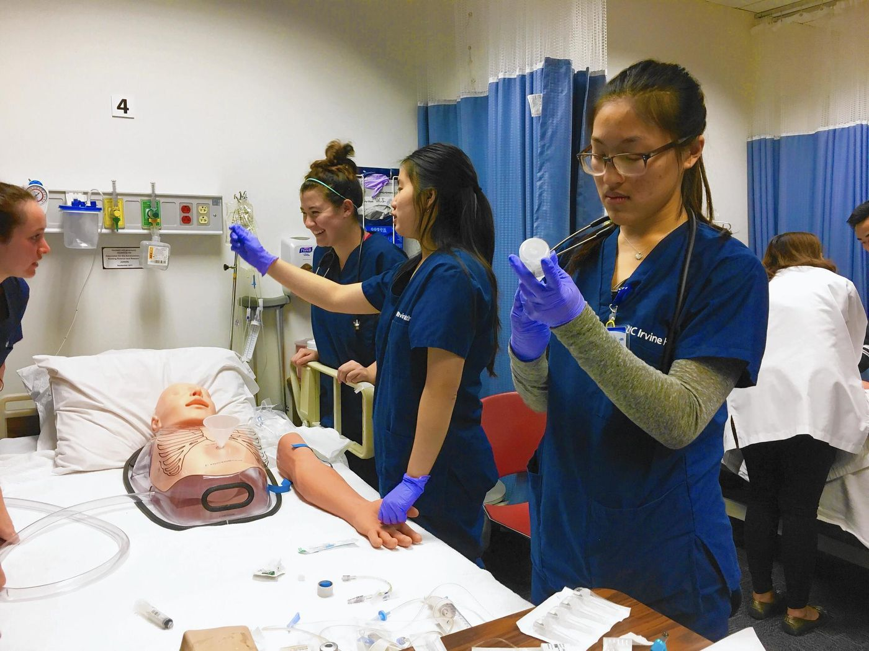
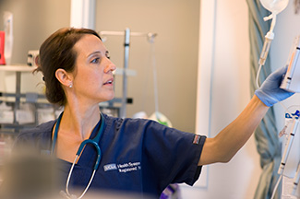
UC NURSING PROGRAMS
VERY COMPETITIVE
UCI 3.6% admit rate, UCLA 2% admit rate
Both schools only look at the supplemental applications
Supplemental application in addition to UC application
Letters of recommendation, more details regarding medical experience, additional essay to complete
Important to demonstrate knowledge of the profession

Slide 7
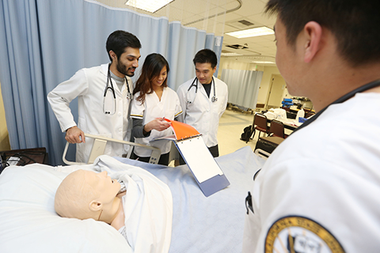
CAL STATE NURSING PROGRAMS
Solely based on the grades and test scores
What is the applicant’s Academic Index?
Focus is on test scores and academic record
Blend of Direct Entry and Pre-Nursing programs
Direct Entry Cal States: CS Fullerton, San Diego State
Pre Nursing Cal States: CSU Chico, CSU Bakersfield, CSU Channel Islands, CSU East Bay, Fresno State, CSU Long Beach, Cal State LA, Sacramento State, CSU San Bernardino, SF State, San Jose State, CSU San Marcos, Sonoma State, CSU Stanislaus
Northridge does pre nursing at local CC then student transfers to CSUN for clinicals/upper division work

Slide 8
PRIVATE CALIFORNIA NURSING PROGRAMS
Common Traits of Private Schools in CA
Smaller class sizes and environment
Highly interactive classes/personalized education
Easier to attain 4 yr. graduation rate
Direct Entry: University of San Francisco, Dominican University, Point Loma Nazarene University, Azusa Pacific University
Pre-Nursing Programs: Mount Saint Mary’s University, Biola University, California Baptist University
Example: University of San Francisco

Slide 9
TIPS FOR PREPARING TO APPLY
Do your research
Classes to consider taking to stand out
4 years science (Biology, Chemistry and Physics)
4 years math
ROP or other medical exploration classes
Challenging coursework (honors, AP or IB)
Experience in the medical field
Notes:
\

Slide 10
HELPFUL QUESTIONS FOR STUDENTS TO ASK
Average Academic Profile for Nursing Program
Direct Entry vs. Pre-Nursing
Clinical Experiences
Admission process for Nursing
Pass score on the NCLEX exam
Notes:
Education meme

Slide 11
SO YOU’RE IN!
HERE’S WHAT YOU SIGNED UP FOR
GPA and other requirements to stay in program
Social life
Test heavy profession
What does this profession entail?

Slide 12
OTHER PATHWAYS TO CONSIDER
Out of State programs
Transfer Route
Good route for students that aren’t as competitive as a first-year student or still need to explore nursing field before committing.
Master’s Programs for Non-BSN students
Nursing Programs by Region/Type in US
 | ADN | BSN | MSN
Midwest | 269 | 209 | 146
North Atlantic | 161 | 147 | 132
South | 481 | 246 | 156
West | 236 | 94 | 70
Notes:
http://nln.matrixdev.net/docs/default-source/newsroom/nursing-education-statistics/AS1112_T02.pdf-pdf.pdf
National League for Nursing

Slide 13
QUESTIONS?

