Slide 1
Native American Students & Higher Education
Share Learn Connect 2019
Shawntelle Bivens, Multicultural recruiter
Heather torres, Director of native student programs
Elizabeth shulterbrandt, assistant director of native programs

Slide 2
POP QUIZ

Slide 3
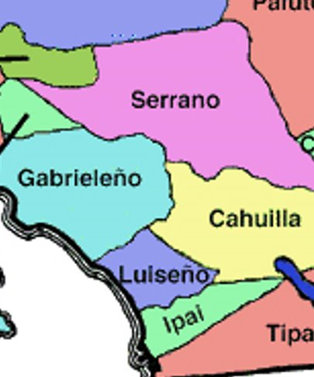
Serrano & Cahuilla Territory
The University occupies Serrano and Cahuilla territory. ​
(SEH RAH NO)​
(CAH WEE YA)​
​
Land acknowledgement is one way to recognize the history of colonialism and a need for change in settler colonial societies. It allows people to shift how they see the spaces and places they occupy.

Slide 4
Brief History of American Indian Education
Dealing with the “Indian Problem”
Death: military acts and illness
Missions
Education - 1819: Indian Civilization Act, federal funding for mission schools
Boarding School - “Kill the Indian Save the Man”
1870s-80s: creation of boarding schools away from reservations.
Carlisle Indian School founded in 1879 by US Army officer Richard Henry Pratt.​
"A great general has said that the only good Indian is a dead one. In a sense, I agree with the sentiment, but only in this: that all the Indian there is in the race should be dead. Kill the Indian in him and save the man.”
Notes:
Pratt said in a speech in 1892

Slide 5
Reciprocity & Responsibility
AIM Survival Schools
Colleges & Universities
Land grant institutions
Charters
The Charter of 1650, by which Harvard University continues to be governed, pledges the University to “the education of English and Indian youth of this Country in knowledge: and godliness."
Tribal Colleges & Universities
Notes:
AIM - responsibility to act, in the 1970s AIM opened up survival schools to provide an alternative to federally run schools
Land grant- In 1862, President Lincoln signed the Morrill Act into law, which provided every state and territory land, equal to 30,000 acres per member of Congress, to be used as a critical asset to start a “land grant” university. There are now 57 universities that were launched, or expanded, thanks to these land grants. They’re referred to as the “1862 land grant institutions.” In all, more than 17 million acres of land was granted under the Morrill Act.
In 1890, the federal government conferred land grant status to 18 historically black colleges or universities, and in 1994 designated now 34 tribal colleges as land grants. But neither the 1890 nor the 1994 land grants received any land as permanent endowment.
--- do you know if your institution or local institutions are land grant institutions?
Charters - ivy leagues
TCUs - 1968 the Navajo tribal council passes a resolution founding Navajo Community College (renamed Diné College in 1977), the first tribal college. In 1978, Congress passes the Tribally Controlled Community College Assistance Act.
Use a Land-centered approach to work with Native Nations; Figure out whose land you are on. Research and understand about their history. Then look broadly about the history of your area and its relations to Native peoples - ex. Xanja on campus

Slide 6
The Effects
Major distrust of the education system in the American Indian community​
Left students disconnected from their families and communities in a society that was not ready or wanting to accept them​
Tore apart the family structure of American Indians for several consecutive generations​
Although tactics of boarding schools have changed, and many Native students don’t attend boarding schools, current students are still dealing with the historical trauma left in their families from past generations

Slide 7
Challenges for Native Students
Identity
Representation
Textbooks
Media
Communities
Family/Community Obligations
Responsibilities
Who am I ?
Assimilation
Dominant Culture
Traditional Culture
The Upside Down
First Generation
College Prep/Search
K-12 curriculum
Finding a school that fits
Financial Burden
Financial Aid
Family Support

Slide 8
Supporting Native Students
High School
Transitional Programs
College Horizons
Summer Bridge
Overnight visits
Teaching Growth Mindset
Supporting Autonomy
Adequate Advising
Attention to advising will contribute to academic success
Historical Context
A reminder that you must understand them to help them
College
Connecting students to their surrounding communities both on and off campus
Student clubs/orgs?
Any local tribes or local events?
Emergency Funding
Health issues, food, textbooks, etc.
Be a mentor
Provide guidance
Check on your students
Historical Context
A reminder that you must understand them to help them

Slide 9
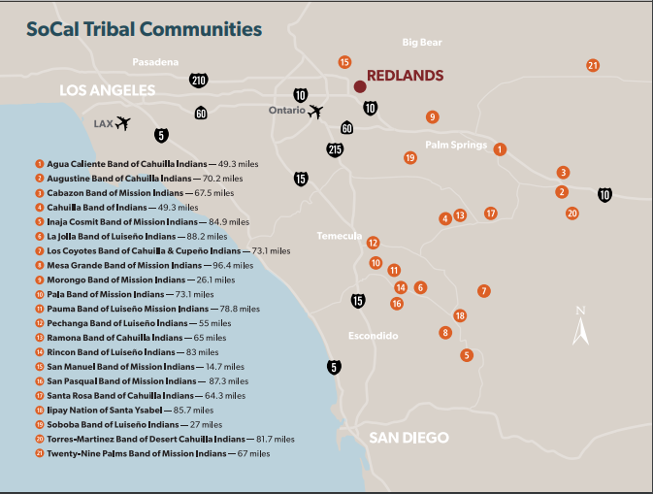
Contemporary Issues
Native Americans (both American Indians and Alaska Natives) comprise only 1% of the U.S. undergraduate population and less than 1% of the graduate population, these students are often left out of postsecondary research and data reporting due to small sample size.
16% of Native Americans had attained at least a bachelor’s degree in 2017, compared to 42% of White students.
Notes:
http://pnpi.org/native-american-students/

Slide 10
“New Mexico Teacher Accused of Calling a Native Student a "Bloody Indian" and Cutting Another's Hair on Halloween”
“Native American 2nd grader kicked out of class for traditional Mohawk haircut”
“Native American Brothers Pulled From Campus Tour After Nervous [White] Parent Calls Police”
“Native American Student Wears Feather to Graduation, Is Denied Diploma”

Slide 11
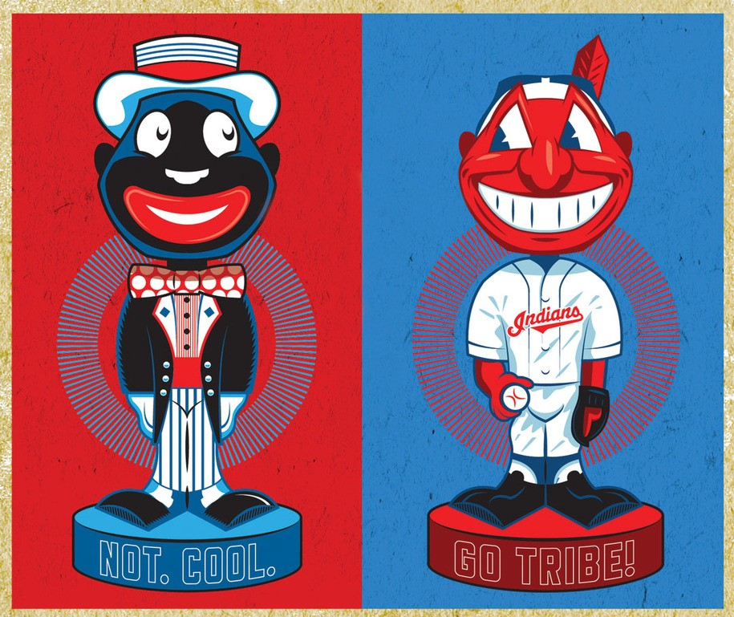
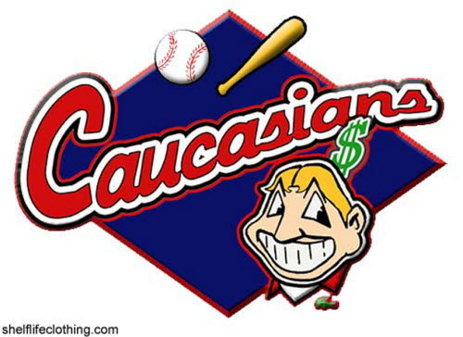
Mascots
Why is one acceptable or the other not?

Slide 12
Bill AB 738 - California
This bill would require the commission to develop, and the state board to adopt, modify, or revise, a model curriculum in Native American studies, and would encourage each school district and charter school that maintains any of grades 9 to 12, inclusive, that does not otherwise offer a standards-based Native American studies curriculum to offer a course of study in Native American studies based on the model curriculum. The bill would require the model curriculum to be developed with participation from specified entities, including, among others, certain Native American tribes...

Slide 13
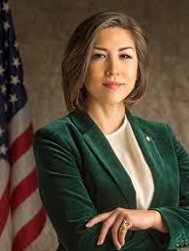
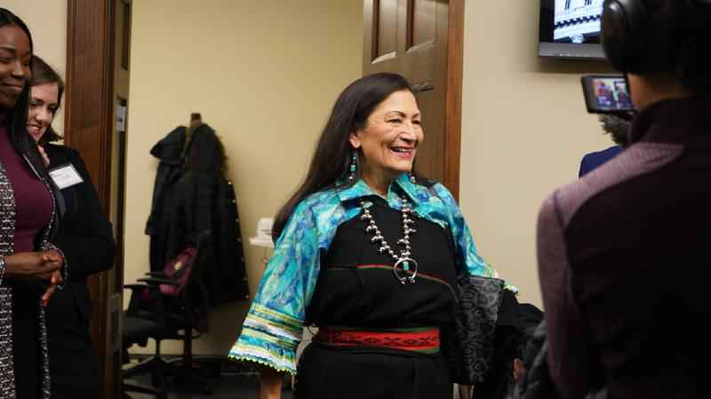
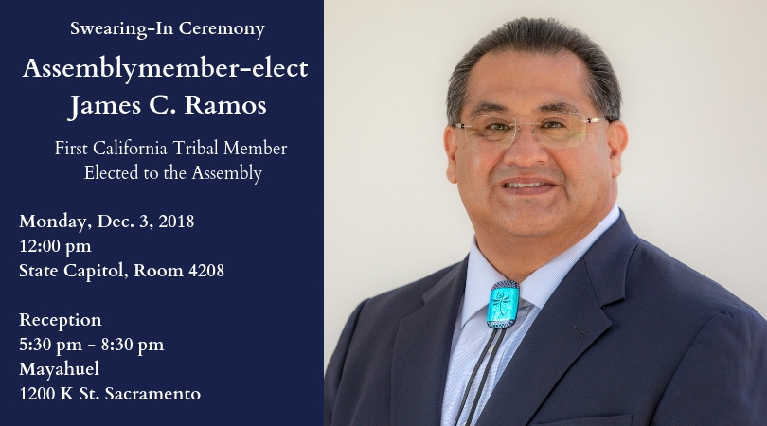

Slide 14
Pop Quiz Reflection/ Q&A
Thank you!

