Slide 1

WACAC SLC: U of Redlands
The Diluted Value of High Test Scores
Matt Steiner, Compass Education Group
Mark Lim, Ramona High School
Notes:
Welcome!
Busy 12 months since we last met:
--Online tutoring and PT locations in: NYC, DC, Seattle, Houston, Denver, S. Florida, more…
--About to embark on a multi-month tour de college admission testing
--Online tutoring has exploded and we’ve deepened our tutor team, staff, and technology to support it; THE FUTURE IS NOW!
--To add to the excitement, I decided to come out as nonbinary (transfeminine), which should add layers of intrigue and complexity to my work across the US…
--Of course, these efforts would not be possible without your advocacy and referrals, which form the heart of our business
--I also want to re-acquaint you with the faces at Compass, some old, some new. I’ll start with Torsten who has taken the torch from Sara Berard as Managing Director – Sara is now spearheading our Denver office!
Today’s presentation:
--Fundamental assumptions about how tests work and why they are used
--How these assumptions have been challenged thanks to: 1) diluted value of tests scores, and 2) major inconsistencies in difficulty and raw-to-scaled score conversion
--Revisiting landscape of testing policies, esp. Subject Tests and how to better understand “what constitutes a good ST score…”
--Ending with showcase of new Compass scoring engine; upward trend in students beginning prep in 10th – when is it appropriate?; when is it unreasonable?

Slide 2
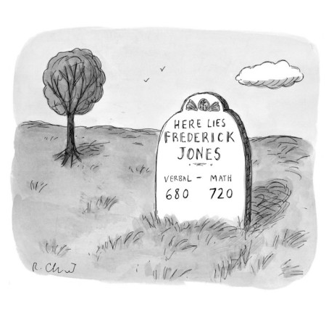
Notes:
Speaks to our culture’s tortured obsession with these tests
Fatalistic edicts handed from down on high that predict how smart we are, how successful…
Parents laugh; students don’t
At best: crude assessment of a narrow band…

Slide 3

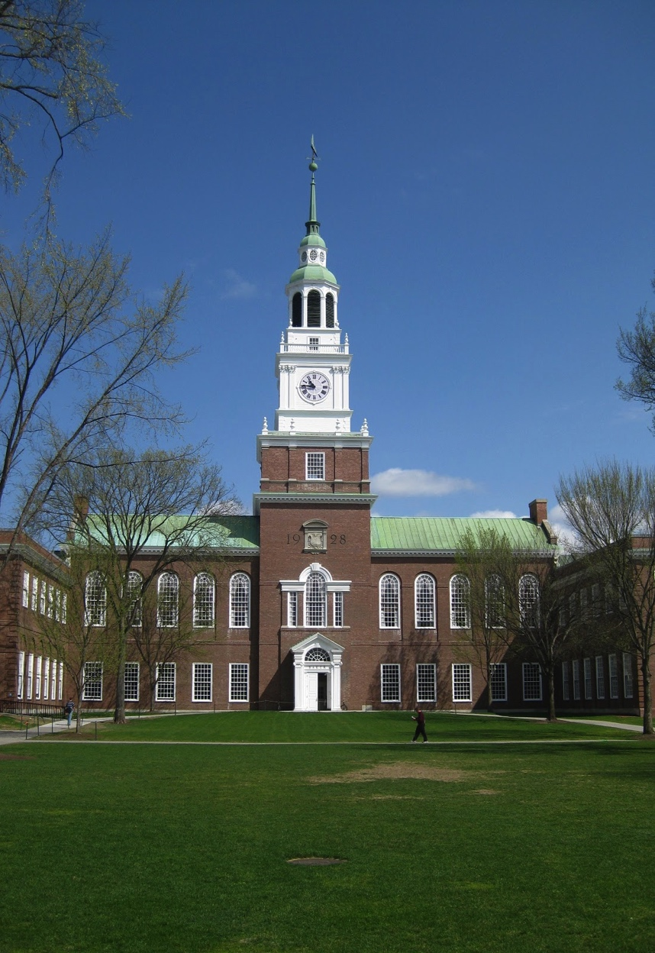
Role of Standardized Testing Today
National Association for College Admission Counseling Report on Standardized Testing (2009):
  “Typically, the validity of admission tests as a selection tool for higher education institutions is judged by [how well the tests] can predict first-year college grade-point average (FGPA).”
Notes:
Research suggests cumulative GPA and rigor most important; test scores provide additive value
Most useful in predicting FGPA
For admission offices at selective colleges, added value – hope is that scores can decode the transcript and help prioritize evaluation
Crude assessment of a narrow band of academic skills…

Slide 4
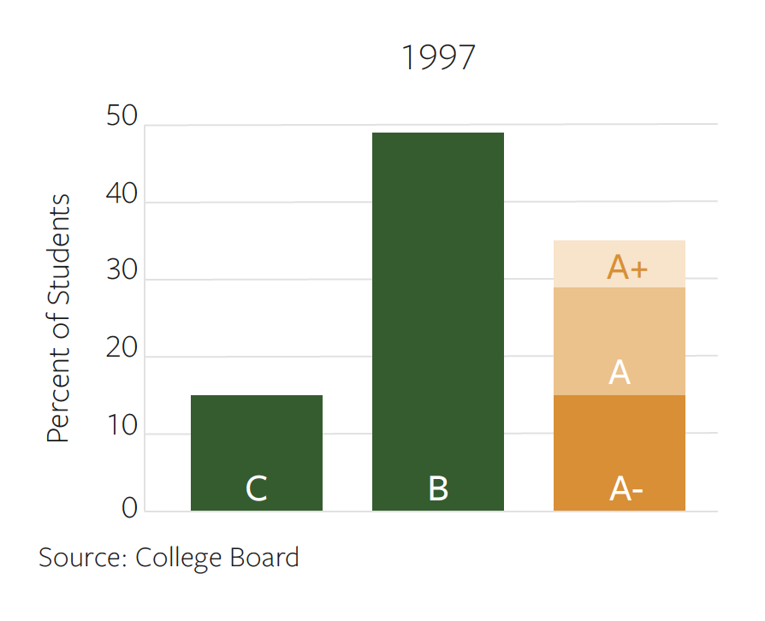
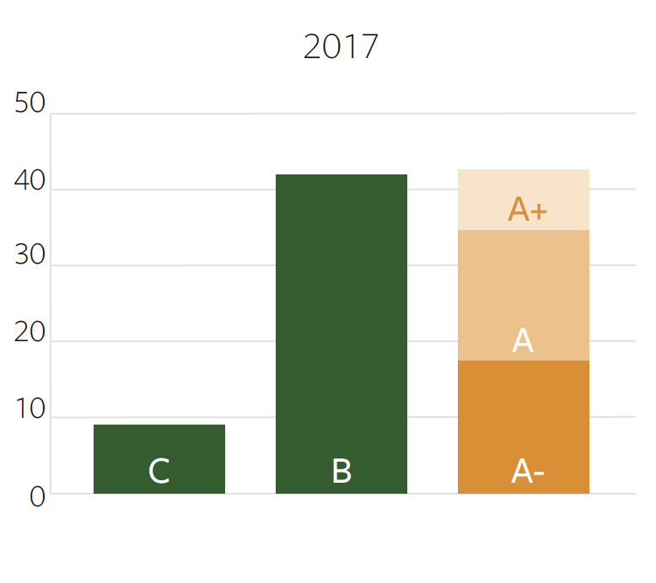
Why Standardized Tests?
Notes:
Grade inflation is at work here
Tests help cut through the noise because of their consistency* in ranking students
Makes life easier for massive institutions trying to translate transcripts all over the country (and world); common yardstick
Jack as perfect example…

Slide 5
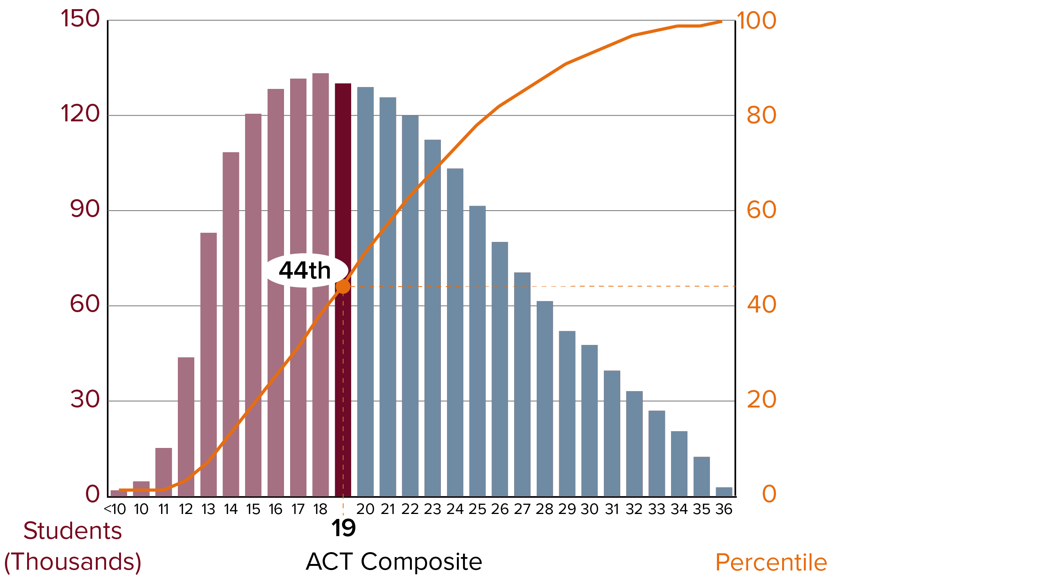
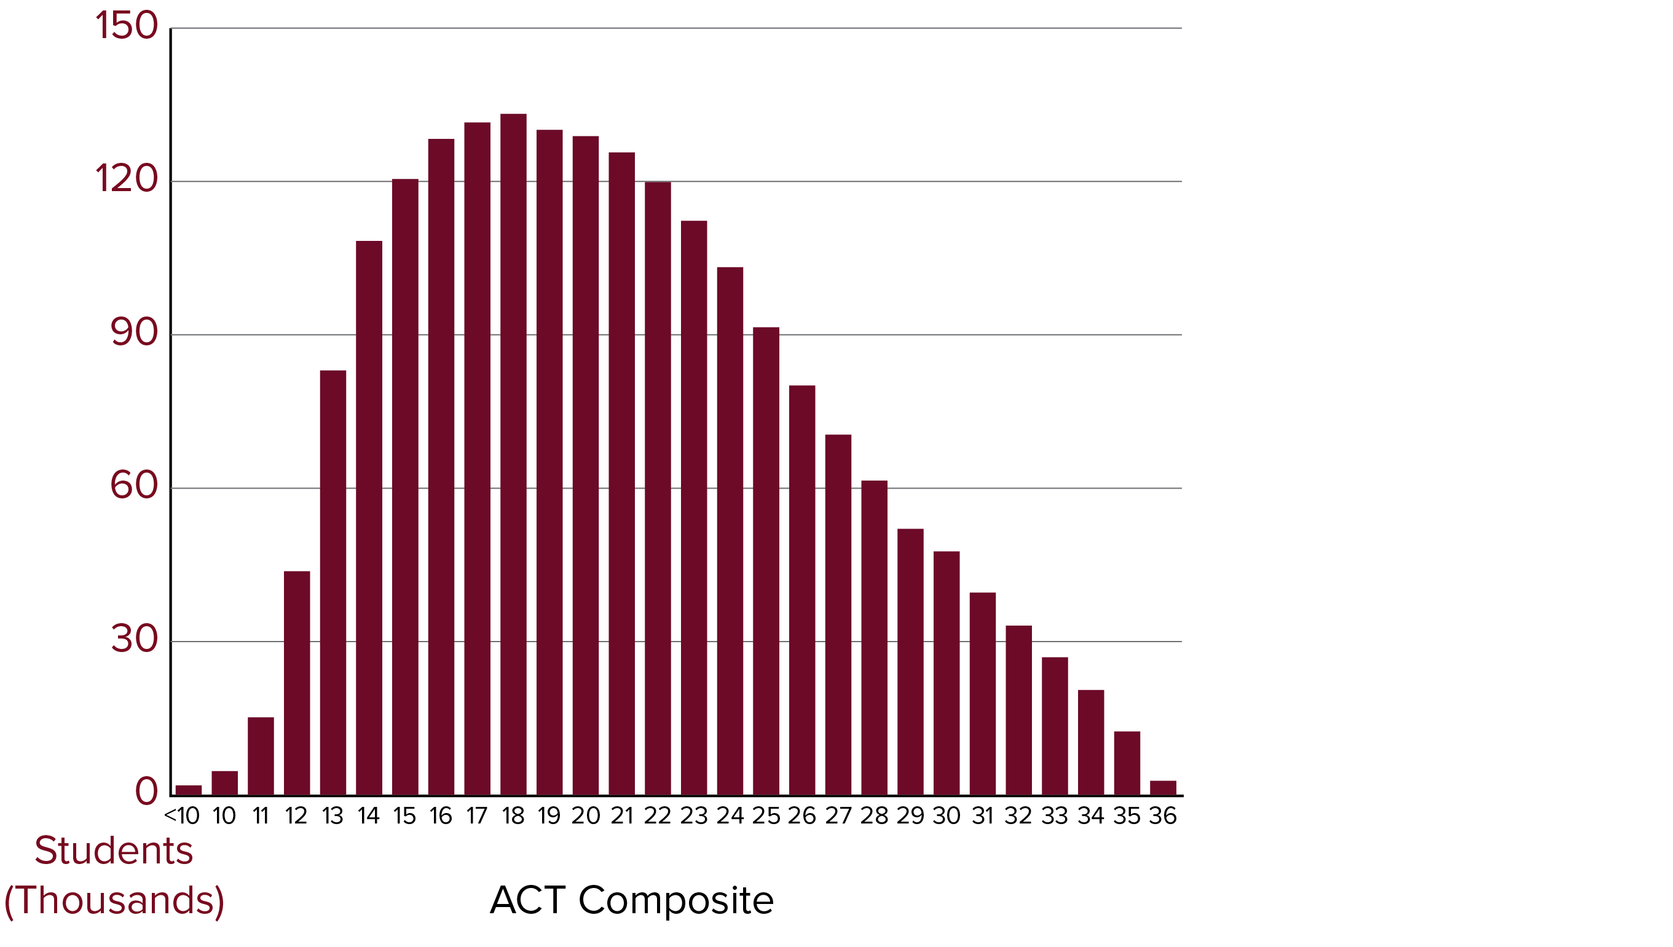
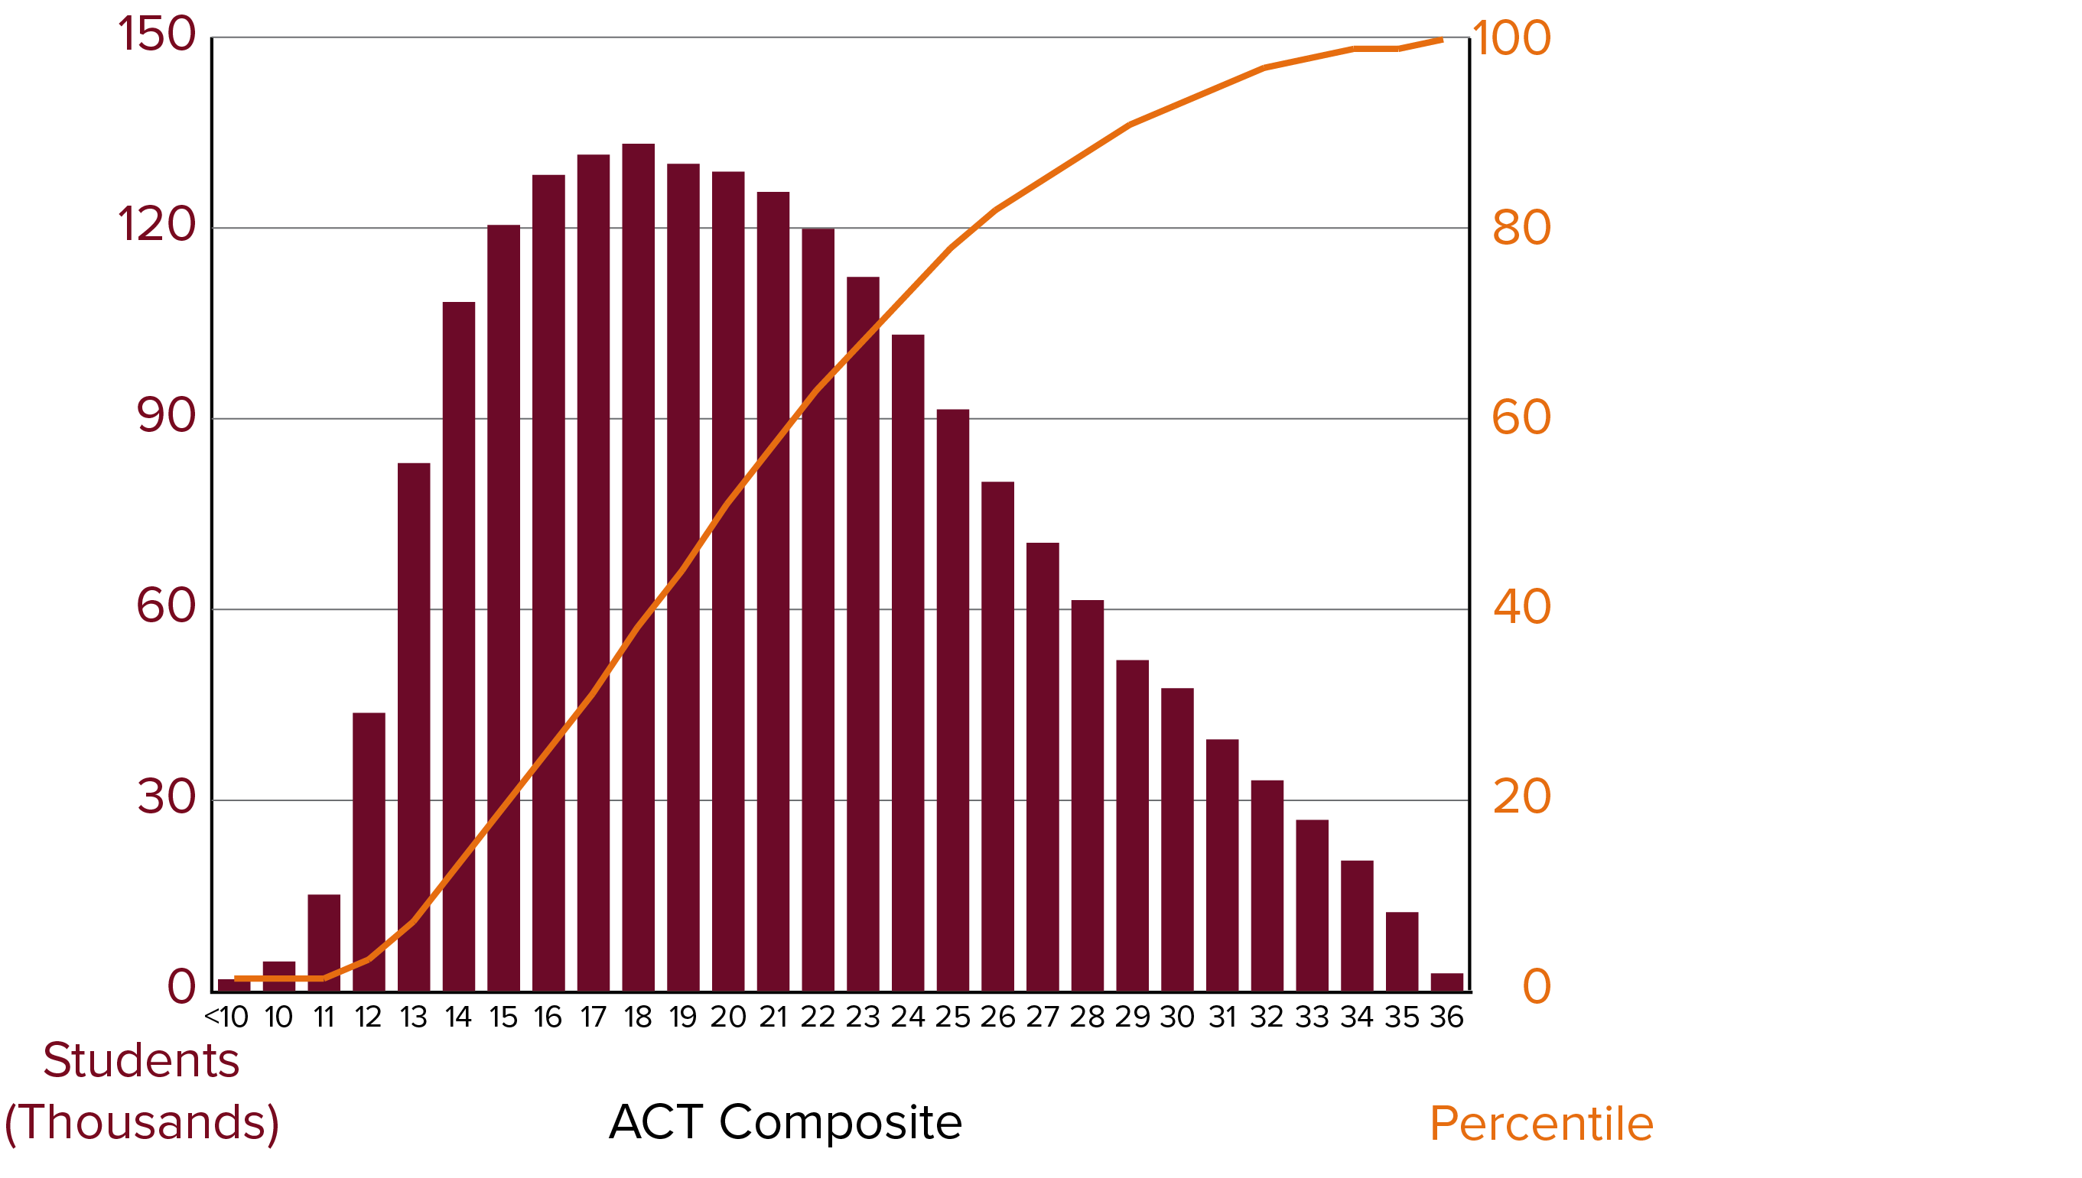
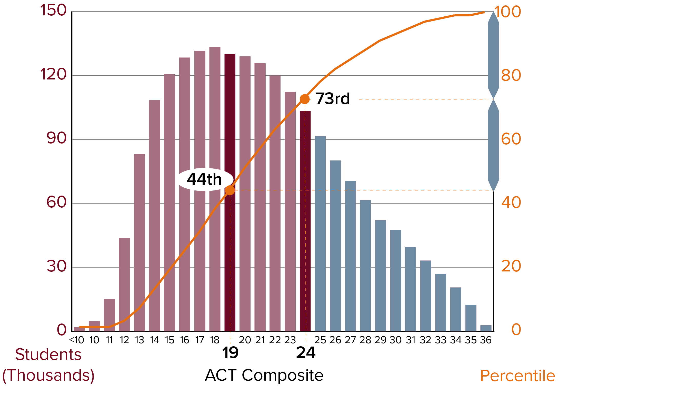
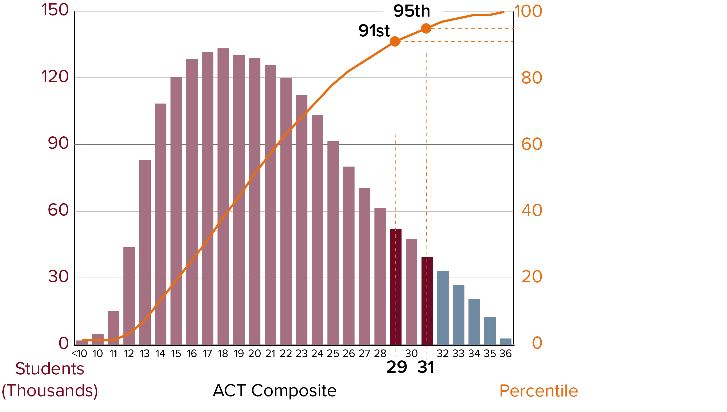

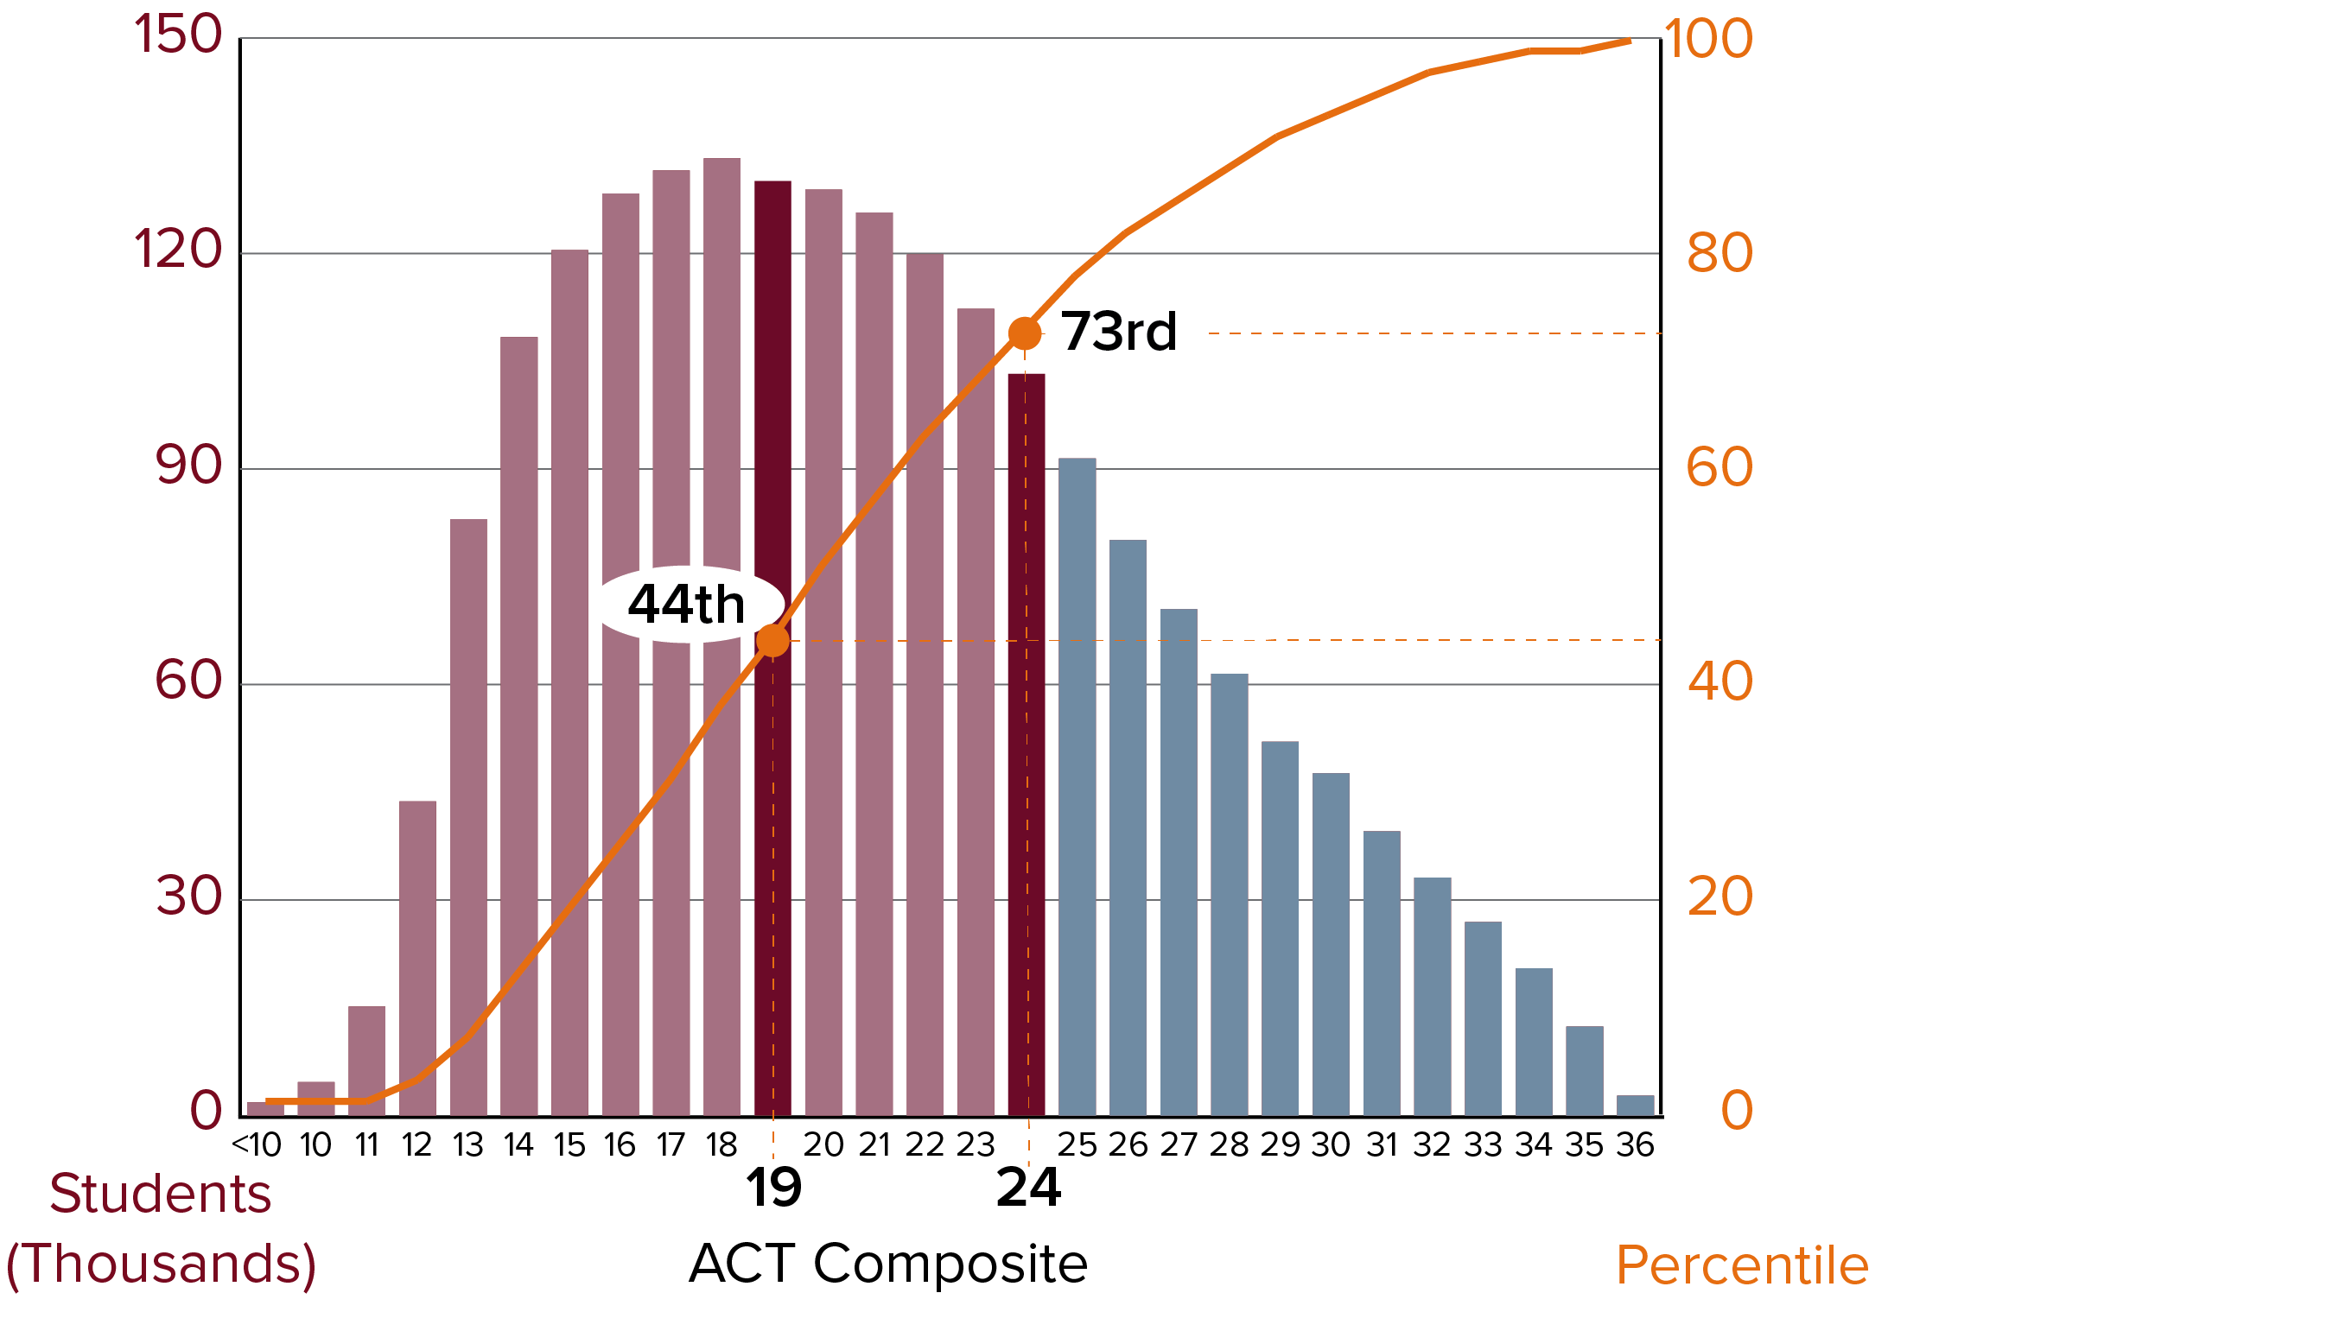
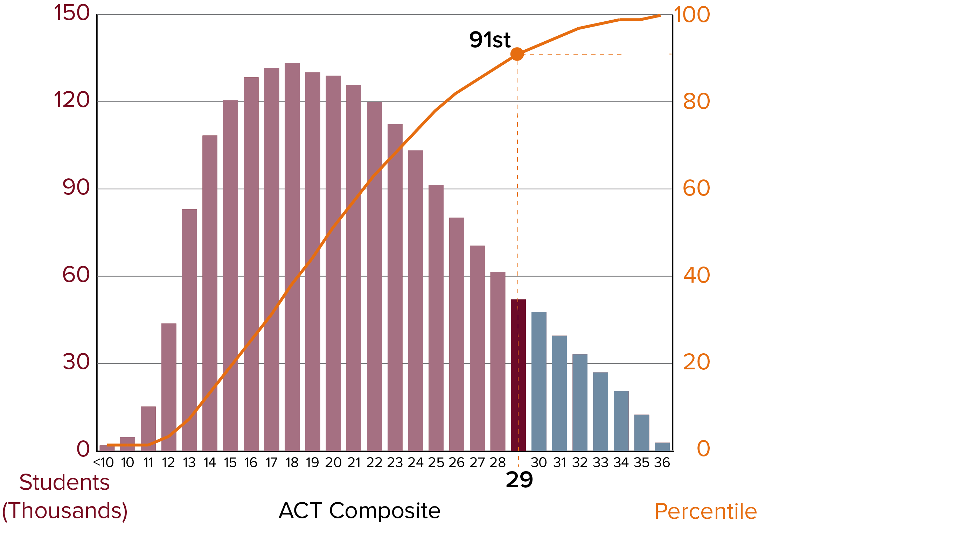
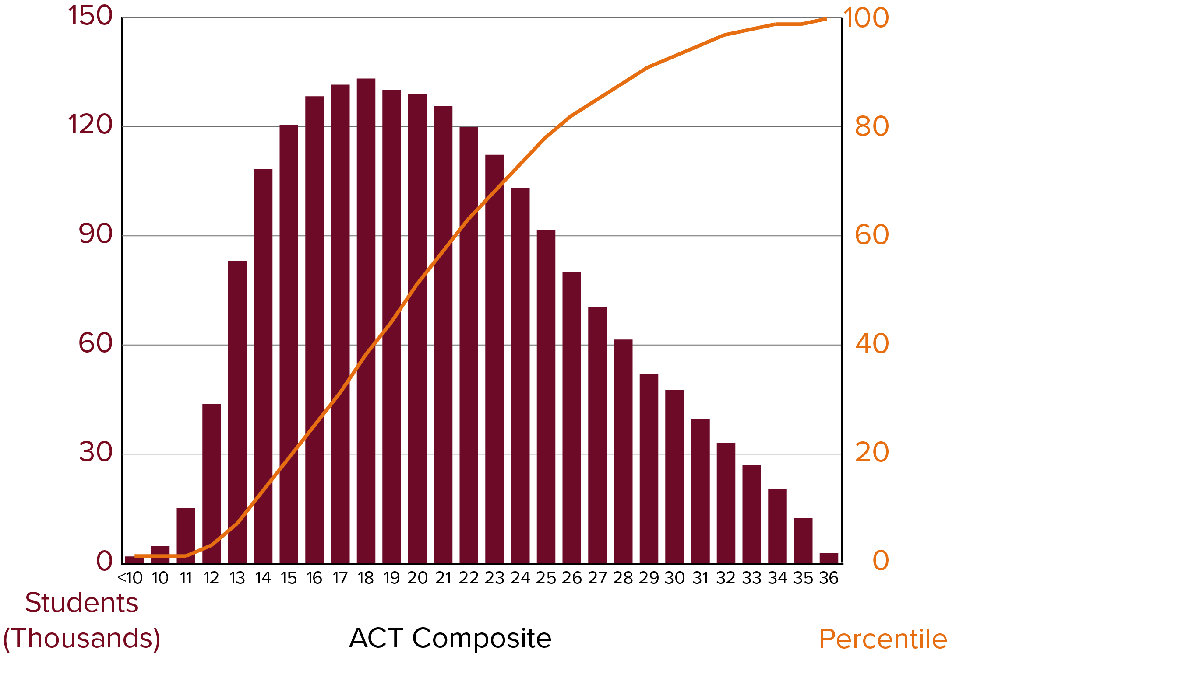
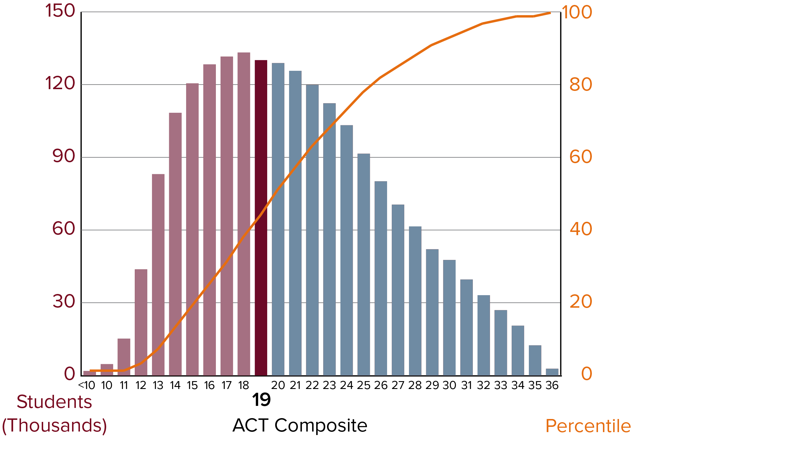
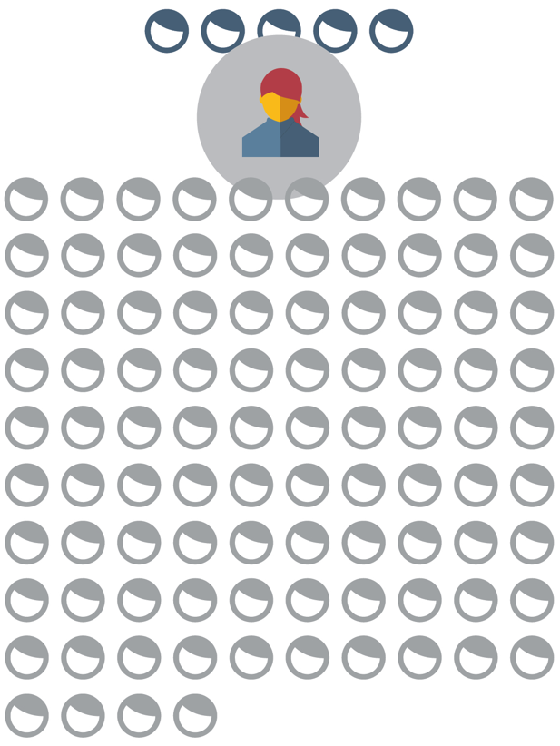
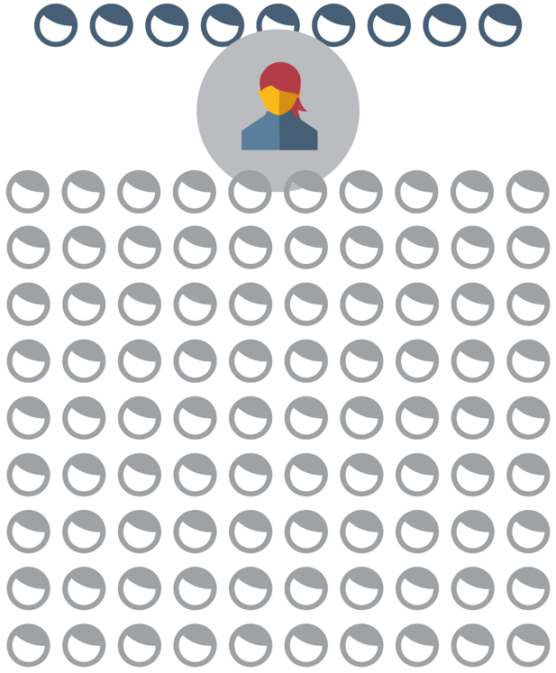
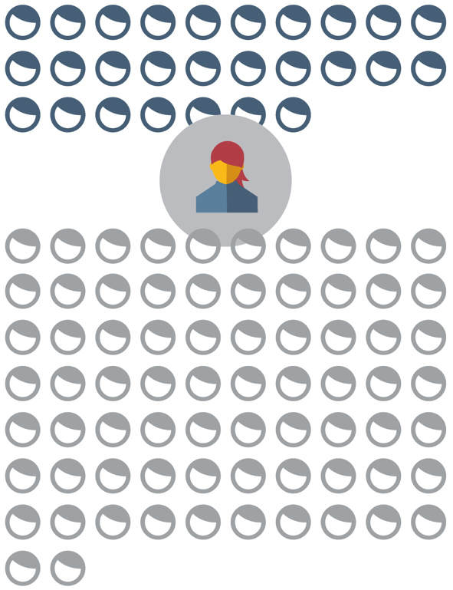
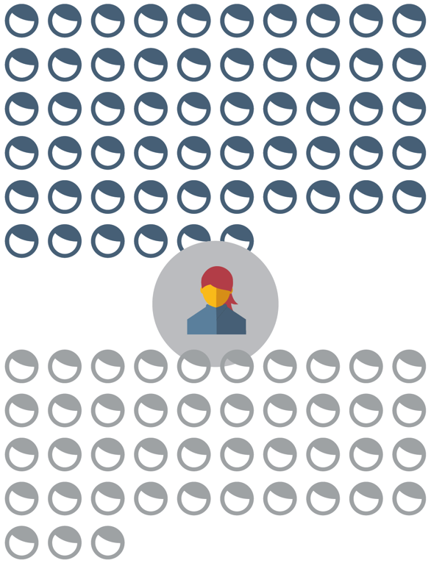
Standardized Tests Are Consistent*
Notes:
Test scores provide us with consistency; slight fluctuations in shape of distribution, but mostly stable; no cap on the number of low, middle, and high scores, but generally the tests are constructed to produce this result
Norm-referenced test not on a traditional “curve”; no test date that is easier and ensures a higher score (big old asterisk here); can’t game this in advance
Consequently, not all students meant to get a perfect score; endless effort doesn’t yield endless reward
Avg. increase is “x” at middle of distribution; expected increment of improvement changes based on starting score – harder to move the needle (here) vs. (here) by the same amount
Here’s a trick we use: map on percentiles, imagine we are standing in line of 100 (each person = 1 percentile); we’re at a 19 (44th percentile), 56 folks in front of us, goal is to cut the distance in half…
Although absolute gains are different, relative gains and the effort required to achieve them are identical
7) Caveat, still plenty of room for kiddos at top of distribution, specialized and surgical approach required to get at these points; looking at near-perfection in performance

Slide 6
*Issues w/ Inconsistency: June 2018 SAT
Raw Score
Final Score
42 Correct ----------------------------------------------------------------650
Typical
43 Correct ----------------------------------------------------------------650
41 Correct ----------------------------------------------------------------650
June 2018 SAT
50 Correct ----------------------------------------------------------------650
June 2017 SAT
50 Correct ----------------------------------------------------------------740
Old SAT scaling never varied by more than 50 points in 10 years
Notes:
Here comes the epic facepalm on the part of College Board…the June 2018 SAT
Each test comes with its own raw to scaled score conversion table. No two tests can be perfectly identical – scaling and equating smooth away differences.
For instance, I sit for three SAT math sections, and my raw scores, although slightly different, still align with the same scaled score of 650. The behavior of the raw-to-scaled conversion is supposed to remain mostly stable from exam to exam.
Students sat for the June 2018 SAT 50 questions right gave you a 650; when just a year before, 50 questions right yielded a 740. Our office was teeming with calls from confused students who made fewer errors on the June test than any previous practice or official test, only to see their scores go down.
Response – this test was far too hard! In reality, test-maker’s made the exam too easy, so small mistakes dramatically sank top scores.

Slide 7
*Issues w/ Inconsistency: June 2018 SAT
Possible 700 Scores
700
710
720
730
740
750
760
770
780
790
800
Notes:
1) In fact, so few hard questions to differentiate students that we lost the ability to achieve these scores – known as “score gaps” by College Board.

Slide 8
Are we over-reacting?
In general, issues with difficulty/scaling did not impact most test-takers:
Avg. June 2017 SAT was 1111
Avg. June 2018 SAT was 1111
6.65% of students scored between 1400-1600 on the June 2017 and 2018 SATs
Notes:
Fair question to ask: are we overreacting? Does this only impact the highest-performing students in a narrow way?
CB said look: avg. scores is the same; % of kiddos achieving 1400+ is the same; but the distribution of scores above a 1400 was very different, and colleges evaluate scores differently above a 1400 (1410 and 1550 feel categorically different, even if we take into consideration CB’s “standard error of measurement,” which it rattles as its ultimate insurance policy)

Slide 9

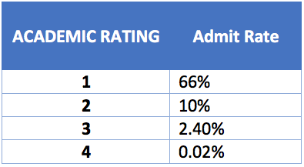
Harvard et al Hair-Splitting Test Scores
Notes:
Harvard lawsuit lays bare the hair-splitting in scores that occurs even when colleges have the best of intentions
You can see massive disparities in admit rate based on academic rating…which is essentially a proxy for test scores
Students deemed “Summa Potential” (1) were admitted 66% of the time; they had near-perfect scores (first) and grades along with unusual creativity and evidence of original scholarship (fluffy)
Then we get down to “Magna Potential” students (2), who are only admitted 10% of the time, the only perceivable difference being their scores, which are WOEFULLY in the high 700’s or 33+ range.
I don’t mean to paint too crude a picture – there are certainly folks weighing test scores holistically and in concert with many other factors, but I think Harvard sets the tone for its peers at selective colleges.

Slide 10
What about the PSAT/NMSQT?
PSAT Total: 320-1520
ERW: 160-760 | Math: 160-760
October 10th PSAT
5 wrong on Math; 700
October 24th PSAT
1 wrong on Math; 710
  SUPER-easy test
  Result: High # of 760s and 710s w/ no in between
Oct. 24
Possible Scores
710
720
730
740
750
760
Notes:
Even more recently, the raw difficulty debacle reared its head on the October 24th administration of the PSAT
Here’s what traditionally happens; Oct. 10th test, 5 wrong yields a 700
Alternate test day, Oct. 24th, conspicuously far less popular and ripe for tossing out a Frankenstein test, 1 wrong dropped you 50 points, 760 to 710, knocking juniors out National Merit Scholarship contention
Again, we have a test that is far too easy, so the raw to scaled score conversion is more punishing.
Effectively wiped out the top of the scale…
I have less of an issue with the inherent inconsistency among tests, but when there is no historical precedent for how a test performs – if it completely departs from the previous practice and official tests that the student has been using to prepare – how is that fair?
--To add insult to injury, the October 24th PSAT (alternate date) fell victim to the same raw difficulty/scaling mishaps
--The main date was consistent with past tests
--Oct. 24th test was far too easy, causing a single question to drop you down from a 760 to a 710 and eliminating you from National Merit potential
--Fair question to ask: is a perfect score on the 10/24 test on par with a perfect score on another PSAT? Getting every question right, even on a bum test, has to give us the highest score possible. Perhaps there were just as many students advantaged by this easy test as those who were victimized.

Slide 11

How Will I Be Judged?
Ice Skating at the Olympics
Oct 10th PSAT
  Traditional routine with plenty of tough jumps
  Mistakes not judged as harshly given overall technical difficulty; smaller deductions
Oct 24th PSAT
  Atypical routine with low technical difficulty; far fewer tough jumps
  Precise execution critical to a high score; mistakes yield higher deductions

Slide 12
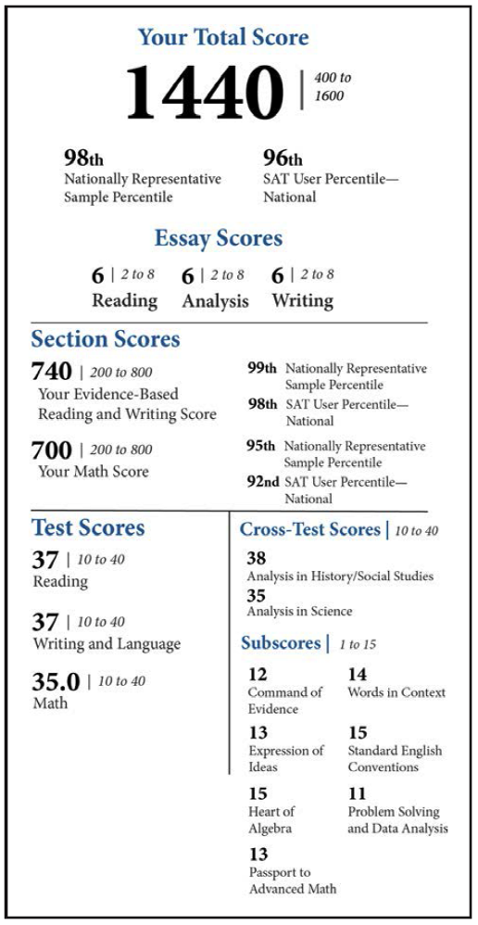
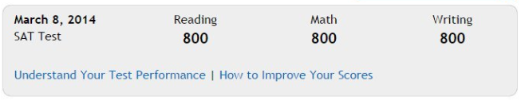
SAT Specs: Lots of Boxes to Check
Old SAT (2005 – 2016)
SAT (2016 – Present)
Notes:
--Prior to the redesign, you had three section scores in Reading, Math, and Writing
--Now we have an array of subscores that mean little to college admission officers – e.g. heart of algebra, passport to advanced math, or cross-test scores like Analysis in Science or Social Studies – but that may appeal to public school districts tied to the common core
--As a psychometrician, I have to develop a test that conforms to these new standards (each one should be meaningful) and historical standards
--Developers also have to produce and release enough new forms to prevent test re-use (the chief cause of cheating)

Slide 13
A Prize to be Won
Notes:
--We often hear counselors frame the admission process as a “match to be made” rather than a “prize to be won.”
--For College Board and ACT, massive district and state contracts are the prize to be won, and there are still huge states out there that College Board and ACT are targeting: California, Texas, Pennsylvania, Virginia, Florida, etc.
--The SAT was overhauled in 2016 with this map in mind. College Board built a product that would appeal to the educational goals of the public school system – e.g. measuring student progress, accountability, benchmarks against minimum standards – while maintaining its promise to rank high-performing students for selective colleges.
--These aims don’t perfectly overlap. The result is two competing admission tests that are bloated with technical standards.
--It’s a test developer’s nightmare…

Slide 14
SAT vs ACT: Total Test-Takers
Notes:
--For College Board, the multi-pronged ambitions of its new test appear to have been realized
--ACT was on top for a good 8-year run, but as of 2018, College Board has re-emerged as the nation’s most popular college admission test.

Slide 15
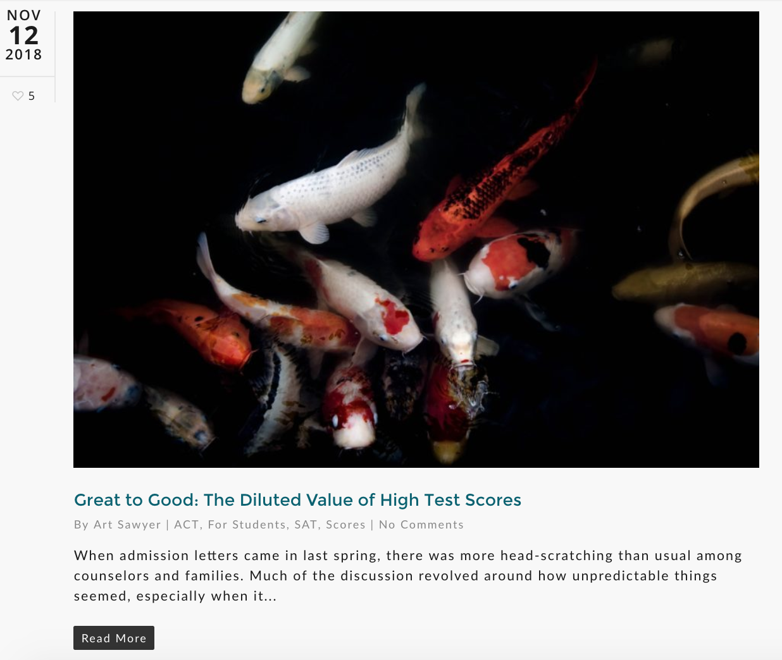
Diluted Value of High Test Scores
Highlights
1400-1600 and 31-36 scores have doubled in last 10 years
1500-1600 and 34-36 scores have doubled in last 5 years
Increase in SAT top scores from 2017 to 2018 was especially high
Super-scoring and cross-testing increases incidence of high scores
compassprep.com/great-to-good-the-diluted-value-of-test-scores
Notes:
--Another great topic, surge of high scores at the top of the distribution
--This piece is incredibly thorough – we’re hoping that you can share with families if you’re worried about distilling the complexities in the moment
--Doubling of scores in last 10 years, 31+ 1400+
--Doubling of scores in last 5 years, 34+ 1500+
--Increase is particularly steep between the Class of 2017 and Class of 2018
--Super-scoring and cross-testing has a compounding effect. College Board and ACT typically report the last formal administration of a student, while ignoring the realities of the applicant pool at a college: where super-scoring is often allowed. As far as cross-testing goes, students are no longer limiting themselves to the test offered in their state; they are taking practice tests and selecting the exam where they have an edge
--We’re now going to review this issue from multiple vantage points

Slide 16

Diluted Value of High Test Scores
70k students
Class of 2017
700
750
Class of 2018
120k students
700
750
Notes:
Let’s say you were a student in the class of 2017; your practice test shows you coming in at a 750
But you end up having a bad day, or perhaps the test bucks the trend in difficulty that you’ve been used to via practice tests
You end up achieving a 700 and allow 70k students to pass you;
In the class of 2018, your score means that you are passed by 120k; your drop ends up pushing nearly double the number of students in front of you

Slide 17
Diluted Value of High Test Scores
Why the unprecedented increase for the SAT?
Massive return to the SAT
Increased familiarity w/ new version of SAT
  Possible exposure to new PSAT in 10th and 11th grades
More cross-testers; going beyond state-mandated testing
Superscoring
  Compass estimates College Board understates students’ highest scores by up to 30 pts – data reflects last official sitting rather than highest sitting
  Superscoring increases incidence of top scores by 15-20%; for SAT, 140k to 170k; for ACT 135k to 160k
International students
Ambitious, competitive testers starting earlier, prepping more, re-testing repeatedly…an arms race among top-scorers
Notes:
--Students return from the ACT diaspora and have brought their friends
--Students may also have increased familiarity as a result of exposure to PSATs and potential prep
--Higher number of cross-testers not beholden to their state’s testing offering
--Superscoring – we discussed
--International students, although a marginal number of the testing population, are routinely getting the highest scores
--Ambitious students are starting earlier, prepping more, and re-testing, which creates an arms race for the most coveted scores

Slide 18
Not Either/Or
Notes:
Not just College Board’s SAT that is seeing highest scores;
in fact, many of the highest performing students are sitting for both exams (trophy-seeking); so testers in one pool don’t necessarily take away from testers in another
ACT was growing quite a bit; SAT more steadily
Big transition year in 2018 – flight to the familiar ended; SAT regains ground and has a ton of top-scorers

Slide 19
36 Still Perfect, Less Special
3,741
2,760
2,235
1,598
1,407
1,162
638
704
781
588
2009
2010
2011
2012
2013
2014
2015
2016
2017
2018
Notes:
A 36 is now less special than it used to be; you’re sharing this gilded score with more and more students.
Only 89 in 2001; close to 4k in 2018; we expect this number to grow

Slide 20
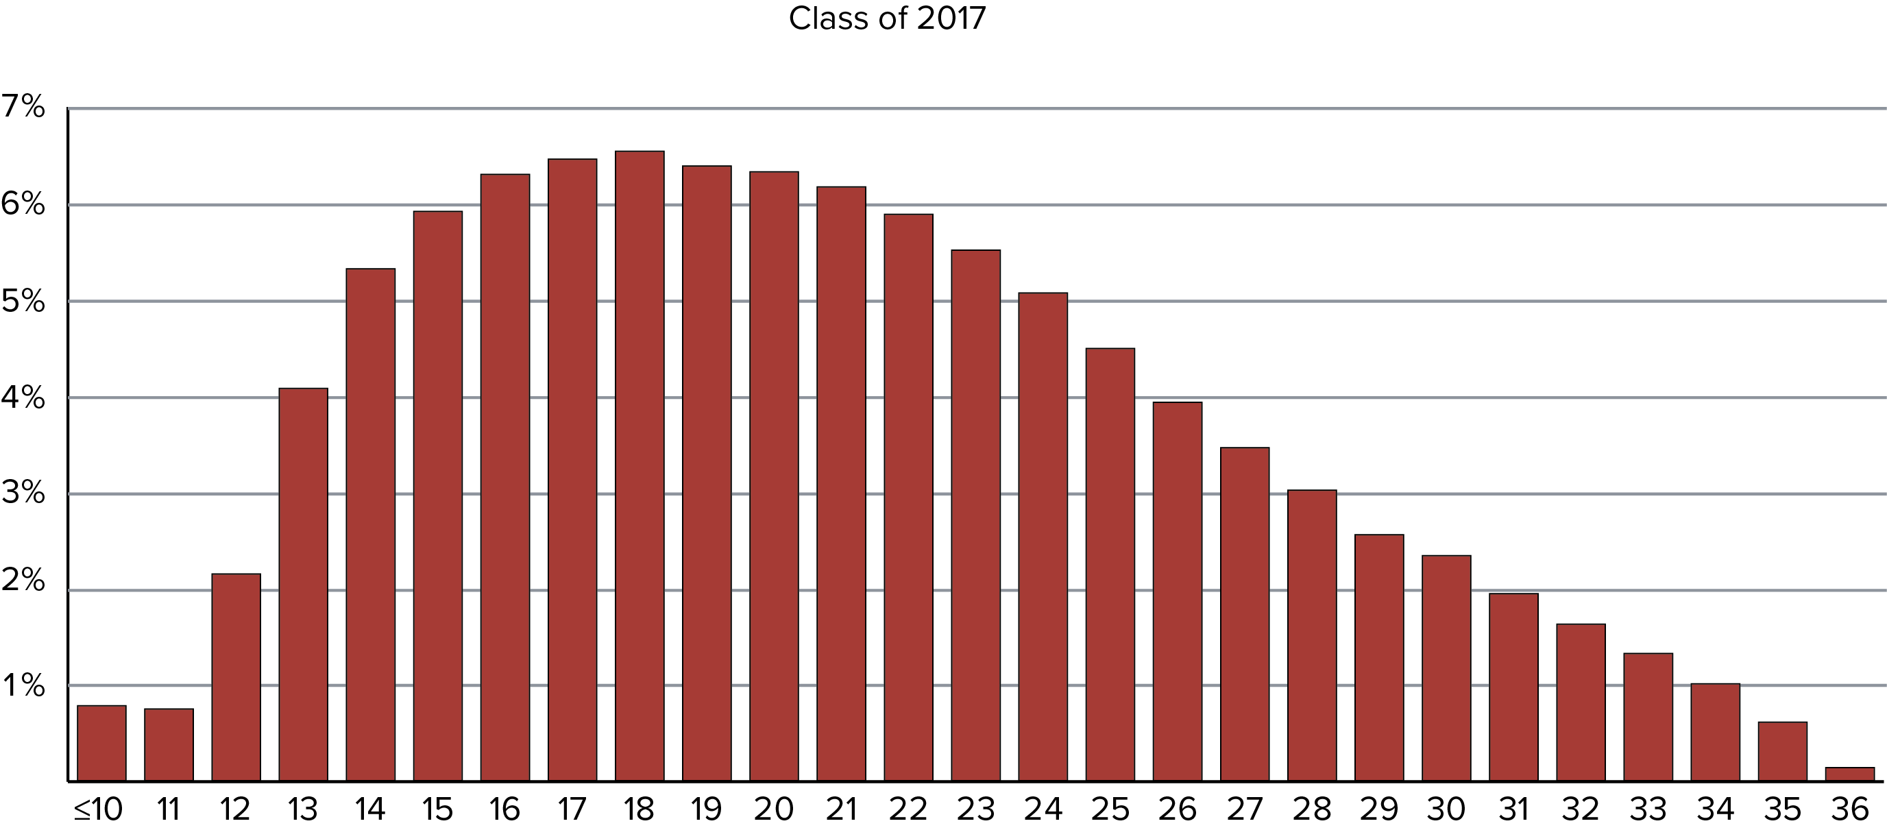
ACT Score Distribution

Slide 21
Diluted Value of High Test Scores
Takeaways
1) High scores increasingly common and undistinguishing at most selective schools
“More essential, less sufficient…”
2) Be cautious and realistic when weighing competitiveness of scores
3) Carefully evaluate improvement potential when considering preparation and retest options
Notes:
--More essential, less sufficient
--No golden ticket scores, lottery ticket score that may prop you up for consideration among an increasingly exceptional applicant pool
--Consider prep and re-testing only when you’re sure you can move the needle in a meaningful way; awareness should allow families to be that much more realistic in creating a college list and understanding their odds

Slide 22

The Moral of this Story…
Admit Rate: 70%
Yield: 33%
Stanford (<5%) denied 70% of applicants with perfect test scores
Notes:
--End on a positive note
--Less than 5% of colleges nationwide accept less than 50% of applicants
--On average, colleges say yes to 70% of applications.
--Conversely, after being accepted, students typically only say “yes” 1/3 of the time. In other words, it’s the universities competing for your favor, and you have a ton of college options that will be a great fit for you.
--And lastly, to throw a little shade at test scores and Stanford, 70% of applicants with perfect test scores were rejected by Stanford. Admission process is more like a lottery because applicant pool is so powerful (and homogenous!).

Slide 23
Q & A
matt@compassprep.com
mlim@rusd.k12.ca.us

