Slide 1
Life Hacks:
Building Skills for a Successful Transition to College
Notes:
Life Hacks: Building Skills for a Successful Transition to College
Much attention is given to the academic content and skills students should know in order to be college ready, but what about the soft skills to make for a smoother transition to college? Presenters will share information about their programs to fill some of these gaps for students like personal finance, career preparation and "adulting" skills.

Slide 2
Agenda
Think, Do & Discuss with a College Personal Finance Mini Activity [7 min]
Crucial Skills for a Successful College Transition [15 min]
Paying-For-College Simulation [10 min]
Resource Goldmine for Personal Finance & Paying for College [5 min]

Slide 3

Notes:
We wanted to find a way to bring current events to the classroom EVERY week in an engaging way so we created FinCap Fridays (as in “put on your thinking FinCaps”). The initial reception to this product which we launched about a month ago has been VERY positive. Here’s what it is...

Slide 4
NEW! FinCap Friday
Engaging way to bring current events into the classroom
5 question Kahoot
90 second explainer video
Discussion prompt
Activity ideas
Receive every Friday morning by subscribing to NGPF Blog

Slide 5

FinCap Friday
No
Tech
Tuition, Fees, & Books, Oh My!

Slide 6


Tuition, Fees, & Books, Oh My!
September 28, 2018 Edition
Click above to let the games begin! OR
Click here for the no-tech version with same Kahoot questions embedded in the presentation

Slide 7

FinCap Friday
The Explainer
You’ve completed this activity, now it’s time to learn more about this current event:

Slide 8
FinCap Friday
Discussion Prompt
What advice would you give someone who believes they will never be able to afford college?

Slide 9
FinCap Friday
Extend Your Learning
Three Relevant Resources from NGPF:
PAYBACK (Interactive)
Finding Scholarships & Grants (Activity)
FAFSA: Gateway to Financial Aid (Lesson)
References:
Educational Attainment in the United States: 2015 (Census Bureau)
College Costs Reach As High As $75,000 (The Washington Post)
Discounting Keeps Climbing (Inside Higher Ed)

Slide 10



Some Topics in the “Transition to College” Curriculum at Eastside and CRSJ
Executive function skills
Personal finance
College catalogs
College roadmaps/4-year plans
College note-taking
Selecting Majors
Resources at college
Advice from alumni
Notes:
At Eastside and CRSJ, we’re fortunate to have a mandatory class for seniors built into the school. In the first semester, we focus on the college application process; in the second semester, we cover various topics in the transition to college.

Slide 11

Notes:
Being a college student (and a prospective college student) requires learning a new language and acclimating to a new environment, even new norms and a different culture than what the student experienced in high school.

Slide 12
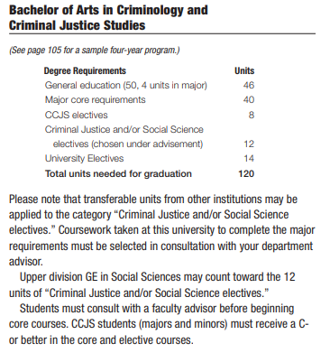
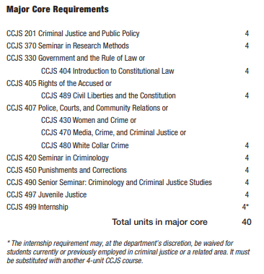
Reading & Dissecting a Course Catalog
Notes:
We spend time in class reading and dissecting course catalogs (available online) giving students practice in figuring out what goes into specific majors, deciphering terms and navigating a system that expects students to play an active role in forging their educational path.

Slide 13
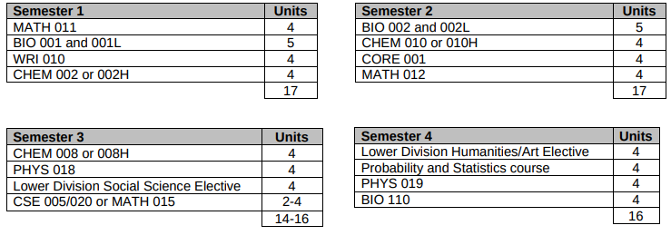

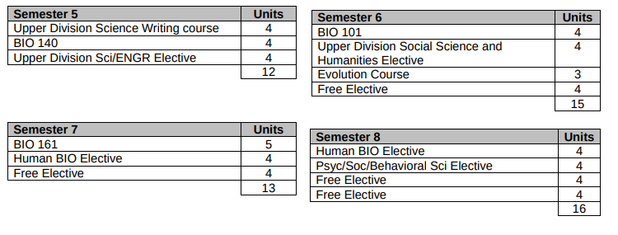
Creating a Roadmap
Notes:
We work with students on creating four-year “roadmaps” at the college they’re likely to attend in majors they’re interested in pursuing. This is not set in stone, but it gives students experience in figuring out how they might make a long-term plan. It might also demonstrate how flexible (or inflexible) their areas of interest might be, the likelihood of double majoring or studying abroad, the opportunities to take a range of classes or electives.

Slide 14
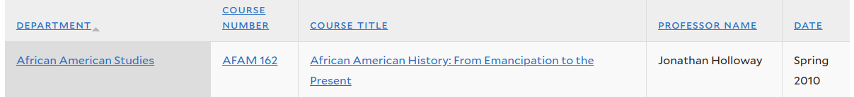
Note-taking in College Courses
Open Yale Courses (oyc.yale.edu)
Notes:
A number of our students will be attending colleges where they can expect to have large lecture classes, especially as first-year students. Using actual college lectures online, we practice taking notes - some professors are very structured and clear, others mumble, some move quickly through material, some are dry, etc. We have interesting debriefs after the lectures discussing the different styles of teaching as well as the different ways of taking notes. We also discuss ways students might approach the class and future lectures in order to be more engaged and effective.

Slide 15
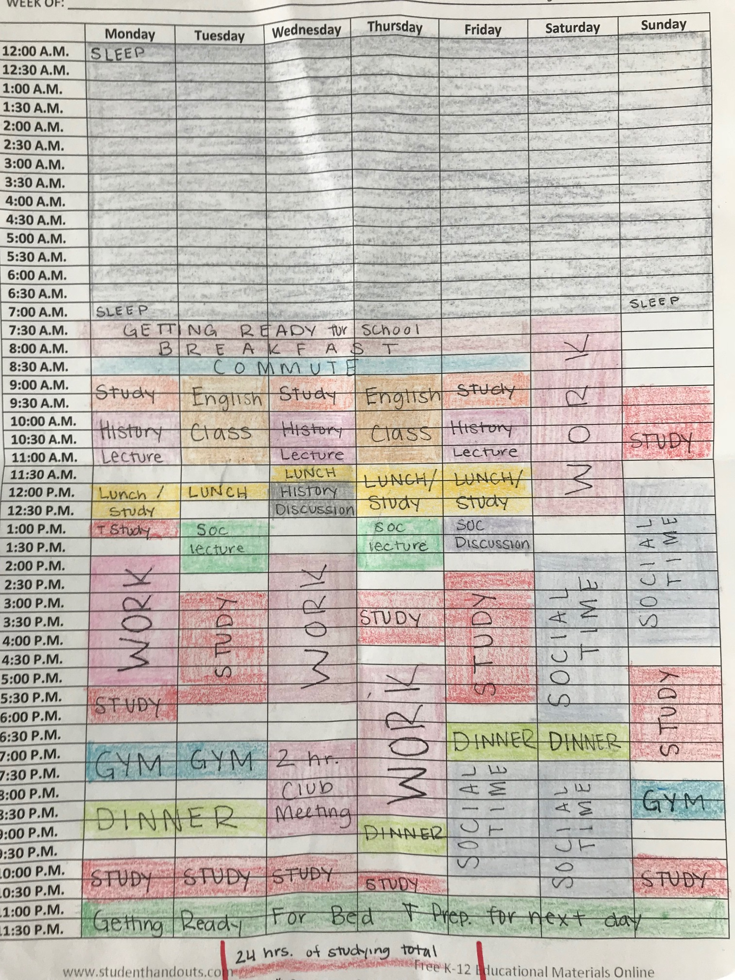
A week in the life
of a college student
Time Management Exercise:
History Lecture (1 hour class at same time on M/W/F)
History Discussion (1 hour class on Wed)
English Class (2 hour class at same time on T/Th)
Sociology Lecture (1.5 hour class at same time on T/Th)
Sociology Discussion (1 hour class on Fridays)
2 Hour Club Meeting 7pm on Wednesday
Gym (3 days per week for 1 hour)
Study for 26 hours of the week
Work for 15 hours per week
10 hours of planned social time
7.5 hours of sleep per week night
Breakfast, Lunch, Dinner
Getting Ready for School and Bed
Notes:
Time management is typically a struggle within the high school / family
College presents new challenges/higher stakes - expectation to manage free time for reading & assignments, work study, as well as when to exercise, eat, and socialize

Slide 16

Notes:
Traditional introduction to sexual health framed with prospective that regardless of personal choices, students will encounter individuals with different identities

Slide 17

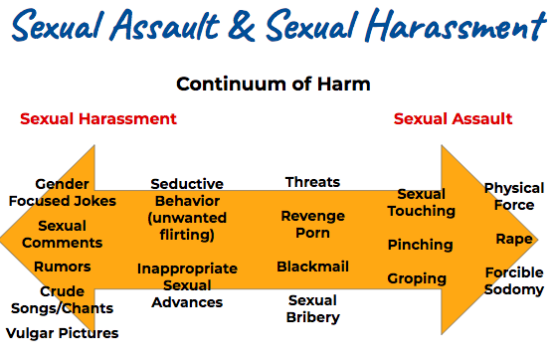
Discussion on: Effectiveness of Family Planning Methods, Legal Concerns, and STI transmission

Slide 18
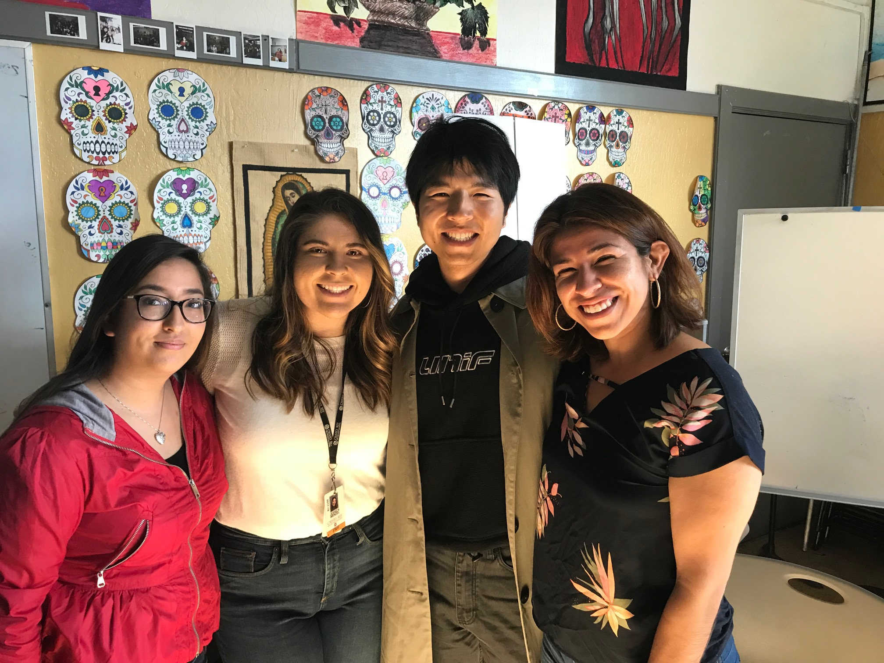
Diversity/Identity:
Why I Belong in College
Watch Movie: Dear White People
(3 days- introduction/discussion)
Extra credit for completing viewing guide
Current 1st Gen College student presentations
Students gave presentations to Class
Notes:
Preparing students to enter PWIs, identifying campus affinity group resources

Slide 19



Rubric:
Background Information
Marginalized/Privileged Identities
Fears of Being in College
Support Network

Slide 20


Methods of instruction
Make it interactive (e.g., role play)
Make it personal (use anecdotes or testimonials from alumni or other near-peers)
Bring in guests/experts
Notes:
Each day is different when it comes to these topics. These are some tips that have worked for our students.

Slide 21



Notes:
Our co-founder established a personal finance course at a high school serving first gen kids in East Palo Alto, CA. He hoped to use an off-the-shelf curriculum and when he didn’t find one that he was excited to teach he built his own 25 hour course. How? The way many of you do it today. Through Google Searches. Google as blessing and a curse: Blessing in that you have access to all the world’s information and curse because...you have access to all the world’s information. You know what happens when you hit SEARCH..It’s a Deluge of Resources coming at you...

Slide 22
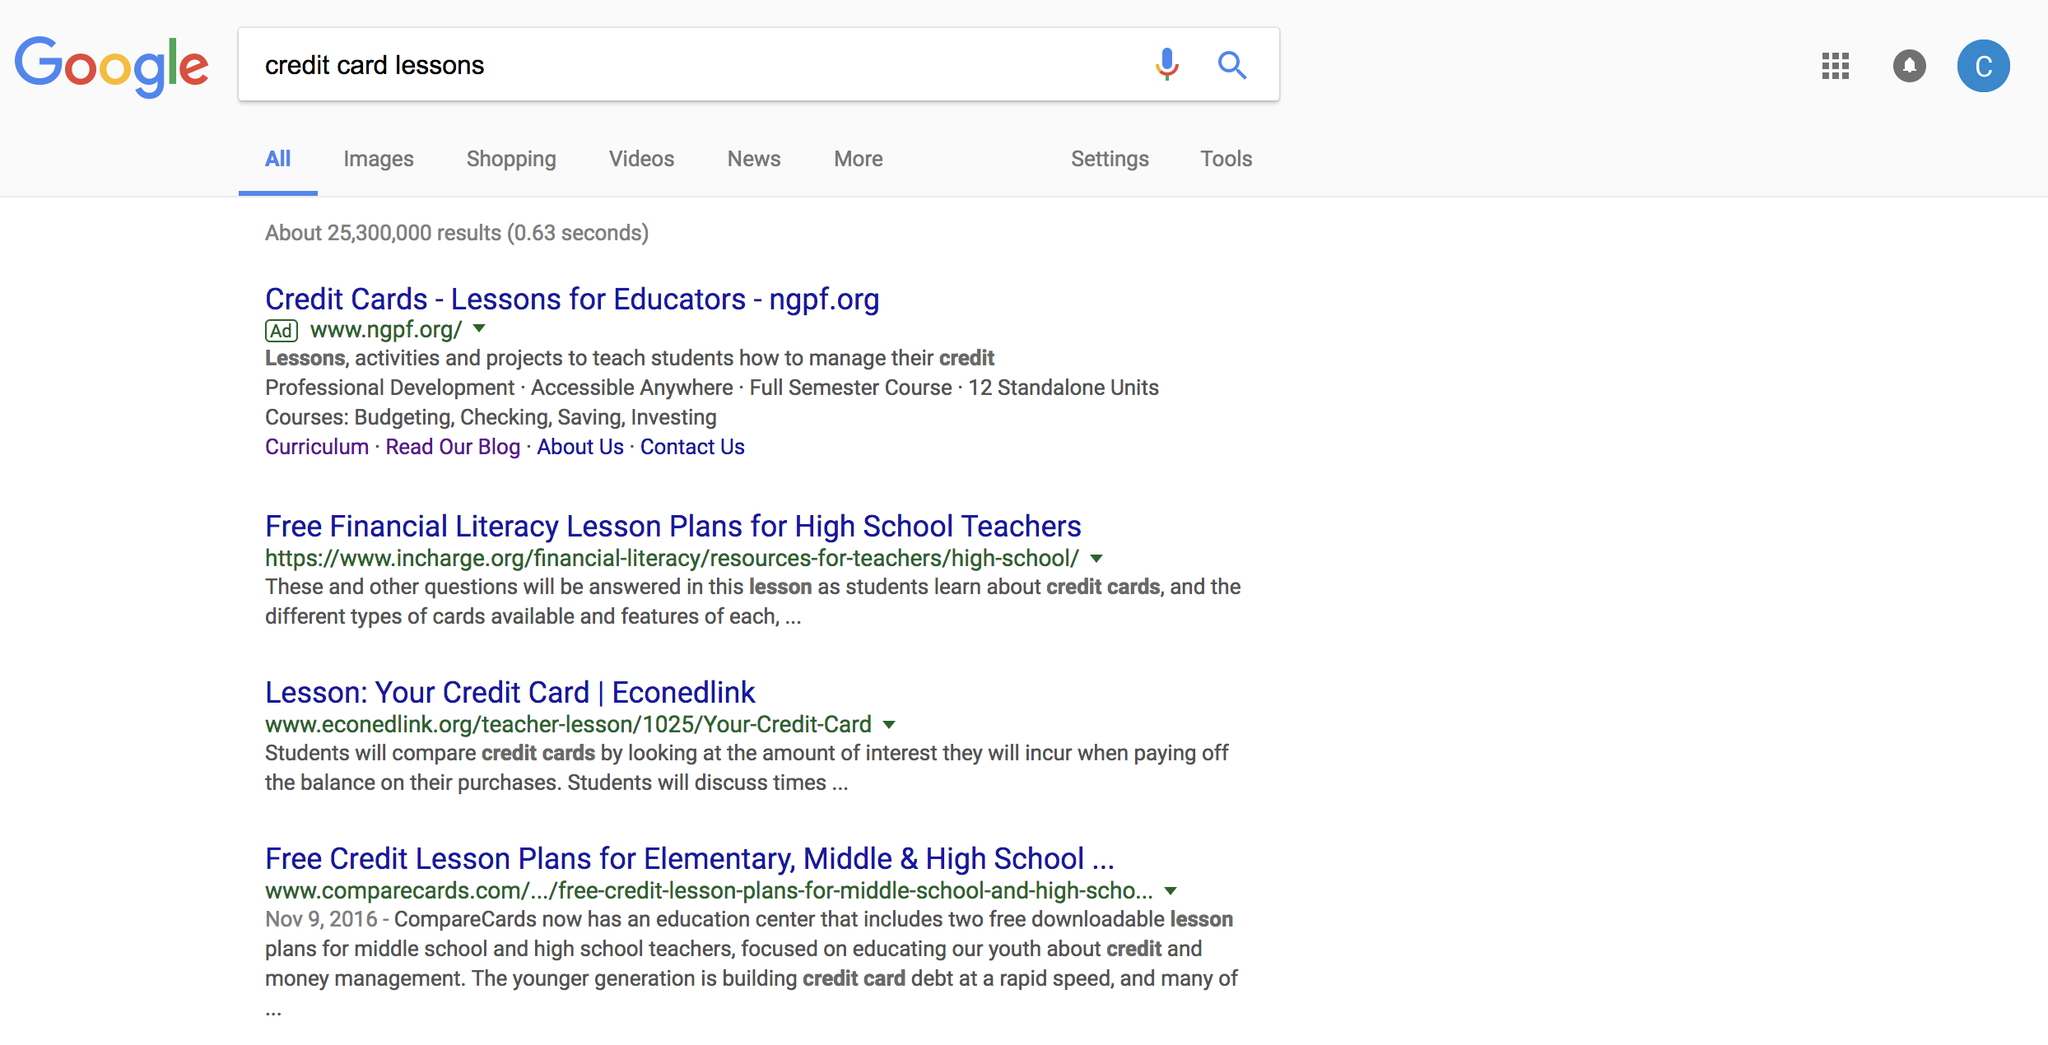
Google Search
Notes:
25.3 million in the case of credit card lessons. Yet buried within those millions of resources are some gems. Like video “how credit card debt is like a pitcher of water.” or an interactive that shows what something purchased with credit card debt will end up costing in the end. That experience teaching at Eastside Prep inspired our co-founder to build NGPF. He saw how all students engaged with this curriculum and also received emails from parents which showed how teaching students well can have a much broader impact beyond the classroom. His first hire, our co-founder, Jessica Endlich made this vision a reality.

Slide 23




COMPREHENSIVE
4 Cs
CUSTOMIZABLE
CURATED
CURRENT
Notes:
We started with a blank sheet of paper and engaged a core group of teacher advisers and and asked them what they wanted. Here’s what they told us which serves as foundational principles. It’s what we call our 4 Cs)....

Slide 24

FREE...and Always Will Be!
Notes:
One of our co-founders had some success as an entrepreneur and investor and has chosen to create an endowment to fund the organization. He has said “There is no better investment that I can make then helping the next generation develop the skills they need to improve their financial capability.” By not taking outside funding, we can focus on one thing: How can we support teachers to be the best that they can be in the classroom.

Slide 25

Notes:
Find some resources that you can use in your classroom immediately

Slide 26
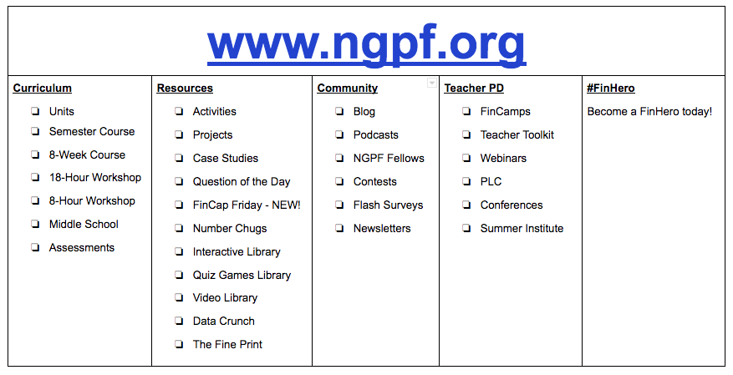
Navigate
Notes:
Slide matches format of our website. Work through Scavenger Hunt (18 questions) using this overview to help you. Create incentive for teachers to complete their Scavenger Hunt forms (anyone who gets at least 9 completed in drawing for $20 gift card). Model Data Crunch question to show teachers how to get around the website. Play music. Circulate around the room to answer questions, inquire, etc.

Slide 27
Contact us
Todd Hicks
Director of University Access and Success
Cristo Rey School San Jose Jesuit High School
todd.hicks@cristoreysj.org
Christian Sherrill
Director of Advocacy & BD
Next Gen Personal Finance
christian@ngpf.org
Anna Takahashi
Director of College Counseling
Eastside College Prep
annat@eastside.org

