Slide 1

The Future of Work:
Education for a Global Future
Angel B. Pérez, Ph.D.
Vice President for Enrollment and Student Success
Faculty in Educational Studies
@angelbperez
Notes:
Intro
Happy to Be Here
A little about me – dedicated my life to HE, areas I oversee, why I’m passionate about this work
But before I talk….

Slide 2
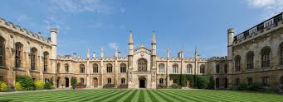
What is the Purpose of College or University?

Slide 3




What Did You Want to Be When You Grow Up?
1/3 of Jobs Your Generation Will Have Don’t Exist Yet
Notes:
Ask the Question
Then talk about me wanting to be a lawyer
Clearly different from what I am doing now
1/3rd of Jobs

Slide 4
The World of Work Is Rapidly Changing
By the time they are 38 years old, today’s students will have between 10 and 14 jobs
Only 27 percent of university graduates will work in the field of their major
“Work” is now a global endeavor
The change which employees have to adapt to is unprecedented
“Things are moving so fast that by the time my employees are done with a project, they usually can’t use the same strategies on the next one.”

Slide 5
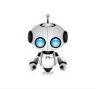
ROBOT-PROOF
Up to 50% of the Jobs Will Become Automated
Education Must Be a Life-Long Venture
Constant “Re-Tooling”
HUMANICS: Technical Ability, Data Literacy, Human Discipline
The Dawn of the robot age is an opportunity, not a threat.
Joseph Auon

Slide 6
Employee Expectations are Changing
“The purpose economy is defined by the quest for people to have more purpose in their lives. It is an economy where value lies in establishing purpose for employees and customers.”
Aaron Hurst, Author, “The Purpose Economy”
“Of all the events that can deeply engage people in their jobs, the single most important is making progress in meaningful work.”
- Teresa Amabile, Harvard Business School
Notes:
Then share stats: * between 31 million people between the ages of 44 and 70 want an encore career – unsatisfied
Study by Researcher at Stanford – 70% of all employees are dissatisfied with their jobs
The Millennials and generation Z have taken notice and they do not want to be the same way!

Slide 7
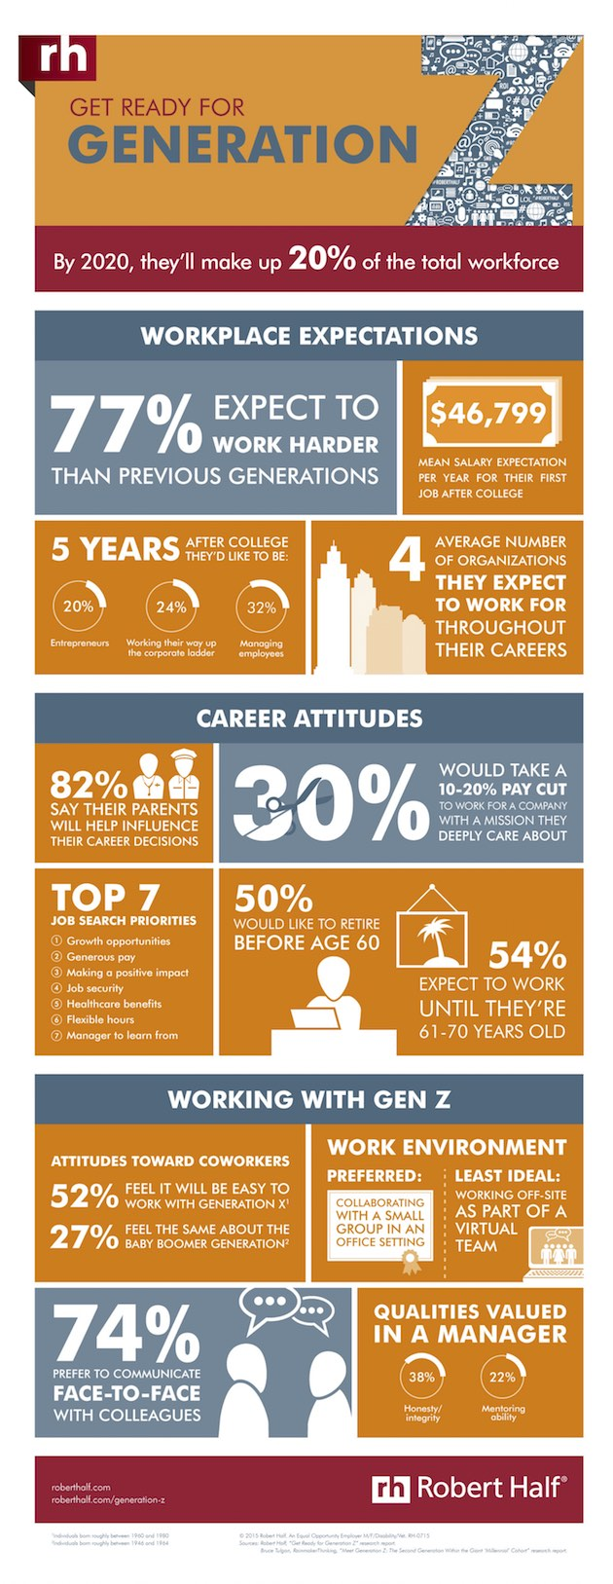
Purposeful Work Programs
Design Thinking Coursework
Reflection Advising
Notes:
Point out a few stats
Colleges are adapting:
Companies are adapting too: Conscious Capitalism: Twitter, Starbucks, Whole Foods, Google, Pepsi, Tata in India

Slide 8
How Do We Train an Entire Generation of Young People for Careers that Don’t Exist?

Slide 9
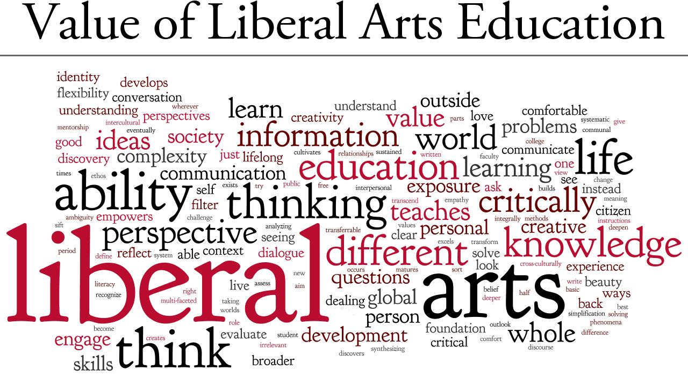
How Do We Prepare Students for the Future?
Notes:
History of Liberal Arts – what is it
Myths: It’s about arts, no science
Freeing of the Mind (artes liberales (it frees the mind)

Slide 10
What Does The Liberal Arts Teach?
Critical Thinking, Writing, Analyzing, Data, Quantitative, Communication
Study of human nature, societies, belief systems, and adaptability to change, Innovation
Sympathetic Imagination (Martha Nussbaum)
Global and Cultural Competency
Notes:
Global knowledge identified as key requirement from employer – including another language
Sympathetic Imagination “I never thought of it that way” My own classroom experiences

Slide 11
But…Technology!
“Creativity and Innovation Occur When Disciplines Cross”
- Fareed Zakaria, CNN Foreign Affairs Correspondent
“Facebook is as much psychology and sociology as it is technology.”
Mark Zuckerberg, Facebook
“A Liberal Education is not so much about learning to do a job, as it is about learning to learn and to love learning.”
Scott Harley
“In many cases, technology will not replace human workers. It will liberate people to spent more time on aspects of work that require human skills, such as complex problem solving.”
- Scott Harley

Slide 13
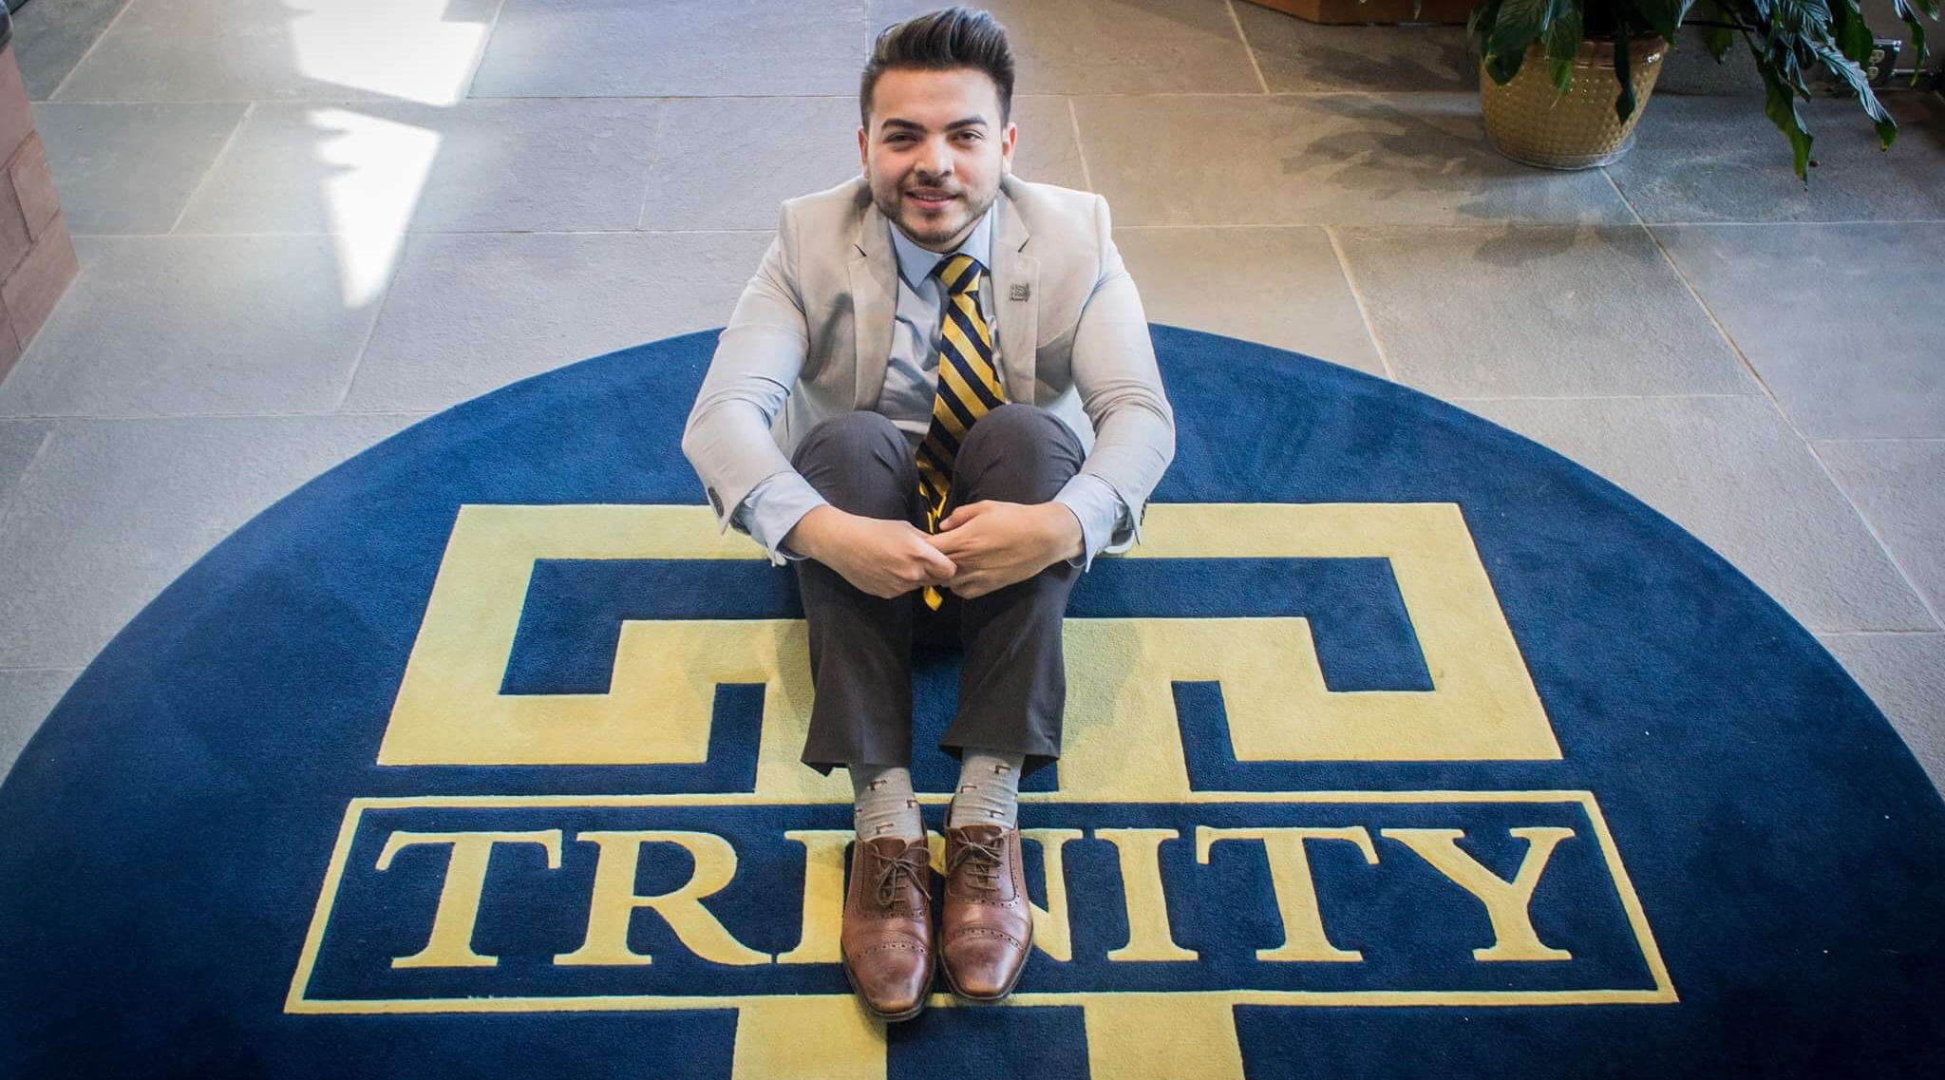
Henry Chavez

Slide 14
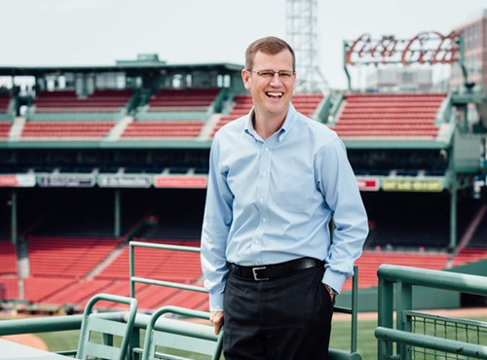
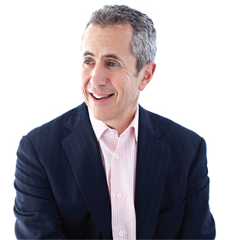

Slide 15
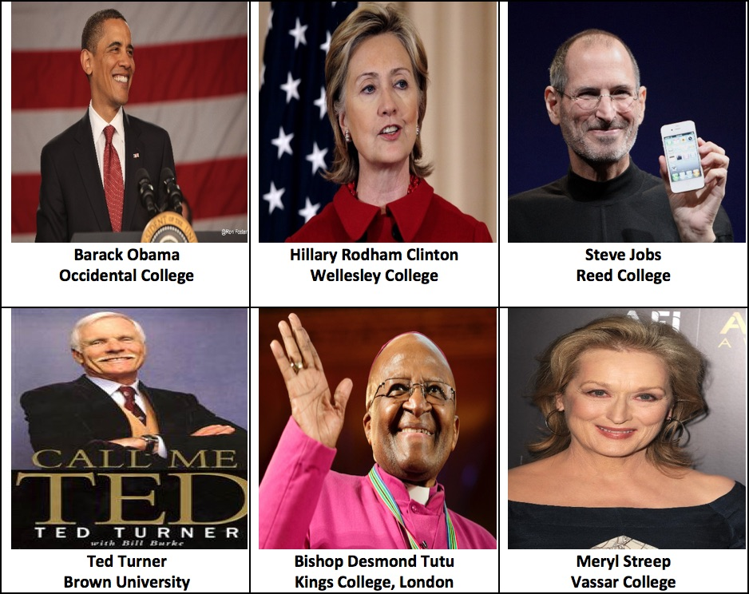
Famous Liberal Arts Graduates

Slide 16
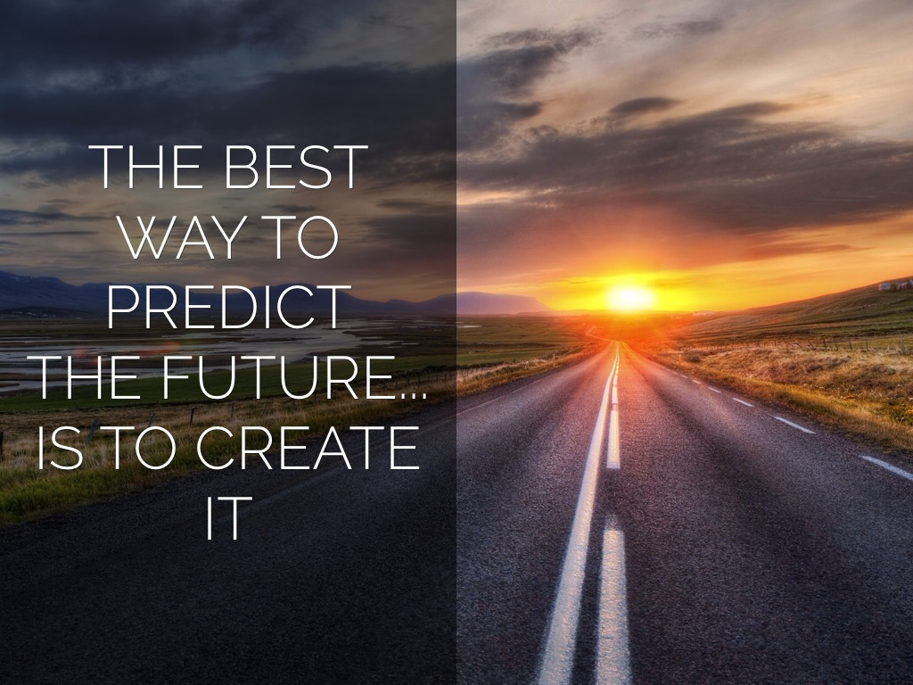

Slide 17
Contact
Angel B. Pérez, Ph.D.
Vice President for Enrollment and Student Success
Faculty in Educational Studies
www.angelbperez.com
Angel.perez@trincoll.edu
@angelbperez

