Slide 1
CTCL - How Can We Help You Help Students and Families?

Slide 2
Welcome
500
No magic wand

Slide 3
What’s this session about again?
No sciences? No jobs? Too much debt? The liberal arts are being talked about... and not always in a good way. This session will give counselors tangible takeaways to help students and parents see the value in this type of college or university. The session will offer examples of research and articles that can help counselors encourage students to expand their search criteria and to counter their students' and parents' struggle with getting beyond the usual list of highly visible schools to create a list that reflects the student's talents, needs, and loves. Samples will include data from Colleges That Change Lives member schools and other small, liberal arts schools.

Slide 4
Challenges You Probably Commonly Face…
Students’ and parents’ inability to look beyond USNWR, SEC, Ivy, PAC 10 schools, Ucs, land-grant publics.
Concern about return on investment
“Those schools are too small.”
“How can you do science at a liberal arts school?”
These schools are only for liberals.
No one has heard of these schools. No one. Anywhere. Ever.

Slide 5
Ideas on how to push back…
Reading USNWR data
Peer assessment (20%)
Faculty Resources (20%)
Selectivity (10%)
Financial Resources (10%)
Graduation Rate Performance (8%)
Alumni Giving (5%)
Graduation and Retention Rate (22%)
Social Mobility 5%
Are these the important values for your family?

Slide 6
Gallup-Purdue Index
Gallup-Purdue Index 2015 report is based on a Web survey of more than 30,000 graduates from across the U.S. with a bachelor's degree or higher and with Internet access. http://www.gallup.com/services/185924/gallup-purdue-index-2015-report.aspx

Slide 7
What about those name-brand schools?
"Our survey clearly indicated that it wasn't so much where you go to college as much as it is how you go to college — what you extract from the campus experience. Students and their families are making a significant investment in college, and it should be done with eyes wide open.“ – Mitch Daniels, President, Purdue University

Slide 8
What were they trying to understand?
“Do U.S. universities provide students with opportunities and experiences equal to increasing college fees? Do students graduate well-equipped to find good jobs and prosper financially as well as pursue their passions and lead healthy, fulfilling lives?”

Slide 9
1) Do specific undergraduate experiences matter more to alumni’s overall impression of their alma mater, and which most consistently relate to positive outcomes such as high well-being and workplace engagement after graduation? 2) Do alumni from different types of schools (for example, public vs. private, research-intensive universities vs. others) hold consistently different views of their college experience?

Slide 10
Fear of the unknown…
“The type of school alumni went to — public or private, small or large, very selective or less selective — was far less likely to be related to the quality of alumni’s lives after they graduated than specific experiences they had in college.”

Slide 11
How to address some of the ROI issues
The odds of strongly agreeing education was worth the cost are: 1.9x Higher if ... My professors at [University Name] cared about me as a person. 1.9x Higher if ... I had a mentor who encouraged me to pursue my goals & dreams. 1.8x Higher if ... I had at least one professor at [University Name] who made me excited about learning. 1.6x Higher if ... I worked on a project that took a semester or more to complete. 1.6x Higher if ... I was extremely active in extracurricular activities and organizations while attending [University Name]. 1.5x Higher if ... I had an internship or job that allowed me to apply what I was learning in the classroom.

Slide 12
Does the experience at school X seem likely to offer these results? Questions to ask.
Do professors care about individual students? Is mentoring valued and considered in the tenure process?
How does the school talk about mentoring?
Are the faculty excited about teaching? About teaching undergrads?
Long-term collaborative work – do they mention this type of experience and partnerships between students and faculty? Is research and collaborative work available to many or to just a select few? When?
Do students get involved on campus and in the community?
How does the school support internships?
Are there opportunities for leadership? And not just for “that stellar student.”
Do they have frats and sororities? How do they factor into campus life?
How many students do a paid internship or have a job?

Slide 13
National Survey of Student Engagement (NSSE)
What does NSSE do? Through its student survey, The College Student Report, NSSE annually collects information at hundreds of four-year colleges and universities about first-year and senior students' participation in programs and activities that institutions provide for their learning and personal development. The results provide an estimate of how undergraduates spend their time and what they gain from attending college.
NSSE provides participating institutions a variety of reports that compare their students' responses with those of students at self-selected groups of comparison institutions. Comparisons are available for ten Engagement Indicators, six High-Impact Practices, and all individual survey questions. Each November, NSSE also publishes its Annual Results, which reports topical research and trends in student engagement results. NSSE researchers also present and publish research findings throughout the year.

Slide 14
School Participation
Participating Institutions: 560 colleges and universities participated in NSSE 2016. Over 1,600 have participated since 2000.
Student Participation: 322,582 students completed NSSE in 2016. Approximately 5.5 million students have completed the survey since 2000.
Not all schools participate every year.
In 2017, 20 of the 45 CTCL-member schools participated.

Slide 15
Which “educationally effective practices” does NSSE address?
Student-faculty contact
Active learning
Prompt feedback
Time on task
High expectations
Cooperation among students
Respect for diverse talents and ways of learning

Slide 16
NSSE Benchmarks
Level of academic challenge
Active and collaborative learning
Student-faculty interaction
Enriching educational experiences
Supportive campus environment

Slide 17
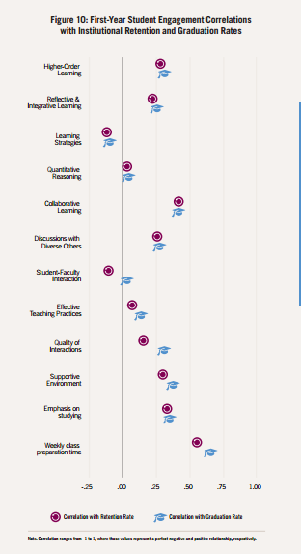
First-year Student Engagement Correlations with Institutional Retention and Graduation Rates

Slide 18
http://nsse.indiana.edu/NSSE_2016_Results/pdf/NSSE_2016_Annual_Results.pdf#page=14

Slide 19
Other important outcomes (using CTCL schools as a sample group)
Fulbright Scholars – 42 in 2019
Watson Fellowships – 6 in 2018
Gilman Scholars – 32 in 2018-19
Why does this matter to you and your families?
CTCL-member colleges and many other small, liberal arts schools are still inclusive in their admission. The average admission rate to these colleges and universities is ~65%.
This is also the national average for four-year colleges and universities.

Slide 20
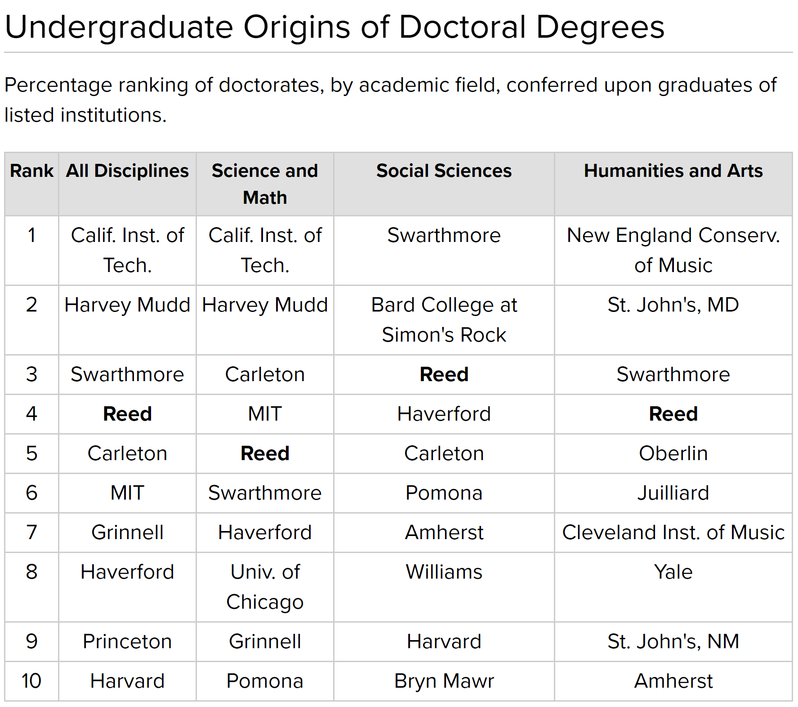
Great Data Set

Slide 21
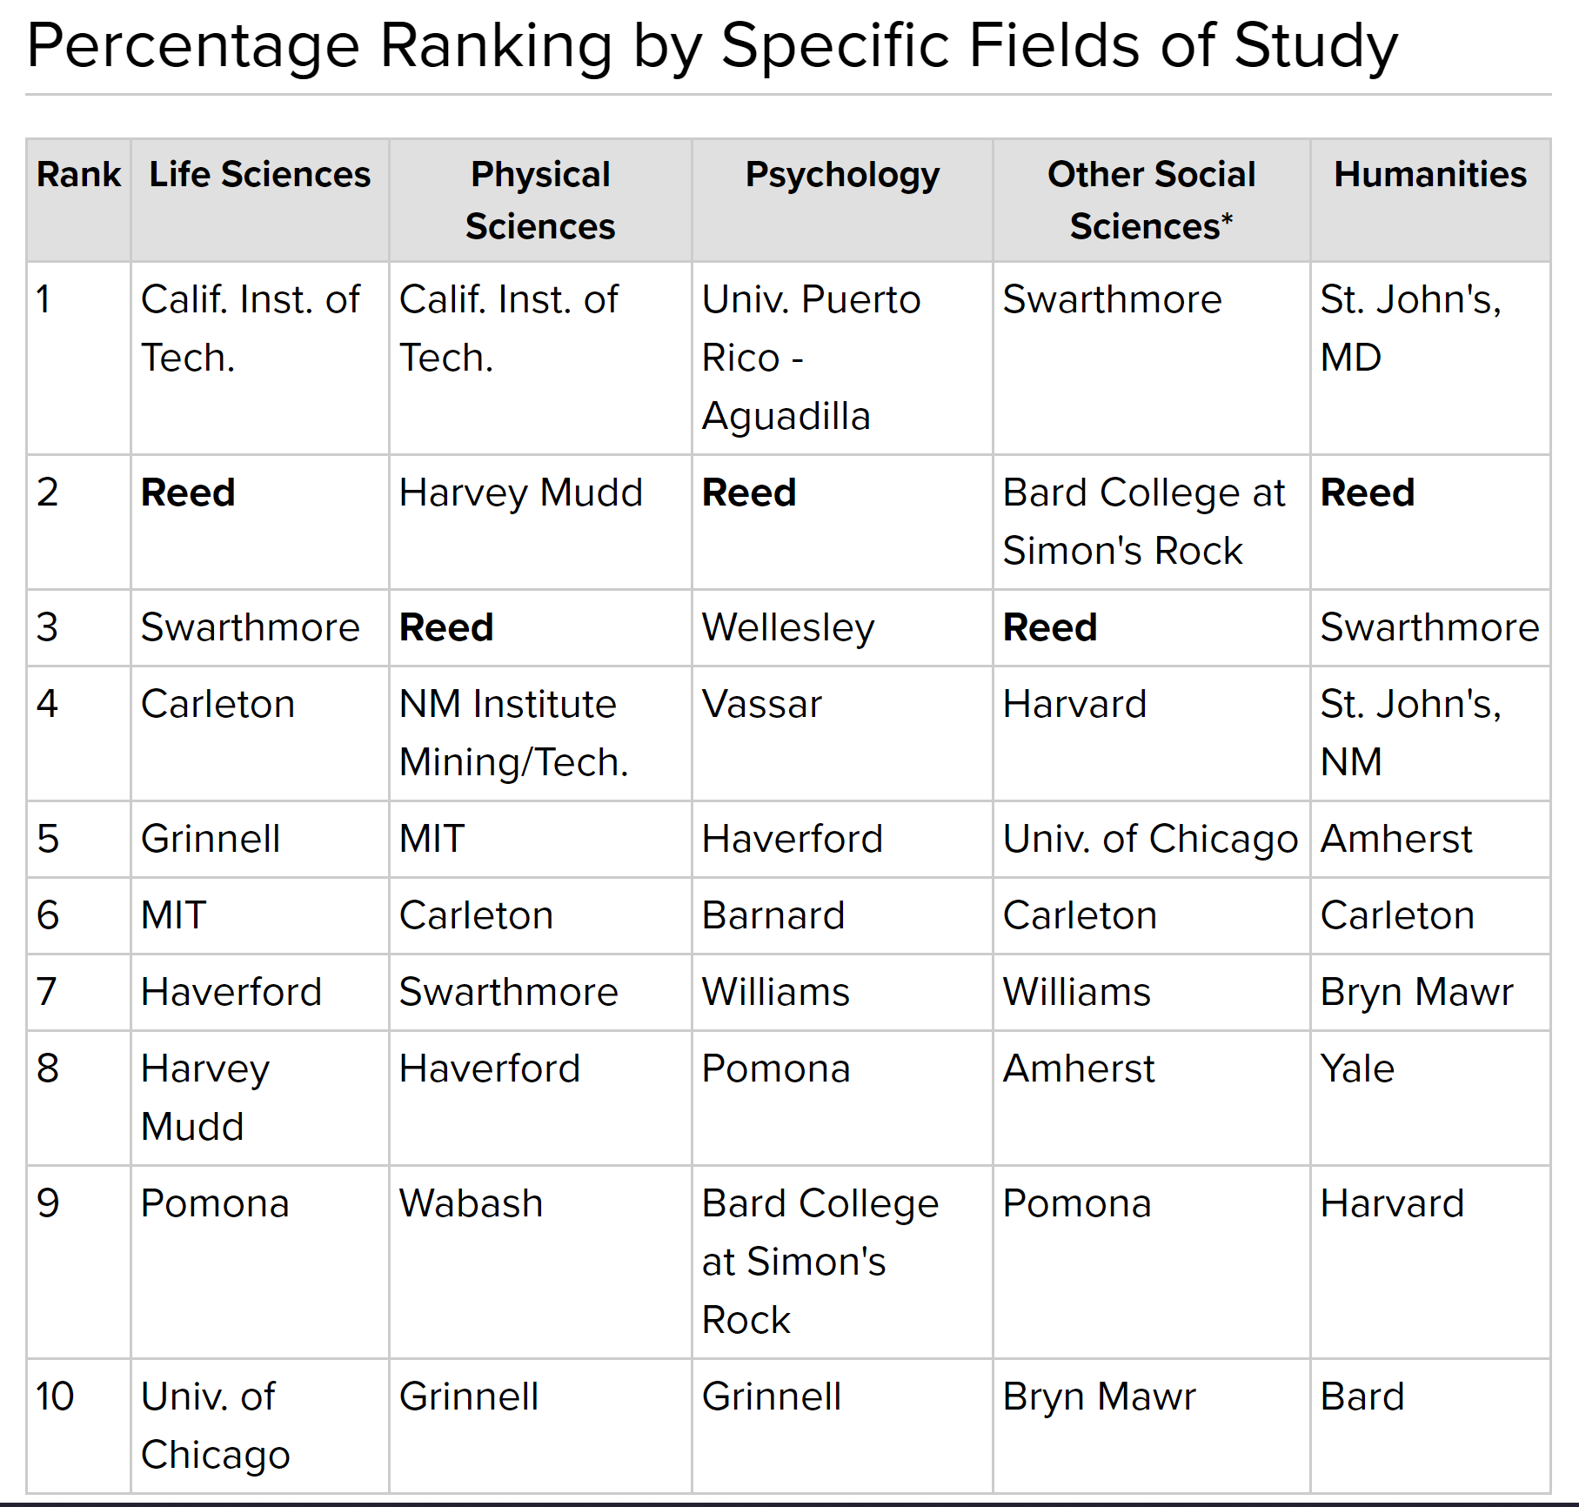
More Great Data https://www.reed.edu/ir/phd.html

Slide 22
Liberal Arts Education… Education for a Lifetime
Skills for lifetime of work in jobs that don’t exist yet.
Creative thinking
Collaborative work
Interdisciplinary thinking
Leadership (many types) and the ability to follow
Communication skills (in person, in writing, one-on-one, small group, large group)
Data analysis
Creative problem solving

Slide 23
Liberal Arts Education… Education for a Lifetime
“the No. 1 thing we look for is general cognitive ability, and it’s not I.Q. It’s learning ability. It’s the ability to process on the fly. It’s the ability to pull together disparate bits of information.”
“leadership — in particular emergent leadership as opposed to traditional leadership. Traditional leadership is, were you president of the chess club? Were you vice president of sales? How quickly did you get there? We don’t care. What we care about is, when faced with a problem and you’re a member of a team, do you, at the appropriate time, step in and lead. And just as critically, do you step back and stop leading, do you let someone else? Because what’s critical to be an effective leader in this environment is you have to be willing to relinquish power.”

Slide 24
More…
“It’s feeling the sense of responsibility, the sense of ownership, to step in,” he said, to try to solve any problem — and the humility to step back and embrace the better ideas of others.”
“what we’ve seen is that the people who are the most successful here, who we want to hire, will have a fierce position. They’ll argue like hell. They’ll be zealots about their point of view. But then you say, ‘here’s a new fact,’ and they’ll go, ‘Oh, well, that changes things; you’re right.’ ”
Lazlo Bock, former senior vice president of people operations for Google
http://www.nytimes.com/2014/02/23/opinion/sunday/friedman-how-to-get-a-job-at-google.html

Slide 25
Marathon, not a sprint
“Humanities and social sciences students, for example, make 84% as much as professional and pre-professional students like nurses and criminologists at ages 21-25—but they pull in about $2,000 more during their peak earning years from 56-60 ($66,185 compared with $64,149).”
http://blogs.wsj.com/atwork/2014/01/22/liberal-arts-salaries-are-a-marathon-not-a-sprint/
We are a culture of here and now, which makes “selling” a liberal arts education at a small school challenging. We are also a culture fascinated by name-brand items, and we struggle with lesser known anything, especially a financial commitment like college tuition.
However, liberal arts skills serve well in a changing market when the jobs these students have may not yet exist.

Slide 26
Real Life Examples (aka links you can share with the skeptics)
Agnes Scott College
https://agnesscott.edu/academics/majors-minors/gems-program/index.html
Check out the GEMS program (Generating Excellence in Math and Science)
Allegheny College
http://sites.allegheny.edu/news/2017/02/03/allegheny-senior-awarded-grant-for-environmental-research/
Senior Alexandrea Rice received a Davey Foundation Annual Arbor Grant for her work in eco-friendly research.
Antioch College
http://co-op.antiochcollege.edu/why-are-babies-born-when-we-want-to-be-asleep/
Antiochans spend ⅓ of their time in co-op experiences like Cecilia Kouba ‘19 (Advent Midwifery)

Slide 27
Austin College
http://www.austincollege.edu/austin-college-presents-student-scholarship-conference/
Check out the research at Austin College’s Student Scholarship Conference.
Beloit College
https://www.beloit.edu/academics/preprofprgms/
Beloit College offers a cooperative program with the Nicholas School of the Environment at Duke University that leads to the Master of Forestry (M.F.) or Master of Environmental Management (M.E.M.) degree.
Birmingham-Southern College
http://bsc.edu/academics/krulak/rise3/index.cfm
Explore. Experience. Excel. Rise3 at Birmingham-Southern College
Centre College
http://www.centre.edu/centre-college-professor-student-teach-experimental-sessions-italy/
Student and faculty co-teach a summer course in Italy
Clark University
http://www.clarku.edu/articles/sarah-wells-17-perceives-poetry-physics
Physics + English? Of course.

Slide 28
Cornell College
http://news.cornellcollege.edu/2017/04/xu-13-receives-national-podiatric-student-award/
Two first-author papers and an award for Outstanding Professional Conduct -- a great finish to podiatry school for for Dixon Xu ’13.
Denison University
http://denison.edu/feature/91172
What have chemistry and biochemistry students been up to? A lot.
Earlham College
http://tinyurl.com/grboqta
Alumna Margaret Hamilton '58, a NASA pioneer, will be a LEGO figurine!!! LEGO!
Eckerd College
https://www.eckerd.edu/academics/really-excel/
Freshman Research Awards offer $1,000 stipend for research with faculty in the first year.
Emory & Henry College
http://www.ehc.edu/academics/research/
Great student research projects at Emory & Henry College.

Slide 29
The Evergreen State College
http://evergreen.edu/magazine/winter-2017/evergreen-grad-begin-work-astronomical-importance
Nate Gilman ’10, MES ’13, serves as operations officer on the NOAA ship Pisces, which monitors reef populations along the East Coast.
Goucher College
http://www.goucher.edu/academics/mathematics/opportunities-and-internships
Great list of internships directly applicable to math majors.
Guilford College
http://www.guilford.edu/academics/after-guilford/index.aspx
Easy information on examples of life after Guilford.
Hampshire College
https://www.hampshire.edu/news/2017/01/19/dean-couperus-creating-national-model-for-teaching-brain-imaging
A $600,000 National Science Foundation grant was awarded to a team including Jane Couperus, dean of the School of Cognitive Science and associate professor of developmental cognitive neuroscience
Hendrix College
https://www.hendrix.edu/news/news.aspx?id=82701
Hendrix biology faculty and students travel to Belize to review students’ research.

Slide 30
Hillsdale College
https://www.hillsdale.edu/hillsdale-blog/academics/classical-liberal-arts/study-physics-within-liberal-arts/?hootPostID=ff9dcd73656d00460a952e1da69a2ea5
Physics + liberals arts? Yes! Just ask assistant professor Paul Hosmer
Hiram College
http://www.hiram.edu/hiram-news/hiram-college-offers-new-public-health-degree-program/
Hiram College recently announced a major and minor in public health.
Hope College
http://www.hope.edu/academic/hhmi/
The Hope College HHMI program encourages students to become researchers in STEM fields.
Juniata College
http://tinyurl.com/k87sacq
Juniata College geology students are part of a research team looking for abandoned lead mines from the 1770s.
Kalamazoo College
http://www.kzoo.edu/news/katmicwic/
Seven Kalamazoo College computer science students traveled with professors Alyce Brady and Pam Cutter to the 6th Biennial Michigan Celebration of Women in Computing (MICWIC).

Slide 31
Knox College
https://www.knox.edu/news/knox-students-navigate-research-at-sea
Two Knox students recently completed the Sea Semester program.
Lawrence University
http://www.lawrence.edu/admissions/why/life_after_lawrence/node/10256
Lawrence University → Facebook
Lynchburg College
http://tinyurl.com/lvj2yx5
Computer science major, theater minor, virtual reality game designer
Marlboro College
https://www.marlboro.edu/news/story/4859
Great examples of grant-supported student-faculty collaboration at Marlboro College.
McDaniel College
http://tinyurl.com/jxukhst
Pre-med students can study abroad. (And graduate in four years.)

Slide 32
Millsaps College
http://www.millsaps.edu/major-happenings/major-news/posts/2017-nsf-grant-awarded-millsaps-college-professor.html
Professor George Bey PhD and 2 others have received an NSF grant for $286,000 for collaborative research in Mexico.
New College of Florida
https://m.youtube.com/watch?v=v6FciHypAeQ
What’s happening in chemistry at New College of Florida? Plenty, thanks for asking.
Ohio Wesleyan University
https://www.owu.edu/news-media/details/memory-studies-in-tanzania/
Amanda Barry ’17, Biology and Psychology, Theory-to-Practice Grant, “Exploring the Prevalence and Perceptions of Dementia in a Rural Community in Tanzania”
Reed College
http://www.reed.edu/reed_magazine/march2017/articles/features/object-of-study-zebrafish.html
Zebrafish. Check ‘em out.
Rhodes College
https://www.rhodes.edu/stories/urban-forestry-fellows-win-first-place-old-forest-research
Urban Forestry Fellows Helen Hope ’18, Ethan Williford ’17, and Mac Wilson ’17 -- 1st place for their research poster about the Old Forest at Rhodes

Slide 33
Southwestern University
http://www.southwestern.edu/departments/kinesiology/index.php
Southwestern offers a major or minor in kinesiology.
St. John’s College
https://www.sjc.edu/news/conservation-prairie
Julia Berggren Leone ‘12 recently received a National Science Foundation Graduate Research Fellowship.
St. Mary’s College of California
https://www.youtube.com/watch?v=KiKeCw7EyEw&t=36s
Student/faculty collaboration makes the difference.
St. Olaf College
http://wp.stolaf.edu/blog/st-olaf-alumna-awarded-luce-scholarship/
Alumna Corey Ruder '16 was selected for the Luce Scholars Program. Oh, and she is working on a PhD at UW.
University of Puget Sound
https://www.pugetsound.edu/news-and-events/campus-news/details/1558/
#1 in Washington state for grads’ employment
Ursinus College
https://www.ursinus.edu/live/news/2160-ursinus-senior-awarded-prestigious-nsf-graduate
Jenna Pellegrino ’17 earned a National Science Foundation Graduate Research Fellowship. UCSF here she comes!

Slide 34
Wabash College
https://wabash.edu/plus/health
Check out the Wabash Global Health Initiative
Wheaton College (IL)
http://www.wheaton.edu/Student-Life/My-Wheaton/2017/02/The-Study-of-Creation
Art and biology, naturally
Whitman College
https://www.whitman.edu/newsroom/computer-science
Whitman’s new computer science major starts fall 2017.
Willamette University
http://willamette.edu/news/library/2017/03/science-grant-griffith.html
Assistant Professor of Chemistry David Griffith received a $325,157 National Science Foundation grant to investigate the chemical factors that control halogenated estrogen.
College of Wooster
http://www.wooster.edu/about/student/onitsuka/
Sara Onitsuka ‘17, neuroscience major and social activist

Slide 35
CTCL, Inc is a non-profit organization 501(c)(3).
CTCL is dedicated to the advancement and support of student-centered college admission process. We support the goal of each student finding a college that develops a lifelong love of learning and provides the foundation for a successful and fulfilling life beyond college.
www.ctcl.org

Slide 36
CTCL, the non-profit
Push back on the media frenzy about college admission
Help de-stress students and families
Help students and families see beyond the rankings
Speak to the quality and long-term benefits of a liberal arts education
Support the recruitment efforts of the member colleges

Slide 37
CTCL Colleges
2 Public; 43 Private Colleges & Universities
Representing 26 states
Average enrollment ~1,520

Slide 38
CTCL Colleges *public colleges
Agnes Scott Allegheny
Antioch
Austin
Bard
Beloit
Birmingham-Southern
Centre
Clark
Cornell
Denison
Earlham
Eckerd
Emory & Henry Evergreen State*
Goucher
Guilford
Hampshire
Hendrix
Hillsdale
Hiram Hope Juniata
Kalamazoo
Knox
Lawrence
Lynchburg
Marlboro
McDaniel
Millsaps
New College of Florida * Ohio Wesleyan
Puget Sound
Reed Rhodes St. John’s (MD/NM)
Saint Mary’s of CA
St. Olaf Southwestern Ursinus Wabash Wheaton (IL) Whitman
Willamette
Wooster

Slide 39
Highlights of the History of Colleges That Change Lives
1996 Publication of first version of the book
1998 First collaborative work done by the colleges
2006 Last revision by the original author, Loren Pope
2006 Establishment of the 503(C)(3) non-profit, Colleges That Change Lives – 40 founding colleges
2012 Fourth revision of the book by Hilary Masel Oswald – addition of 4 colleges
2015 Establishment of CTCL Scholarship ($1,000/year, renewable)
2018 Bard College joins non-profit organization
2019 SLC Presentation

Slide 40
Upcoming 2019 Programs
Albuquerque ▪ Atlanta ▪ Austin ▪ Boston ▪ Chicago
Dallas ▪ Denver ▪ Houston
Los Angeles ▪ Marin County, CA ▪ Minneapolis/St Paul
New York City ▪ Portland, OR ▪ San Diego ▪ San Jose
Scottsdale ▪ Seattle ▪ St. Louis ▪ Troy, MI
Washington, DC
Upcoming 2019 Counselor Roundtable Events
New York City ▪ Chicagoland ▪ San Jose ▪ Dallas

Slide 41
Maria Furtado
Executive Director
maria.furtado@ctcl.org
Follow us on Facebook
Colleges That Change Lives
Twitter
#CTCLColleges
Instagram
#CTCLColleges

