Slide 1


Welcome to the 2019-20 AP® School Year
February 2019

Slide 2

Discussion Topics
Changes to registration
Data on student outcomes
Fees
Actions for the school community
Tools for AP teachers
Tools for AP coordinators
Next steps
2

Slide 3
Every AP® student deserves the chance to earn college credit, but not all pursue it.
So what stands in their way?
3

Slide 4
Nearly all students start the year
with high expectations for themselves...
Spring: Percentage who actually took the AP Exam
Fall: Percentage intending to take
the AP Exam
96%
93%
75%
58%
White Male
African American Female
...but confidence erodes over the course of the year.
4

Slide 5


Fall Registration
More than half of AP schools already have fall registration.
Registration

Slide 6
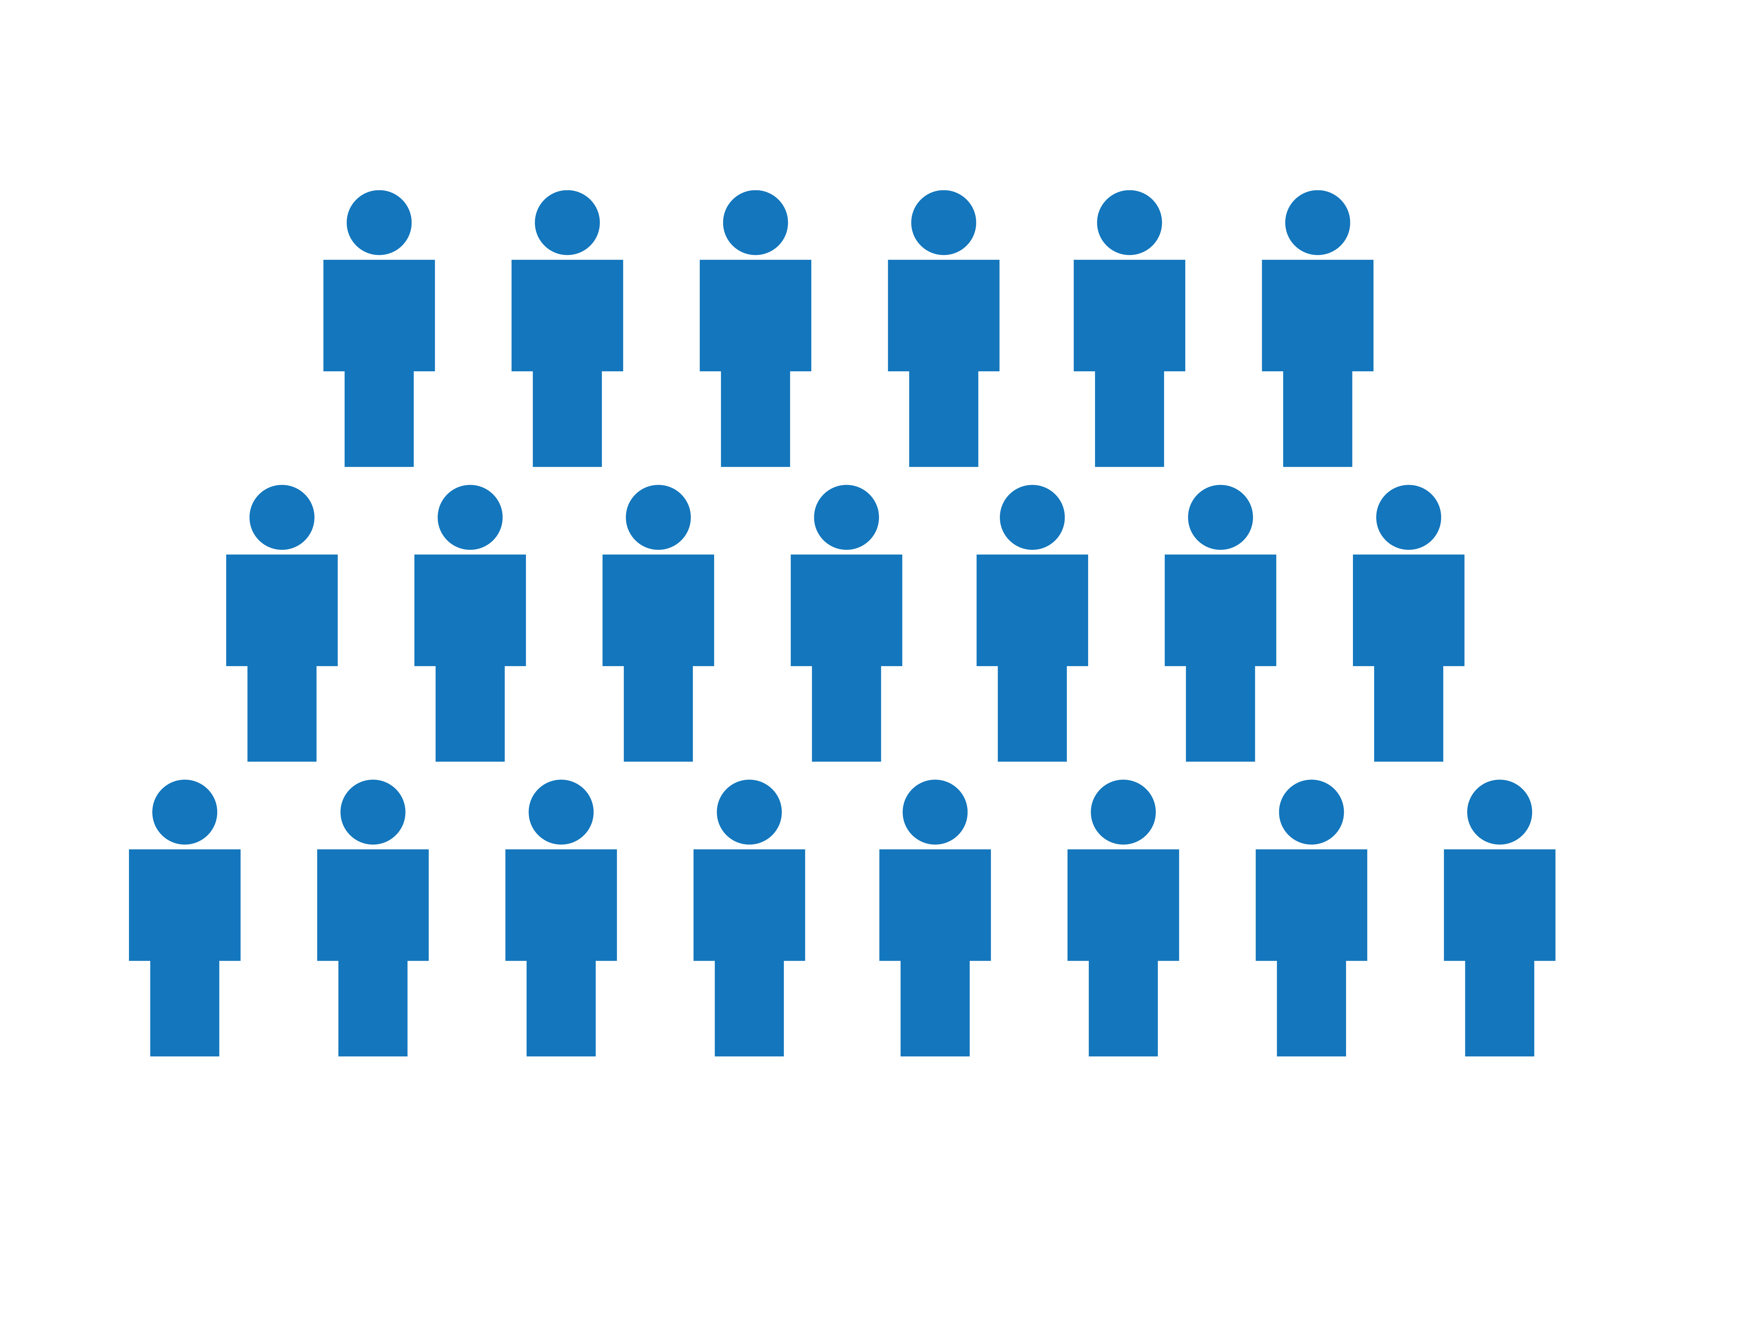

Fall Registration
Putting fall registration into practice
In the 2017-18 school year, we instituted fall exam registration in schools that displayed historically higher-than-average rates of AP students opting out of the exam.
40,000⁺
students
100⁺
schools
What happened next?

Slide 7
Fall Registration
Student participation increased.
AP Exam Takers
33,279
29,335
+13%
26,943
+9%
2016 Admin
Spring Registration
2017 Admin
Spring Registration
2018 Admin
Fall Registration

Slide 8
Fall Registration
More students earned scores of 3+.
AP Exams Taken by Low-Income Students: Scores of 3+
4,468
3,726
+20%
3,363
+11%
2016 Admin
Spring Registration
2017 Admin
Spring
Registration
2018 Admin
Fall
Registration

Slide 9
Fall Registration
Scores of 3+ increased across student groups.
Race/Ethnicity
Socioeconomic
STEM
+20%
+14%
+12%
+5%
+5%
+4%
White and Asian students
Moderate/high-income students
Male STEM students
Underrepresented
minority students
Female STEM students
Low-income students

Slide 10
Fall Registration
Expanding fall registration
In the 2018-19 school year, we expanded the number of schools that implemented fall registration.
180,000⁺
students
800⁺
schools
What’s happening now?

Slide 11
Fall Registration
Student participation accelerated.
Overall growth in AP Exams taken/ordered
+7.7%
~4x
+1.9%
2017-18
growth
in exams taken
2019 exams ordered to date vs. 2018 exams taken

Slide 12
Fall Registration
More students participated.
Growth in AP Exams taken/ordered:
White and Asian students
Growth in AP Exams taken/ordered:
Underrepresented minority students
+14.2%
~6x
+4.4%
~3x
+2.4%
+1.6%
2017-18
growth in exams taken
2019 exams ordered to date vs. 2018 exams taken
2017-18
growth in exams taken
2019 exams ordered to date vs. 2018 exams taken

Slide 13
Fall Registration
Students were more engaged.
Growth in AP Exams taken/ordered: Moderate/high-income students
Growth in AP Exams taken/ordered:
Low-income students
+9.0%
+7.3%
~3x
~10%
+2.7%
2017-18
growth in exams taken
2019 exams ordered to date vs. 2018 exams taken
-0.7%
2019 exams ordered to date vs. 2018 exams taken
2017-18
growth in exams taken

Slide 14
Fall registration dramatically accelerates equity and access. In just one year of fall registration, schools sped up the work of AP equity – the share of AP exam registrations for students of color – by seven years.

Slide 15

Fall Registration
“Although I had my doubts . . .
[the] result was that the students stayed engaged in
the subject through the spring semester. In the past,
students who were not signed up for the exam tended
to lose focus towards the end of the school year.”
— AP Teacher, 2017-18 Pilot

Slide 16
Fall Registration
“It's definitely been a constant reminder that I'm taking an AP class. I'm here to do work and I'm here to make sure that work is shown.”
— AP Student, 2017-18 Pilot

Slide 17
The results are clear.
Leaving exam registration in the spring
ignores the clear benefits of committing early. That’s why we’re moving it to the fall.

Slide 18
Fall Registration
AP Exam Fees: The base exam fee
is not changing.
Fall Registration
No additional fee
Late Registration
+$40
Unused/Canceled
$40
What’s new?
There will be a $40 fee for late exam registrations
and unused or canceled exams.

Slide 19
Supporting student success
Students are more likely to stay engaged in class and tackle challenging topics head-on when they register in the fall. Fees for late registration and exam cancellation have helped teachers create a classroom culture where students are “all in.”

Slide 20
Fall Registration
Exam fees for 2019-20
Description Cost/exam
Fall registration | Exam ordered by Nov. 15 | $94
Late registration | Ordered Nov. 16 – March 13 | $94 + $40 fee
Unused/ canceled exam | Exam that is canceled or not taken by the student | $40 fee
As a best practice – have all students register for each class section in the new AP system by October 4

Slide 21
Actions for the school community
1
2
3
4
Coordinators activate the
online system.
Before School Year
Coordinators or Teachers
create online sections and generate join codes.
Before School Year
Students
use a College Board account and join code to enroll in a section.
Start of School Year
Coordinators
submit an order.
October/November

Slide 22
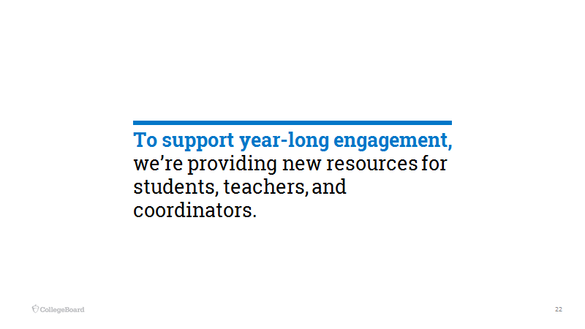

Slide 23

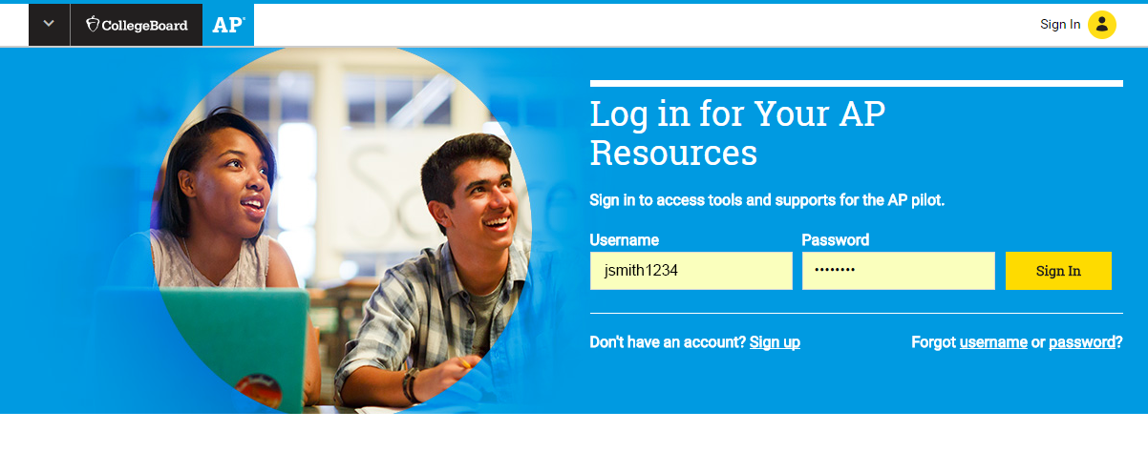
Digital Activation: Unlock new tools and resources in a few clicks
23

Slide 24

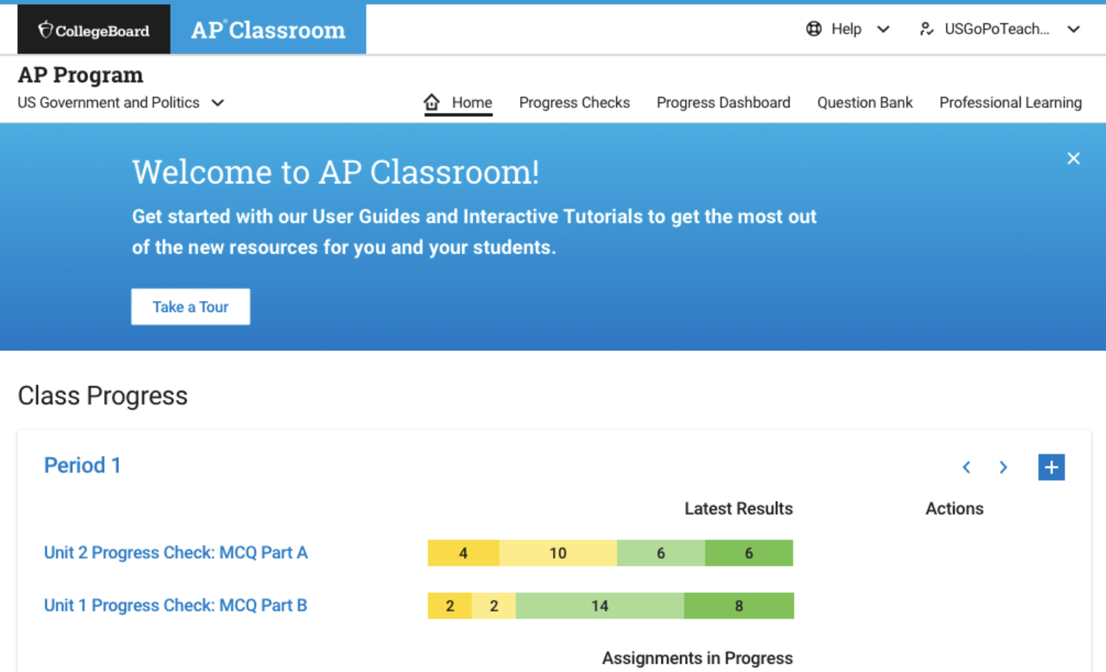
AP Classroom: A powerful resource for teachers and students
24

Slide 25




AP Teachers
Powerful resources,
empowering you
Unit Guides
Personal Progress Checks
AP Question Bank
Progress Dashboard

Slide 26
Built to provide transparency and help students succeed. Our new instructional resources provide teachers with real-time feedback on student progress in the development of knowledge and skills essential for college.

Slide 27
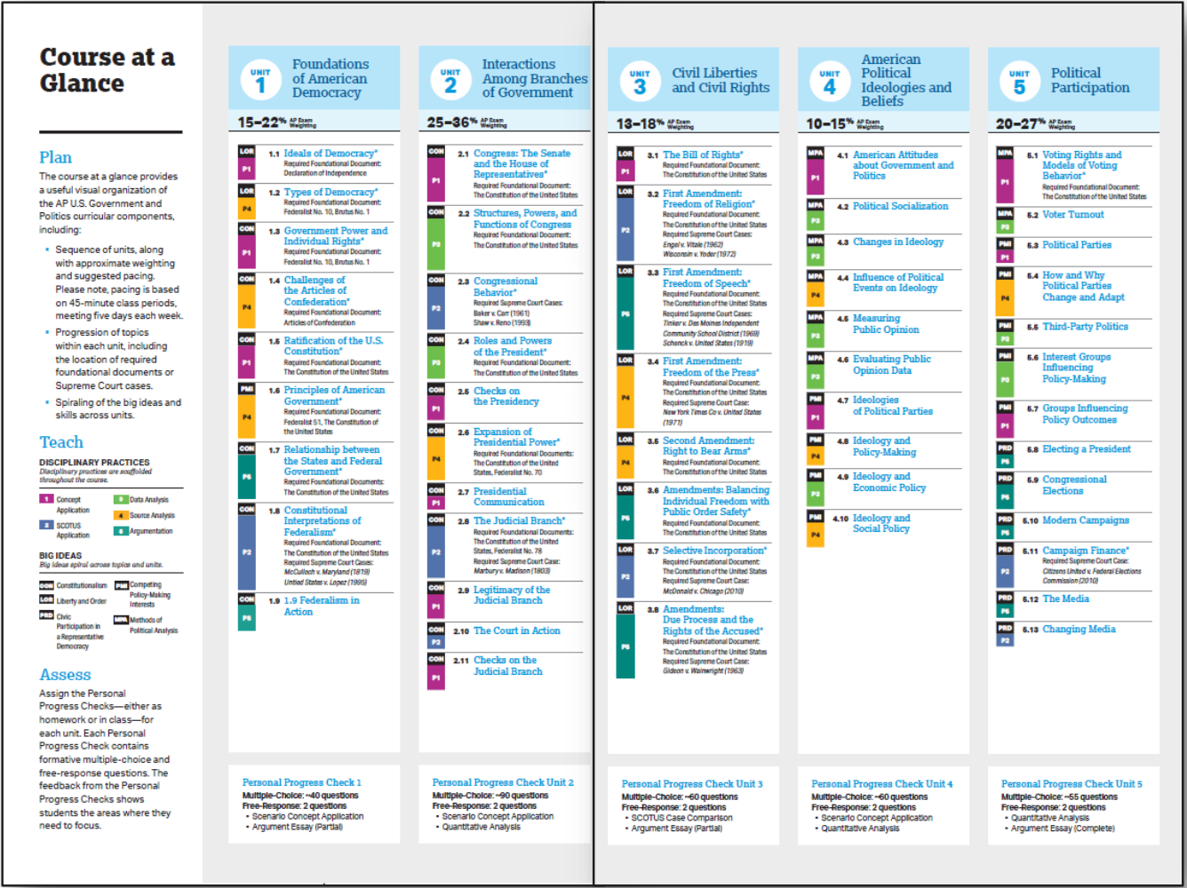
Unit Guides
Course at a Glance provides a comprehensive overview of course content.
Example: United States Government and Politics

Slide 28
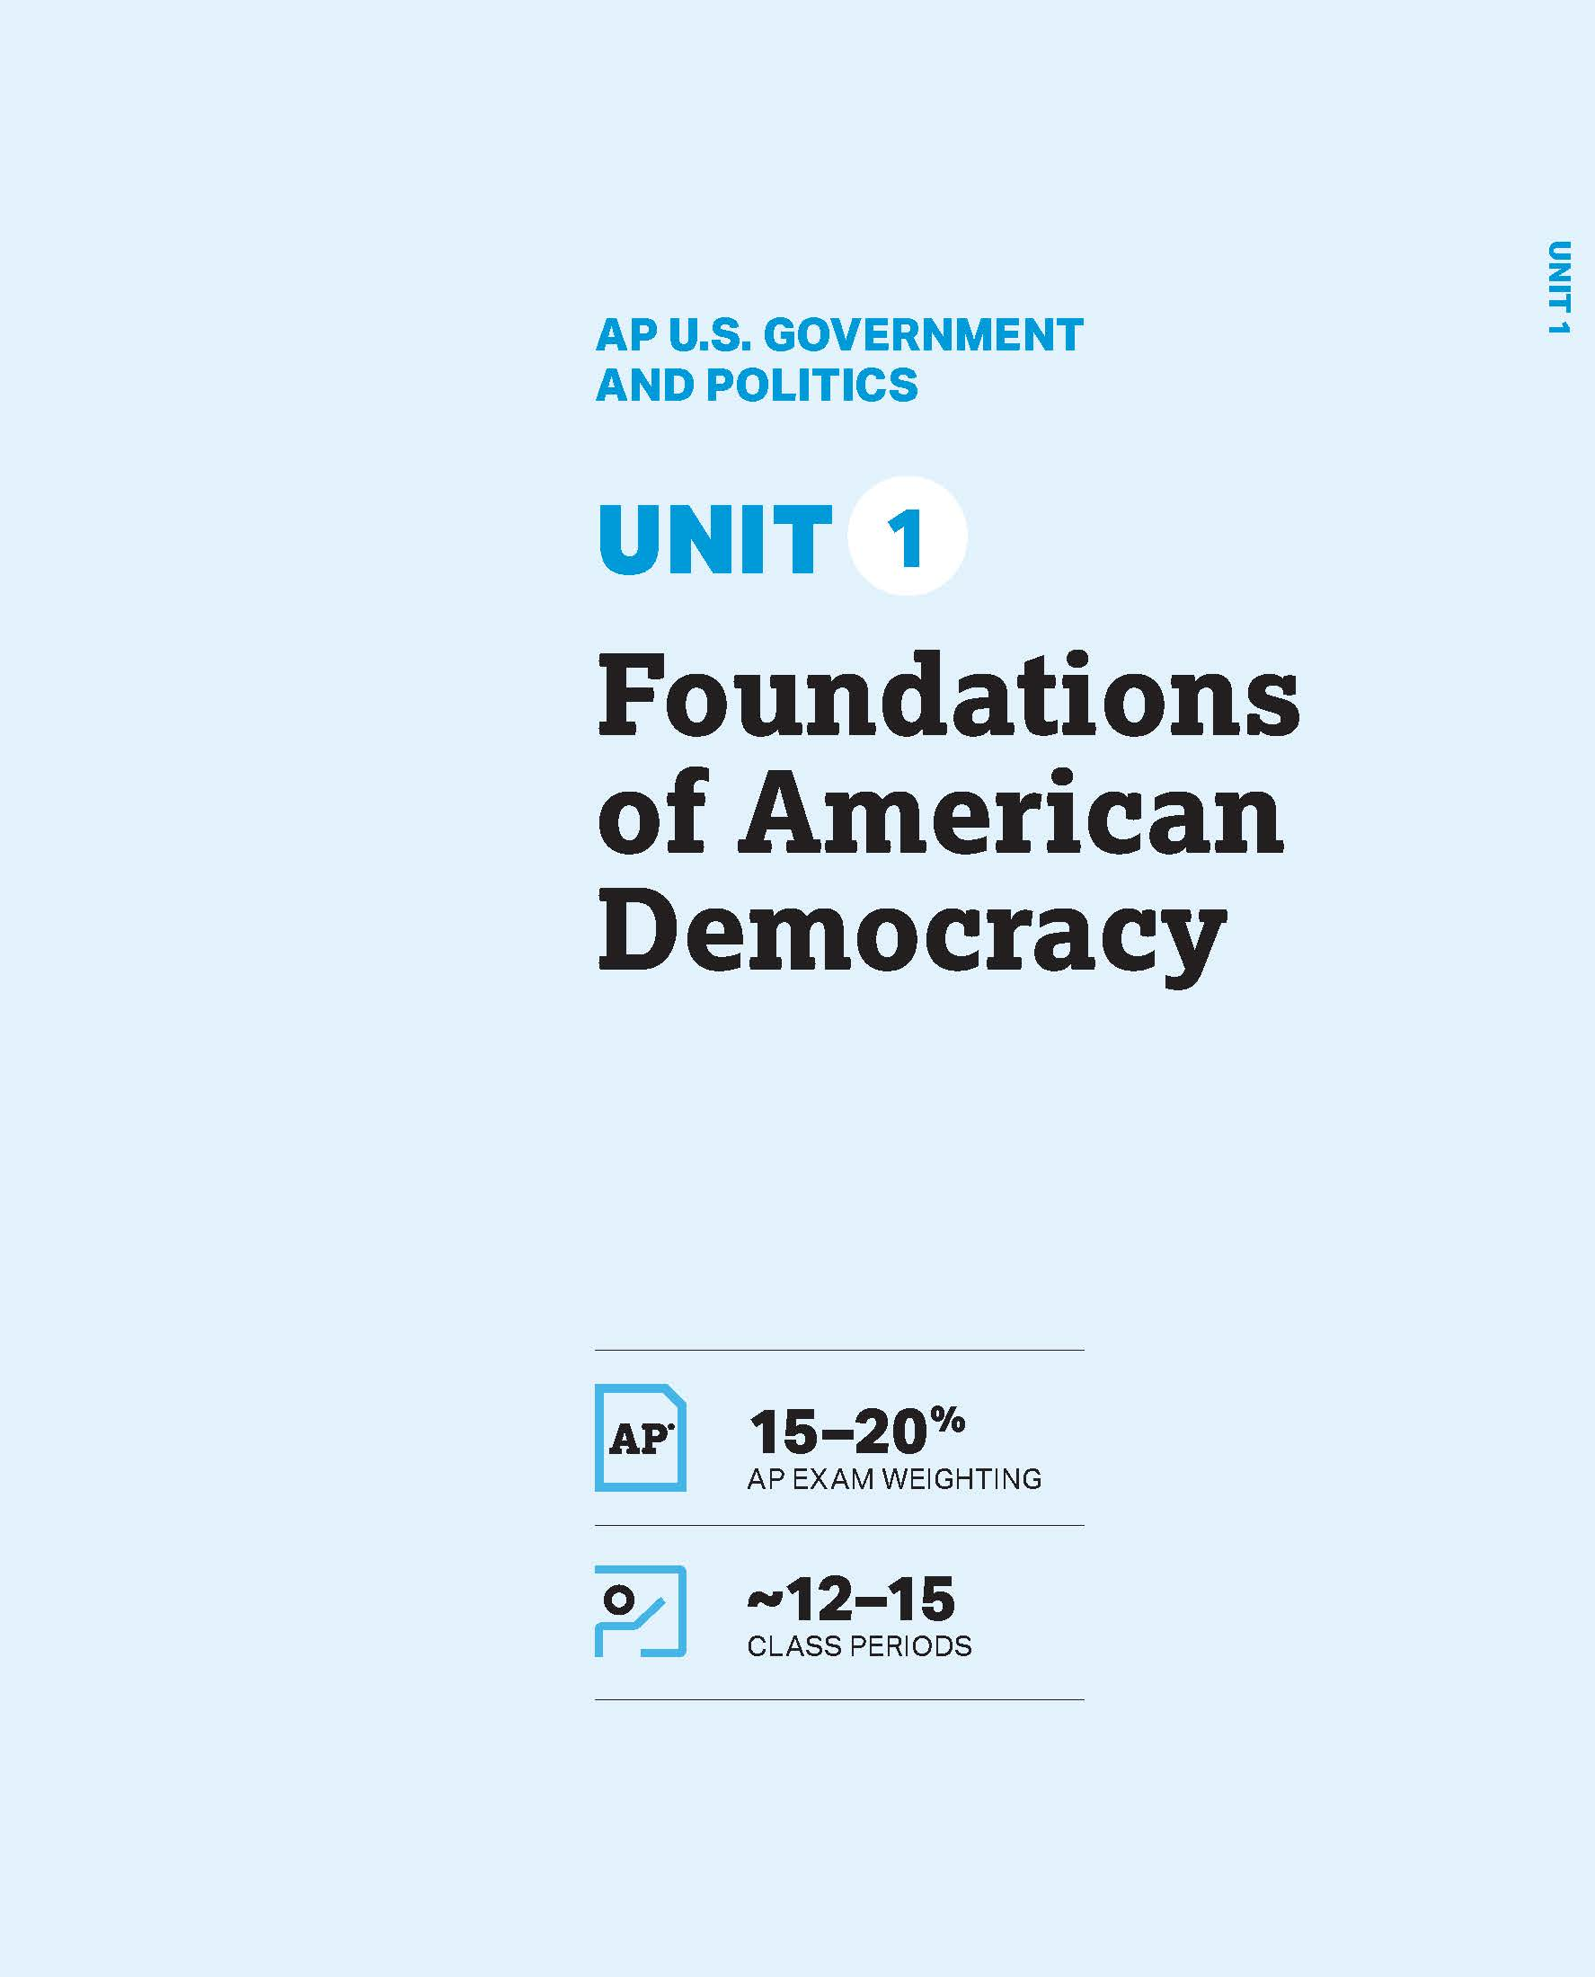
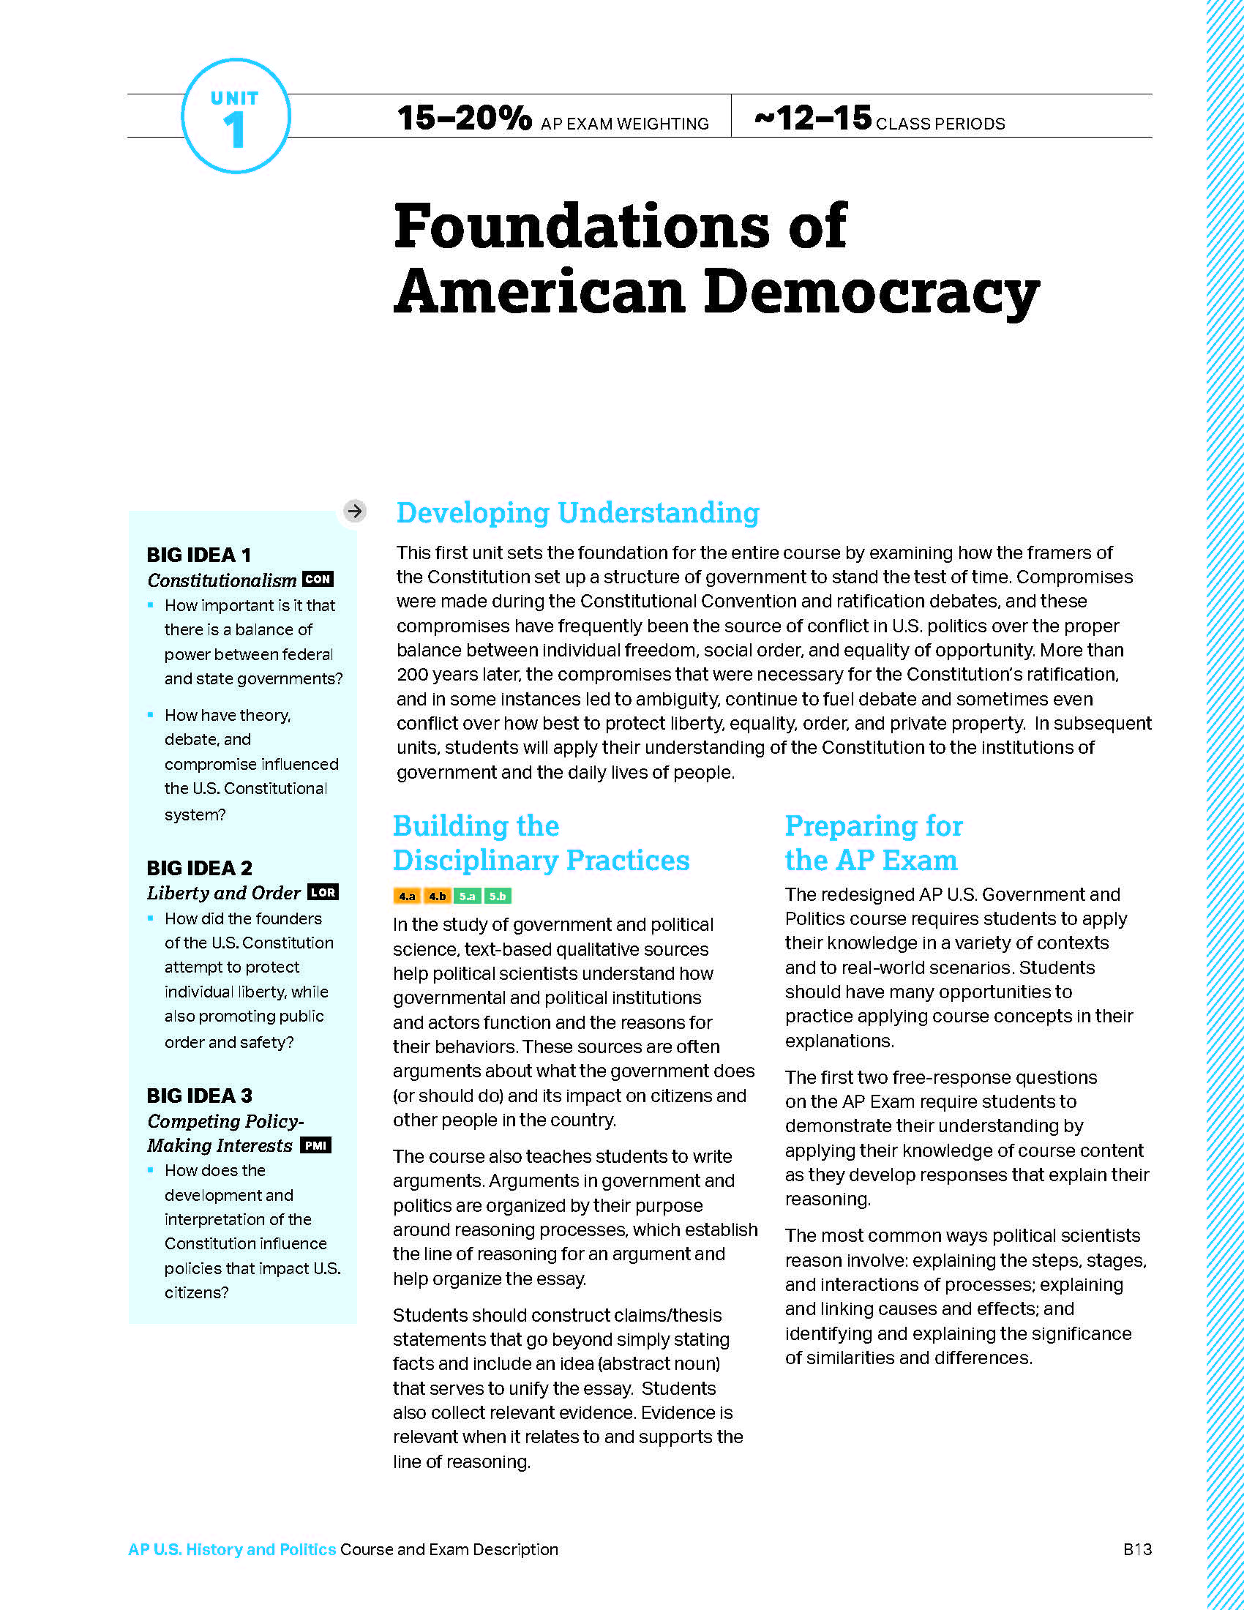
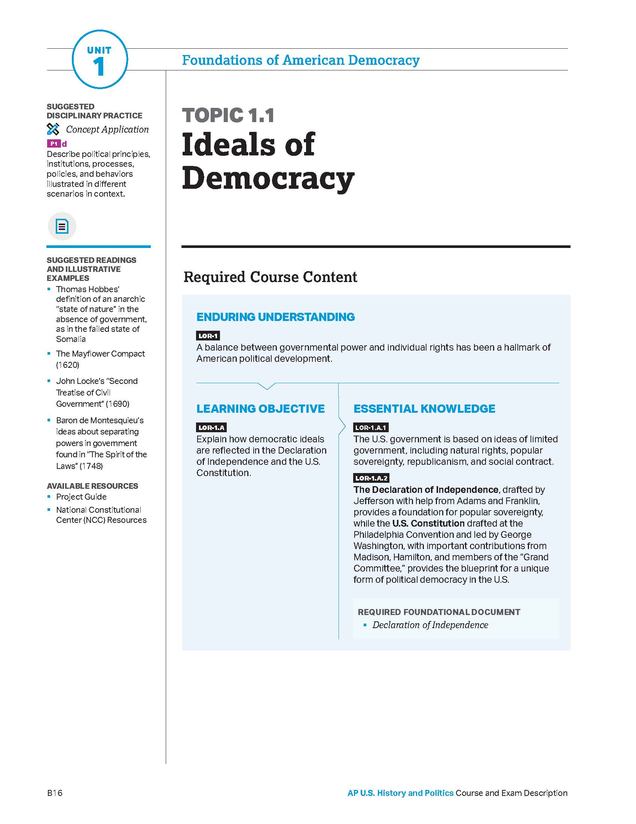
Unit Guides
Unit guides eliminate guesswork by outlining course skills and content.
Example: United States Government and Politics

Slide 29
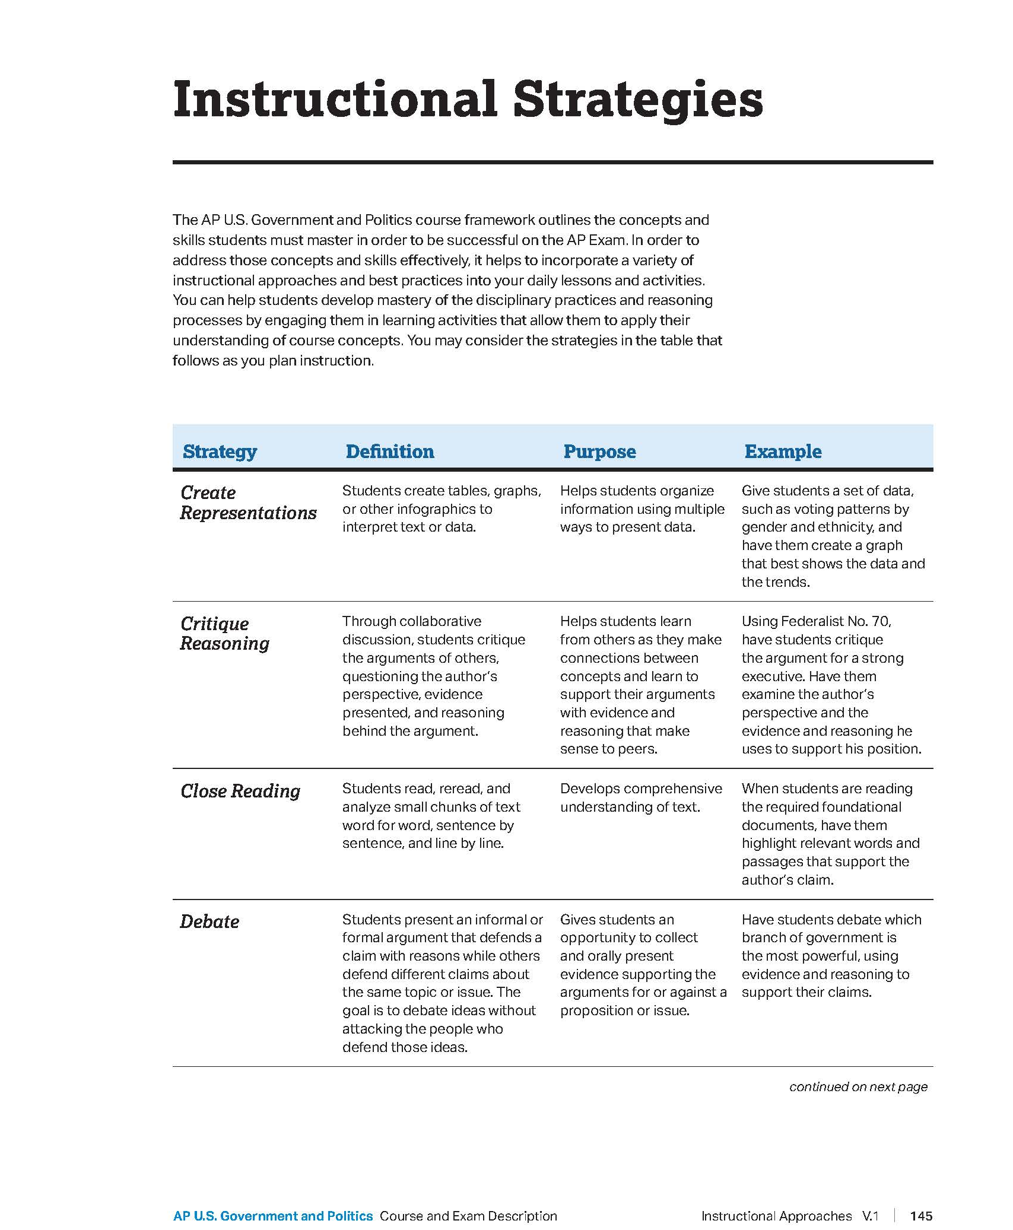
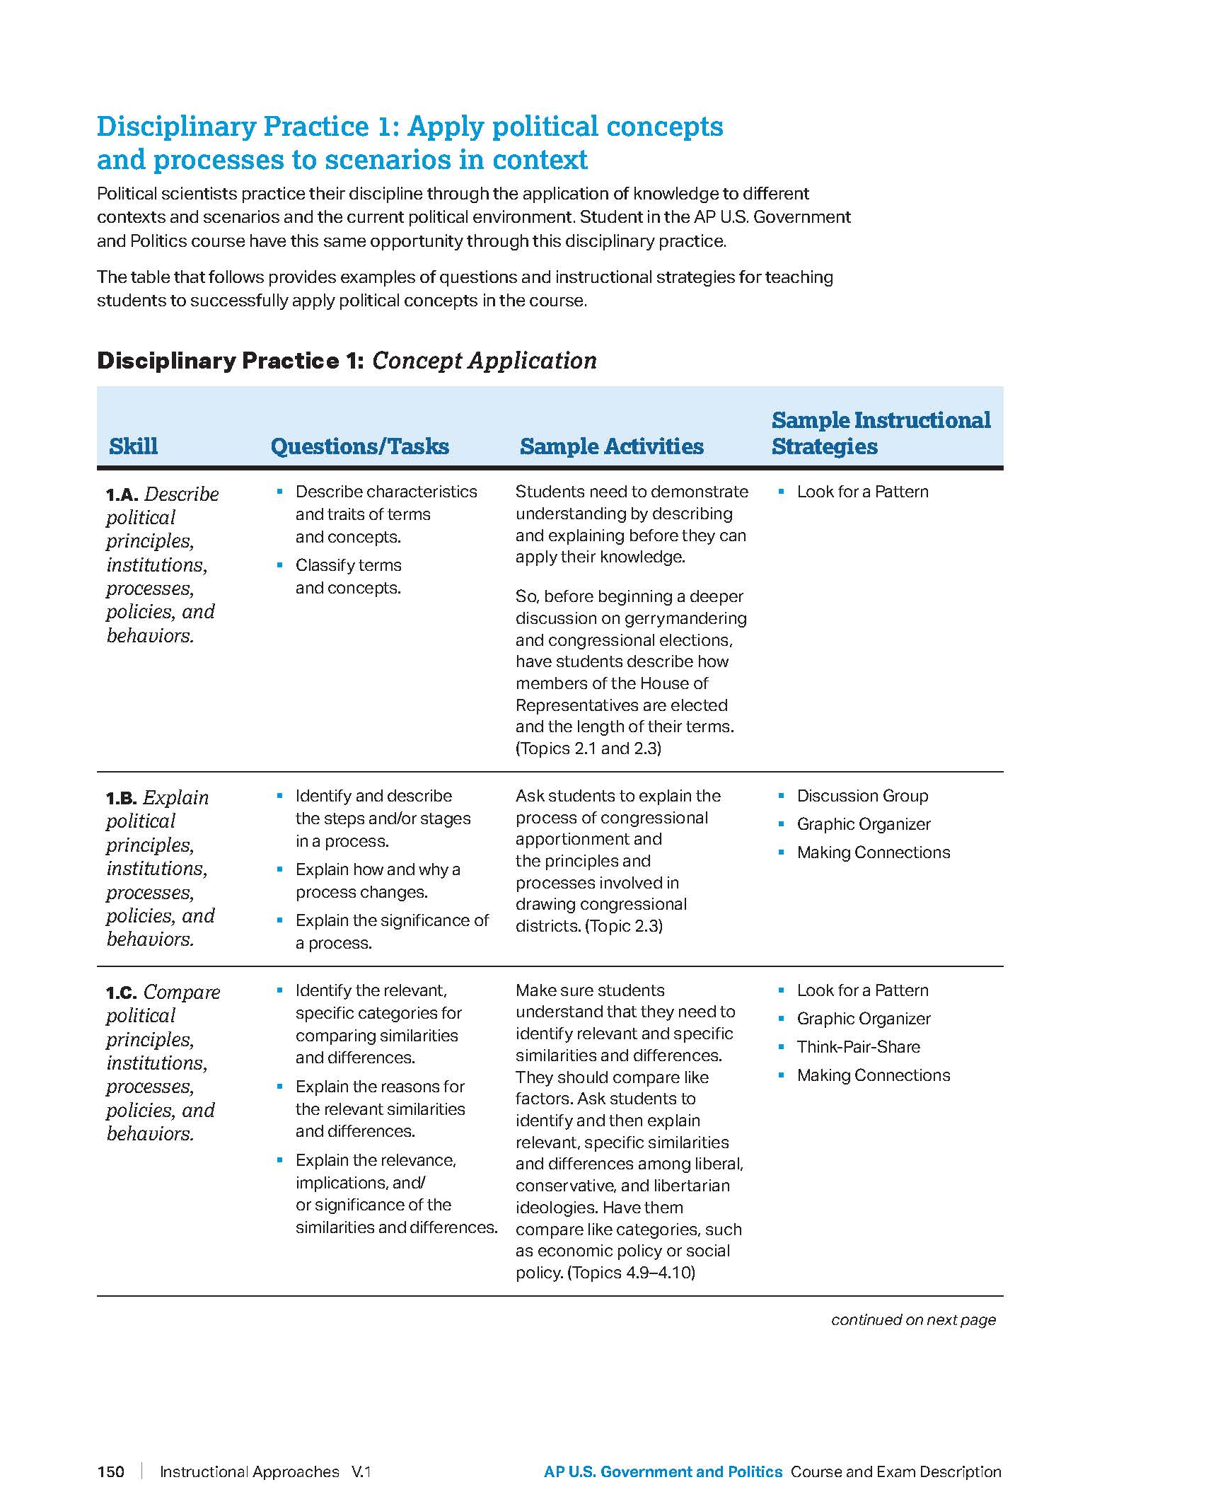
Unit Guides
Instructional approaches offer recommendations on integrating skills and content.
Example: United States Government and Politics

Slide 30
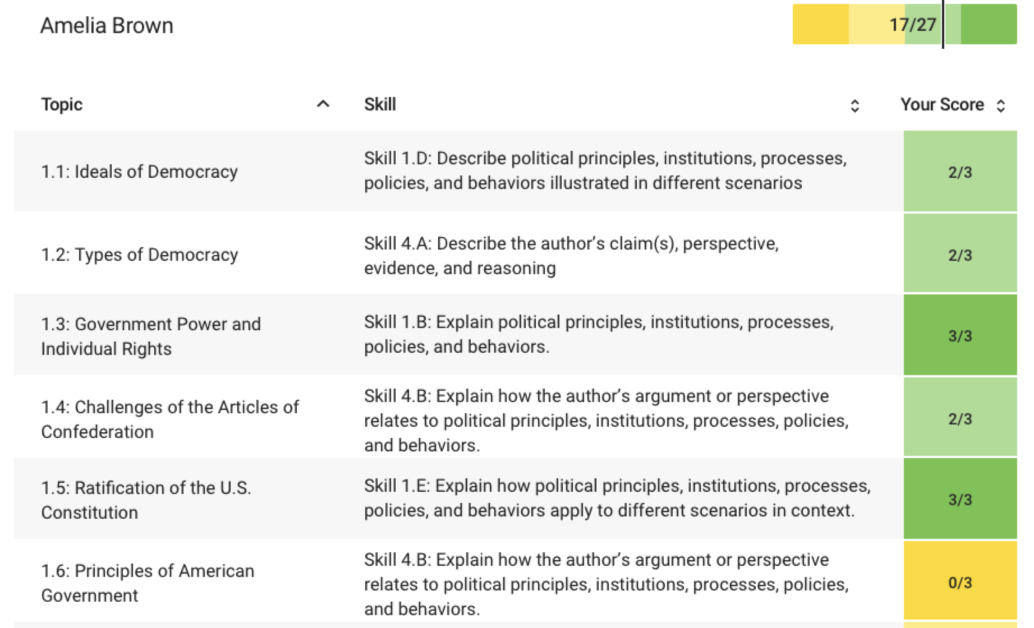
Personal
Progress Checks
Personal progress checks provide students
with actionable feedback throughout the year.

Slide 31
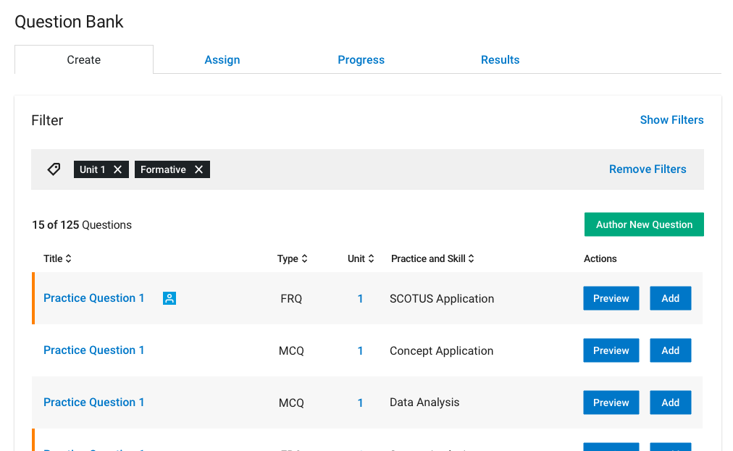
AP Question
Bank
Question bank boosts exam practice with
15,000+ on-demand AP Exam questions.

Slide 32
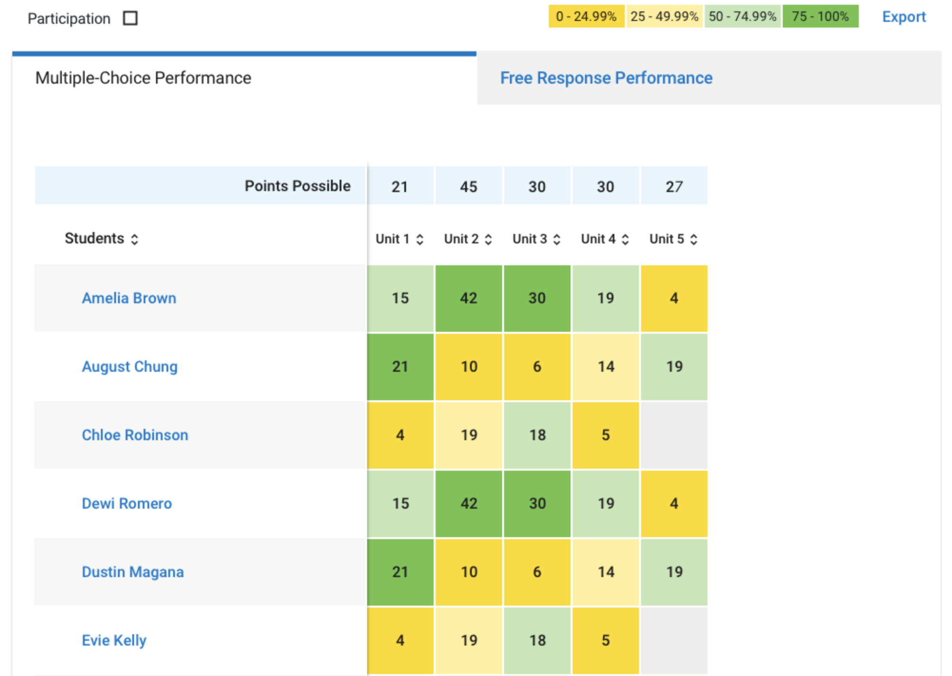
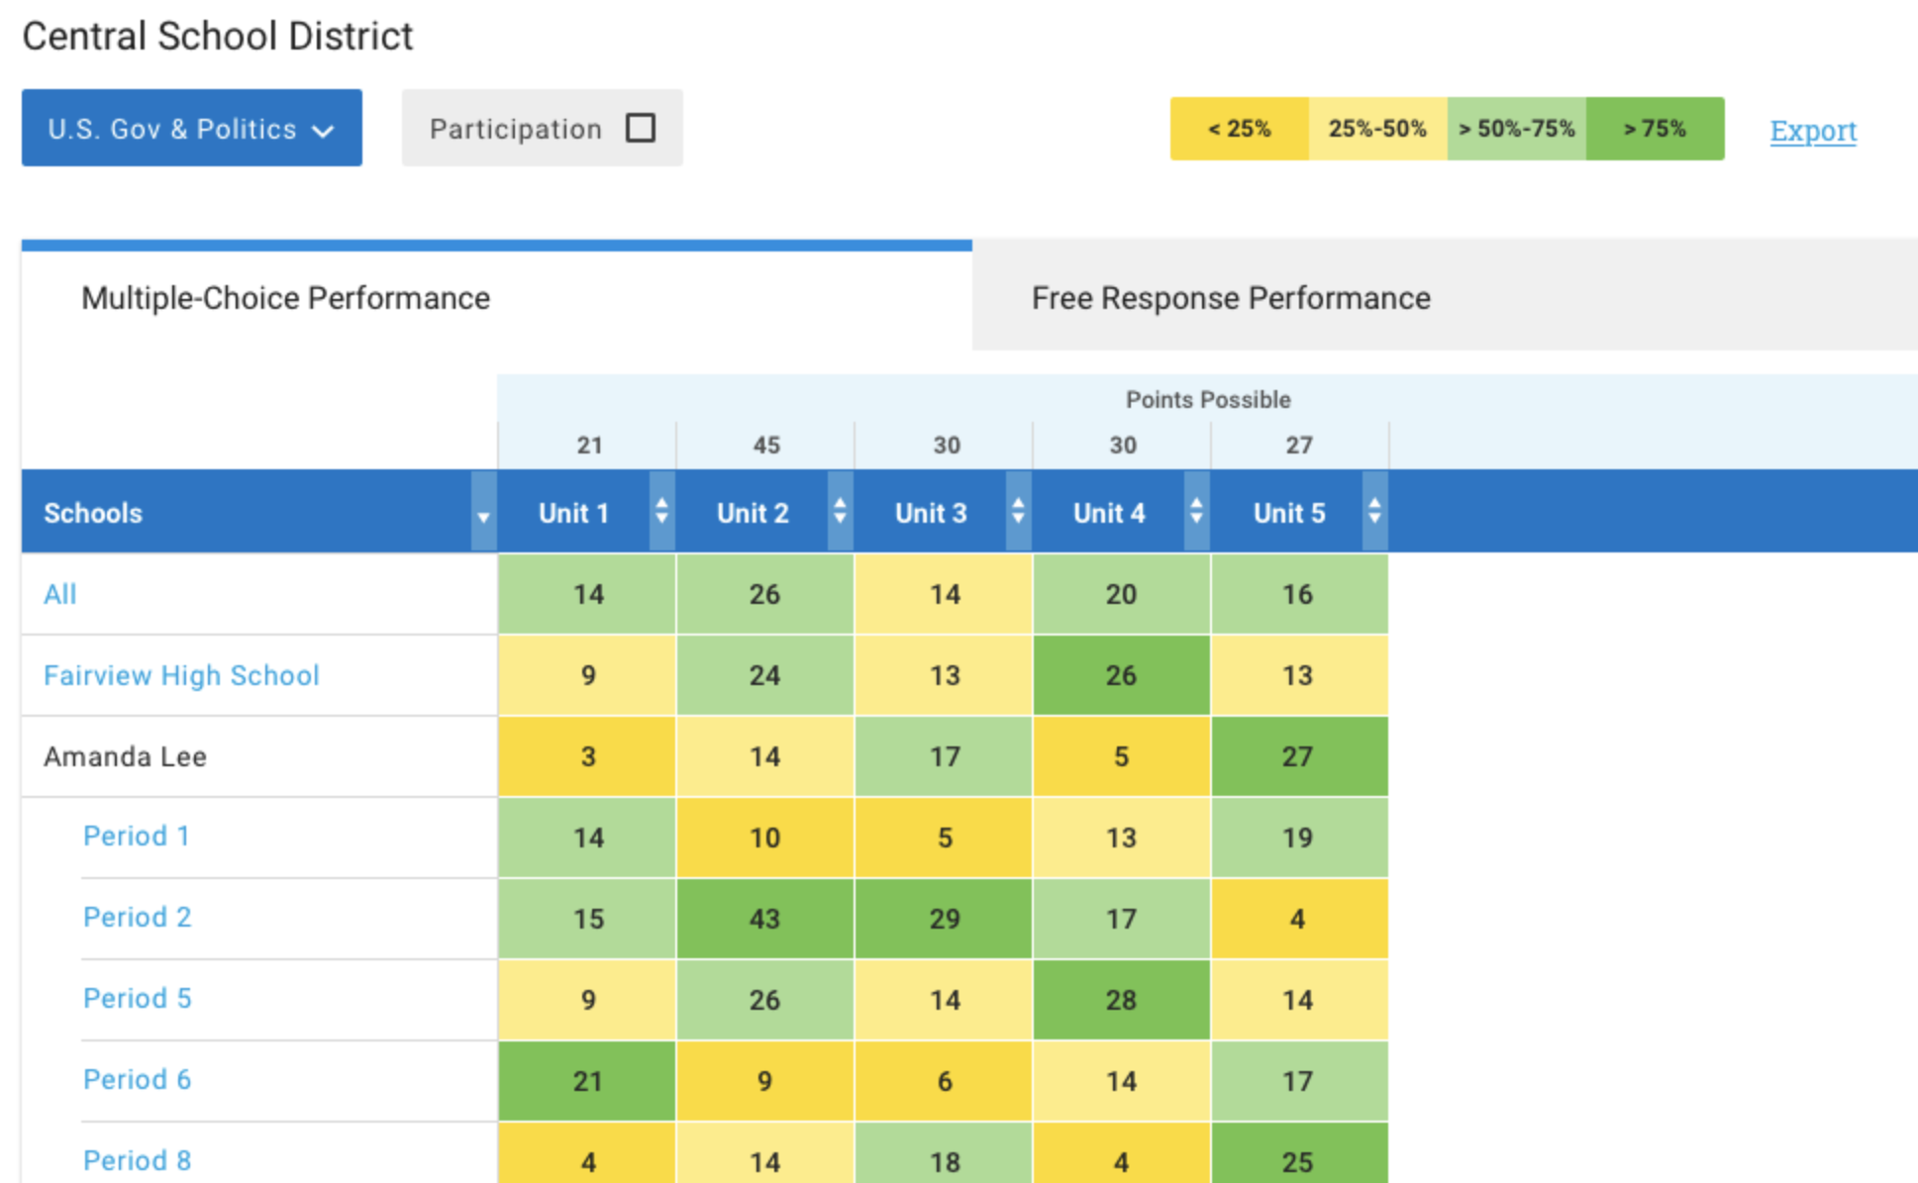
Progress
Dashboard
A progress dashboard highlights progress and areas of focus throughout the year.

Slide 33
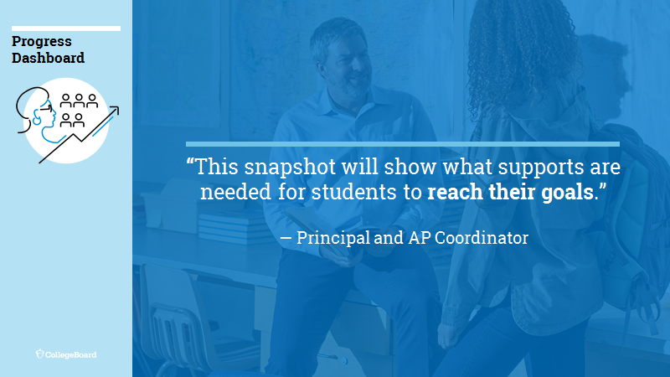

Slide 34
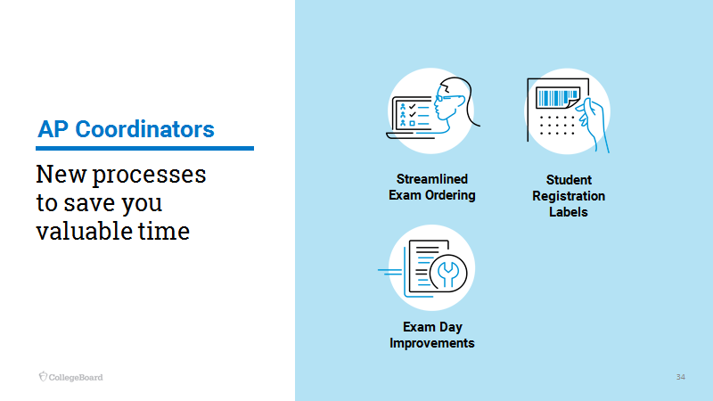

Slide 35
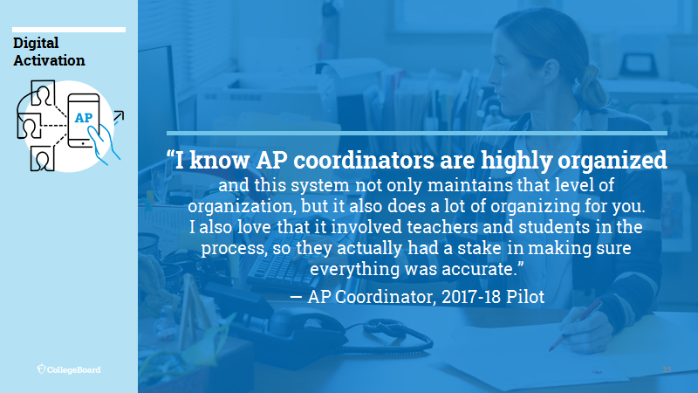

Slide 36
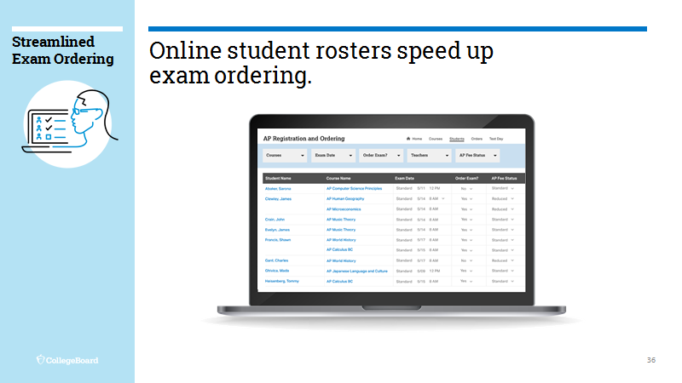

Slide 37
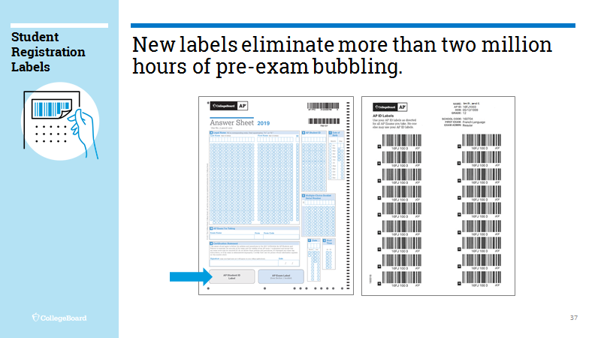

Slide 38
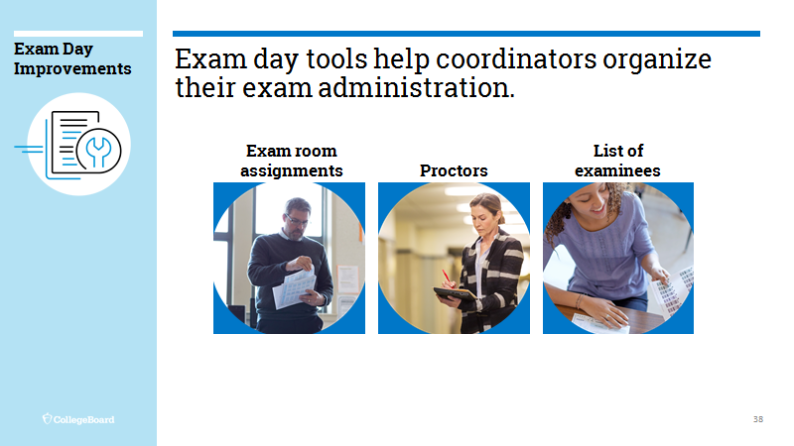

Slide 39

Professional Development
Year-round professional development
opportunities will be available for teachers, coordinators, and administrators to help
prepare you for the upcoming changes to AP.

Slide 40
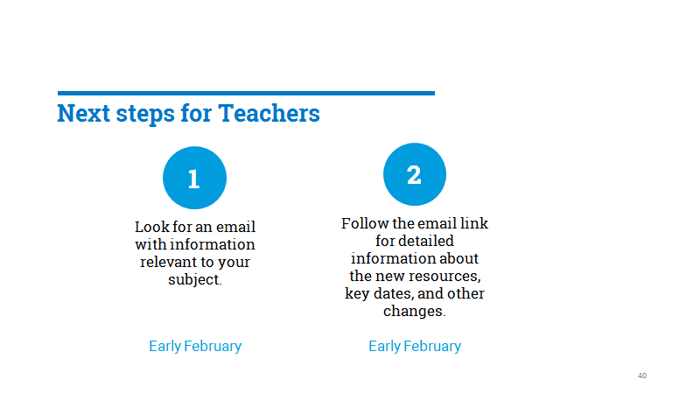

Slide 41
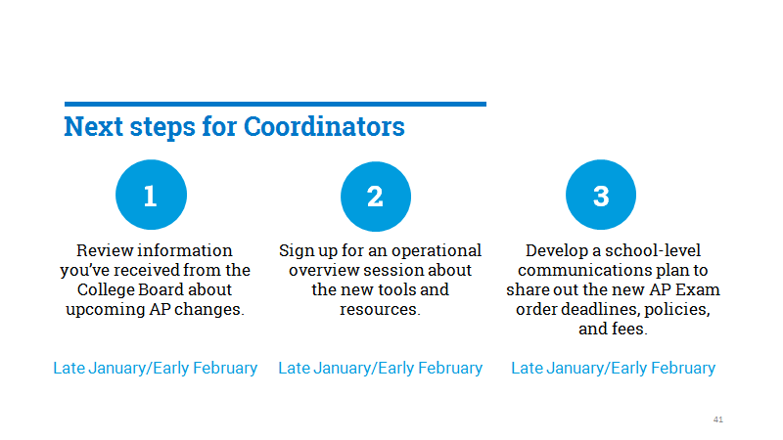

Slide 42
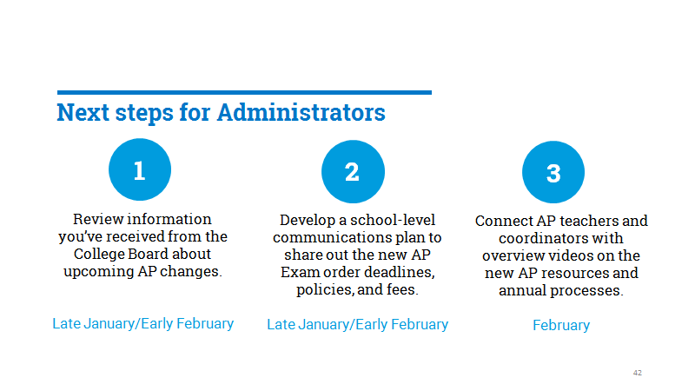

Slide 43
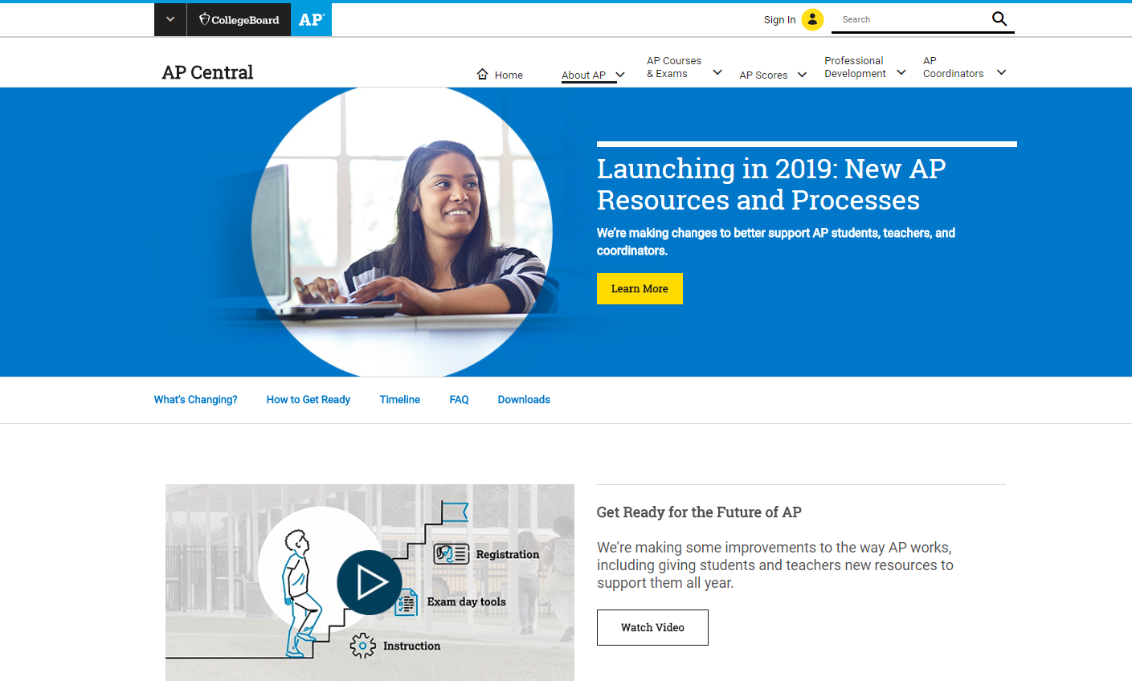
Visit AP Central® for more information.
We’ll be sending follow-up messages and updating the website with additional communications tools and resources throughout the year.
For more on the resources and process changes, please visit collegeboard.org/ap2019

Slide 44

Thank you

