Slide 1
University of California Updates
WACAC Share, Learn Connect 2020

Slide 2
UC system overview
WACAC Share, Learn Connect 2020

Slide 3
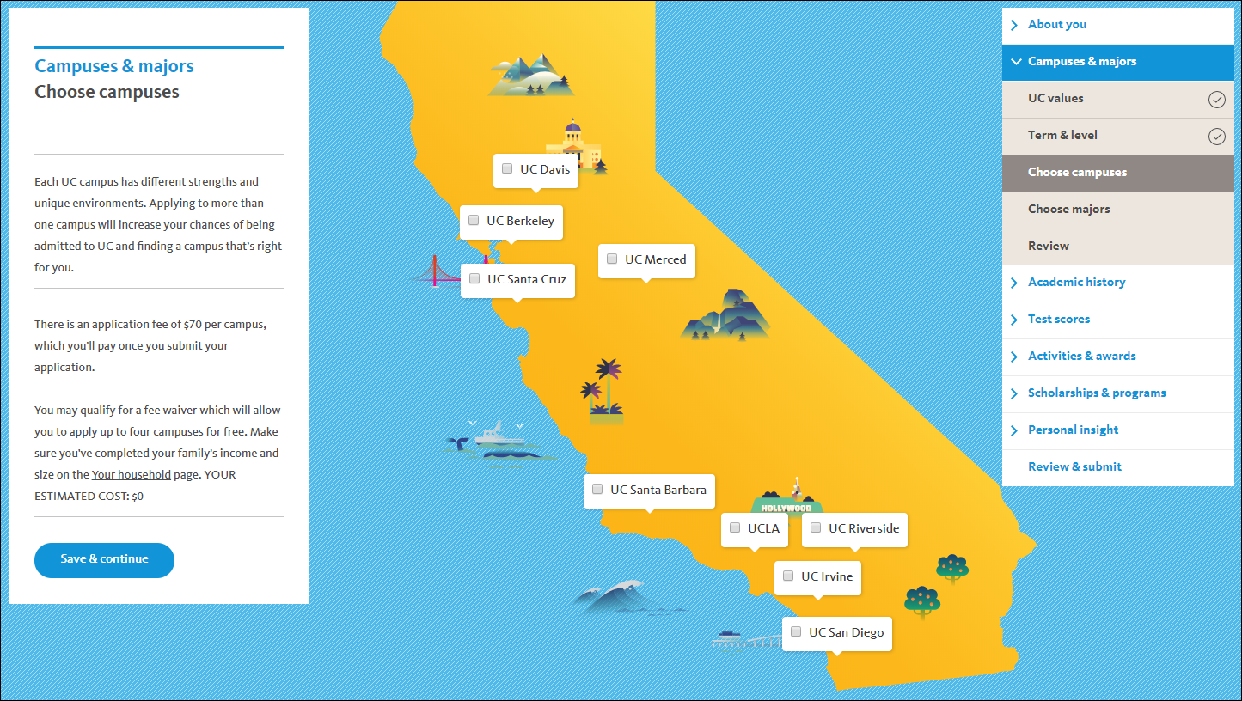
Notes:
This is the screen shot of the redesigned application showing the locations of the campuses.
The UC is one of the largest university systems in the world offering undergraduate and graduate programs on campuses located across the state.
UC is a place for innovation and collaboration.
With 64 Nobel laureates, and 38 Pulitzer Prize winners, students experience a rich tradition of academic excellence. Our last Nobel was awarded in 2017, to Dr. Barry Barish of UCR.
Many of you might think that research is theoretical, with little to no practical impact. At UC, our research has led to over 12,000 active inventions working to improve health care, education, agriculture, transportation, and the environment.
We’re partnering with schools across California to help students be prepared and competitive for the college of their choice. Currently, UC engages in over 1,400 active partnerships with CA schools.
Our graduates enter the workforce and after 5 years make about $10,000 more compared to graduates of other 4 year California institutions. Over 90% of low-income students exceed their parents income 5 years after graduation. The median salary 5 years after graduation is $59,436.
Source: https://www.universityofcalifornia.edu/infocenter/uc-alumni-work
Additional notes for reference if you receive questions:
Campuses with medical centers:
UC Davis
UC Irvine
UCLA
UC San Diego
UC San Francisco
Campuses with schools of law:
UC Berkeley
UC Davis
UC Irvine
UCLA
US Santa Cruz
UC Hastings College of Law (located in San Francisco)
3 national labs:
Lawrence Berkeley lab
Los Alamos lab
Lawrence Livermore lab

Slide 4
UC 2030 Goals
Add 1,100 ladder-rank faculty
Achieve 90% overall graduation rate
Produce 200,000 more degrees
Notes:
Sources:
https://www.universityofcalifornia.edu/infocenter/uc-2030-dashboard
https://www.universityofcalifornia.edu/news/uc-s-ambitious-plan-help-more-students-earn-degree
UC leaders have set their sights on a slate of ambitious multiyear goals that, taken together, would allow UC to confer 1.2 million undergraduate and graduate degrees by 2030, a 20 percent increase over current projections. It would also help more students from low-income California families reap the rewards of a UC degree.
Under the multiyear framework, UC would achieve a 90 percent graduation rate by 2030, with 75 percent of freshmen earning a degree in four years.
UC leaders hope that state lawmakers will embrace the university’s 2030 goals and have asked for $60 million in permanent state funding over each of the next four years to help it succeed. Funds will be used to add 1,100 ladder rank faculty and make other programmatic improvements that support student success.

Slide 5
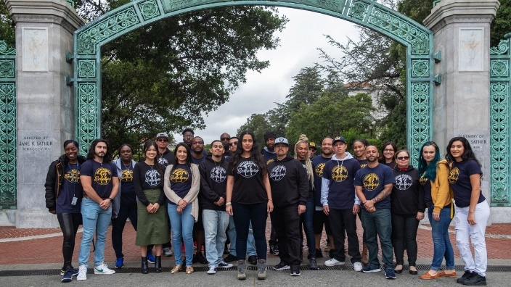
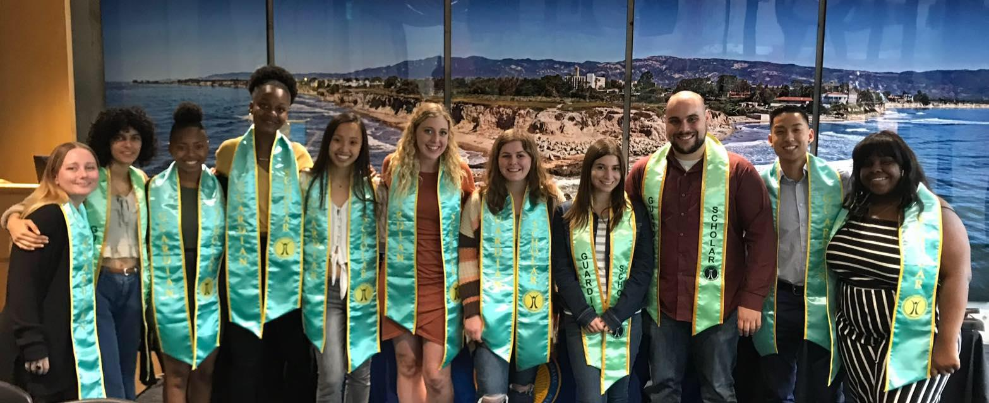

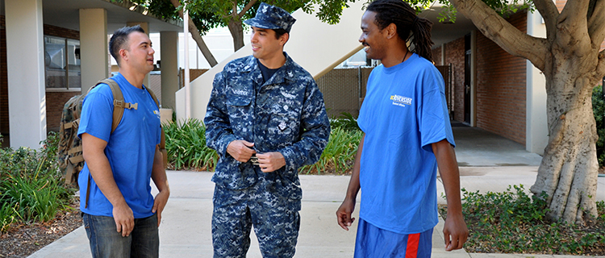
UC supports all students
Underground Scholars
Undocumented students
Guardian Scholars
Veterans
Notes:
Undocumented students:
UC campuses offer a range of support services — from academic and personal counseling, to financial aid and legal advising — that can help your students balance being a full-time student while handling other day-to-day challenges you may face. In fact, every campus has designated staff or faculty members who can work with your students to find the right support on campus and answer their questions.
Each campus has a student group, club or organization where you can find an encouraging peer network.
Source: http://undoc.universityofcalifornia.edu/
Underground Scholars:
UC campuses with Underground Scholars programs create a pathway for formerly incarcerated and system impacted individuals into higher education. These programs are building a prison-to-school pipeline through recruitment, retention, and advocacy. The continued success of our programs directly challenges the stigmas associated with our population.
Guardian Scholars:
The Guardian Scholars Program is committed to improving the educational outcomes for foster youth and former foster youth by providing services and support to meet their needs through transition, graduation, and post-graduate planning. The focus of the Guardian Scholars program is to build a welcoming community and to promote the wellness, and academic achievement of foster youth students.
Veterans:
The University of California – one of the best public university systems in the world – has a long history of welcoming student veterans and military personnel to our campuses. Whether you’re a current or former member of the military, you’ll find a supportive community dedicated to helping you succeed.
Most of UC's veterans who enroll as undergraduates started at a California Community College.
UC undergraduate veterans receive substantial grants and scholarships, in addition to VA education benefits for which many student veterans are eligible.
More than 2,000 veterans and students with military affiliation attend UC.
Source: http://veterans.universityofcalifornia.edu/

Slide 6



UC leads the way
Student mental health & wellness
Basic Needs
Education Abroad Program (EAP)
Notes:
Student Mental Health Initiatives
Source: https://www.ucop.edu/student-mental-health-resources/index.html
(The picture is the drawing of the new Student Health and Athletics Center that will open this fall at UC Merced).
Each Mind Matters:
Each Mind Matters unites the hundreds of organizations working together to create health systems that serve minds and bodies.
Suicide Prevention:
UC has partnered with the American Foundation for Suicide Prevention (AFSP) to launch an anonymous online depression screening program an effort to reach our most vulnerable students.
We also offer a host of prevention programs for students, training for faculty, staff and student leaders, and awareness campaigns to educate the entire community on how to respond effectively to the early warning signs of distress.
In addition, each UC campus has peer programs where peer leaders help fight mental health stigmatization and educate our campus communities on recognizing and responding to the warning signs of distress.
Student wellness
Each campus has a center dedicated to empowering students to make informed decisions to support individual health and a healthy campus environment by providing comprehensive programs and coordinated services including education, trainings, resources, and programming for students in a variety of health and wellness topic areas, through a network of peer educators, mentors, and professionals.
Basic Needs
The Global Food Initiative is a sustained, systemwide effort to develop solutions for food insecurity. More than $4 million have been allocated to the campuses to build support services and programming to ensure student access to healthy food and basic needs resources. Each campus has a basic needs program or center where students can pick up emergency food and toiletries, learn to cook healthy food on a budget, and participate in internship and volunteer opportunities to address campus basic needs efforts.
Source: https://www.ucop.edu/global-food-initiative/_files/food-housing-security.pdf
EAP
UC believes that to change the world, students must experience and explore the world. Whether rainforests or labs, whatever your students academic interests, UC EAP offers 171 programs in more than 40 countries and provides more than $1M in scholarships. All courses abroad through EAP award UC credit.
(The image is of Singapore, where UCEAP offers a program in Biodiversity).

Slide 7
Undergraduates at UC
WACAC Share, Learn Connect 2020

Slide 8

If all of the UC were just 100 students…
82 call California home
78 are non-white
40 are the first in their family to attend college
37 will earn graduate or professional degrees
28 transfer from a CCC
Notes:
Source: https://www.universityofcalifornia.edu/infocenter/fall-enrollment-glance

Slide 9
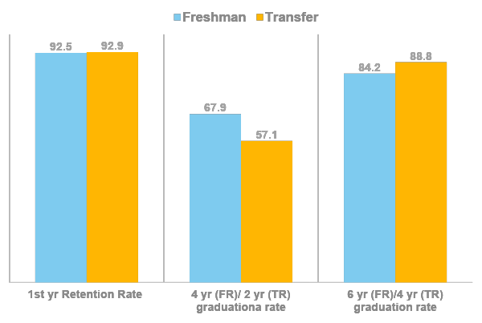
Staying to Graduate
Average Time to Degree
4.1 yrs
Freshman (4 yrs)
Transfer (2yrs)
2.3 yrs
Notes:
92% of both freshman and transfer students return to UC after completion of the first year of enrollment.
More than half graduate in 4 years (Freshman) and 2 years (Transfer), with over 84% of freshman graduating in 6 years and 88% of transfers graduating within 4 years of UC enrollment.
Once admitted to UC, we work hard to help our students graduate in a timely manner. The average time to degree for freshman is slightly over 4 years. Transfers graduate on average 2 years and one quarter after enrolling at UC.
There are good reasons why some students extend their graduation date:
11% of UC students complete double majors
More than 5,000 study abroad (Source: https://visualizedata.ucop.edu/t/EAP/views/AnnualStatistics2012-13Through2017-18/Geography?iframeSizedToWindow=true&:embed=y&:showAppBanner=false&:display_count=no&:showVizHome=no)

Slide 10
Gaining knowledge to make a difference
76% engage in research
61% are involved in student organizations
54% do community service
Notes:
We know that engaged students tend to graduate on time, report higher satisfaction with their undergraduate institutions, and gain important personal and professional skills.
UC students are active participants and leaders before they arrive and once enrolled. They continue to impact others and learn about themselves through community service, student organizations (more than 1200 systemwide), and undergraduate research with faculty.

Slide 11
Undergraduate Fields of Study
Arts & Humanities
Social Sciences
Life & Physical Sciences
Engineering and Computer Sciences
Film & Digital Media
Business & Economics
Biology
Bioengineering
Languages
Global or International Studies
Physics & Math
Computer Science/Computer Engineering
Notes:
Arts & Humanities
All campuses except UC Merced have some kind of film and digital media major. Admission to these majors are based not only on academic achievement, but on talent. Some programs require a supplemental application, portfolio, or interview/audition which gives students the opportunity to demonstrate their skills.
For your reference:
B: Film Studies
D: Cinema and Digital Media
I: Film and Media Studies
LA: Film and Television
R: Media and Cultural Studies
SD: Interdisciplinary Computing & the Arts (ICAM), Visual Arts
SB: Film and Media Studies
SC: Film and Digital Media
Languages:
The ability to speak multiple languages is an advantage in the job market. Did you know that UC teaches more than 40 languages? In addition to our popular Spanish and Asian family language programs, UC teaches Armenian, Greek, Norwegian, and Portuguese.
Social Sciences
Business and Economics are popular majors at UC, with each campus offering one or more programs. Some specialized business majors include Environmental Economics and Policy (Davis); Global Economics at UCSC, Business Information Management (UCI); and Management, Entrepreneurship, and Technology (Berkeley). Did you know that UCR has the largest School of Business at UC with 7 specializations just for Business Administration?
All campuses also offer global or international studies, some build in study abroad experiences as part of the major. The majors encompass a range of interests. Your students might want a business/economics approach, as in UCLA’s International Development Studies. UCSD offers multiple International Studies majors, including IS: Political Science. Students can also explore their interest in global majors through Linguistics (all campuses), or area studies like Middle Eastern Studies, Latin American Studies, or Asian Studies.
Life & Physical Sciences
Did you know there are more than 20 different Biology majors across UC? You may know about Cell and Molecular Biology, Human Biology, and Neurobiology (all campuses have some form of these majors). But did you know that UCLA, UCSB and UCSD have Marine or Aquatic Biology? Irvine has Biology/Education, Davis offers Wildlife, Fish and Conservation Biology, and Berkeley has Integrative Biology. Merced has 5 specializations of Biological Sciences, and Riverside has 4 just for Plant Biology.
The world runs on math. Students majoring in the Physical Sciences will graduate with transferable skills sought after by employers including quantitative analytical ability, critical thinking, and collaboration (ever work on a science project alone?). UC offers more than a dozen Physics and Applied Physics specializations including Astrophysics, Geophysics, Engineering Physics, Biophysics, and Physics Education. Math and Applied Math comprise no less than 3 specializations at each campus. Some offer 7 specializations in Applied Math alone. From Mathematical Finance (UCI), Mathematical Analytics and Operations Research (Davis), Applied Math: Computer Science (Merced), or Statistics and Data Science (UCSB), UC delivers in quality and quantity of options for students.
Engineering and Computer Sciences
Every UC campus has either a school or college of engineering with at least 5 separate Engineering majors. Many of these are among the most selective on campus.
Along with traditional programs in chemical, civil and mechanical engineering, UC offers:
Berkeley: Electrical Engineering and Computer Sciences: Artificial Intelligence, Control, Robotics
Davis: Biological Systems Engineering: Food Engineering
Irvine: Materials Science Engineering: Biomaterials
LA: Aerospace Engineering: Aeronautics
M: Computer Science & Engineering
R: Environmental Engineering: Air Pollution and Water Pollution Control Technology
SD: NanoEngineering
SB: Engineering Sciences (5 year combined bachelor’s and masters); (Cross-disciplinary across all 5 programs)
SC: Technology & Information Management
Source: UC’s Quick Reference Guide to UC Admission has a complete list of all majors grouped by category. It can be found online here: https://admission.universityofcalifornia.edu/counselors/files/quick-reference.pdf

Slide 12
UC admission and enrollment updates
WACAC Share, Learn Connect 2020

Slide 13

Area D update
Name change: from “Laboratory Science” to “Science”
Expand the options for science disciplines fulfilling the 3rd recommended year
  Applied Sciences
  Computer science
  Earth and space sciences
  Engineering
  Interdisciplinary sciences
NO CHANGE in requirement!
  2 years required; 3 recommended
Notes:
As many of you are aware, the Academic Senate has discussed changes to the Area D subject requirement. The final actions approved by the Academic Senate are:
1. Change the area D subject requirement name from “Laboratory Science” to “Science”
2. Expand the options for science disciplines that fulfill the third recommended year of the area D requirement, including (but not limited to) earth and space sciences, interdisciplinary sciences, computer science, engineering, and applied sciences
3. Maintain status quo for the area D requirement: 2 years required, 3 recommended
This announcement is public, as the letter has also been posted to the UC Academic Senate website, so please feel free to share with others as needed:
https://senate.universityofcalifornia.edu/_files/reports/kkb-jn-assembly-area-d-february-2020.pdf
My High School Articulation (HSA) team has taken initial steps to address #1 and #2 above, and now that a final decision has been made regarding #3, we’ll engage in full implementation, which includes following through on the relevant recommendations as outlined in the Academic Senate letter. An announcement to K-12 colleagues in a special HSA Bulletin is forthcoming.

Slide 14
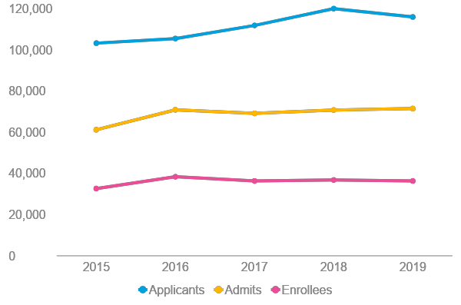
UC trends for California freshmen
UC’s commitment to California’s students remains strong
UC continues to expand its enrollment of California students, enrolling over 17,000 additional California residents since 2015.
Notes:
The data show that interest in the UC continues to grow, but our commitment to California students is stronger than ever.
17,000 additional CA residents enrolled includes both freshmen and transfers.
Source: UC InfoCenter https://www.universityofcalifornia.edu/infocenter/admissions-residency-and-ethnicity

Slide 15
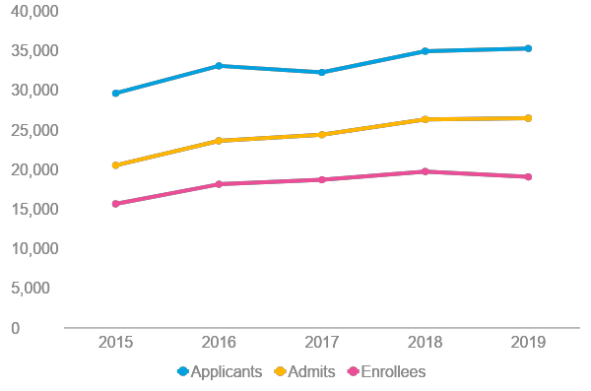
UC trends for California community college transfers
UC’s enrollment of CCC transfers continues to grow
UC admitted its largest class ever of CCC transfers for fall 2019.
Notes:
Source: https://www.universityofcalifornia.edu/infocenter/admissions-residency-and-ethnicity

Slide 16
Commitment to transfer students
GOALS:
Nearly 1 in 3 undergrads come from a California community college (CCC)
Simplifying information about how to transfer
Increase outreach to CCC
More support for transfers enrolled at UC
Transfer Pathways
Notes:
UC’s commitment to transfer student access and success are represented in these 4 goals:
Simplifying information about how to transfer
Increase outreach to CCC
More support for transfer students at UC
All campuses except Merced offer transfer and/or family housing
All campuses have a transfer center or program
All campuses have multiple student organizations for transfer students
Transfer Pathways
Transfer Pathways exist for 20 current UC majors. They are a set of major preparation courses common to all campuses offering that major. This helps students maximize campus choice while minimizing differentiation of campus course requirements.
Presenters: Each of these 4 points are great opportunities for you to highlight examples of how your campus is implementing these systemwide goals.

Slide 17






Transfer Admission Guarantee (TAG)
Guarantees students admission to one campus to a specific major
Students can choose to enroll at any UC (85% of TAG admits enroll across the system)
Some campuses often accept transfer students in Winter/Spring
UC Merced
UC Riverside
UC Santa Cruz
Notes:
UC demonstrates our commitment to transfer students by offering a guarantee of admission. Students meeting TAG requirements are guaranteed to a single campus, and to the major.
TAG students systemwide have almost 100% acceptance rate*, and 85% enroll at one of our 9 campuses. The TAG agreement binds the campus, not the student. So students who TAG to Davis can still enroll at Berkeley.
Three campuses also often accept transfer students in the winter quarter (UYR, UCSC) or spring semester(UC Merced). All other campuses offer only fall enrollment. Students who finish in the fall should strongly consider their options among those 3 campuses.

Slide 18
UC Financial Aid & Scholarships
WACAC Share, Learn Connect 2020

Slide 19
More affordable than you might think
Covers between 10-40% of systemwide tuition and fees for students with family income up to $177,000
36% of undergraduates receive
Middle Class Scholarship
Pell Grants
CA residents qualifying for financial aid and whose total family income <$80,000 pay no systemwide tuition and fees
Blue & Gold Opportunity Plan

Slide 20

Paying for UC
“A high-value education should empower students who don’t already come from wealth”
- Forbes Magazine, April 2018
8 of 9 UC campuses made the list of Forbes Education Best Value with 4 in the top 10
Notes:
Colleges are scored in the following areas: net price, net debt, alumni earnings, timely graduation, school quality and access for low-income students.
Campus rankings
#1 UCLA
#2 UC Berkeley
#4 UC Irvine
#9 UC San Diego
#11 UC Santa Barbara
#13 UC Davis
#64 UC Riverside
#77 UC Santa Cruz
Source: https://www.forbes.com/best-value-colleges/#1287bfbc245b

Slide 21
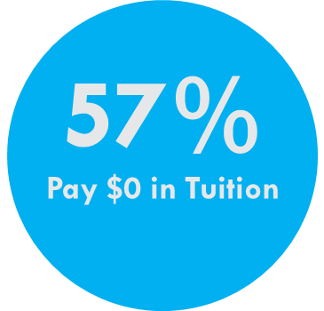


Paying for UC
42% Have no debt

Slide 22

After Graduation
38% earn a graduate degree
73% live and work in CA
Earnings double between 2 and 10 yrs after graduation
Notes:
https://www.universityofcalifornia.edu/infocenter#alumni-economic-mobility

Slide 23
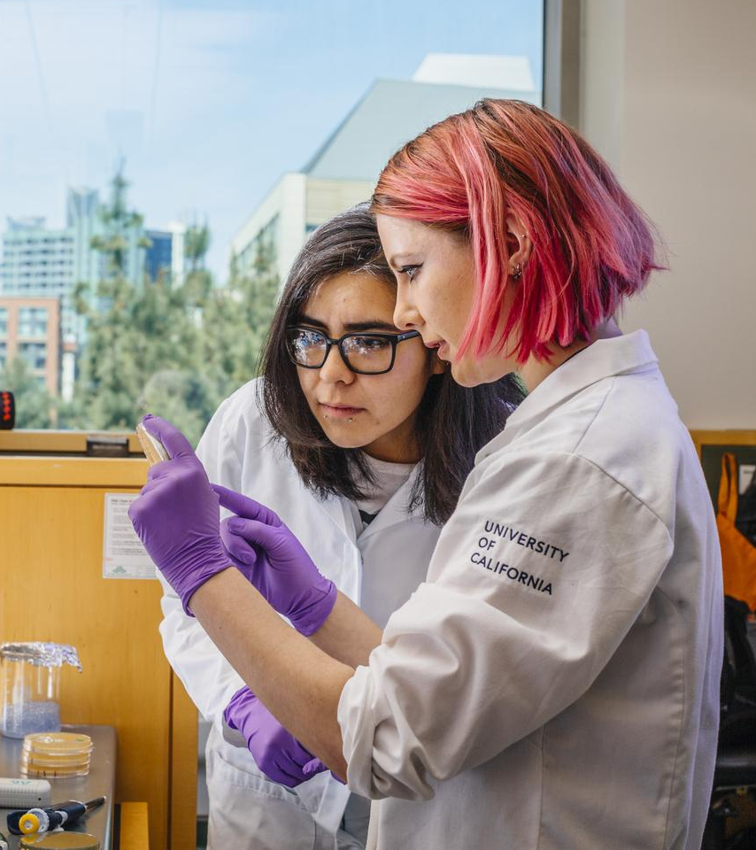
Resources
UC Counselors and Advisers Bulletin:
http://admission.universityofcalifornia.edu/counselors/resources/counselors-advisers-bulletin/index.html
AskUC@ucop.edu
Quick Reference Guide to UC Admissions:
https://admission.universityofcalifornia. edu/counselors/files/quick-reference.pdf
UC Information Center (data!):
https://www.universityofcalifornia.edu/infocenter

Slide 24
Questions?
WACAC Share, Learn Connect 2020

