Slide 2
Jesui-what?
An Overview of the 27 College & Universities
that make up the Jesuit Network
Kaleena Chiddick, Michael Decker, Tara Crisp and Rachel Vaca
Orange County SLC
Tuesday, March 24, 2020

Slide 3
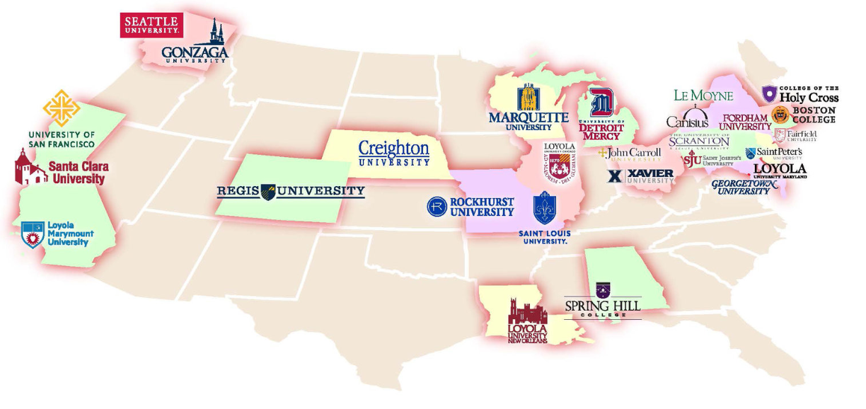
Introduction of Jesuit Network

Slide 4
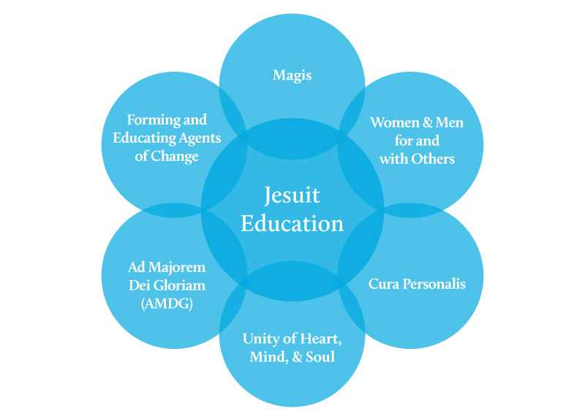
History of Jesuit Education
There are 2,618 accredited four-year colleges and universities.
Among them are 300 Catholic colleges and universities
27 of them are Jesuit
Jesuit education stems back 600 years and they were known as the educators of society and the fathers of what we consider “liberal arts” education today.
The mission of the Society of Jesus is “the service of faith and the promotion of justice.”
A profound commitment to the poor and to issues of social responsibility and justice.
We are called to make a difference as “persons for others”

Slide 5
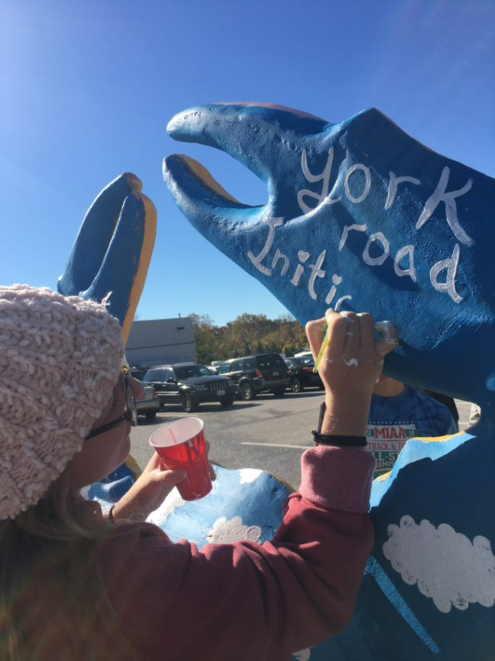
Jesuit Philosophy: Core Curriculum
Time Tested. Proven. In Demand Now More Than Ever!
Critical Knowledge in a wide variety of subjects.
Force you out of your comfort zones - so you won’t have one.
Helps you define, discern and enhance your major.
Foster your development as an ethical and engaged citizen.
Make you a creative problem solver.
Leads you to make connections across disciplines.
Makes you an agile thinker and an interesting person.

Slide 6
Jesuit Philosophy: Inclusivity
Inclusive Excellence
Welcoming to students of all faiths and strive to instill values of meaning and empathy in students.
Create an environment where every individual steps into new understanding respectfully and with delight, and where all are better off by being part of our diverse community.
Passion for Justice
Programming that encourages students to develop values of compassion, justice, and advocacy
We believe our institutions serve not only themselves and our students but are called to be a force for justice and peace in society, above all, in defense of the poor and marginalized.

Slide 7
Jesuit Philosophy: Care for the Whole Person
Mind, Body, Spirit
Mind—Counseling & Psych Services, Academic Success Coaching, Career Development, Health and Wellness Centers
Body—Group Fitness Classes, Intramurals & Club Sports, Personal Training, Healthy Eating Options
Spirit—Campus Ministry, Interfaith Collaboration, Service Learning Requirement
Care for the Environment
Green Campuses
Green Futures

Slide 8
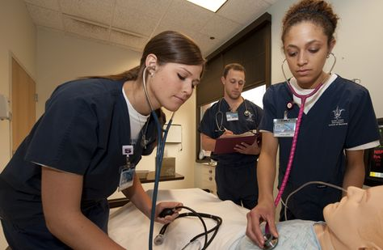
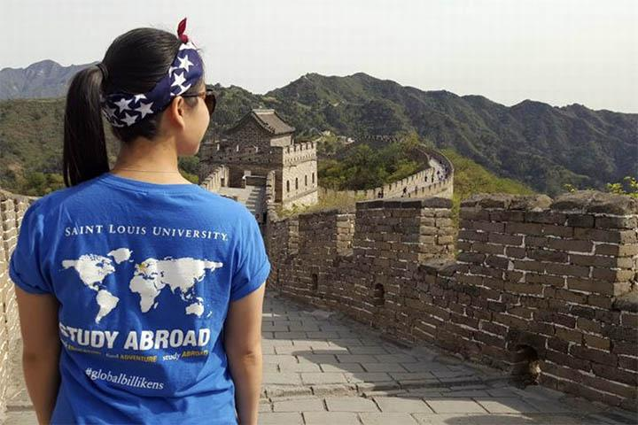
Jesuit Philosophy: Care for Eachother
Ethics, Leadership, and Community Service
Forming and Educating Agents for Change
Critical Thinking
Ethical choices in health care and business
Globally-minded
Leadership Development
Service Leadership Programs
Creating Men and Women for and With Others
Service vs Social Justice
Understanding the community
Staff, Faculty, and Students

Slide 9
Jesuit Mission and Admission Practices
Reading as an accompaniment of the student with appreciation for their unique gifts and experiences
Holistic Admission
Helping the student find the right fit
Focus on educating the whole person
Outreach/community events
Jesuit Network - school for every type of student

Slide 10
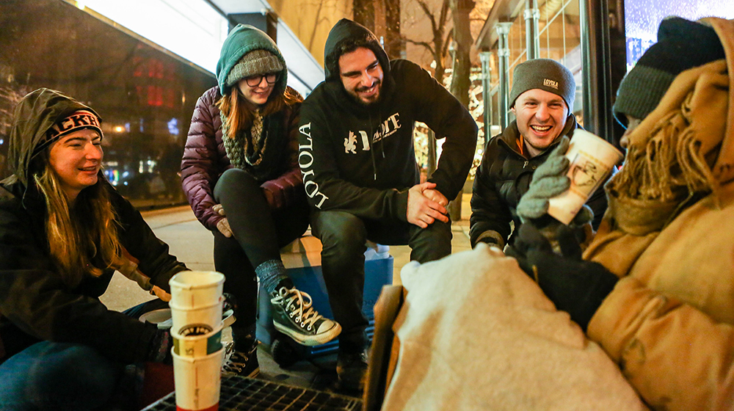
Resources
Association of Jesuit Colleges and Universities: http://www.ajcunet.edu/institutions
Jesuit Excellence Tour
Studying Abroad at fellow international schools
Jesuit Career Center Consortium
Regionals!
FACHEX / Tuition Exchange

Slide 11
Questions?
Kaleena Chiddick
Associate Director and Regional Representative
University of San Francisco
619-780-6278 kchiddick@usfca.ed
Michael Decker
Western Regional Representative
Loyola University Maryland
410-617-2015 mdecker@loyola.edu
Tara Crisp
Assistant Director of Undergraduate Admission
Loyola University Chicago
773-508-7395 tcrisp@luc.edu
Rachel Vaca
Program Coordinator: West and Southwestern States
Saint Louis University
619-915-6571 rachel.vaca@slu.edu

