Slide 1
Introducing WACAC:
The Western Association for College Admission Counseling

Slide 2
In the beginning, there was
The National Association for College Admission Counseling (NACAC) was founded in 1937, and represents a broad collection of over 15,000 enrollment management, admission, and counseling professionals who together support students seeking higher education.
Over time, the organization has expanded to include 22 smaller affiliates around the United States, and one affiliate for professionals who work internationally.

Slide 3
Forming
In 1967, members of the Claremont Consortium received a request from NACAC to form a regional association on the west coast
After some time and debate, Western came to be made up of the states of California and Nevada
We received non-profit status in 1984
Currently have just over 3,000 members - a record number!

Slide 4
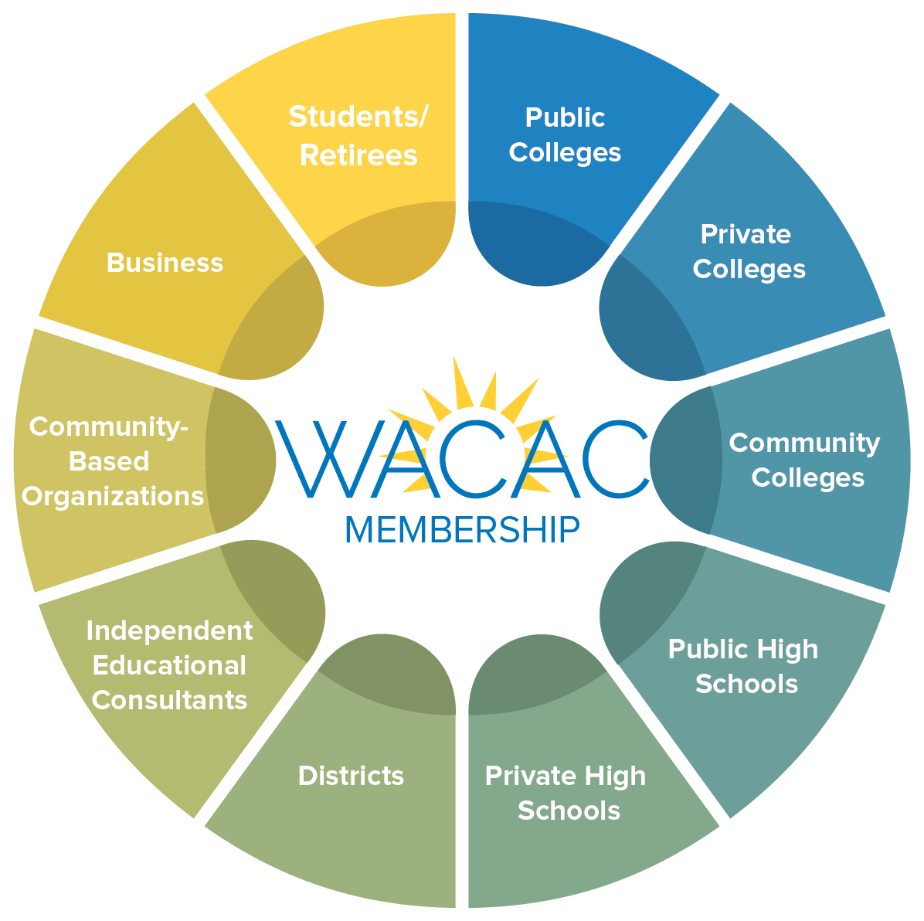
WACAC is the only organization in California and Nevada that serves all professionals invested in the transition between high school and higher education.

Slide 5
Current Membership

Slide 6
Current Leadership
President-Elect: Phil Moreno
Dickinson College (regional)
Conference Planning
President: Lauren Cook
Jewish Community HS of the Bay
Organizational Oversight
Past-President: Marc McGee
Cal State Maritime
Governance and Nominating

Slide 7
Committees

Slide 8
Finances
WACAC is a 501c3 member-directed organization
We employ two paid staff members: an Executive Assistant and a Technology Coordinator
Our annual budget falls between 700k-800k on average
75% of the budget is in reserves
-best practices dictate that number should be between 50-100%

Slide 9
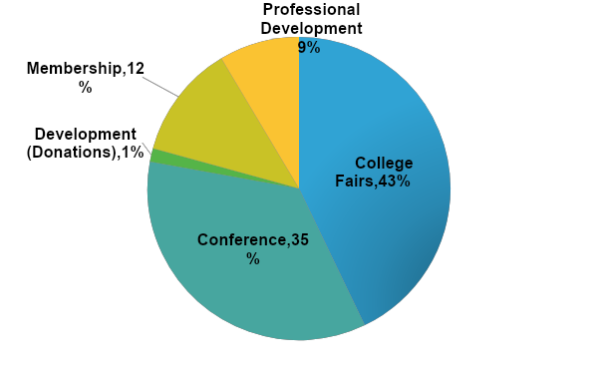
2019-2020 Projected Revenue
Revenue
College Fairs $300,000
Conference $245,000
Development $10,000
Membership $85,000
Interest Income $0
Prof. Development $60,000
_________
Total $700,000

Slide 10
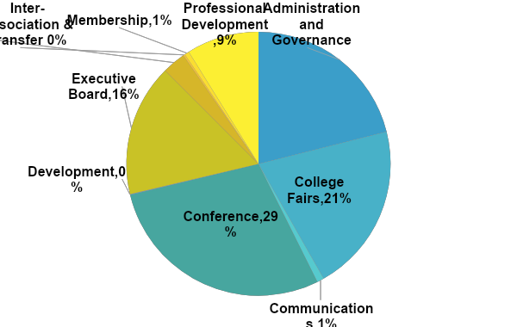
2019-2020 Projected Expenses
Expenses
Admin & Governance $147,500
College Fairs $145,000
Communications $6,000
Conference $200,000
Development $500
Executive Board $113,500
Gov. Relations $20,000
Inter-Assoc/Transfer $1,500
Membership $4,000
Prof. Development $62,000
_______
Total $700,000

Slide 11
Strategic Planning: WACAC 2025
The Executive Board is currently working on a draft strategic plan based on results of a fall 2019 membership survey, Board discussions, and a Past-President focus group. The themes that have emerged are:
Engage, Influence, Evolve

Slide 12
Strategic Planning: WACAC 2025
Each theme has specific goals within it, as well as more prescriptive actions. Example:
Engage
Support, affirm, and empower all members
Clarify a path to WACAC involvement, engagement and leadership
Expand Board representation to reflect all professional backgrounds and social identity categories
Create a more welcoming and effective community for IECs

Slide 13
Strategic Planning: WACAC 2025
Want to know more?
Attend a “WACAC 2025” session at the Annual Conference in Long Beach, where we’ll discuss the results of the membership survey, dive into each theme, and take feedback before the plan is finalized this summer.

Slide 14
Get Involved!
ATTEND:
Annual Conference
College Fairs
Legislative Conference
Share, Learn, Connect
NACAC National Conference
PRESENT:
At Share, Learn, Connect
At the WACAC Annual Conference
At the NACAC National Conference
VOLUNTEER:
For WACAC Events
For a WACAC Committee
Run for WACAC Assembly Delegate

Slide 15
Questions? WACAC.org wacacadmin@wacac.org

