Slide 1
2019 WACAC Share Learn and Connect Counselor Workshop
Advising the Division III Student-Athlete
Keith Gissel, Sr. Associate Director of Admissions-Athletic Recruitment Coordinator, University of Redlands
Jeff Martinez, Director of Athletics, University of Redlands
Tom Whittemore, PE Chair, Professor, Head Men’s Water Polo Coach, University of Redlands
Dominic Lopez, Assistant Cross Country/Track and Field Coach, University of Redlands

Slide 2
NCAA Division Comparisons
Number of Colleges Athletic Scholarships Number of Participants
Division I 350 Yes 170,000 (approximate)
Division II 308 Yes 120,000 (approximate)
Division III 449 No 194,000 (approximate)
https://www.youtube.com/watch?v=KX5jNnDMfxA

Slide 3
Reasons why student athletes are not successfully recruited
Unrealistic Expectations
Athletic scholarships is on the minds of most student athletes
Athletic Scholarships is on the minds of the parents of most Student Athletes
Failure to Initiate Recruiting Activities
Typically due to lack of knowledge
Students need to stay engaged
Timing
Started too late in the process

Slide 4
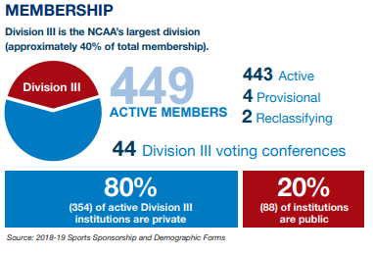
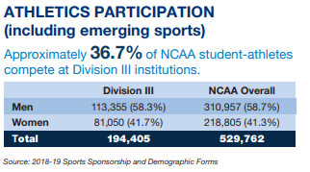
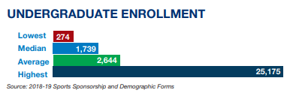
NCAA Division III Facts

Slide 5
Ways to market students to Divisions III institutions
diverse group of institutions to consider
admission criteria
financial aid
lack of scholarships at DI and DII institutions
competition – evaluate the quality each program rather than the level
opportunity to learn more about the university
coaches actively recruit – reach out to coaches

Slide 6
Sample email to coach
Hi Coach Martinez and Coach Gissel,
My name is Keith Gissel and I was recently accepted to Redlands for the class of 2023. I am an outfielder for San Dimas High School and I play travel baseball for the last five years for Coach Tom Whittemore of the LA Blue. I am reaching out to see if there might be an opportunity for me to play for you at Redlands, should I decide to attend?
At San Dimas, I have been a starting outfielder on the Varsity baseball team since my freshman year and the starting quarterback for the Varsity football team since my sophomore year. In my high school career I have hit .341 while stealing 22 bases in 26 attempts. I made first team all Mountain League my Sophomore and Juniors years. This past summer I hit .344 for the LA Gray 18U squad. I was voted team captain by my peers for this upcoming season.
I have attached a resume and a video of my highlights from last summer below.
In addition, I had the opportunity to play in front of Dominic Lopez, LA Dodger Scout, (123-456-7890) who can speak to my abilities and would be happy to talk to you about my abilities as a player.
I will be visiting Redlands on Saturday, April 6th for Admitted Students Day. Would it be possible to meet with you on April 6th? I look forward to hearing from you soon.

Slide 7
Ways to market students to Divisions III institutions
pursue interest beyond the classroom and field of play
well rounded experience
opportunity to play more than one sport
greek life
study abroad
campus employment
club sports
research opportunities
internships
Opportunity to develop life lessons through teamwork, discipline and leadership

Slide 8
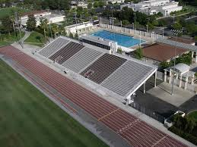
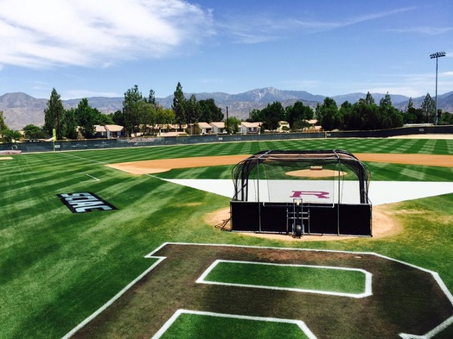
Group Discussion
Counselor
What have you experienced with the athletic recruitment process?
What would make your advising easier for Student Athletes?
Coach - What would make your recruiting easier?
QUESTIONS?

