Slide 1
Admission Interviews: Purpose and Preparation
Courtney Stricklin Burgan, Associate Dean of Admission and Manager of Volunteer Relations and Campus Visit Experiences at Occidental College
Candy Navarro, Director of College Counseling and Advising at Flintridge Sacred Heart Academy

Slide 2
Admission Interviews: Purpose
COLLEGE PERSPECTIVE:
Evaluation of the candidate
Public Relations for the College
STUDENT PERSPECTIVE:
Self advocacy
College Research

Slide 3
Admission Interviews: Purpose
NOT REQUIRED, BUT HIGHLY SUGGESTED!
37% acceptance rate at Oxy in 2019
58% acceptance rate of students who interviews with Oxy

Slide 4
Admission Interview: Purpose
INTERVIEWERS
Admission Officers
Senior Fellows/Admission Ambassadors
Alumni Volunteers
INTERVIEW LOCATIONS
On-campus
Off-campus
Online

Slide 5
Admission Interviews: Purpose
INTERVIEW REPORT FORM

Slide 6
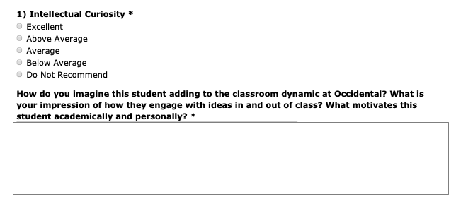
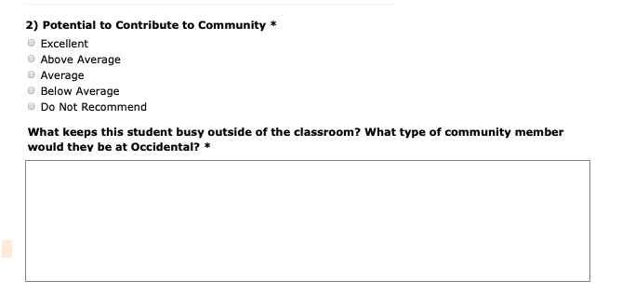
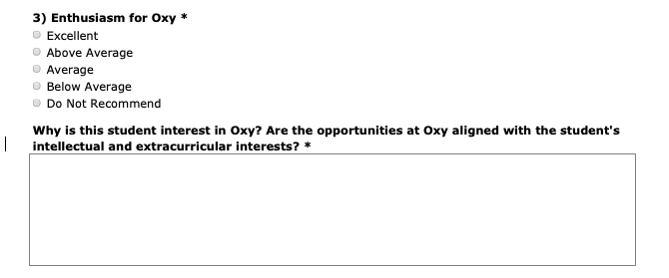
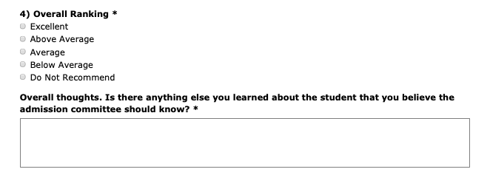

Slide 7
Admission Interviews: Purpose
SAMPLE INTERVIEW QUESTIONS
Why Oxy? What brings you here today?
How would you describe your high school?
What classes are you taking? OR What class are you most looking forward to next year?
What class has been the most challenging during your time in high school?
If you could repeat high school, is there anything you would do differently?
If you could change one thing at your high school, what would it be?
How do you spend your time outside of class?
How do you typically spend your summer? OR What are you doing this summer?
If you could only do one of your activities/hobbies/extra-curriculars, what would it be?
If Aliens landed on earth, what song/book/movie would you recommend to introduce them to humanity?
Do you have any questions for me?
Is there anything you didn’t get to tell me that you would like to share before you go?

Slide 8
Interviews: Counselor Perspective
Purpose:
Evaluative vs. Informational
Types:
Traditional Admission Interviews
Senior Fellow Interviews
Alumni Interviews
Skype/Hotel Interviews

Slide 9
Interviews: Student Preparation
Interview Preparation Workshop
Mock Interviews with peers and/or college counselors
Resource Document
Should all students interview?

Slide 10
Thank You!
Courtney Stricklin Burgan - cstricklin@oxy.edu
Associate Dean of Admission and Manager of Volunteer Relations and Campus Visit Experiences at Occidental College
Candy Navarro - cnavarro@fsha.org
Director of College Counseling and Advising at Flintridge Sacred Heart Academy

