Slide 1
Bridging the Gap: Exploring the Associate Degree for Transfer, Guided Pathways, and the Role of Private and Independent Colleges
Maureen h. laird-articulation coordinator, university of the pacific
Dave hamlett-director, community college partnerships, university of the pacific

Slide 2
Notes:
How many of you are HS counselors? CC counselors?
NEVER too early to start planning for degree completion at a 4-year. Work with your students sooner rather than later.

Slide 3
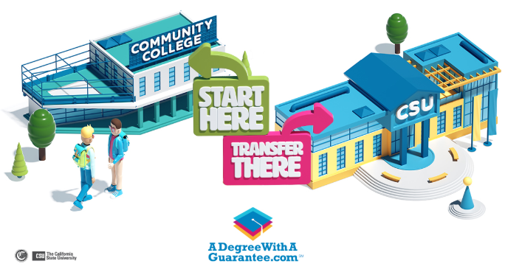
Associate Degree for Transfer History
Implemented in 2011
Senate Bill 1440 and Assembly Bill 2302 to “Ease Transfer Process for Students”
Specific pathway that guarantees community college students the opportunity to transfer to a saved spot at a CSU/UC campus with junior standing (provided that student meets admission criteria specific to each institution)
Quickest path for students to transfer between the two college systems by completing 60 semester units of specified work at a community college, and then completing 60 semester units at a CSU campus to receive a bachelor’s degree.
Notes:
SB 1440:
1. Guaranteed admission into CSU system (23 campuses) and priority consideration when applying to a particular program.
2. Law prohibits CSU from requiring a transferring student to repeat courses similar to those take at CCC
AB 2302:
Designed to enhance transfer pathway to 1 of 9 campuses in the UC system (21 most popular majors)
Ensures that transfer reform is efficient, student-centered and does not disadvantage students who are currently enrolled in a CC.
Starting Fall 2019, UC institutions will begin providing admission guarantee to qualified students with ADT

Slide 4
Associate Degree for Transfer Program Benefits
Provides a clear, focused transfer pathway
Guarantee admission into the CSU/UC system-”A Degree with A Guarantee”
Grants priority consideration when applying to impacted majors and/or campuses based on university capacity
Lets students use the same GE and Major Prep courses for transfer to a CSU/UC campus
Guarantees an associate degree in 60 semester units at a community college and a bachelors degree in 60 semester units at a CSU/UC
Notes:
IGETC for UC fulfills the ADT, however, admission to CSU requires completion of an Oral Comm class

Slide 5
Associate Degree for Transfer California Community Colleges
More than 2.1 million students are served each year at 114 community colleges statewide, representing the largest system of higher education in the nation.
The number of California community college students participating in the Associate Degree for Transfer program has grown from 722 in the first year to 31,000. These degrees are now the most popular and streamlined pathway for community college students wanting to transfer to a CSU/UC with a degree.
Notes:
Expected continued growth of transfer students to 4-years

Slide 6
Associate Degree for Transfer AICCU
MOU signed July 25, 2018 between AICCU and California Community College Chancellors Office
The ADT Commitment is the Association of Independent California Colleges and Universities sector’s adaptation of the ADT pathway
The ADT Commitment is:
Guaranteed admission for the ADT students meeting admission requirements
Guarantees a minimum of 60 semester/90 quarter units will transfer
Guarantees the student starts with junior standing
Recognition of general education pattern
Notes:
Governor Brown maintain Cal Grant Eligibility for system (AB-1307):
2019=2,000 ADT;
yr. 2 (2020-2021) = 3,000 ADT;
yr. 3 2022-23)=3,500 ADT

Slide 7
Associate Degree for Transfer AICCU
40 Participating independent, non-profit CA universities
Unlike CSU/UC, AICCU institutions are not part of a system and each campus has its own admission and graduation requirements
If an ADT transfer student meets all the requirements of admission to a participating institution, admission is guaranteed to that college as opposed to a system
List of participating schools and majors accepted
New website July 2019 http://adegreewithaguarantee.com/
Notes:
As high school & CC counselors, it is important to know the admission/graduation requirements for the AICCU institution that your student is interested in applying to/attending.

Slide 8
Misconceptions About Private Institutions
“Too expensive” – you’d be surprised how affordable a private college can be and all offer some form of financial aid. Often cost may be less than a 4-year college/university. Additionally, it is easier to get the classes you need so that you can graduate in a timely manner and be employed sooner.
“Student body lacks diversity” – students at independent colleges/universities are incredibly diverse and reflect the diversity of California.
“All private colleges are elite” – many different types of private colleges that meet the academic needs of all types of students.
“I want/need to stay close to home” – there are over 80 independent colleges & universities throughout California.

Slide 9
Associate Degree for Transfer
Discussion

