Slide 1
University of La Verne
Private Schools Presentation
Candyce Coleman, Associate Director of Transfer Admission

Slide 2
Affordable Personal Attainable

Slide 3
Affordable
Despite higher costs at private institutions, these colleges and universities typically provide more institutional aid than public universities.
Students at Independent California Colleges & Universities (AICCU):
86% receive some sort of financial aid
79% receive institutional grants

Slide 4
Affordable
Despite higher costs at private institutions, these colleges and universities typically provide more institutional aid than public universities.
Students at Independent California Colleges & Universities (AICCU):
86% receive some sort of financial aid
79% receive institutional grants

Slide 5
Affordable
Despite higher costs at private institutions, these colleges and universities typically provide more institutional aid than public universities.
Students at Independent California Colleges & Universities (AICCU):
86% receive some sort of financial aid
79% receive institutional grants

Slide 6
Affordable – La Verne Aid
State and Federal
Pell Grant - $5,730
Cal Grant - <$9,408
Loans
Work Study
La Verne Grants
Merit-based grants: Up to $14,000 per year for transfers
3.22 GPA and Above = $14,000
3.21 – 2.88 = $11,000
2.70 – 2.87 = $6,000
Need-based grants: based on FAFSA
Performance Scholarships: $25,000 per year

Slide 7
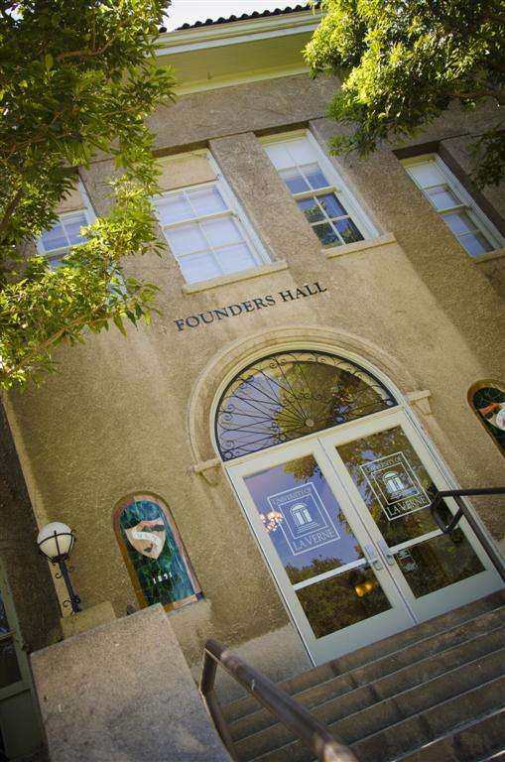
La Verne Cost (2016-17)
Direct Costs
Tuition and Fees | $39,900
Room and Board | $13,730
Total Direct Cost | $53,630
Payment Plans Available!
Notes:
Subtract your financial aid from costs above:
Pell Grant (full) last year : $5,550
Cal Grant A: approx $9,000
Average La Verne merit and need-based grants = $16,000
Everything added above = $30,550, which almost covers all of tuition, plus any external scholarships and loans

Slide 8
Personal
Private schools tend to be significantly smaller:
Smaller classrooms
13:1 student to faculty ratio at La Verne
Average class size has 19 students
Students often have greater opportunities available to them within

Slide 9
Personal
Application Review:
Most private schools review applications holistically
We take the time to read the application Exceptions can be made

Slide 10
Attainable
Notes:
In 2008 incoming transfers – 68% graduated in 4 years

Slide 11
Fast Facts
Average class size: 19
Founded in 1891
Student to faculty ratio: 13:1
50 academic majors
2,864 traditional undergraduate students
40% of students are first generation
Top 11% of safest institutions nationally
Western Association of Schools and Colleges (WASC) accredited

Slide 12
Transfer Facts
Average transfer GPA: 3.12
Average size of incoming fall transfer class: 200
Average Transfer Acceptance rate: 45%
Top majors of transfer students:
Psychology
Business
Kinesiology
Communications
Educational Studies/Child Development
Where most of our students transfer from:
Citrus College
Mt. San Antonio College
Chaffey College
Pasadena City College

Slide 13
Housing
Close to 1/3 of students live on campus in one of four residence halls
1/3 live off campus with family
1/3 live off campus with friends
Priority housing deadline: May 1(for fall)

Slide 14
Student Life
80+Clubs and Org’s
Sororities & Fraternities
Study Abroad
Performing Arts
Community Service

Slide 15
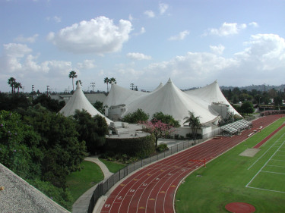
Athletics
Men’s Sports Baseball Basketball Cross Country Football Golf Soccer Swimming & Diving Track & Field Water Polo
Women’s Sports Basketball Cross Country Golf Soccer Softball Swimming & Diving Tennis Track & Field Volleyball Water Polo

Slide 16
Student Services
Learning Enhancement Center
Career Services
Student Health Services
Counseling & Psychological Services
Disable Student Services Department

Slide 17
La Verne Transfer Requirements
Minimum of a 2.7 GPA
At least 28 transferable semester units
College-level English
College-level math recommended
No more than 88 semester units will transfer
Transferable units: www.laverne.edu/transfer

Slide 18
Transferable Units
Follow an IGETC, CSU or La Verne gen ed plan
“Certified” IGETC / CSU = all gen ed complete
Exceptions: potential foreign language and La Verne Values courses
Any courses from IGETC or CSU general education plan are guaranteed to transfer
Max of 88 units will transfer to La Verne
Minimum of 44 residency units at La Verne
Transfer Report given after admitted
Determines what gen ed will transfer

Slide 19
Transfer Application
Apply online: Common Application or La Verne Application
Essay
Official Transcripts
Letter of Recommendation
$50 Application Fee or NACAC Fee Waiver
Fall Priority Application Deadline: April 1
Spring Priority Application Deadline: December 1

Slide 20
Contact Information
Candyce Coleman Office of Admission University of La Verne 1950 Third Street La Verne, California 91750
Phone: (909) 392-2800 Toll Free: (800) 876-4858 Fax: (909) 392-2714 E-mail: ccoleman2@laverne.edu
Web: laverne.edu/admission
www.laverne.edu/transfer

